Slide 1
ELEC-E8423 - Smart Grid Demand Response of HVAC loads
Eric Harrison
Eero Levo
23.3.2021

Slide 2
Introduction
Demand Response (DR)
modifying electricity consumption to match production (load shifting)
agreeing to use less electricity when demand exceeds production ("downward potential") or more when production exceeds demand ("upward potential")
Heating, ventilation and air conditioning systems (HVAC) are very suitable for DR:
Moderate temperature fluctuations (± 2 C°) in buildings are usually acceptable
Buildings store heat which slows the impact of reduced heating (thermal inertia)
Almost half of the electricity use of households is for space heating
Possible sector coupling with district heating
Economic/environmental incentive: optimal control of HVAC system can achieve energy savings of up to 45 % (Zavala et al. 2011)
Demand Response of HVAC loads

Slide 3
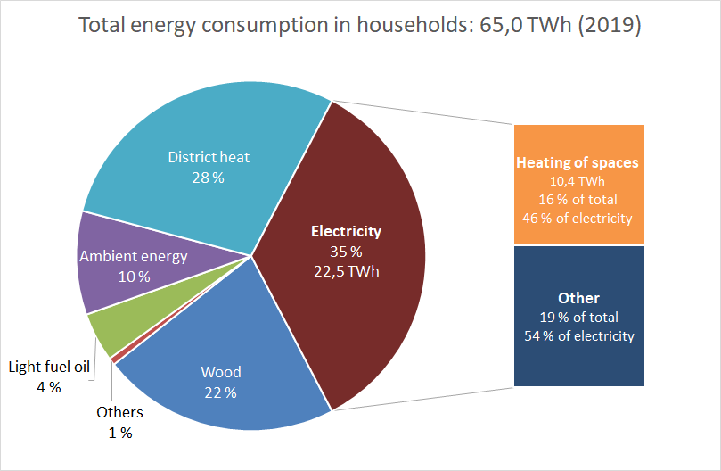
Household HVAC in a larger context (Finland)
In 2019, total electricity use in Finland was 86,1 TWh.
Data: Official Statistics of Finland
Demand Response of HVAC loads

Slide 4
How HVAC DR works
Modelling the storage
Outside temperature and consumer's temperature comfort zone affects how long DR can be activated over time
To keep the temperature within acceptable limits, heating can e.g. be increased hours before a downward DR period
Central control
Power market/Utilities ⬄ Aggregator company ⬄ Households
Two-way communication via Internet
Smart metering: aggregator controls smart thermostats over time
Demand Response of HVAC loads

Slide 5
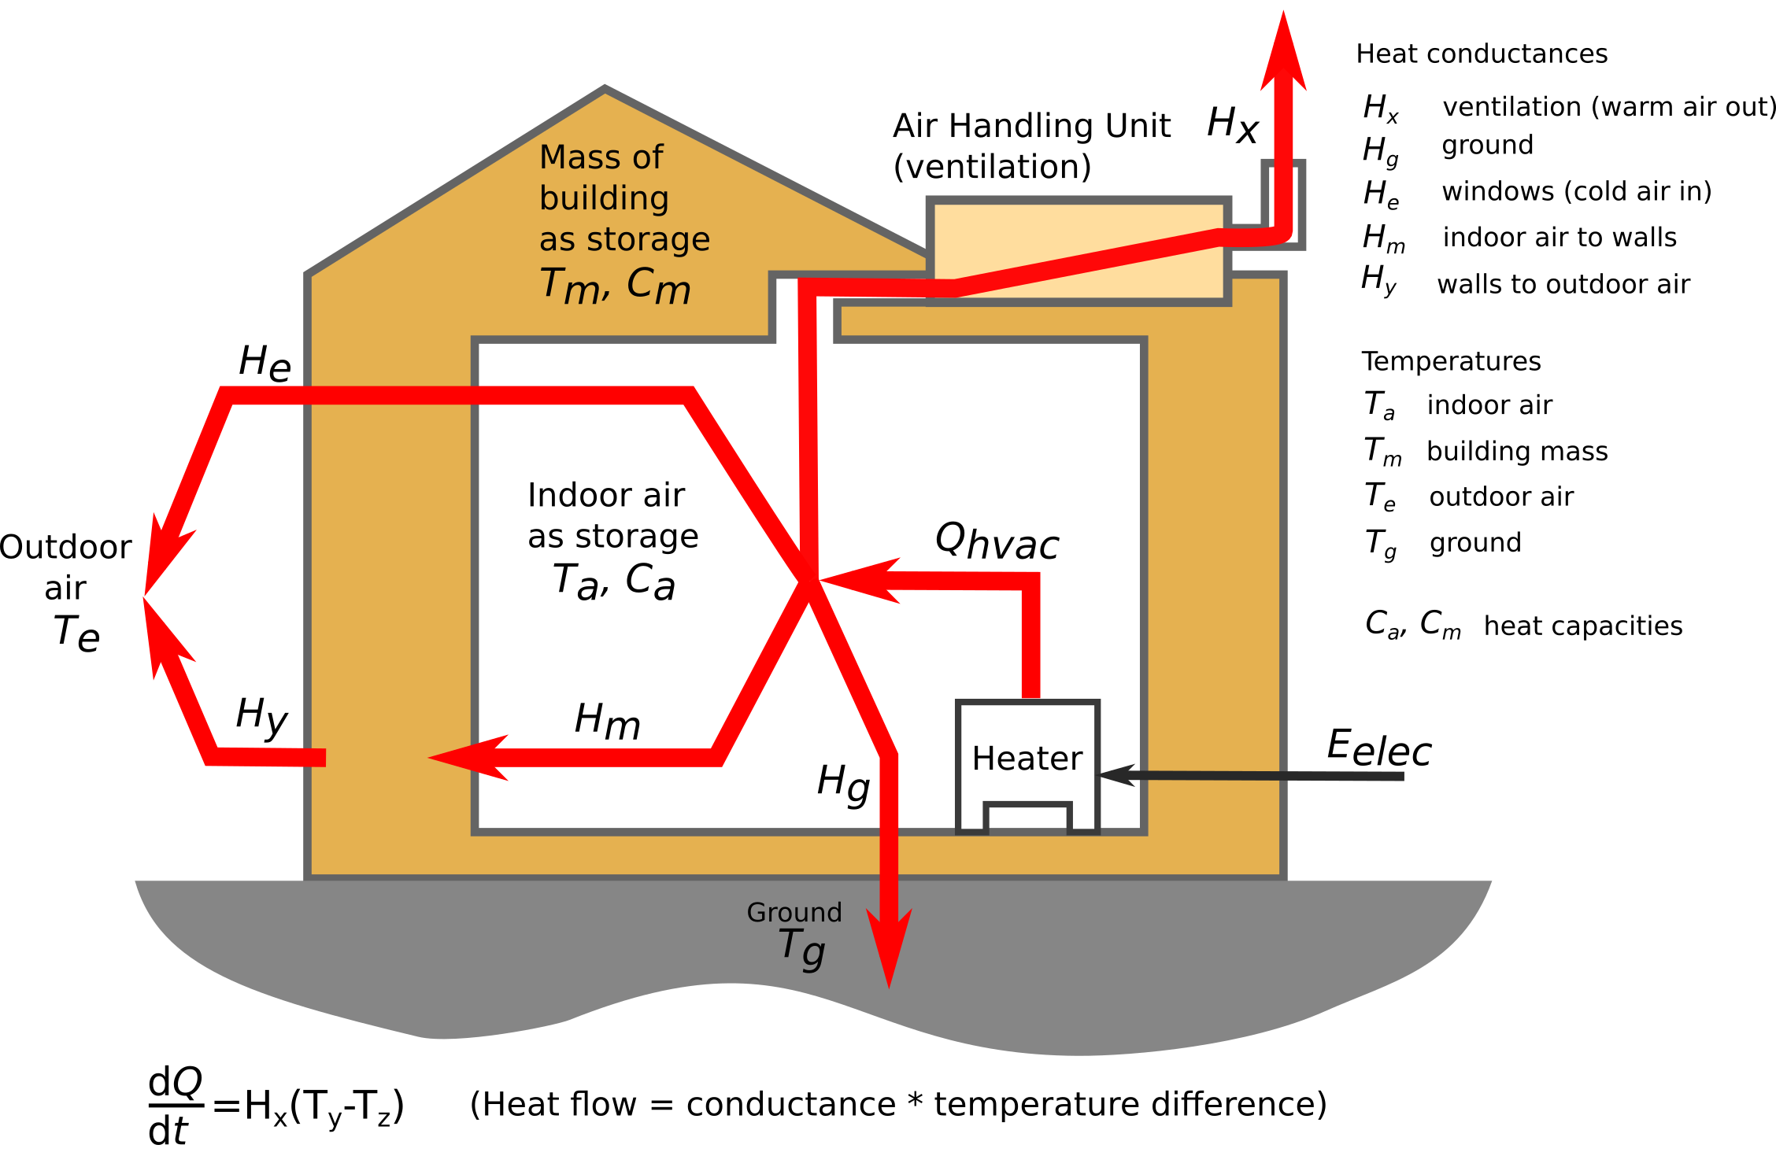
Building as a thermal energy storage
Building mass and air store heat, heater on at Winter
Heater off: Q_{hvac} = 0, building mass slows decrease of T_{a}
Ventilation rate (~H_{x}) affects heating.
Air conditioning: opposite heat flows.
Picture according to Ali (2016)
Additional hot water storage would increase DR capability.
Demand Response of HVAC loads

Slide 6
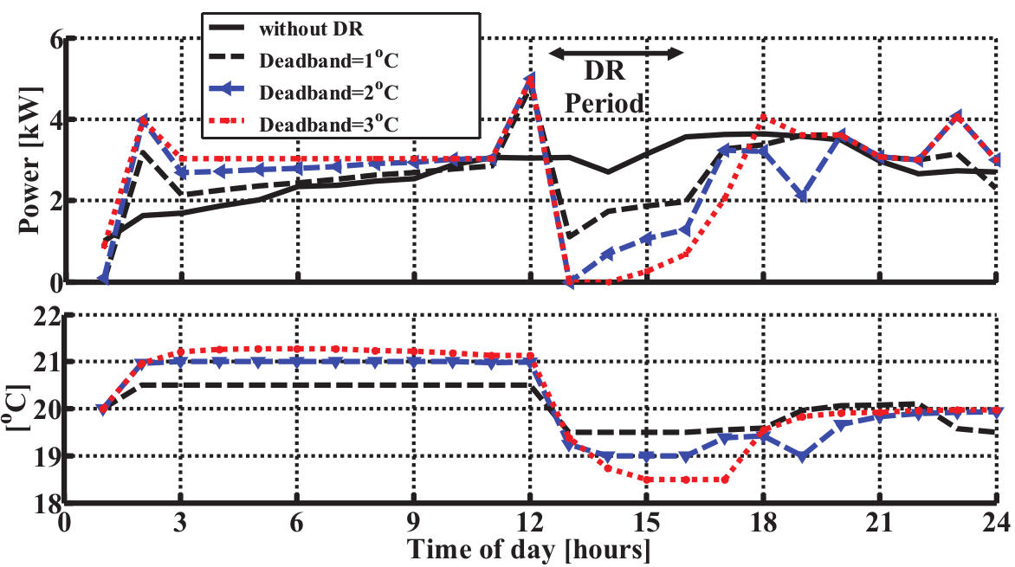
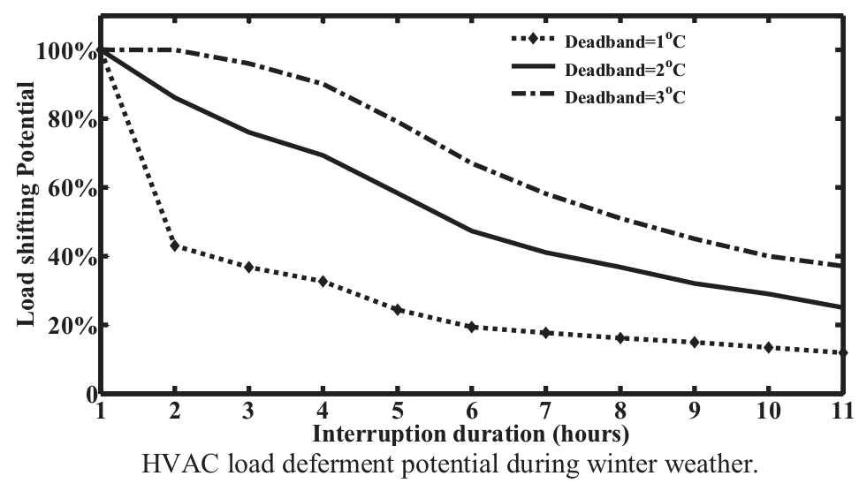
Electric heating of a residential house
Simulation of direct electric heating with DR
The resident sets a comfort zone for temperature:
20 ± 1...3 °C -> constraint for demand response
Thermal model: Need for heating varies during the day. Electric heating decreases at DR period of 13:00-16:00 hours -> house cools slowly due to stored heat in the building masses
Also great potential for increasing load when demand smaller than generation. Heat is stored in the building masses
Even 100% reduction for several hours:
- Can be increased by extending the comfort zone
- Winter is the hardest case, spring and summer allow for larger load shifting for longer durations
Simulation: load reduction potential at Winter.
Results and figures from Ali, Safdarian and Lehtonen (2014).
Demand Response of HVAC loads

Slide 7
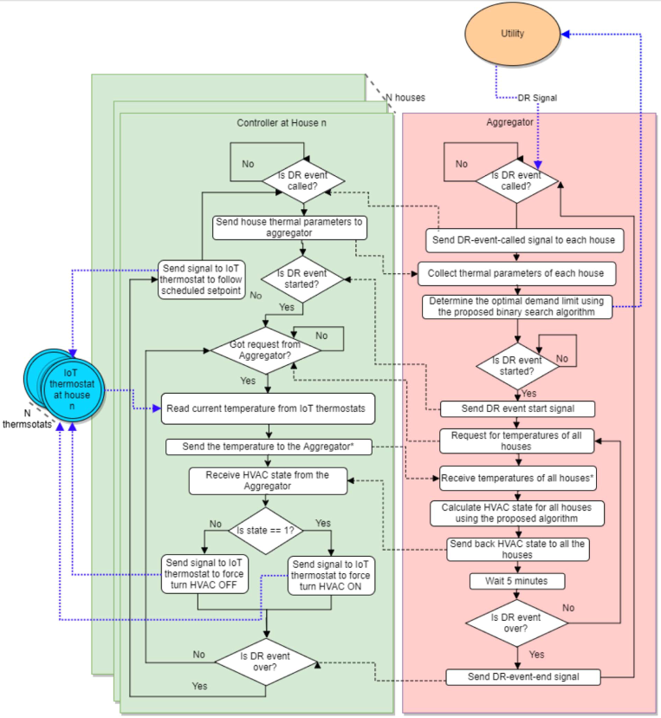
Controlling DR of electric heating
Utility ⬄ Aggregator ⬄ Customer
One aggregator controls N number of houses.
Houses have IoT thermostats that send signals to house controller unit.
House controller unit and aggregator communicate in real time via Internet
Figure by R. Adhikari et al. (2018)
Demand Response of HVAC loads

Slide 8
Requirements for HVAC demand response
Control in residences
House control units
Smart meters enable hourly participation to DR
Currently water heating in residential buildings is usually automatically timed for night when electricity is cheap and there is less demand
Control and communication: load aggregators
- Third party company responsible for controlling the DR
- Even frequency control possible by real-time communication via Internet
Price incentives for customers
Different types of price-based DR programs
Goal: transfer maximum amount of consumption from peak hours to off peak hours
Demand Response of HVAC loads
Notes:
Price incentives steer customers: they could still rapid-charge their car at peak time, but it costs extra

Slide 9
Conclusions
HVAC loads are suitable for demand response because they allow both upward and downward control
HVAC loads have significant DR potential because they consume a major part of energy in buildings
Customer participation has a big role in DR of HVAC
Demand Response of HVAC loads

Slide 10
Source material used
R. Adhikari, M. Pipattanasomporn, S. Rahman. (2018) An algorithm for optimal management of aggregated HVAC power demand using smart thermostats. DOI 10.1016/j.apenergy.2018.02.085
M. Ali, A. Safdarian and M. Lehtonen. (2014) Demand Response Potential of Residential HVAC loads Considering Users Preferences. DOI 10.1109/ISGTEurope.2014.7028883
M. Ali. (2016) Domestic Space Heating Load Management in Smart Grid: Potential Benefits and Realization. http://urn.fi/URN:ISBN:978-952-60-6962-3
Official Statistics of Finland (OSF): Energy consumption in households (referred 22.3.2021). http://www.stat.fi/til/asen/index_en.html
Official Statistics of Finland (OSF): Energy supply and consumption (referred 22.3.2021). http://www.stat.fi/til/ehk/index_en.html
Y. Shen et al. (2020) State-shift priority based progressive load control of residential HVAC units for frequency regulation. DOI 10.1016/j.epsr.2020.106194
M. Short et al. (2019) Optimal Dispatch of Aggregated HVAC Units for Demand Response: An Industry 4.0 Approach. DOI 10.3390/en12224320
Zavala VM, D. Celinski ST, Dickinson P. Techno-Economic Evaluation of a Next-Generation Building Energy Management System. Technical Report ANL/MCS-TM-313, Argonne National Laboratory, 2011. Available at: https://www.mcs.anl.gov/papers/MCS-TM-313-FINAL-6-7-11.pdf
Demand Response of HVAC loads

