Slide 1
ELEC-E8423 - Smart Grid Demand response of industrial loads
Antti Saulamo, Sakari Huhtanen
27.04.2021

Slide 2
Introduction
Manufacturing industry is a big electricity consumer
Industry is under an electrification trend → Demand for electricity increases and new potential sites for demand response (DR) are created
Electricity consumption in Finland accounts only for 2.8% of the consumption in Europe

Slide 3
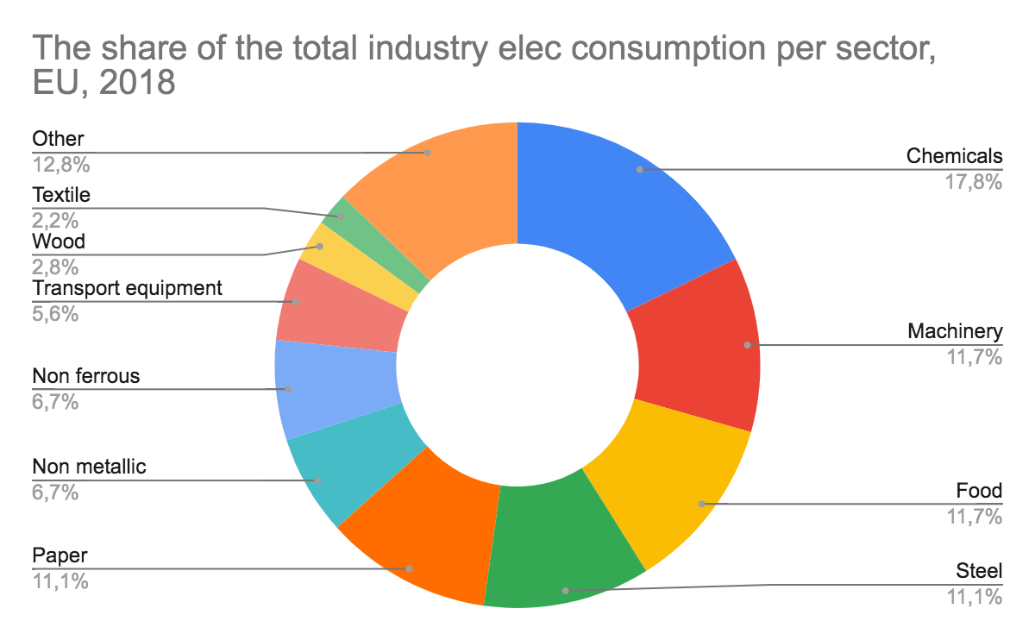
Electricity consumption in EU in 2018
Total electricity consumption: 3 053 TWh
Industry’s electricity consumption: 1 047 TWh → 34 % out of the total consumption

Slide 4
Frequency Containment Reserves in Finland and Central-Europe
 | Central Europe, FCR | Finland, FCR-D | FCR-N
Market area | AT, BE, DK-West, DE, FR, NL, SK, CH | FI | FI
Minimum bid | 1 MW | 1 MW | 0.1 MW
Symmetric products | Yes | No | Yes
Frequency zone | 49.8-50.2Hz | 49.5-49.9Hz and 50.1-50.5Hz | 49.9-50.1Hz
Contract types | 4 hours | Hourly / Yearly | Hourly / Yearly
Activation time | Linearly, 15s (50%) 30s (100%) | Linearly, 5s (50%) 30s (100%) | Linearly or Step, 3 min (100%)
27.04.2021

Slide 5
Demand response in steel industry
Electricity bill is one of the biggest costs in steel industry approx. 12 % on average
Loads are flexible and can be shifted
SPOT -market optimization for lower electricity bills
Scheduling of the steel plant based on day-ahead prices
Furnes can be used to offer spinning reserve to reserve markets to make revenue
In one case study, linear optimization model is used to minimize the costs of use of electricity
27.04.2021

Slide 6
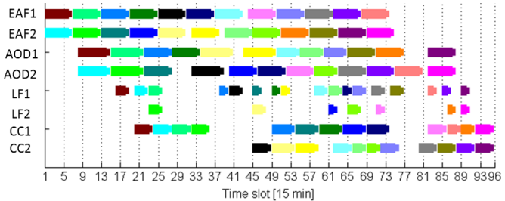
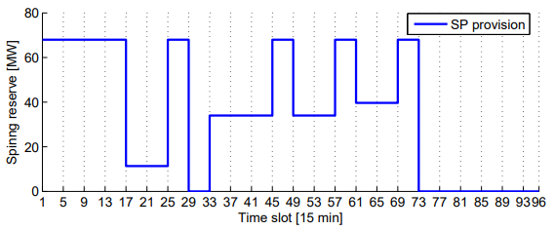
Demand response in steel industry
According to the study, scheduling the operation of the steel plant based on day-ahead prices is feasible.
Additional revenue can be made by offering spinning reserves to reserve markets
With 15 min resolution:
Objective without SP 39.307 k€
Objective with SP: 39.002 k€
Energy cost: 39.321 k€
SP Revenue: 0.319 k€
≈ 1 % additional savings with spinning reserve
27.04.2021

Slide 7
Economic evaluation
SPOT market optimization lowers the energy costs
Participating in the reserve markets creates an additional revenue stream
Factors which affect the economic feasibility of implementing a DR solution into industry:
Normal operation of a manufacturing plant can’t be disturbed
The loads which can be shifted, need to be big enough
Price volatility of SPOT markets
Cost of implementation
Risk of oversupply in reserve markets which could lead to market price reductions
27.04.2021

Slide 8
Conclusions
There isn’t one size fits all solution for different industries. Need for industry specific DR optimization
There are lots of electricity related demand response products including reserve markets and market price optimization
DR in big scale can reduce the volatility of electricity markets and drive down the average prices

Slide 9
Source material used
Give the list of references used for the presentation preparation
https://zicokolter.com/publications/zhang2015industrial.pdf
https://www.entsoe.eu/network_codes/eb/fcr/
https://www.eurofer.eu/assets/Uploads/European-Steel-in-Figures-2020.pdf
https://www.odyssee-mure.eu/publications/efficiency-by-sector/industry/industry-eu.pdf
https://www.eurofer.eu/assets/Uploads/European-Steel-in-Figures-2020.pdf
https://www.iea.org/data-and-statistics/?country=EU28&fuel=Electricity%20and%20heat&indicator=ElecConsBySector
https://www.researchgate.net/publication/282282212_A_review_of_demand_response_business_cases
https://en.energinet.dk/Electricity/Ancillary-Services/Prequalification-and-test
https://www.fingrid.fi/en/electricity-market/reserves_and_balancing/

