Slide 1
ELEC-E8423 - Smart Grid Demand Response of Commercial Loads
Eevi Laasanen
Seela Tervo
23.03.2021

Slide 2
Introduction
The structure of the presentation:
Commercial buildings
Flexible loads
Peak time
Load control
Example case
Conclusion
Key terms:
Demand Response = DR
Commercial Loads: Most of the commercial loads are in commercial buildings.
Notes:
Demand response can be implemented by increasing or reducing the consumption at certain times, by flexible and possibly own generation units, or with the utilization of storages. The best solution is to have combination of these. Demand response may not be useful by flexible consumption only, or by only one technical solution.
Most of the commercial loads are in commercial buildings, so we are presenting the topic from the perspective of commercial buildings. With buildings, energy efficiency is also important, and energy efficiency must be good before using demand response. Demand response can't replace the energy efficiency.
Flexible consumption, own generation units, and own storages are realistic options for commercial buildings. Commercial buildings are large, so own generation and storages would be very beneficial for them and for DR system.

Slide 3
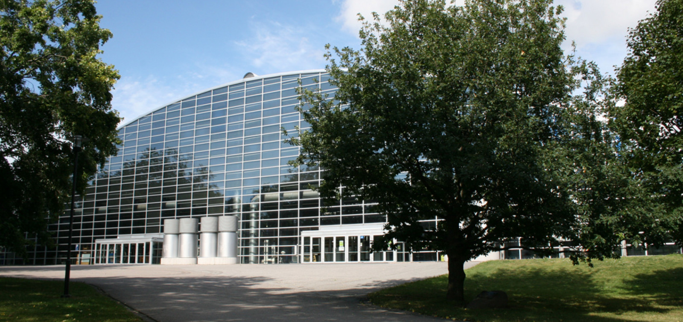
Commercial buildings
Offices
Shops/malls
Data centres
Educational, sport and cultural facilities
Benefits
Technical: Large loads, varying usage time, many commercial buildings have automation systems
Economical: lower electricity prices, energy savings
Environmental: more renewable generation, emission reduction
Challenges
How to get DR in large scale use in commercial loads?
Health and wellbeing issues need to be considered.
Notes:
Benefits of DR:
Technical benefits: Demand response enables integration of more renewable generation to the grid. Renewables cause more variation on generation time and more voltage fluctuation, but demand response is helping to balance the consumption and grid voltage. Also local generation and storages help with the grid issues and production time variation. (Prosumers would be the best.)
Economical benefits: Electricity price is lower to the customer, when there is no need to pay from expensive peaks. For the system operators there is no need to pay for expensive peak capacities or construct power grid when the demand side management helps with the grid congestions.
Environmental benefits: More renewables and cleaner production is possible with the help of DR, emissions are smaller and this is significant for the climate change prevention.

Slide 4
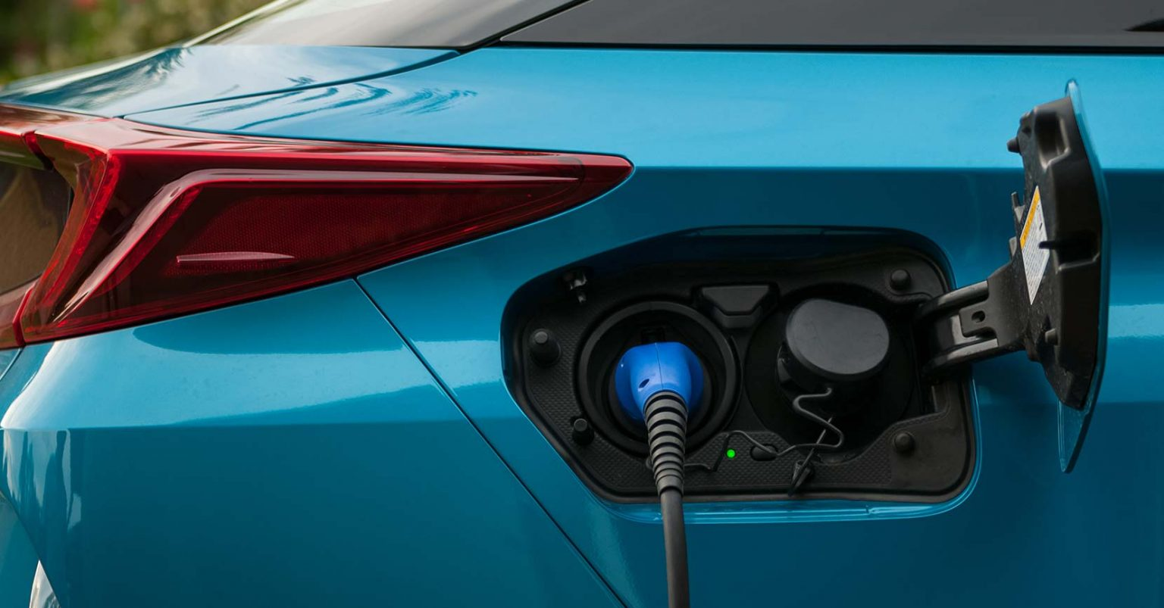
Flexible loads
Demand response can be achieved either by reacting directly to the electricity market price or by participating in the DR market.
Commercial buildings often have the same type of flexible loads as residential buildings, but larger size and different peak time.
Examples of flexible loads
Heating and cooling
Ventilation and air conditioning
Lighting
Non-critical servers
Elevators
EV charging

Slide 5
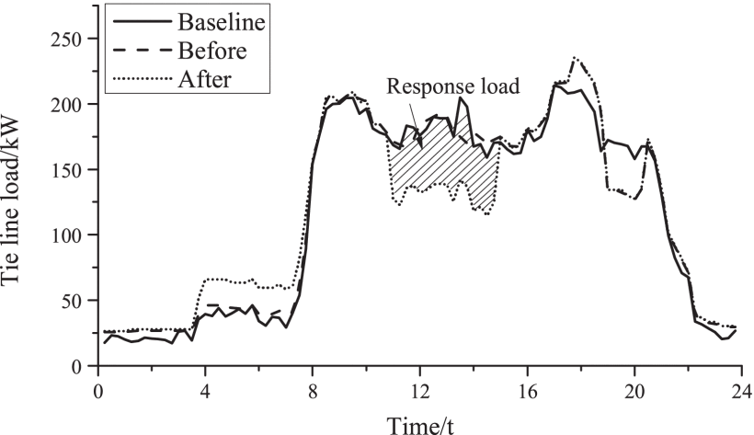
Peak time
Peak time in the commercial buildings vary a lot, but the largest loads are during the office working hours.
Good DR potential for the passive loads is when the commercial buildings are not in use.
Peak time DR brings the largest (proportional) benefits.
Notes:
There is a huge potential in varying peak time. Different types of commercial buildings are having their peak time in different times. This enables comprehensive optimization of DR. Furthermore, office working hours have the largest loads. Compared to residential loads, peak time is varying much more in commercial loads.
Figure:
From study, which optimizes the peak-shaving capacity of commercial buildings in combination with demand response measures under the premise of ensuring energy comfort. By modifying lighting, cooling, heating and hot water loads. In addition, charging and discharging battery and using PV. The benefits include incentive compensation from the grid and savings in electricity costs. The model also considers tie line constraint in order to avoid excessive load fluctuation of the tie line before and after demand response.
Buying price, peak periods (14:00-17:00, 19:00-22:00).
Valley periods (0:00-8:00, 0.471).
Demand response periods are 11:00-15:00.
After optimization, the optimized peak-shaving capacity is 40kW, the incentive compensation from the power grid is 480 ¥, and the saving of electricity cost is 158¥, so the total demand response revenue is 638¥.
The building baseline load is determined according to regulation and used for benefit evaluation of demand response.
The dotted lines show the comparison of the tie line load before and after demand response. The shadowed part is the response load.

Slide 6
Load control
Price-based control
Loads are scheduled to lower price hours
Suitable for operations that can be done anytime
Does not require complicated control
Incentive-based control
Allows system generators to control specific loads
Can be used in the DR market
Requires advanced control, for example limitations of temperature and ventilation modification
Notes:
Price-based:
- Customers (DR provider) intentionally manage their energy consumption based on varying prices.
- The customers are compensated by variable electricity tariffs that fluctuate following the real-time wholesale electricity price or the prevailing spot market prices.
- Price-based programs encourage customers to modify their load depending on electricity prices by using flexibility of loads to balance daily variations in net load.
- Price-based programs are most suitable for Elspot and Elbas markets.
- Does not require complicated control.
Incentive-based control:
- Customer (DR provider) grants the right to control their load in certain limits and get compensated after.
- The flexibility is used when unexpected variations and events occur or it can be utilized to alter the energy consumption during peak periods.
- The benefit of these programs is that the amount of DR can be estimated beforehand thus operators can be more flexible in controlling the loads.
- It should be taken into account that customers lose privacy due to the disclosure of personal information.
- Most suitable for Fingrid’s markets, such as FCR-N and FCR-D.
- Requires more control, for example limitations of temperature and ventilation modification.

Slide 7
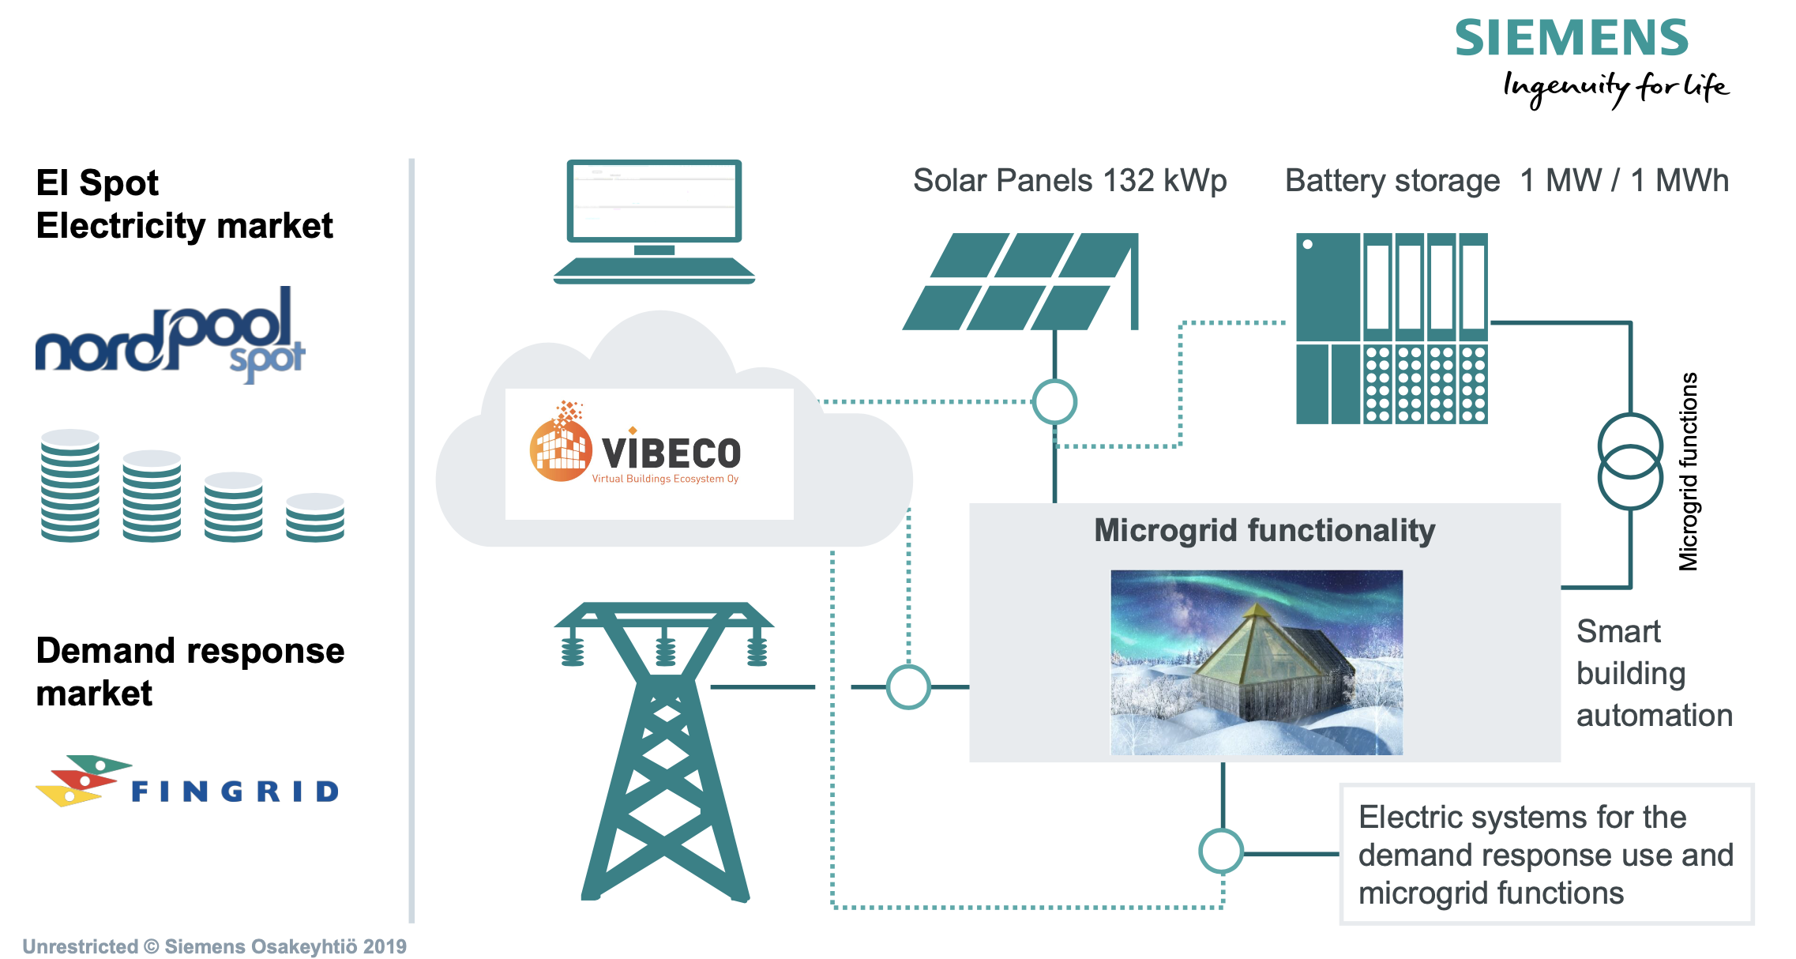
Example case:
Smart and flexible control system.
Is able to automatically increase or reduce electricity consumption to balance the power grid.
This is done by modifying ventilation, heating and cooling.
Stabilizing grid also by storing energy and selling it to the grid.
Can be also an independent network.
Fingrid pays compensation for load-balancing operations.

Slide 8
Conclusion
DR has many technical, economical, and environmental benefits, for example renewable energy integration.
Commercial loads' varying peak time has a huge potential for DR.
Load control can be done by price-based control or by incentive-based control.

Slide 9
Source material used
Drasch et al. 2020. Demand response through automated air conditioning in commercial buildings – a data driven approach. [Referred to 11.3.2021]. Available: https://link.springer.com/article/10.1007/s40685-020-00122-0.
https://doi.org/10.1007/s40685-020-00122-0
Yu et al. 2020. Peak-shaving capacity assessment of commercial buildings with time-varying energy comfort.
[Referred to 21.3.2021]. Available: https://doi.org/10.1109/APPEEC48164.2020.9220341
Mohajeryami et al. 2015. Including the behavioral aspects of customers in demand response model: Real time pricing versus peak time rebate. [Referred to 21.3.2021]. Available: https://doi.org/10.1109/NAPS.2015.7335116
Siemens. Levin uudet pyramidit ovat uusimman talotekniikan suunnannäyttäjä – alueelle oma virtuaalivoimalaitos. [Referred to 19.3.2021]. Available: https://new.siemens.com/fi/fi/yhtio/stories/talotekniikka/aurora-pyramidit.html
Mahmud et al. 2018. Peak-Load Management in Commercial Systems With Electric Vehicles. [Referred to 11.3.2021]. Available: https://doi.org/10.1109/JSYST.2018.2850887
Jin et al. 2019. ESS Optimal Scheduling considering Demand Response For commercial Buildings.
[Referred to 20.3.2021]. Available: https://doi.org/10.1109/IYCE45807.2019.8991566

