Slide 1
ELEC-E8423 - Smart Grid Methods for Fault Location and Detection in Smart Grids
Joakim Lyyski,
Saku Muukka
05.04.2021

Slide 2
Introduction
Fast and accurate fault detection and locating is essential in power grid management and operation
Fault location in smart grids is more complicated compared to conventional grids due to the bidirectional power flow and power electronics
Measuring and protection equipment designed for conventional grids are not sufficient to operate in all fault scenarios
Smart grid aims to improve grid quality, flexibility and reliability, not lessen it
In smart grids, the faults are located by using multiple methods:
Impedance based location methods
Travelling waves-based fault location methods
Intelligent electronic devices (IED) and Directional fault passage indicators (DFPI)
Smart meters, data and machine learning methods

Slide 3
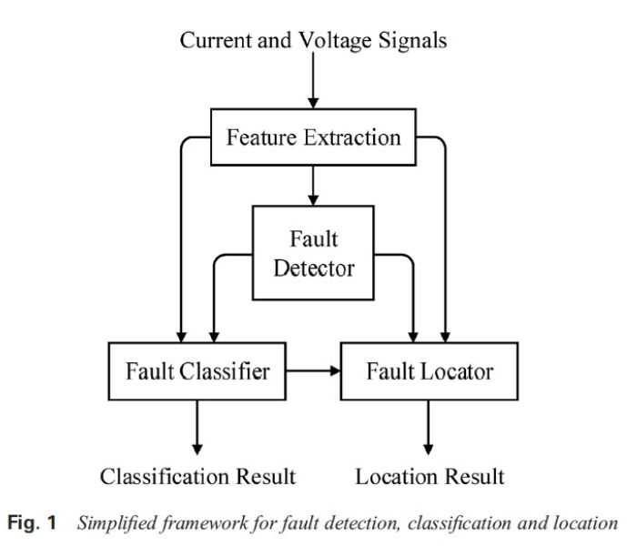
Fault detection and response in grid operation
[1]

Slide 4
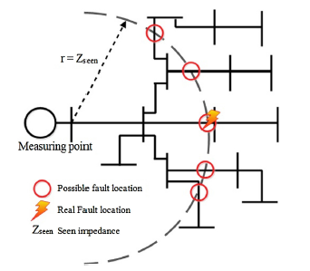
Impedance Based Fault Location Methods [2]
Uses impedance value as seen from measurement node for locating the fault
Based on Ohm’s law
Can indicate multiple possible fault locations from the measurement point
Requires data from:
Substation voltage and current
Network topology
Line and load
The problem of multiple estimations [2]

Slide 5
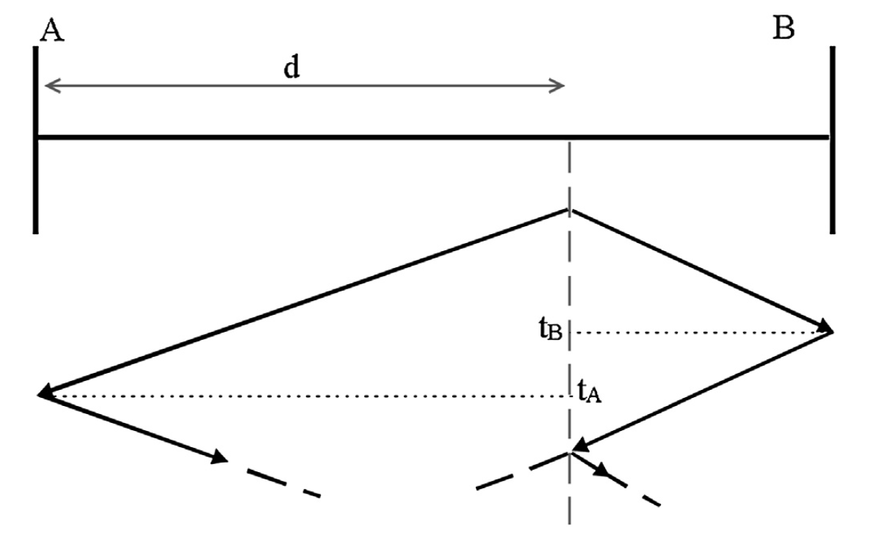
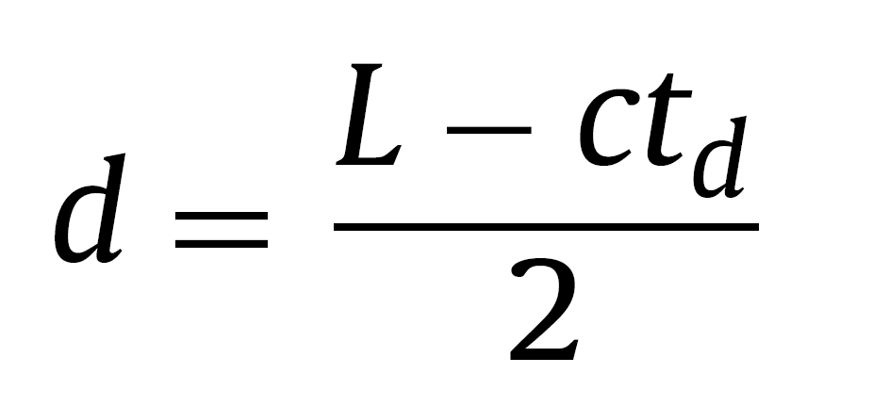
Travelling Waves-Based Fault Location Methods
“When a fault occurs, it generates high frequency travelling waves of currents and voltages propagating away towards both ends” [2]
Double-ended methods
Distance to the fault is calculated by using the times that the waves takes to arrive to the bus A and B
Requires:
Measuring devices with very high-frequency sampling rates
GPS for synchronizing the measured values
Lattice diagram for a fault at distance d from A. [2]

Slide 6
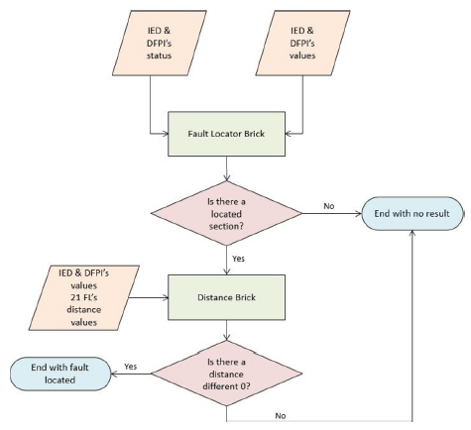
Fault location by using IED & DFPI [5]
DFPI = Directional Fault Passage Indicators
IED = Intelligent Electronic Devices
ANSI 21 FL = Impedance based fault location method
Method uses DFPI’s with advanced fault location algorithm to estimate the location of the phase and earth faults
Fault locator brick
identifies faulty section of the network
Distance brick
detects at what distance is the fault in the faulty section

Slide 7
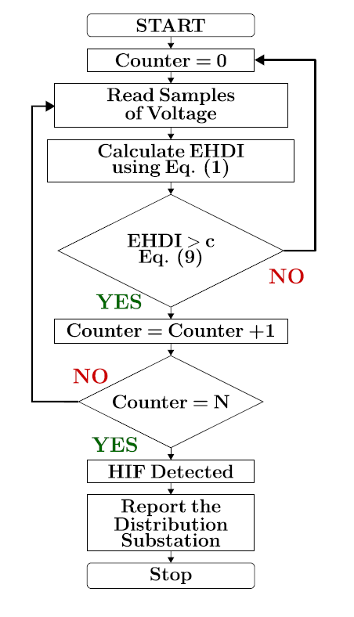
Smart meters in fault detection
Can improve performance of the impedance based methods [6]
Smart meters identify the area where the voltage is low due to the proximity of fault location
Can be used to detect the high impedance faults (HIF) in distribution grid [3]
Fault is detected depending on the amount of even harmonics in the grid
Even Harmonic Distortion Index (EHDI)
Algorithm implemented in SM for HIF detection [3]

Slide 8
Data and Learning Based Fault Location Methods
High amount of data available by multiple measuring instruments and sensors:
AMI = Advanced Metering Infrastructure (Smart meters)
PQA = Power Quality Analyser
PMU = Phasor Measurement Unit, PDC = Phasor Data Concentrator
SCADA = Supervisory Control and Data Acquisition system
WAMS = Wide Area Monitoring System
Combined with Machine Learning/Artificial Neural Networks (ML/ANN) [7]
A trained ANN algorithm is powerful in identifying a faulty pattern (grid fault and fault location) and can classify the fault by pattern recognition.
Fault prediction and mitigation
Real-time monitoring enables fast and accurate response to faults

Slide 9
Conclusions
Fast and accurate fault detection and locating is essential in power grid management and operation, especially with smart grids
Fault location in smart grids is more complicated compared to conventional grids due the bidirectional power flow and power electronics
Computer algorithms and machine learning analyzation of monitoring data is essential in the future of smart grid fault prevention and detection
Accelerating utilization of information technology, big data and artificial intelligence providing new opportunities for fast fault location and detection in complex networks, also for those containing distributed, intermittent generation

Slide 10
Source material used
Chen, K., Huang, C., He, J. “Fault detection, classification and location for transmission lines and distribution systems: A review on the methods”, 2016, High Voltage, pp. 25-33.
A. Bahmanyar, S. Jamali, A. Estebsari, E.Bompard: “A comparison framework for distribution system outage and fault location methods”, Electric Power System Research 145, 2017, 19-34
S. Chakraborty and S. Das, "Application of Smart Meters in High Impedance Fault Detection on Distribution Systems," in IEEE Transactions on Smart Grid, vol. 10, no. 3, pp. 3465-3473, May 2019
Andresen, C.A., Torsaeter, B.N., Haugdal, H. & Uhlen, K. 2018, "Fault Detection and Prediction in Smart Grids", 9th IEEE International Workshop on Applied Measurements for Power Systems, AMPS 2018 - Proceedings.
Silos-Sanchez, A., Villafafila-Robles, R. & Lloret-Gallego, P. 2020, "Novel fault location algorithm for meshed distribution networks with DERs", Electric Power Systems Research, vol. 181
F. C. L. Trindade and W. Freitas, "Low Voltage Zones to Support Fault Location in Distribution Systems With Smart Meters," in IEEE Transactions on Smart Grid, vol. 8, no. 6, pp. 2765-2774
D. Deveraj, M. Krishna Paramathma, I.Rajalakshmi: “Simulation And Implementation of Phasor Measurement Unit for Wide Area Monitoring System”, IEEE International Conference on Intelligent Techniques in Control, Optimization and Signal Processing, 2017.

