Slide 1
ELEC-E8423 - Smart Grid Wind power generation variation and its modeling
Julius Beranek, Ahmed Kishk

Slide 2
Introduction
Wind is the one of the fastest growing energy sources in the world
It has the potential to cover all of the world's energy consumption
Main problem: Fluctuating power output
→ Ways to work with this fluctuations and solutions for it are needed

Slide 3
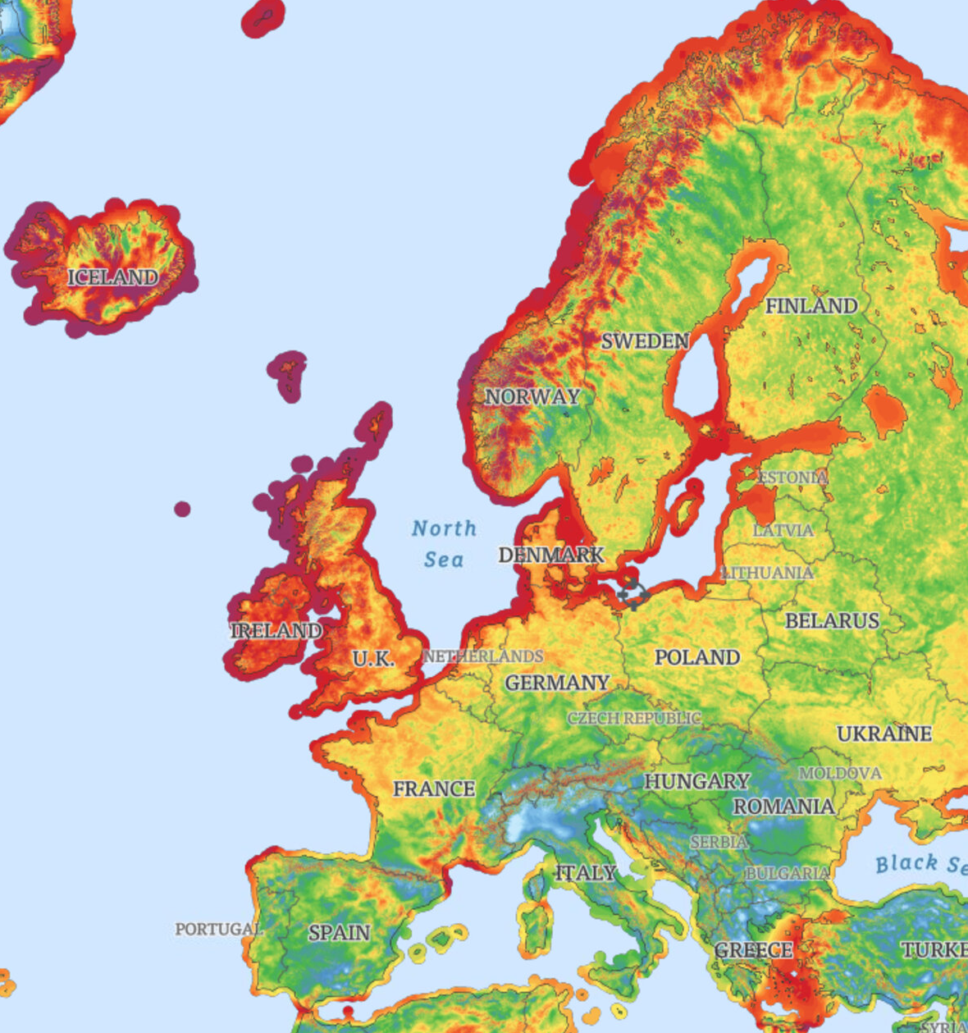
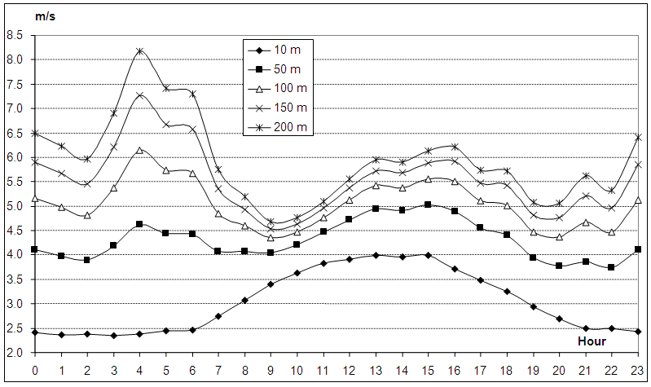
Wind speed variation
Approximate increase of speed with height: v₂ = v₁($\frac{H2}{H1} )$^{n}
Source: www.vortexfdc.com
Source: Tar et al (2015)

Slide 4
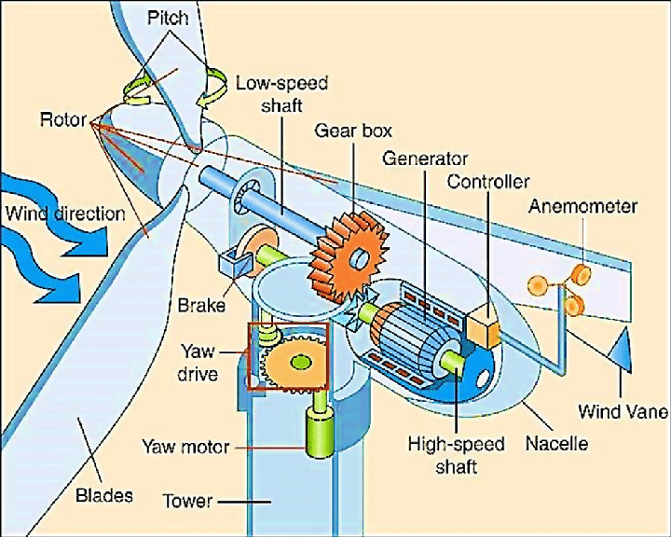
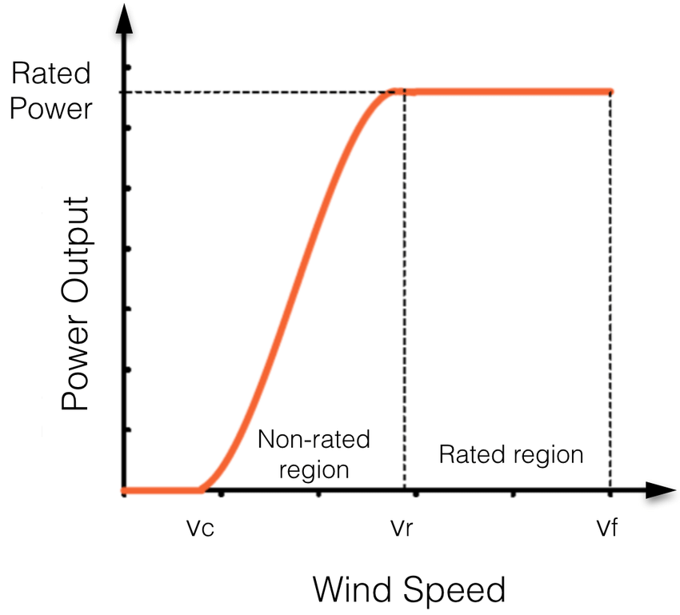
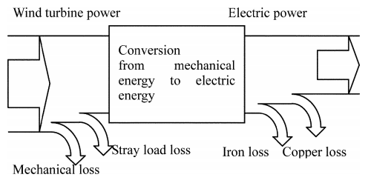
Wind power calculation
Wind power
Source: Madvar et al (2019)
Source: Dupont et al (2017)
Power output
Max Cp for HAWT = 0.59 (Betz Limit)
For VAWT, potential energy can be converted to kinetic energy and the max theoretical Cp can reach 1.18
Source: Inoue et al (2006)

Slide 5
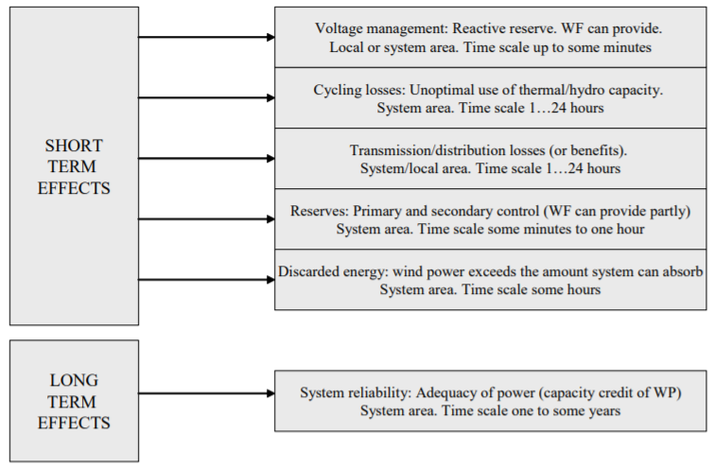
Impacts: Short- and Long-Term effects
Source: Holttinen & Hirvonen (2005)

Slide 6
Forecast of wind power
Why do we even need a forecast?
Wind power variation has enormous effects on the whole grid
Needed to install effective countermeasures against these effects
Without a forecast, a TSO has to assume that there is no wind generation
Types of forecasting
Very short term
Short term
Medium term
Minutes to hours
Controlling wind turbine
Up to 72 hours
Used by TSO
Up to following week
Scheduling maintenance
How is it used?
Used for trading/setting bids to the electricity market based on the view of the power production in the near future
Forecast tool needs a capability of at least 36 hours with hourly resolution

Slide 7
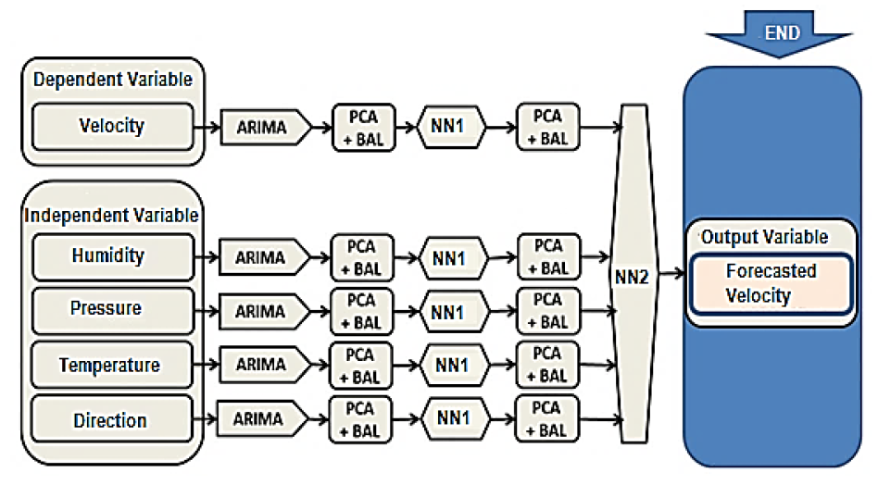
Types of wind power models
Statistical
Hybrid Model
Time Series
Autoregressive
Source: D. de Alencar et. Al. (2017)

Slide 8
Conclusions
Wind speed variation is highly dependent on numerous factors such as height, weather and climate
Forecasting is crucial for system security, TSOs have to know the exact wind power output
There are multiple ways to model wind power generation, the best was shown to be a hybrid model of multiple variants

Slide 9
Source material used
D. de Alencar, C. de Mattos Affonso, R. de Oliveira, J. Rodríguez, J. Leite, J. Filho (2017) “Different Models for Forecasting Wind Power Generation: Case Study” Energies vol. 10, no. 12.
H. Holttinen, R. Hirvonen (2005) "Power system requirements for wind power" in Wind Power in Power Systems. New York: Wiley pp. 143-167.
H. Holttinen, J. Miettinen, S. Sillanpää (2013) ”Wind power forecasting accuracy and uncertainty in Finland”. Espoo: VTT Technology 95.
P. Lecanu, J. Breard & Mouazé, D. (2019). "Theoretical calculation of the power of wind turbine or tidal turbine". HAL archives-ouvertes.
S. Watson, (2014). "Quantifying the variability of wind energy". WIREs Energy Environ 2014, 3:330–342".

Slide 10
Source material used
A. Inoue. (2006). "A calculation method of the total efficiency of wind generators". Wiley Online Library.
N. Al-Abbadi, S. Rehman. (2009). "Wind Speed and Wind Power Characteristics for Gassim, Saudi Arabia". International Journal of Green Energy, 6(2), 201–217.
K. Tar, A. Kircsi, S. Sándor, T. Tóth, V. Róbert, K. László. (2015). "Investigation of the wind power potential of the Hernád valley". Landscape & Environment.
E. Dupont, R. Koppelaar, H. Jeanmart. (2018). "Global available wind energy with physical and energy return on investment constraints". Applied Energy, 209, 322–338.
M. D. Madvar, F. Ahmadi, R. Shirmohammadi, A. Aslani. (2019). "Forecasting of wind energy technology domains based on the technology life cycle approach". Energy Reports, 5, 1236–1248.

