Slide 1
ELEC-E8423 - Smart Grid Communication solutions for Smart Grid
Denis Yeboah
Jasmin Hoikkala
07.02.2018

Slide 2
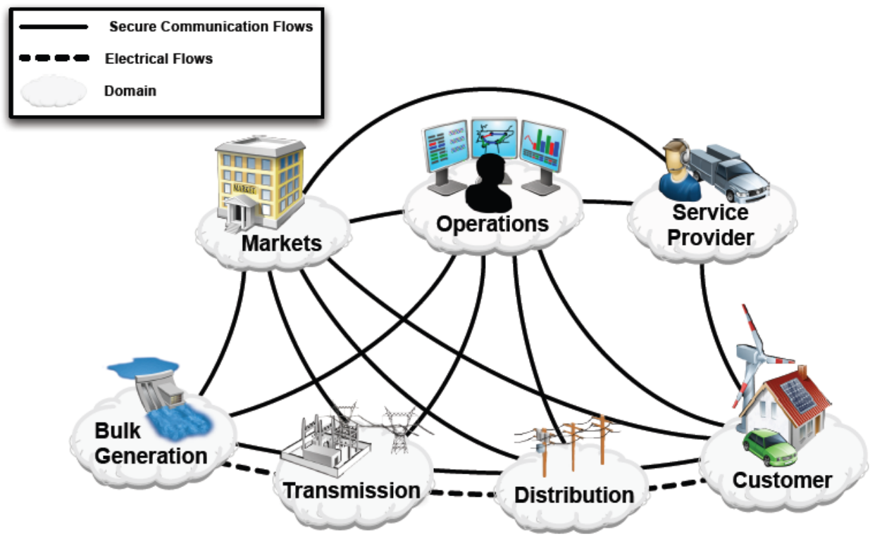
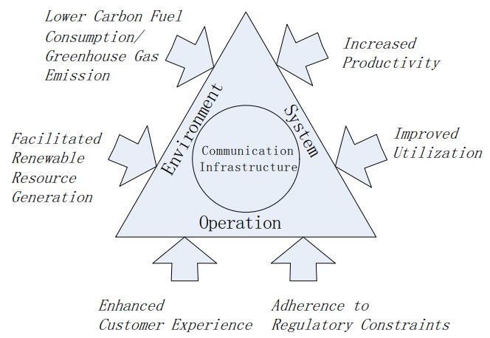
Introduction
For the power network to be smart it must include communication technology.
The utilization of bidirectional communication between smart devices is crucial for the smart grid to achieve better automation and efficiency.
OVERVIEW:
- Communication architecture in SG
- Communication technologies
- Customer experience
- Challenges
- Conclusions

Slide 3
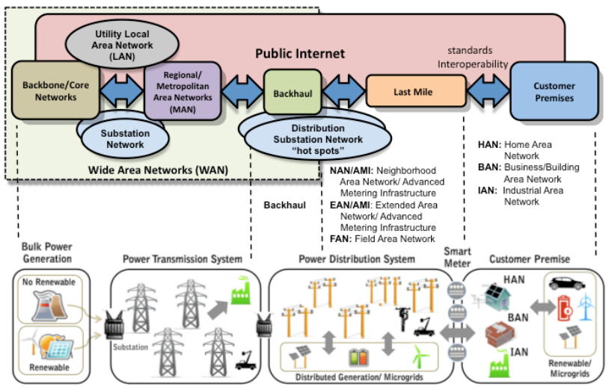
Communication architecture in SG
Smart grid domains can be divided in 3 main area networks.
Costumer premises networks (HAN, BAN, NAN)
NAN
WAN
The area networks enable two-way communication among actors (e.g. devices and systems) between and within domains.

Slide 4
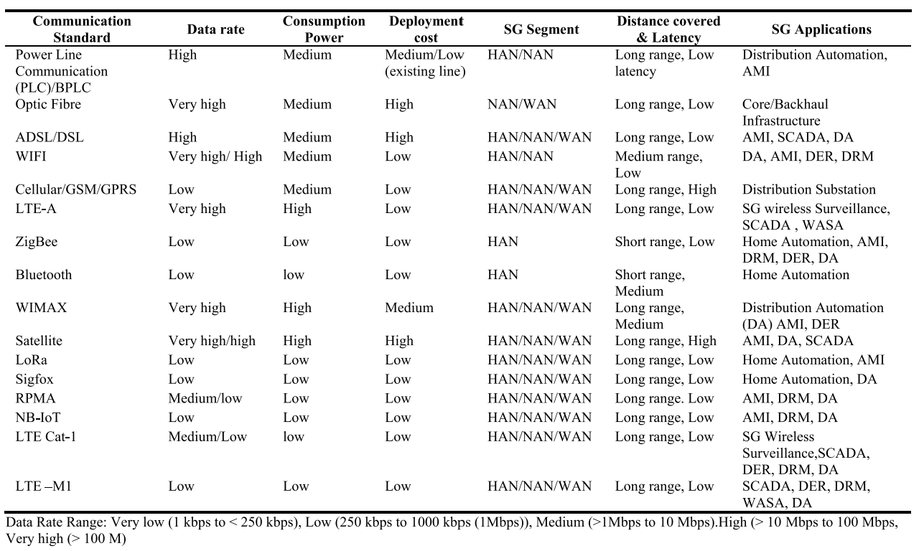
Communication technologies
The selection for the appropriate communication technology is application-specific.
Cognitive radio based sensor network in smart grid: Architectures, applications and communication technologies

Slide 5
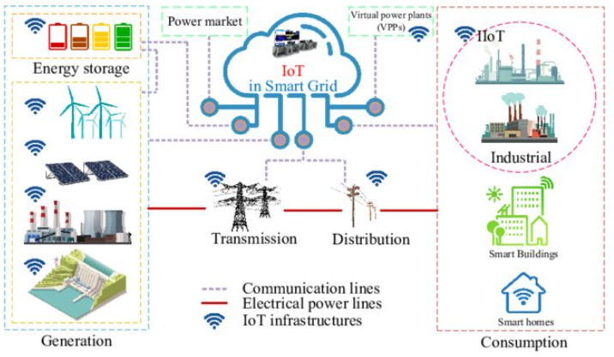
Internet of Things in the SG context
IoT is considered as the next step evolution of current grid networks
IoT helps to transfer and manage large amounts of data
Enables real-time monitoring of energy consumption and energy demand
Data is transferred between sensors, smart meters and programs
Advanced Metering Infrastructure (AMI) can be easily implemented

Slide 6
Cyber security threats
The development of smart grids lay more and more on the cyber security of the systems
Threats:
Attack on Automatic Generation Control Malware spreading
False information attack
Network attack

Slide 7
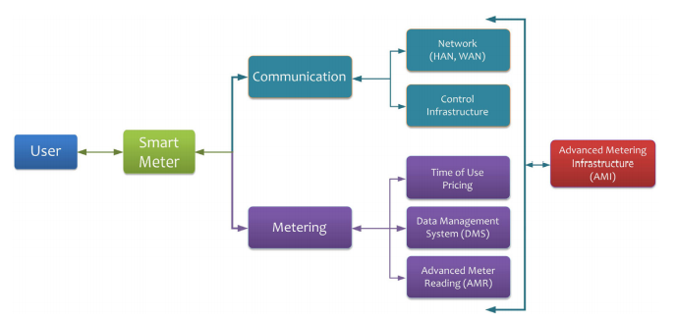
Customer experience
Smart meters interface between the customer and smart grid:
The smart meter is in charge of:
metering
monitoring energy usage and production
time-of-use pricing control
monitor the number of interruptions/outages
voltage levels and more…
communicating
bidirectional communication with the utility and control infrastructure
The joint metering and communication scheme enabeles:
more accurate electricity consumption data
better (and perhaps real-time) billing system
Improved efficiency demand response
signaling of status of the grid and creation of appropriate control signals
more responsive fault handling
A survey on smart metering and smart grid communication. Renewable and Sustainable Energy Reviews.

Slide 8
Protocols and standards
Protocols needed for transforming data in a closed environment
Protocols needed to transmit data externally back to a central location
Most of the protocols used are designed for connectivity, not security
Standards
IEEE P2030 - Guide for Smart Grid Interoperability of Energy Technology and Information Technology Operation with the Electric Power System (EPS), and End-Use Applications and Loads
IEEE P1901 - Standard for high speed communication devices via electric power lines, often called broadband over power lines (BPL)
IEC 62351 - Power systems management and associated information exchange - Data and communications security
IEC 62056 - Electricity metering data exchange
PLC G3 - Powerline communications standard that will enable the smart grid vision
IEC 61850 - Communication networks and systems for power utility automation
All the standards required for smart grid communications in various applications and domains can be traced from IEC webstore - http://smartgridstandardsmap.com/

Slide 9
Challenges
Due to the diversity of actors between and within domains, interoperability is challenging and requires further research.
Dated communication technology present
Scalability concerns as the number of users in a Smart Grid is large and expected to increase.
As the internet is utilized more for communication, cybersecurity and data privacy become reason for concern.

Slide 10
Conclusions
IoT is considered as the next step of evolution in grid network
The development of Smart Grids depend on the cyber security of the system
Standards ensure interoperable connectivity in the grid

Slide 11
Source material used
ENISA, “Communication network interdependencies in smart grids”, 2015 Available at https://www.enisa.europa.eu/publications/communication-network-interdependencies-in-smart-grids
Greer, C. et al. (2014), NIST Framework and Roadmap for Smart Grid Interoperability Standards, Release 3.0, Special Publication (NIST SP), National Institute of Standards and Technology, https://doi.org/10.6028/NIST.SP.1108r3
Jingcheng Gao et al. (2012), A survey of communication/networking in Smart Grids, Future Generation Computer Systems, Volume 28, Issue 2, P. 391-404, https://doi.org/10.1016/j.future.2011.04.014
Kabalci, Yasin. (2016). A survey on smart metering and smart grid communication. Renewable and Sustainable Energy Reviews. 57. P. 302-318. 10.1016/j.rser.2015.12.114.
Ogbodo, E. U. et al. (2017). Cognitive radio based sensor network in smart grid: Architectures, applications and communication technologies. IEEE Access, 5, P. 19084-19098.
Kenneth Kimani, Vitalice Oduol, Kibet Langat,Cyber security challenges for IoT-based smart grid networks,International Journal of Critical Infrastructure Protection,Volume 25,2019,Pages 36-49,ISSN 1874-5482,https://doi.org/10.1016/j.ijcip.2019.01.001.
C. Donitzky, O. Roos, S. Sauty, A Digital Energy Network: The Internet of Things & the Smart Grid, Available at: https://www.intel.com/content/dam/www/public/us/en/documents/white-papers/iot-smart-grid-paper.pdf
Rishab Niranjan, Digitalization for Optimization: Smart Grid operations in Finland, Available at:https://www.theseus.fi/bitstream/handle/10024/264028/Niranjan_Rishab.pdf?sequence=2
Janne Hakulinen, ÄLYKKÄÄN SÄHKÖVERKONTOIMINNOT PIENJÄNNITEJAKELUVERKOSSA JA SEN TULEVAISUUDENNÄKYMÄT, Available at: https://www.theseus.fi/bitstream/handle/10024/208039/Hakulinen_Janne.pdf?sequence=2&isAllowed=y

