Slide 1
ELEC-E8423 - Smart Grid AMR – Systems in SG
Iisa Saunamäki
Janne Teinilä
20.04.2021

Slide 2
Structure
1. Introduction
2. Components of automatic meter reading (AMR) system
3. AMRs in smart grids
4. AMRs in low, medium and high voltage level grids
5. AMRs in households
6. Conclusions

Slide 3
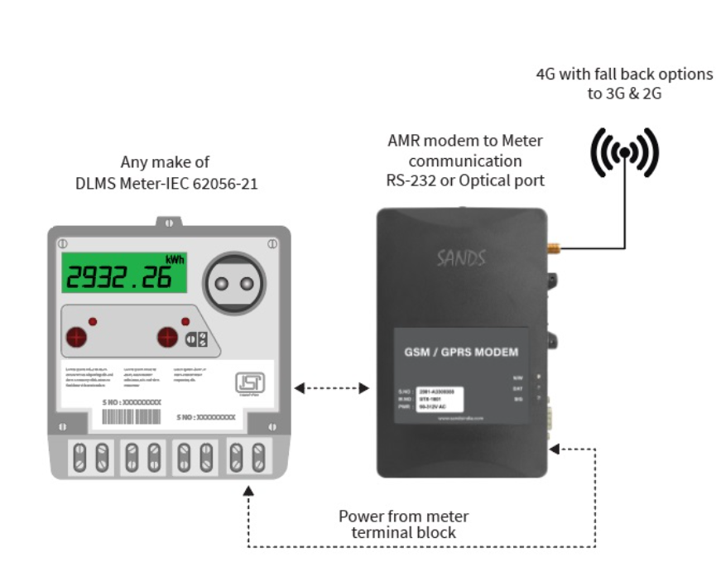
Automatic Meter Reading (AMR)
AMR is a meter that can automatically collect energy or water data
AMR is a part of smart grid
Enables more accurate data collection in order to control network
Most important function of AMR is to measure the amount of produced and consumed electricity
In the past, meter reading used to be manual
Notes:
The implementation of AMR systems will change the function of basic energy meter, which will become a smart terminal unit and gateway for multiple service providers and enable real time two-way communication between customers and utilities.
Utilizing AMR offers better efficiency in fault situations and network management. Following is based on Aidon’s experience and meter functionality. AMR support fault management, optimization of field work, customer service, network planning and monitoring of contractual issues

Slide 4
Components of AMR-system
AMR system consists of three main components:
Reading unit
Communication unit
Data receiving and processing unit
Notes:
AMR sytems consists of three main components:
Reading unit, which collects the produced electricity or consumption of electricity (from electricity grid or houshold)
Then communication unit that is connected via, for example radio frequenqy or mobile network to the data receiving and procressing unit, which nowadays is usually so called cloud, So every meter brings data to the cloud where data is processed.

Slide 5
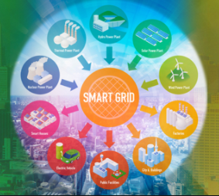
AMR in smart grids
AMRs are needed in future energy systems
An important aspect in a Smart Grid AMR. It is used for monitoring of load on transformers, grids and households, automated reading and two-way connection between customers and utilities
Demand response, fault detection, real time markets..
With AMR, it is possible to connect different energy system components
Notes:
In order to make other tech or innovations in this course to make work -> better monitoring i.e., amr is needed. (DR)
Hourly measurements enable new kind of dynamic tariffs that support energy‐efficient targets and operation of electricity market. Using hourly measurements, more accurate and even customer‐specific load models can be created to support load estimation and forecasting.
With AMR meters faults can be perceived and identified immediately and located automatically which enable to guide field staff directly to the fault site. Based on AMR data control center have real time snapshot from faulted area at the field. This is essential for optimized allocation of needed work for fault repairing and distribution restoration. With reliable snapshot the scope of faults is in control which remarkably intensifies work of control center operators. There is also possibility to prioritize the order of repairs e.g. important sites are handled first and the number of metering points that can be repaired on one occasion. When prioritizing work order essential is to know the location of the staff in the field. DMS systems are capable to utilize GPS information to show location of each field group. For example next benefits are obvious.

Slide 6
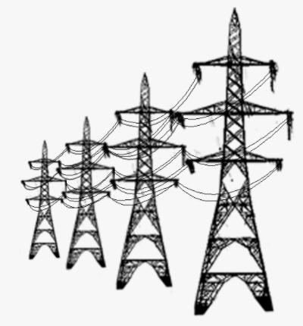
AMR in networks
AMR systems are used for improving monitoring and control at the LV grid level.
In the LV grid, AMR is most used in households and transformers
Managing faults in the LV network.
AMR offers two-way communication to the customer site
Enlarge online monitoring also to the low voltage network
Notes:
The implementation of AMR systems will change the function of basic energy meter, which will become a smart terminal unit and gateway for multiple service providers and enable real time two-way communication between customers and utilities. From that viewpoint the AMR system can also be seen as an extension of SCADA and network management systems for controlling and monitoring the last parts of the network (i.e. the low voltage network) between medium voltage network and customer.
AMR offers two-way communication to the customer site, which makes it possible to enlarge online monitoring also to the low voltage network. This enables alarms on exceptional events, e.g. network faults and voltage violations, and here meters can also have some protective functions adding the safety. The use and integration of AMR in network operation can be seen as an extension of SCADA and distribution automation to the low voltage level. So far automatic monitoring has been used mostly in 20 kV medium voltage networks.
Low voltage network is the key element in quality of supply to most of the end customers of DNO. Improving the quality of supply requires that network operation and planning and technical customer service would have access to low voltage network measurement information using their operational systems. This would decrease the amount of work done in these processes. Integrating advanced AMR solution with alarms and more accurate measurement information with additional measurement quantities to current operational information systems provides additional values to improve planning and operation and technical customer service business processes.

Slide 7
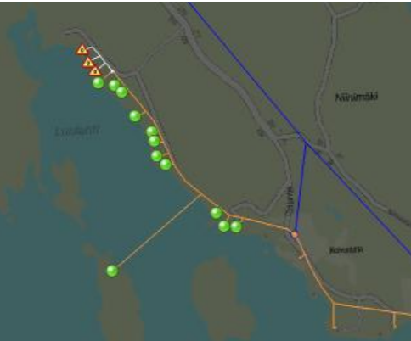
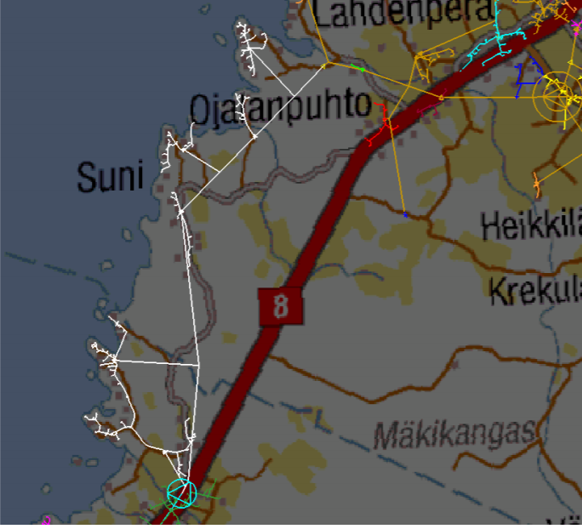
AMR and distribution management system integration
AMR-DMS integration is one of the development steps for the network fault management process. Main functionality can be divided to two parts:
Alarms
• Phase missing, voltage level, voltage unbalance, neutral conductor fault
Queries
Device responding, no alarms, device responding, active alarms, device not reached, device unknown, device switched off
Notes:
In the next pictures are shown some examples utilizing automatic meter alarms. This figure above presents a situation where three meters have sent spontaneous alarms about neutral fault and how they are shown on the DMS screen. After receiving spontaneous alarms DMS query other meters in the same LV feeder.
In this case DMS automatically generate a query to the other metering points in the same low voltage feeder to find out statuses of all the other meters. Therefore, all meter in the same LV feeder are presented, not only faulted meters. This functionality offers quick snapshot to the control center operator from the faulted area.
One feature support finding low voltage faults under medium voltage fault. In the figure under is shown a situation when MV fault is just occurred. Faulted line is presented with white color.

Slide 8
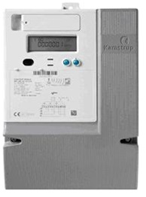
AMR in Households
In Finland, a household AMR takes measurements for every 15 minutes.
AMR devices can be remotely called, and they can remotely give fault data.
Measures phase voltage, current, power consumption, neutral and ground connection.
Notes:
For example, you can use AMR to HVAC (heating ventilation and air conditioning) systems demand response. The two-way connection AMR needed in order to this working. You can avoid electricity demand spikes for example staggering the starting time for heating.
It is easier to detect low quality phase voltage i.e., with AMRs

Slide 9
Conclusion
AMRs are used for billing, fault location and network designing
AMRs are most commonly located in transformers, substations, and consumer distribution boards (households)
Data need to be collected and processed, in order to smart grids to work

Slide 10
Source material used
https://www.researchgate.net/publication/235337176_A_reliable_and_economically_feasible_automatic_meter_reading_system_using
power_line_distribution_network
https://www.sandsindia.com/automatic-meter-reading-amr/
https://www.businessfinland.fi/48cd02/globalassets/julkaisut/invest-in-finland/white-paper-smart-grid.pdf
https://lutpub.lut.fi/bitstream/handle/10024/149256/kandidaatinty%C3%B6_niinikoski_2018.pdf?sequence=1&isAllowed=y
https://www.power-grid.com/smart-grid/amr-communication-technologies-101-four-ways-utilities-connect-to-meters/#gref
https://onlinelibrary-wiley-com.libproxy.aalto.fi/doi/abs/10.1002/9781118991978.hces129
http://sgemfinalreport.fi/files/SGEM-D4.5.5-Analysis%20of%20needs%20and%20available%20solutions%20(for%20second%20generation%20AMR).pdf

Slide 11
Thanks! Any questions?
20.04.2021

