Slide 1
ELEC-E8423 - Smart Grid Power markets in Nordic Countries: Day-ahead market and intraday balancing
Aleksi Toivanen & Nuutti Hernesniemi
16.03.2021

Slide 2
Introduction
Physical power markets:
Day-ahead market (Elspot)
Transmission capacity and price coupling
Intraday market (Elbas)
Key terms:
CET = Central European Time
Transmission congestion (bottleneck) = transmission line power capacity limit is exceeded
Price coupling = hourly power market price is same between interconnected bidding zones
Marginal cost = Fuel and variable O&M costs of producing unit of electric energy
Power markets in Nordic countries
Scope
Derivatives market
Physical markets
Balancing markets
Elspot
Elbas
10 y… 1 d
36h…12h
36h…1h
1h…
Delivery
Time before delivery

Slide 3
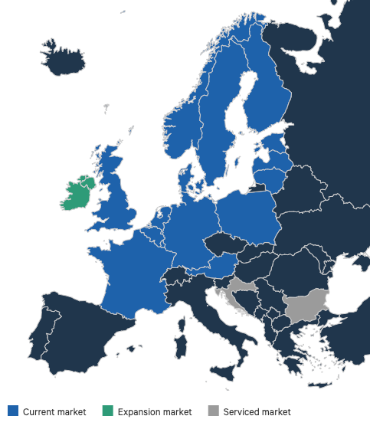
Physical power markets
In the physical power markets the electricity is always delivered after trading activity
Physical markets are traded at Nord Pool which is partly owned by Nordic transmission system operators including Fingrid and Svenska Kraftnät as examples
Nord Pool trading mechanisms:
1. Day-ahead market (Elspot)
2. Intraday market (Elbas)
Source: https://www.nordpoolgroup.com/

Slide 4
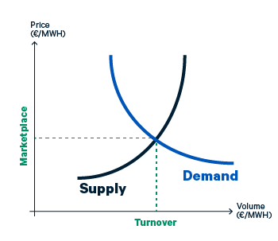
Day-ahead market (Elspot)
It is the main platform for trading electricity for the following day
In 2019, 381 TWh of electricity was traded in the day-ahead market (includes Nordic and Baltic countries)
Price formation:
Participants submit their supply and demand orders (price and quantity) to Nord Pool for each hour of the following day
After 12:00 CET, Nord Pool clears the final hourly trading price for all market participants
In the future moving towards the 15 min settlement period
Supply and demand curve
Source: https://www.nordpoolgroup.com/the-power-market/Day-ahead-market/

Slide 5
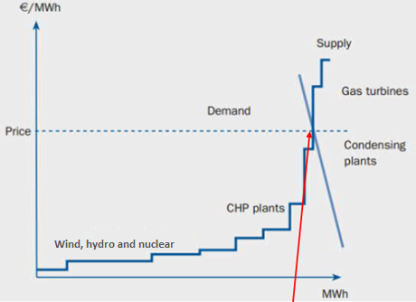
Merit order curve
Market price of electricity for all hours of the next day are determined as follows:
Offerings of electric energy at marginal cost are placed on ascending order (see picture)
Bid orders are placed on descending order
All accepted will get the clearance price which is the intersection point of these two curves
In the Nordic power markets hydro, wind and nuclear dominates
What happens in the future when more and more wind is coming to the market?
More expensive production will be used less and also profits of wind power production will decrease
Profit
Clearance
Notes:
Marginal cost / variable cost = fuel and variable O&M costs of producing unit of electric energy

Slide 6
Transmission capacity and price coupling
There is a limit to how much power a transmission line can carry, and when capacity limit is reached, the line is said to be congested
Because of transmission congestion (bottlenecks) in the grid, there are different bidding zones (price areas) within a country as well as between countries (more expensive production needs to be used near the load)
If transmission capacity between two price areas is not in full use, the zones have the same hourly electricity price (Price coupling)
If transmission capacity between two price areas is in full use, the prices in the zones differ from each other (Price decoupling)
Power will always flow from the lower price area to the higher price area where the demand for power is the highest
Natural balancing properties of the electricity grids decreases as the amount of intermittent renewable generation increases, and more flexible thermal power plants are being shut down
The need for larger transmission capacities between bidding zones will increase

Slide 7
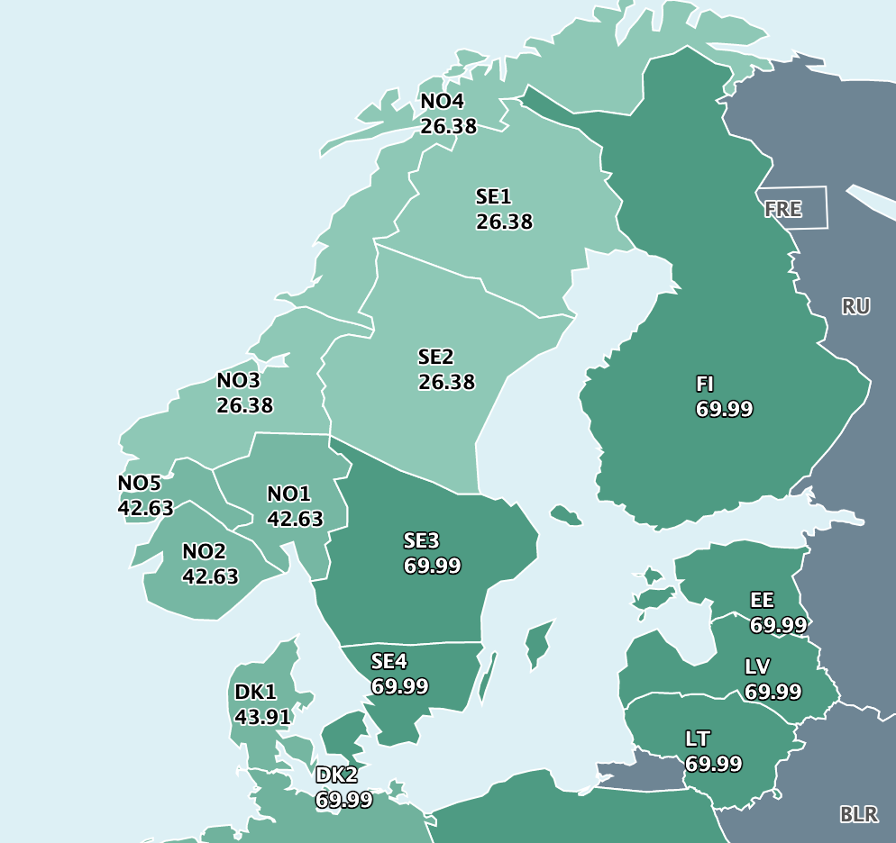
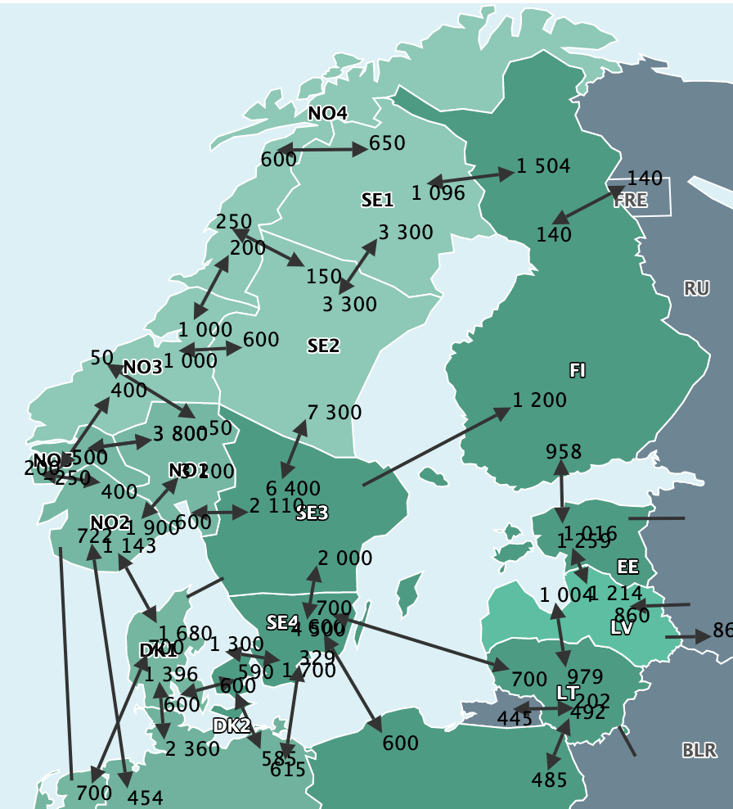
Transmission capacities (MW) and prices (€/MWh) 10.03.2021 12-13 CET
Source: https://www.nordpoolgroup.com/Market-data1/#/nordic/map

Slide 8
Intraday market (Elbas)
Nord Pool's intraday market is continuous market that enables power trading between the closing time of the day-ahead market (12:00 CET) and the next day delivery (starting at 00:00 CET) until one hour before the delivery
The intraday market is tool to find a balance between supply and demand as unexepected changes occur in consumption or production.
In 2019, 15.8 TWh of electricity was traded in the day-ahead market (includes all 15 countries)
Because of the increasing amount of renewable intermittent production, such as wind and solar, it becomes more challenging for market participants to be in balance closer to delivery
The importance of the intraday market will increase
On the intraday market, prices are set up based on ”pay-as-bid” principle, where best prices come first:
Highest buy price and lowest sell price
https://www.nordpoolgroup.com/the-power-market/Intraday-market/

Slide 9
Conclusions
In the Nordic power system, a major share of electricity is traded in the day-ahead market where the market price of each hour is determinded based on the supply and demand
The Nordic electricity market prices are greatly affected by the hydro and wind production.
The intraday market is continuous market that enables trading one hour before delivery which makes balancing easier. This might be more and more important in the future.

Slide 10
Source material used
Alahäivälä, A. (2017). Doctoral dissertation. Aalto University. School of Electrical Engineering, Department of Electrical Engineering and Automation. Espoo. 172 p. Available at: https://aaltodoc.aalto.fi/bitstream/handle/123456789/24665/isbn9789526072968.pdf?sequence=1&isAllowed=y.
Empower. (2018). Enabling a Smooth Transition to 15 Minute Balance Settlement. 39 p. Available at: https://energiavirasto.fi/documents/11120570/13026619/Final+Report+-+15+Minute+Balance+Settlement%2C+Delivered+version.pdf/b9d7ae4d-a0e0-ca4d-4d8e-748d382d5436/Final+Report+-+15+Minute+Balance+Settlement%2C+Delivered+version.pdf
Millar, J. (2021). Electricity Distribution and Markets, Lecture 10 – Electricity Markets the Nordic Way.
Nord Pool. (2021). Market data. [Accessed 10.03.2021]. Available at: https://www.nordpoolgroup.com/Market-data1/#/nordic/map
Nord Pool. (2020a). [Accessed 09.03.2021]. Available at: https://www.nordpoolgroup.com/
Nord Pool. (2020b). Day-ahead market. [Accessed 09.03.2021]. Available at: https://www.nordpoolgroup.com/the-power-market/Day-ahead-market/
Nord Pool. (2020c). Bidding areas. [Accessed 09.03.2021]. Available at: https://www.nordpoolgroup.com/the-power-market/Bidding-areas/
Nord Pool. (2020d). Intraday market. [Accessed 09.03.2021]. Available at: https://www.nordpoolgroup.com/the-power-market/Intraday-market/.
Nord Pool. (2019). Annual Report 2019. [Accessed 11.03.2021]. Available at: https://www.nordpoolgroup.com/49ea17/globalassets/download-center/annual-report/annual-report_2019.pdf
Saulny, N. (2020). Energy Markets, Lecture 11 – Energy markets Batteries in Nordic Power Markets.
Syri, S. (2020). Energy Markets, Lecture 5 – Nordic Electricity markets.

Slide 11
Thank you! Any questions?

