Slide 1
ELEC-E8423 - Smart Grid Prosumer / Consumers. Local energy resources and energy matching
Quirin Bufler
27.04.2021

Slide 2
Introduction
“Prosumer” – Producer and Consumer
“Prosumage” – Production, Consumption and Storage
Production: Local energy resources
Wind power
Solar power
Heat generation (Geothermal heat, fireplaces, biomass boilers)
Consumption and Storage: Energy matching
Load management (balancing electricity supply by managing loads)
Energy storages with smart management (time between production and demand peaks)
Notes:
”energy produced at the site of consumption”

Slide 3
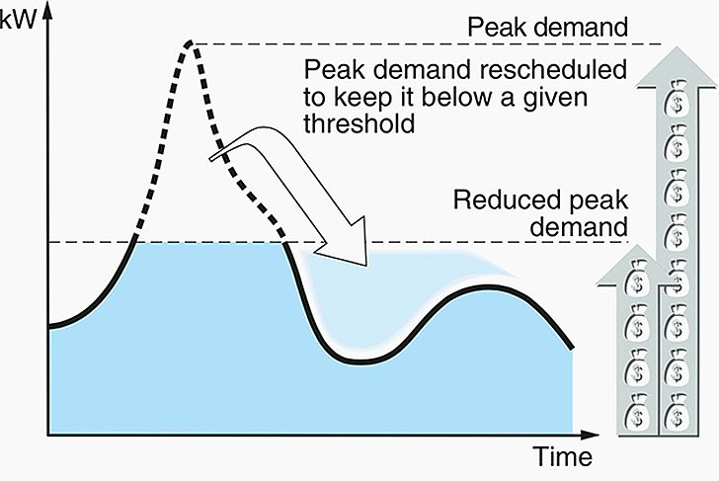
Motivation
Distribution grid relief
Flatten local net-consumption profile
Reduced load management demand for higher hierarchy grid operators
Economic
Small Scale: self-consumption can be increased
retail electricity price < wholesale price
Reduce Emissions
Local energy communities have a broader load distribution
Commercial local energy matching reduces transmission losses and favors sector coupling
https://electrical-engineering-portal.com/smart-load-management-strategies-to-save-energy
Notes:
Small scale: (13-24%) for 0.5-1.0 kWh storage per kW of installed PV capacity
Larger system sizes become profitable with higher electricity retail prices and lower wholesale prices
Single: 1600 kWh (40% Germany)
Couple:2500 kWh (1/3 Germany)
4-Pers: 4000 kWh (10% Germany)
(Family House: 6 kWp, 800kWh/kWp= 4800kWh)
Advantages of Consumage
+ Consumer preferences ? Participation and acceptance of energy transformation
+ Lower and less volatile electricity costs
+ Activation of private capital ? Flexibility, sector coupling, and energy efficiency
+ Distribution grid relief
+ Transmission grid relief
+ Increased competition
+ Local benefits
+ Political economy and new institutional arguments
Disadvantages
Efficiency losses
Distribution Impacts
Reobound effects
Concerns about data protection and privacy

Slide 4
Local energy resources and storages
Wind and PV are widely installed
Potential depends on geographical conditions
Potential of geothermal resources are negligible in comparison
Different Storage Technologies
Electrical Energy Storage (EES) including electric vehicles
Thermal Energy Storage (TES)
Power to Gas (H2)
Storage capacity sizing is an important engineering task
Smart management is crucial for optimized storage usage
(DMS: Air conditioning, clothes dryer, electric vehicles etc. offer largest potential)
Notes:
alternative renewable energy resources, such as bioenergy, solar thermal, hydro, and geothermal are not used. These Techs are not growing compared to PV/Wind
TES and H2: Sectorcoupling! Individual local requirements / often unique solution depending on resources etc. (Industrial, not so much residential)
Storage capacity sizing is an important engineering task (optimize Demand Side Management potential vs Storage capacity)
Oversized capacity does not increase selfconsumption
Smart management is crucial for optimized storage usage (Grid goals vs. selfconsumption. Gridload relief vs economic drive)
Large scale batteries
Li-ion: Tesla Powerwall 14 kWh at pricepoint of 7300 €
Redox Flow Batteries 6,3 kWh at pricepoint of 6000 €
Electric vehicles
Contain 30-90 kWh batteries
Could be used for charging as well as discharging
Goal: Reduce peak demand and provide flexibility
Could reduce demand up to 8-32%, depending on the operation algorithm
Electricity consumption rises marginally due to losses
Do not yet provide true independance from the grid
Battery sizes low / too expensive to scale
Useful tool on local electricity matching

Slide 5
Current technology combinations and applications
Higher share of wind in commercial use
Multiple: Combination of EES, TES, Gas e.g. electrolizer + fuel cells + EES
Notes:
Research Paper on current comparable Prosumage projects distribution (Terminology)
Residential:
PV+EES (TES)
Electrolyzer + fuel cell
(micro) combined heat and power (boiler/furnace
heat pump, and electrical heater/chiller or heat exchanger
commercial
more Wind+ H2 Technology
Utility Applications
More combinations of different Techs
Island Mode
High Share of Wind + H2
full autarky would require excessive oversizing of both the PV system and the battery

Slide 6
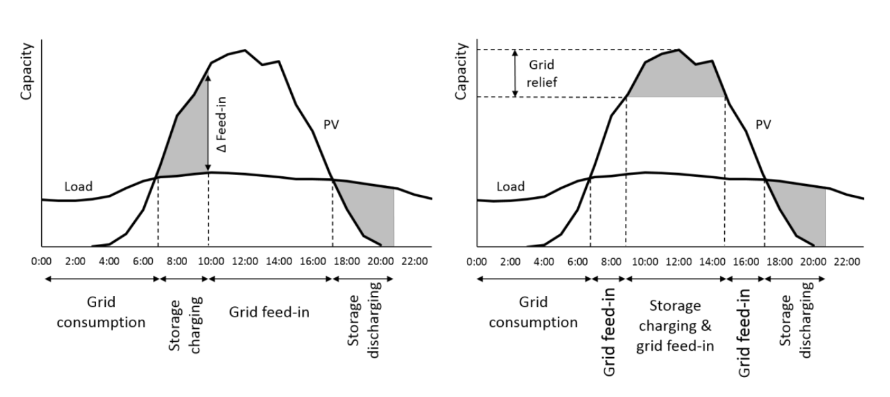
Energy matching – Methods
Mixed integer linear programming models
Most used for creating an optimized operation of smart components
Based on constraints in system (Capacity, max. load/power/current/voltage, time etc.)
Optimization
Optimizing for price, self consumption, grid relief, minimum load, max. efficiency etc.
Demand side management
Notes:
Other Models:
1. Genetic algorithm, Random Hill Climbing algorithm, Particle Swarm Optimization, etc.

Slide 7
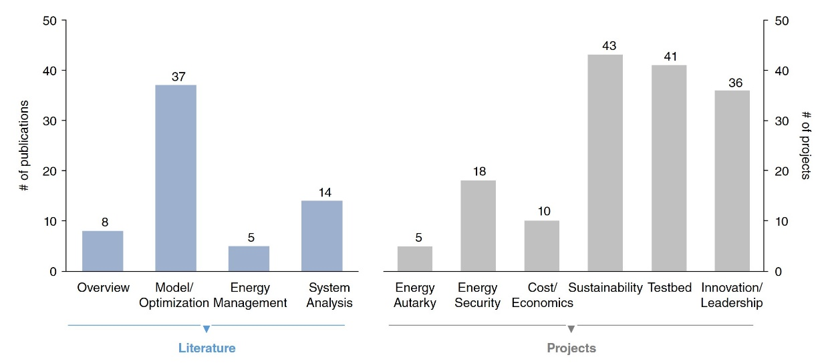
Theoretical research and practice
Discrepancy between research and projects
Notes:
Different approaches in research and real-life projects
Literature emphasizes on theoretical research regarding optimization techniques and efficientcy
Projects look to the operational challenges like interaction between components and boundaries of regulatories
Communicationsprotocols not regarded in literature -> more pilot projects
Industrie could optimize systems better. E.g. lower emmisions and find financial advantages in literature

Slide 8
Conclusions
Local electricity resources consists of wind and solar
Energy matching increases stability and profitability of the system
Energy matching can be done
By load side management
Smart energy storages

Slide 9
References
W. P. Schill, A. Zerrahn, and F. Kunz, ‘Prosumage of solar electricity: Pros, cons, and the system perspective’, International Association for Energy Economics, 2017. doi: 10.5547/2160-5890.6.1.wsch.
D. Grosspietsch, M. Saenger, and B. Girod, ‘Matching decentralized energy production and local consumption: A review of renewable energy systems with conversion and storage technologies’, Wiley Interdiscip. Rev. Energy Environ., vol. 8, no. 4, pp. 1–18, 2019, doi: 10.1002/wene.336.
M. La Scala, From Smart Grids to Smart Cities, 1st ed. ISTE Ltd and John Wiley & Sons, Inc., 2016.
Wang, Caisheng, and M. Hashem Nehrir. "Power management of a stand-alone wind/photovoltaic/fuel cell energy system." IEEE transactions on energy conversion 23.3 (2008): 957-967.
Kelleher, J., and J. V. Ringwood. "A computational tool for evaluating the economics of solar and wind microgeneration of electricity." Energy 34.4 (2009): 401-409.
Pipattanasomporn, M., Kuzlu, M., Rahman, S. "An Algorithm for Intelligent Home Energy Management and Demand Response Analysis", IEEE Transactions on Smart Grid ( Volume: 3, Issue: 4, Dec. 2012 )
Hittinger, Eric. "Distributed generation: Residential storage comes at a cost." Nature Energy 2.2 (2017): 17006.
Brahman et Al. “Optimal electrical and thermal energy management of a residential energy hub, integrating demand response and energy storage system”. Energy and Buildings 90 (2015) 65–75
https://www.wemag.com/energiesparberatung/stromverbrauch-single-2-3-4-personen-haushalt
https://www.energieheld.de/solaranlage/photovoltaik
https://electrical-engineering-portal.com/smart-load-management-strategies-to-save-energy

Slide 10
ELEC-E8423 - Smart Grid Prosumer / Consumers. Local energy resources and energy matching
Thank you for your attention
Quirin Bufler
27.04.2021

