Slide 1
ELEC-E8423 - Smart Grid Different market mechanisms for SG: bidding, real-time pricing and blockchains
Iida Willberg & Heidi Manninen
30.3.2021

Slide 2
Introduction
The equilibrium of supply and demand must be maintained at all times to avoid system disturbances and power interruptions. In this presentation we introduce how this equilibrium can be maintained using demand side approach.
Market mechanisms:
Incentive-based → Demand bidding (DP)
Price-based → Real-time pricing (RTP)
Blockchains
Although demand-side participation brings more flexibility and options for both supply and demand side, it also increases uncertainties in the planning and operation of smart grids

Slide 3
Demand Bidding 1/2
Demand response program
Actions that aim to maintain the supply-demand equilibrium of the power grid from the side of the demand
Market driven program, incentive-based
Consumers bid to reduce their loads
Bids are accepted if they are lower than the market price
If consumers are unable to decrease their loads as agreed, they face penalties
Emergency Demand Response Program (EDRP)
voluntary
no penalties for customers
reliability-driven program

Slide 4
Demand Bidding 2/2
Advantages:
increases market efficiency
larger social surplus
mitigates suppliers ability to exercise market power by raising power prices significantly above production cost
financial benefits
potential savings to customers
avoided investments
lower wholesale market prices
system-wide performance benefits
increases reliability as it lowers the likelihood of outages
improved choice
customers have more options for managing their electricity costs
Disadvantages:
privacy issues
identifiable load profiles etc.
security
ensure that entities participating are legitimate
it takes time to recruit customers for a demand response program
mainly offered to large customers

Slide 5
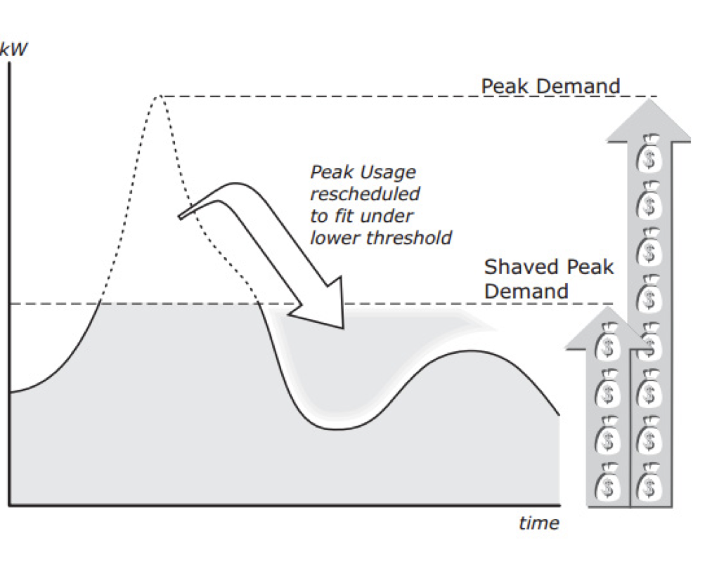
Real-time pricing (RTP) 1/2
Price of the electricity is placed in real time
Demand response program, price based program
Balances the differences between supply and demand
Encourages the customers to shift their consumption
savings in electricity expenses
Peak shaving effect
Advanced real-time metering methods are needed

Slide 6
Real-time pricing (RTP) 2/2
Advantages:
lower electricity expenses for consumers
highest financial rewards comparing to other
dynamic pricing mechanisms
raises customers awareness considering electricity markets and possibly also climate
good way to get more renewables to the grid
Disadvantages:
complex metering systems create more expenses
price predicting can create challenges
high transaction costs
decreasing the profit and maybe not even profitable

Slide 7
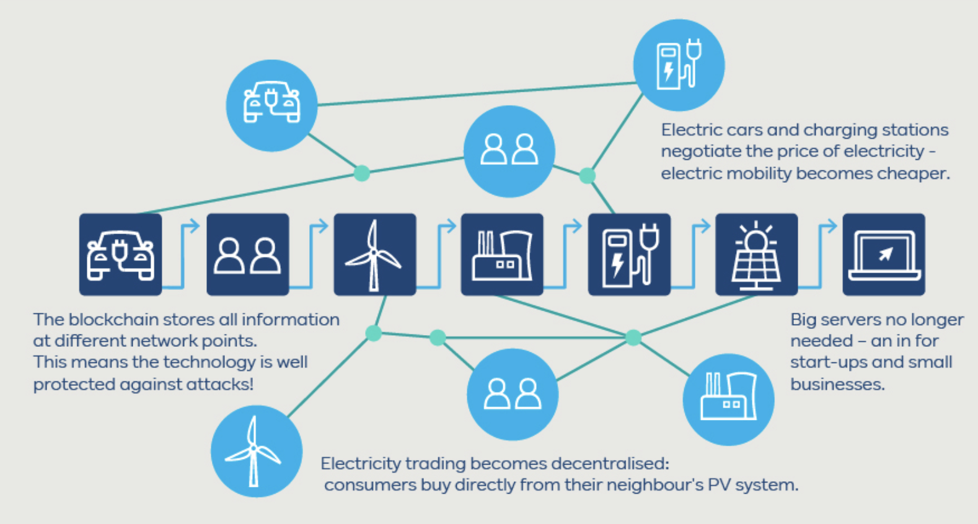
Blockchain 1/2
a peer-to-peer system where all of the participants are linked to each others using cryptography and their actions create a network
blockchains could help both demand bidding and real time pricing in the future
blockchains enable high automatisation

Slide 8
Blockchain 2/2
Advantages:
no central monitoring needed
no expensive separate metering system needed, can be integrated
works with extremely complex systems
prosumers can buy and sell without a third party
Disadvantages:
hard to regulate
needs development to be able to compete with RTP and demand bidding

Slide 9
Conclusions
Demand bidding brings major advantages into the grid operation such as improved market efficiency. However, ensuring customer’s privacy still remains the biggest issue.
RTP brings savings for customers by peak shaving effect. Still more advanced metering systems are needed.
Blockchain is not yet a competitive market mechanism but it will be important in the future.

Slide 10
List of references
Aalami, H. A. & Khatibzadeh, A. 2016. Regulation of market clearing price based on nonlinear models of demand bidding and emergency demand response programs. International Transactions on Electrical Energy Systems. Vol. 26(11). pp. 2463-2478.
AGUNG, A.A.G. and HANDAYANI, R., 2020. Blockchain for smart grid. Journal of King Saud University - Computer and Information Sciences, .
Albadi, M. H. & El-Saadany, E., 2008. A summary of demand response in electricity markets. Electric Power System Research, 78(11), pp. 1989-1996.
ASWIN RAJ CA*, ARAVIND EA, RAMYA SUNDARAM BA, SHRIRAM K VASUDEVANB, 2015. Smart Meter Based on Real Time Pricing. Smart grid technologies, pp. 120-124. Accessed Mar 15 2021.
BECK, F. and MARTINOT, E., 2004. Renewable Energy Policies and Barriers. In: C.J. CLEVELAND, ed, Encyclopedia of Energy. New York: Elsevier, pp. 365-383.
Livingston, D., Siviram V., Freeman M., Fiege M, 2018. Applying block chain technology to electric power systems. Smart energy international. Accessed Mar 15 2021. Available: https://www.smart-energy.com/industry-sectors/policy-regulation/applying-blockchain-technology-electric-power-systems/
Rahman, M. S., Basu, A., Kiyomoto, S. & Bhuiyan, M. Z. A., 2017. Privacy-friendly secure bidding for smart grid demand-response. Information Sciences, 379, pp. 229-240.

