Slide 1
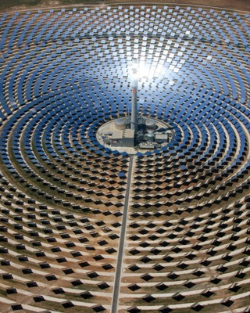
ELEC-E8423 - Smart Grid
Solar power generation variation and its modelling
Nima Javanshir & Anahita Farsaei
06.04.2021

Slide 2

Introduction
Solar cells
Why solar power generation is variable?
What is the solution?
Conclusion
Prediction horizon
Forecast modellings

Slide 3
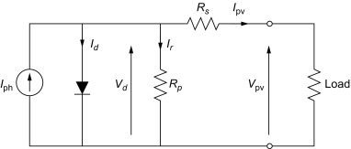
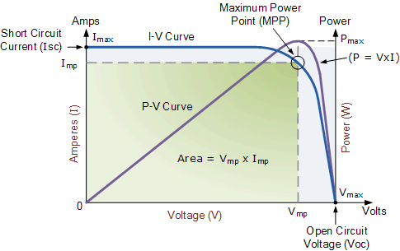
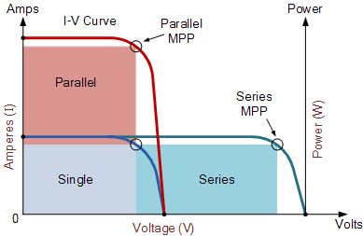
Solar cells
Convert the energy of sun directly into electricity by the photovoltaic effect.
Are modeled with a simple equivalent circuit [1].
Solar Cell I-V Characteristic Curves:
  show the relationship between current and voltage.
  provide the information required to configure a solar system operate as close to its optimal peak power point (MPP) as possible.
  The amount of solar irradiance controls the output current ( I ), and the operating temperature of the solar cells affects the output voltage ( V ) [2].

Slide 4
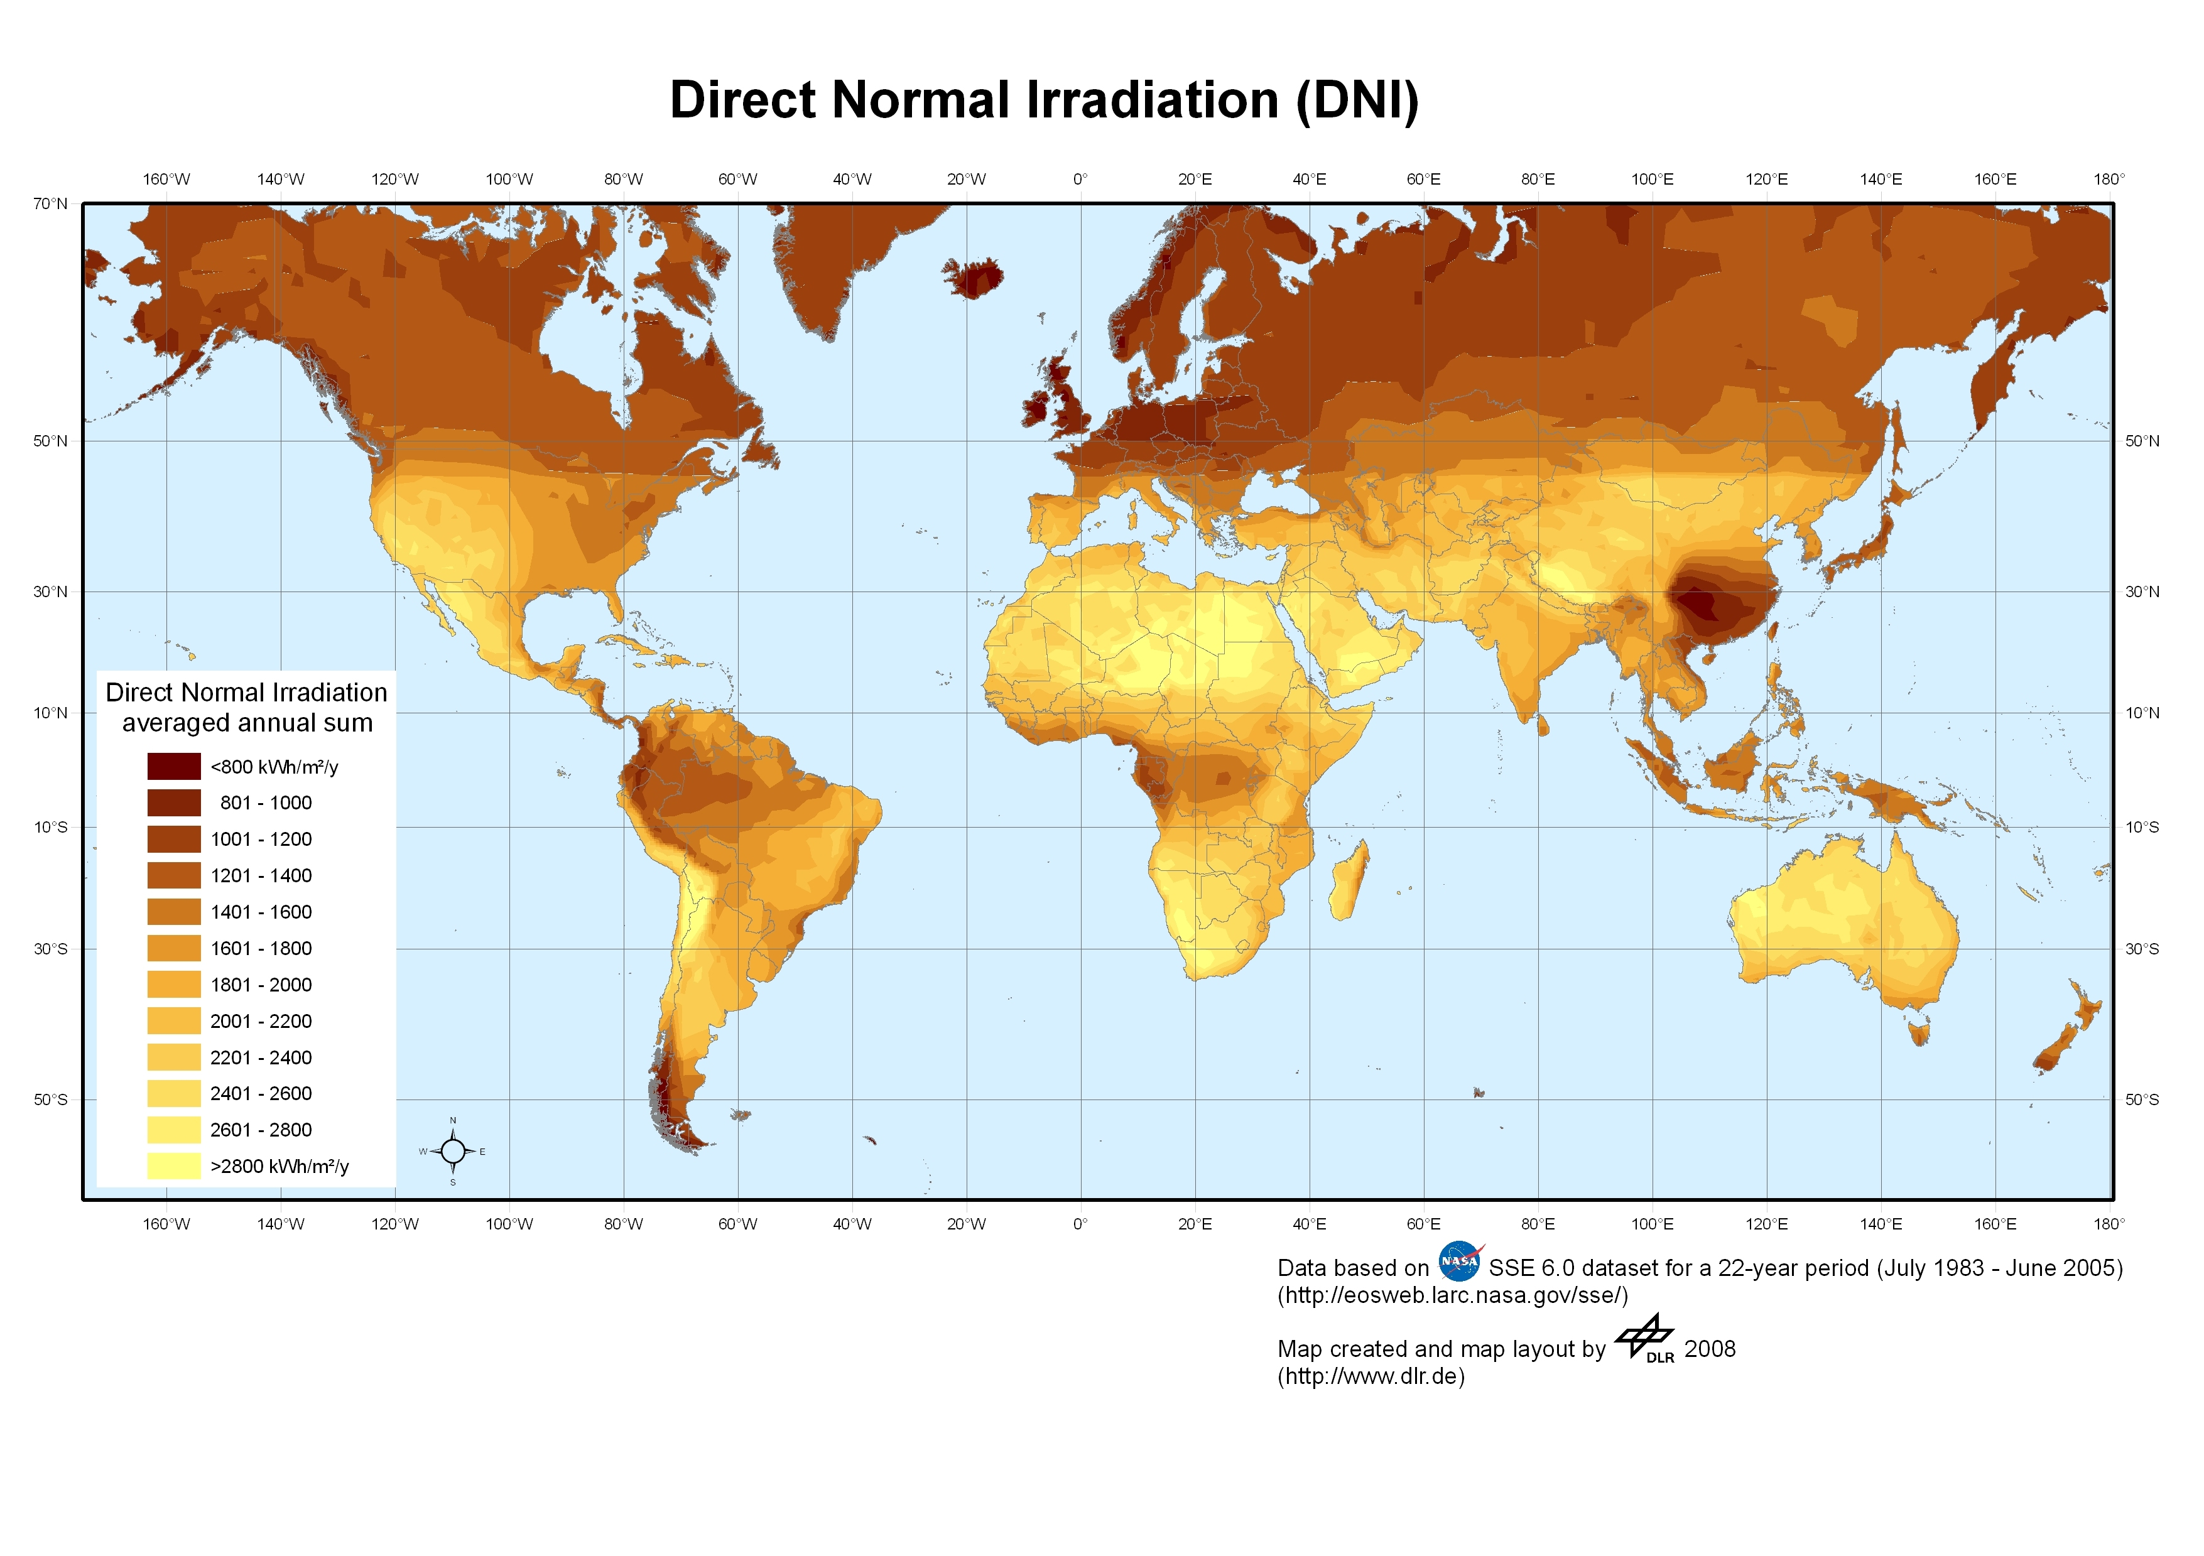
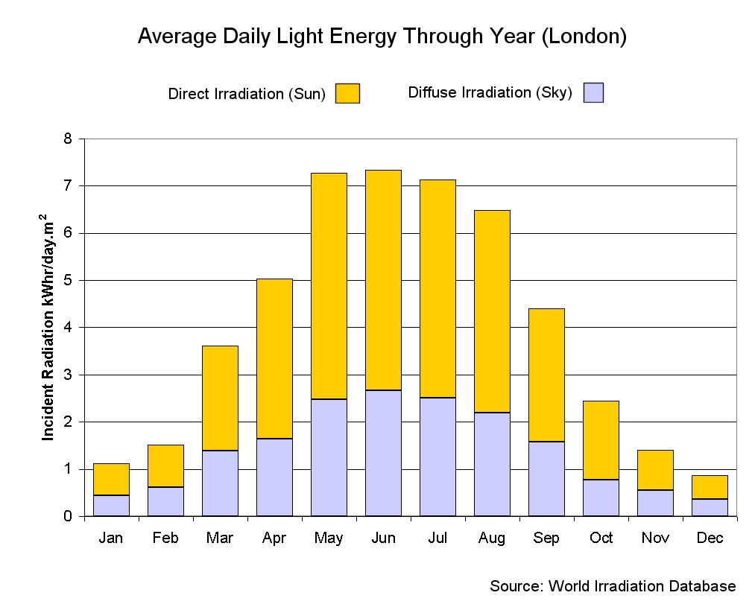
Why solar power generation is variable?
Geographical location (weather conditions, solar radiation)
season
Time of day
Unknown daily factors like cloud cover, frost, and snow
Cell properties (incident angle)
Local landscape (shadowing objects)

Slide 5
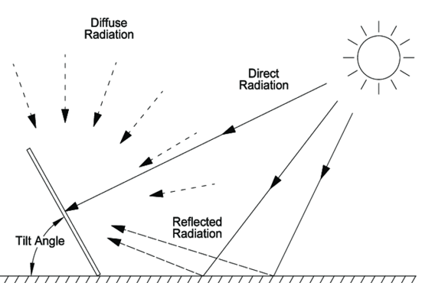
Why solar power generation is variable?
Forms of radiation (direct, diffused, reflected)
  Direct radiation (beam radiation): describe solar radiation traveling on a straight line from the sun down to the Earth
  Diffuse radiation: sunlight that has been scattered by molecules and particles in the atmosphere
  Reflected irradiation: sunlight that has been reflected off of non-atmospheric things such as the ground

Slide 6


What is the solution?
  Beneficial for system operators since it reduces costs and uncertainties
  Beneficial for PV plant managers, as they avoid possible penalties that are incurred due to deviations between forecasted and produced energy
Accurate forecasting
Some of the inputs for forecasting PV systems:
solar radiation
atmospheric temperature
atmospheric pressure
aerosol changes
Humidity

Slide 7
Prediction horizon
Very short-term forecasting (from a few seconds to minutes)
Short-term (up to 48–72 hours ahead)
Medium-term (up to one week ahead)
Long-term (up to months to years)

Slide 8




Forecast modellings
  Statistical approach
  based on data-driven formulation using historical measured data to forecast solar time series
  Artificial Intelligence (AI) approach
  utilize advanced AI techniques, such as artificial neural networks (ANNs), to construct solar forecasters, which can be also classified into the category of the statistical approach
  Physical approach
  based on numerical weather prediction (NWP) or satellite images that predict solar irradiance and PV generation
  Hybrid approach
  combination of the three aforementioned methods

Slide 9

Conclusions
solar power generation is highly variable due to weather conditions, solar radiation, and technical properties of cells.
Grid management and stability requires determining the solar power generation contribution in advance →Accurate forecast of solar power generation is essential.
Forecasting models of PV and solar power are divided in to four classes: statistical models, AI-based models, physical models and hybrid models.

Slide 10
Source material used
1] Gray, J.L., The Physics of the Solar Cell, in Handbook of Photovoltaic Science and Engineering, A. Luque, Hegedus, S., Editor. 2011, John Wiley and Sons.
[2] Vinod, Raj Kumar, S.K. Singh, Solar photovoltaic modeling and simulation: As a renewable energy solution, Energy reports, 2018, 4, 701-712.
[3] Tao Ma, Hongxing Yang, Lin Yu, Solar Photovoltaic system modeling and performance prediction. Renewable and Sustainable Energy Reviews, 2014, 36, 304-315.
[4] National Solar Radiation Database. Available: https://nsrdb.nrel.gov/
[5] Wan, C., Zhao, J., Song, Y., Xu, Z., Lin, J., & Hu, Z. (2015). Photovoltaic and solar power forecasting for smart grid energy management. CSEE Journal of Power and Energy Systems, 1(4), 38-46.
[6] Son, N., & Jung, M. (2021). Analysis of Meteorological Factor Multivariate Models for Medium-and Long-Term Photovoltaic Solar Power Forecasting Using Long Short-Term Memory. Applied Sciences, 11(1), 316.
[7] Ahmed, R., Sreeram, V., Mishra, Y., & Arif, M. D. (2020). A review and evaluation of the state-of-the-art in PV solar power forecasting: Techniques and optimization. Renewable and Sustainable Energy Reviews, 124, 109792.

Slide 11
Source material used
[8] Hakkarainen, T., Tsupari, E., Hakkarainen, E., & Ikäheimo, J. (2015). The role and opportunities for solar energy in Finland and Europe. VTT Technology, 217, 6-16.
[9] Netsanet, S., Zhang, J., Zheng, D., & Hui, M. (2016, October). Input parameters selection and accuracy enhancement techniques in PV forecasting using Artificial Neural Network. In 2016 IEEE International Conference on Power and Renewable Energy (ICPRE) (pp. 565-569). IEEE.
[10] Aler, R., Martín, R., Valls, J. M., & Galván, I. M. (2015). A study of machine learning techniques for daily solar energy forecasting using numerical weather models. In Intelligent Distributed Computing VIII (pp. 269-278). Springer, Cham.
[11] Liu, J., Fang, W., Zhang, X., & Yang, C. (2015). An improved photovoltaic power forecasting model with the assistance of aerosol index data. IEEE Transactions on Sustainable Energy, 6(2), 434-442.

Slide 12

Thanks for your Attention
Anahita.Farsaei@aalto.fi
Nima.Javanshir@aalto.fi

