Slide 1
ELEC-E8423 - Smart Grid Power and Energy Balance in Microgrids
Mikko Jantunen
Henri Vaitomaa
16.03.2021

Slide 2
Introduction
What is a microgrid?
How does it integrate to the main grid, or does it?
How demand response helps to balance a microgrid?
How power and energy are balanced in microgrids?

Slide 3
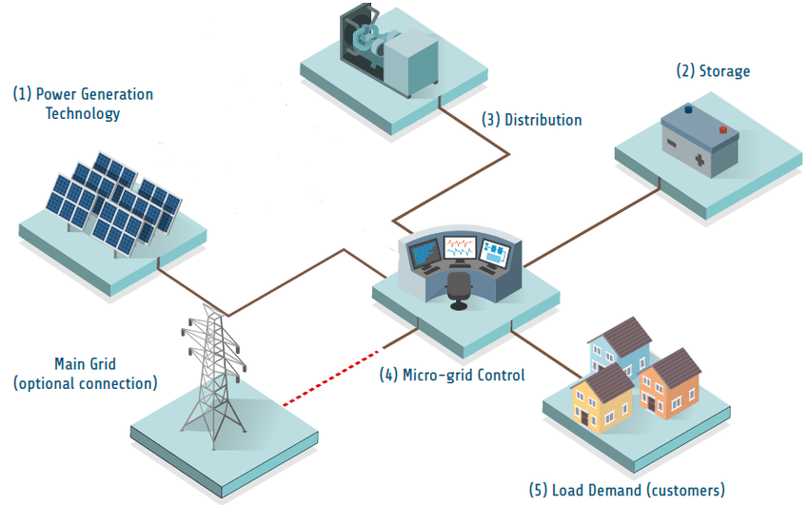
Microgrid
Hospital
Separate grid system
Geographical
Infrastructural
Distributed
Prosumers
Picture 1.

Slide 4
Island mode & grid connection
Disconnected and connected
Microgrids can operate independently or alongside main grid
Preplanned or unplanned islanding
Protection against main grid failure

Slide 5
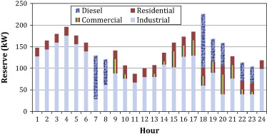
Reserve & Demand response
Case study 2014: Reserve from industrial demand response
Demand response can't solve all
Diesel generators for daily power spikes
Picture 2. Scheduled reserve in the case study
Notes:
Case study had 100 residential customers, 2 commercial customers and 2 medium-sized industrial customers. The case assumed that 40 percent of residential customers are willing to participate in demand response program.
There are different kinds of reserves, but there's also storages, which can provide immediate power, of which Henri will tell more.

Slide 6
Energy storages in MGs
Important part of balancing microgrids
Energy can be stored for example in
Electric batteries
Flywheels
Fuel cells
The main grid, when connected to MG, can
charge an energy storage
be considered itself as a battery
Energy storages are expensive for large scale
Picture 3.

Slide 7
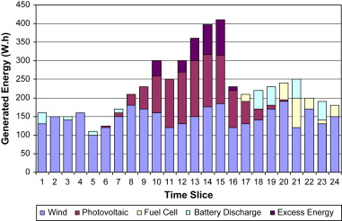
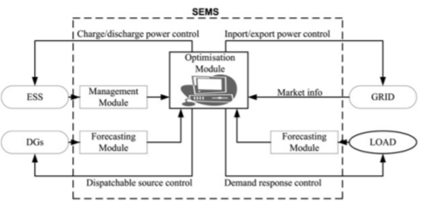
Balance control systems of power & energy in MGs
Balance control depends on production and storage methods
Smart Energy Management System (SEMS) optimizes the microgrid operation
Power forecasting module
Energy storage system (ESS) management module
Optimisation module
Clusters of microgrids can balance each other and provide benefits
Picture 4. Hourly values of produced electricity
Picture 5. Schematic of the inputs and outputs of SEM

Slide 8
Conclusions
Well balanced microgrids prevent blackouts
SEMS could be the solution for optimal control of a microgrid
Practical applications of microgrid for commercial use requires development in energy storage technologies

Slide 9
Source material used
Picture1: https://www.researchgate.net/publication/334277511_Assessing_the_Feasibility_of_Solar_Microgrid_Social_Enterprises_as_an_Appropriate_Delivery_Model_for_Achieving_SDG7 Picture 2: https://www.sciencedirect.com/science/article/abs/pii/S0196890414006037?via%3Dihub#! Picture 3: https://www.dnvgl.fi/training/training-course-on-solar-and-energy-storage-105479 Picture 4: https://www.sciencedirect.com/science/article/abs/pii/S0960148109001001 Picture 5: https://fardapaper.ir/mohavaha/uploads/2019/10/Fardapaper-Smart-energy-management-system-for-optimal-microgrid-economic-operation.pdf
https://www.vox.com/energy-and-environment/2017/12/15/16714146/greener-more-reliable-more-resilient-grid-microgrids https://www-sciencedirect-com.libproxy.aalto.fi/science/article/pii/S0960148109001001?via%3Dihub https://ieeexplore-ieee-org.libproxy.aalto.fi/document/1375102
https://www-sciencedirect-com.libproxy.aalto.fi/science/article/pii/S0196890414006037?via%3Dihub#! https://www-sciencedirect-com.libproxy.aalto.fi/science/article/pii/S0360544216306624?via%3Dihub
https://fardapaper.ir/mohavaha/uploads/2019/10/Fardapaper-Smart-energy-management-system-for-optimal-microgrid-economic-operation.pdf

