Slide 1
ELEC-E8423 - Smart Grid Interconnection of Micro Grids with each other / power system
<Mobina Pouresmaeil>
18.05.2021

Slide 2
Introduction
Overview
Benefits of Microgrids
Microgrid structure
Interconnection of Microgrids to power system
Control system of Microgrids
Challenges
Conclusion

Slide 3
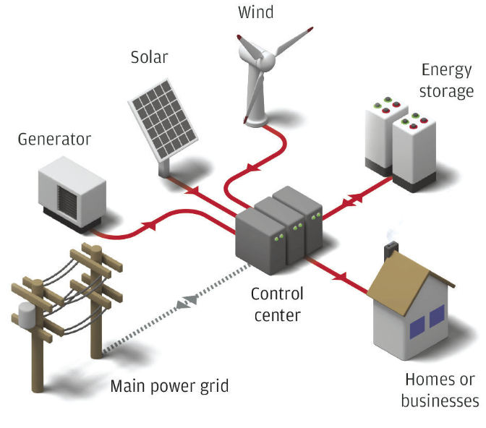
Microgrids
Microgrid (MG)
A group of interconnected loads and distributed energy resources within clearly defined electrical boundaries that acts as a single controllable entity with respect to the grid.
Operation Modes
Grid-connected mode
Islanded mode
Microgrid central controller (MGCC)
Controls the MG operation through the local generator controllers

Slide 4
Benefits of MG
Provides clean electric energy and improves environment
Microgrids can employ a wide range of green power production technologies, such as solar, wind, fuel cells, etc.
Improves electric reliability
Even if the main grid goes down, MG can continue to supply power to the loads through MG’s generators and possibly batteries
Improves electric resilience
Resilience describes the ability to avoid power outages in the first place or to recover quickly if they do occur.
Can lower energy costs for consumers and businesses
Microgrids can both reduce costs and provide a revenue stream for their customers. They reduce costs through the efficient management of energy supply. They supply revenue by selling energy and services back to the grid.
Strengthens the main grid
If the MG generates more electricity than the neighborhood needs, the surplus can be fed back into the main grid.
Offers power access to remote locations
Providing electric energy locally instead of transmitting power through long transmission lines

Slide 5
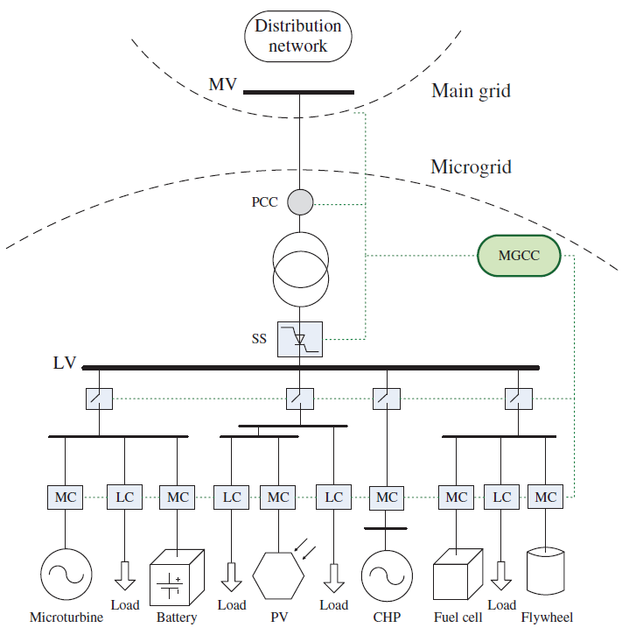
Microgrid Structure
Local controllers of loads (LC)
Local controllers of microsources (MC)
Circuit breaker (CB) is used for connecting/ disconnecting of each feeder in an MG
Static switch (SS) is used to connect to/ disconnect from the main grid

Slide 6
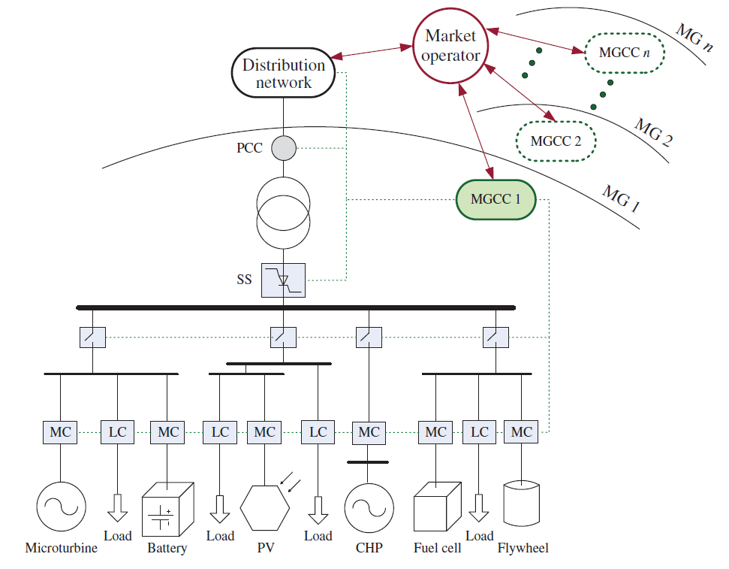
MG in an interconnected distribution power grid

Slide 7
Microgrid Control System
Important objectives expected in the control system of a microgrid are as follows:
Proper load sharing and DGs coordination
Voltage/frequency regulation in both operating modes
Transition from grid-connected to islanded mode when needed
MG resynchronization with the main grid
Operating cost optimization
Power flow control between the MG, neighborhood grids, and the main grid
Providing ancillary services and supports to the grid

Slide 8
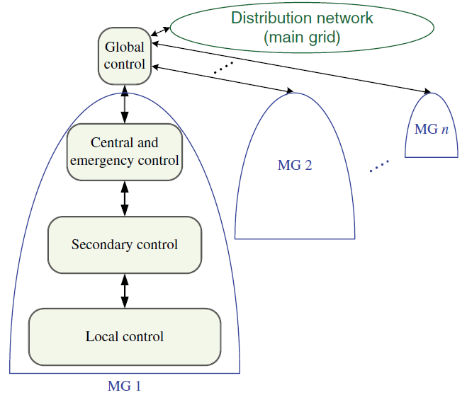
Microgrid Hierarchical Control
The local control
Managing the output power of RESs which consist of voltage and current loop
The secondary control
Provides power sharing as a communication-based method for parallel configuration of DGs and compensates the voltage and frequency deviations caused by the load variation and local control operation
The central/emergency control
It operates as an MG energy management system (EMS) and monitors the MG’s local and secondary controllers.
The global control
Manages the power flow between the given MG, other interconnecting MGs and the main grid, and facilitates an economically optimal operation.

Slide 9
Global control- the highest control level
Optimizing the MG operation and setting its interaction with the distribution network and neighborhood MGs
This optimization are usually based on:
Demand-generation balance
Economic aspects
Supervises the MG’s market activities such as buying and selling active and reactive powers to the grid and possible network congestions.
The MGCCs and global control level coordinately manage the exchange powers and some ancillary services.

Slide 10
Challenges
The intermittent characteristics of renewable energy resources
Time-varying loads in the MGs
Bidirectional power flow
Dynamic modeling and stability
Low inertia and high oscillation
Balancing between generation and load in islanded mode

Slide 11
Conclusions
Microgrids offers the increasing penetration of renewable energy sources into the power system.
Microgrids improves the electric reliability and resilience and can lower energy costs. So, are the crucial part of the future power system.
The challenges of microgrids in both operating modes needs to be considered.

Slide 12
Source material used
https://ieeexplore.ieee.org/document/8726309
https://ieeexplore.ieee.org/document/7046443
https://ieeexplore.ieee.org/stamp/stamp.jsp?arnumber=7127029
https://ieeexplore.ieee.org/document/8023892
https://ieeexplore.ieee.org/document/7350150
https://ieeexplore.ieee.org/document/7042324
https://www.wiley.com/en-us/Microgrid+Dynamics+and+Control-p-9781119263678
https://ieeexplore.ieee.org/stamp/stamp.jsp?arnumber=6423249
https://ieeexplore.ieee.org/stamp/stamp.jsp?tp=&arnumber=7582518

