Slide 1
ELEC-E8423 - Smart Grid Demand response in power system energy balance management
Miika Suutala
Emil Lindström
16.3.2021

Slide 2
Introduction
Intermittent & distributed renewable generation introduces new challenges for energy utilization
High hourly/daily variance in available power
→ Undesired mismatch between supply and demand
Demand response as a possible solution

Slide 3
Demand Response and Load Management
Optimization of supply and demand
Shiftable loads
Interruptible loads
Requires communication
Notes:
Demand Response aims to optimize supply and demand better by shifting peak loads from peak hours to lower load periods. The loads are categorized into shiftable and curtailable loads. Shiftable loads refer to loads that are not time-dependent and can be consumed at any time. This allows using them for reducing load during peak hours. Interruptible loads are loads that can not be used at any given time because of their essential nature. Instead, they can only be used during specified times.
Essential for demand response is two-way communication between the supply and demand side. Currently, next-generation smart electricity meters are being tested and installed in pilot programs in Finland. These smart meters will allow more precise and frequent communication between load and demand.

Slide 4
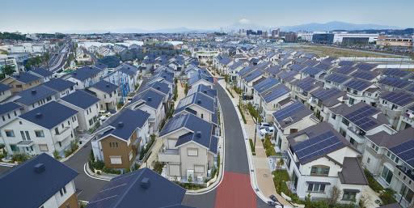
Main incentives for Demand Response
Increasing consumption
Economic efficiency
Environmental aspects
Notes:
Electricity consumption is increasing even with current energy efficiency actions. This has risen a growing worry about the capacity of the current electricity networks. That combined with an increasing amount of renewable energy demands a large transformation of the current energy system to keep the electricity grids secure. Demand response is one option to address this problem.
One way to tackle this increased consumption is to use different demand response strategies to optimize the load curve by shifting it to fit the supply curve more accurately. This momentary adjusts the load in the power system and allows us to integrate more renewable energy into the system through increased flexibility. Also, this has significant benefits to the frequency balance of the grid due to the more manageable variability of the demand.
Demand response also offers benefits for the consumer by reducing the price volatility through larger reserves provided by demand response strategies. Different programs such as incentive-based models can offer benefits for participating, for example by reducing the load during low network capacity.
Environmental benefits of the demand response are also becoming more and more relevant in today’s battle against climate change. By reducing the peak loads, we don’t need to activate environmentally more polluting peak load production such as gas turbines that often. Instead, most of the energy can be produced with less polluting options such as wind, solar and nuclear power.

Slide 5
Defining demand response strategies
Market DR
Real-time pricing, price signals and incentives
Physical DR
Grid management and emergency signals
Notes:
In market DR, the demand response strategies involve utilizing driving electricity markets which form the price of electricity. However, the response time of such markets is not necessarily able to respond in an arbitrarily short period. For this, most of the market transactions are concluded in a day ahead markets – the exception being real-time pricing which functions based on energy spot markets in which the data is relayed to users without delay. While market DR can encourage grid stabilizing load behavior in consumers, it does come with limitations. Limited customer elasticity and physical limitations are not considered in the electricity pricing resulting in the need for additional strategies.
Physical DR accounts for the limited operational capacity of the system components which send signals to grid operator due to grid frequency or voltage abnormalities.
DR programs can also be divided into categories based on different incentives and time-based programs. Where incentive-related programs encourage consumers to participate either voluntarily or through different subscription models where they can be compensated for predetermined load curtailment or shifting. In time-based programs, load curtailment or shifting is based on varying electricity prices due to the amount of available electricity.

Slide 6
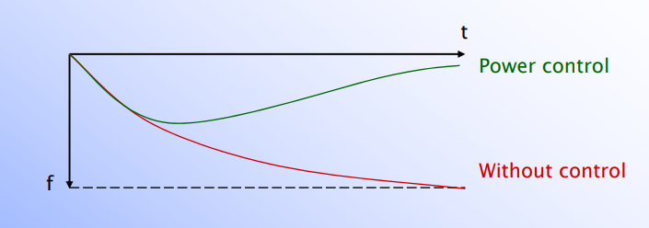
Frequency control as a means of power balance
Generated power > consumption → grid frequency increases
- and vice versa
Need for grid frequency balancing
Frequency control strategies:
Centralized control
Decentralized control
Power Systems Lecture on Frequency Control of Power System by Matti Lehtonen
Notes:
Due to the intermittent nature of distributed generation, supply and demand are not often balanced, which creates frequency imbalance in the grid. This can cause equipment damages and in the worst-case power outages. The controls in the power system are used to maintain system balance in terms of keeping voltage and frequency in an acceptable range and close to the nominal value (in Finland 50 ± 0.1 Hz). Whether it is in response to normal load and generation variations or major disturbances.
For balancing, two different control strategies can be implemented simultaneously:
Centralized: This strategy is aimed at functioning during normal load operation implementing strategies based on a central operation of information. This could be e.g., direct load control where utility or grid operator is given free access to consumer loads.
Decentralized: This strategy is aimed to be used during a loss of generation and faults. This could be implemented as mechanical actions based on signals that are detected locally and using dynamic pricing strategies and autonomous load responses.
Key benefits from using load-side frequency balancing are:
Improved economic and ecological operation of the power system
System reliability and availability of power
Fast response time
Better disturbance localization

Slide 7
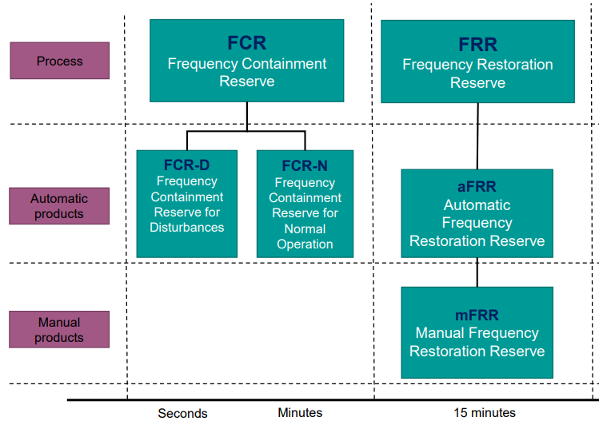
Frequency control from ancillary services
Demand response ancillary service markets as frequency control
Notes:
Frequency control has been traditionally achieved on the generation side of the network providing additional supply capacity in times of need.
However, demand response can be utilized as an ancillary service where the reserve capacity is achieved on the load side of the network. It is not a traditional reserve in terms of stored power or additional generation capacity, but the potential of freeing or increasing demand based on available power during a given time.
One of these services is the frequency containment reserve (FCR) in which consumers or aggregators offer a certain capacity that is automatically activated during frequency imbalance. In a predetermined agreement is reached between load users and grid operator, corresponding capacity must be freed during under frequency or added to demand during over frequency deviation.
FCR can be further divided into:
FCR-N where control of frequency happens during normal operation, e.g., controlling household appliances. It operates autonomously to minor frequency changes.
FCR-D where control of frequency happens during disturbances.
The energy balancement market can also utilize frequency restoration reserves (FRR), which can operate as automatic (aFRR) or manual (mFRR). FRR operates based on a power activation signal by TSO and aims to restore the frequency to the nominal value.
These balancing controls are operated by the transmission system operators (in Finland Fingrid) and are based on hourly balancing markets.

Slide 8
Benefits and Challenges
Benefits:
Increased reserve capacity
Increased security of the transmission grids
Improved distribution network investment efficiency
Increased capability of integrating RES
Challenges:
Information communication technology (ICT) infrastructure
Security
Forecasting loads and production
Market and regulatory framework
Notes:
Demand response has several benefits and challenges. The major benefits can improve the efficiency, security, and flexibility of the current electricity grid dramatically. With DR less peak production is necessary, because we can shift loads away from those peak times. This also reduces the need for this expensive usually idle peak load production. With the increased reserves the transmission system has more tools to balance the frequency during normal and contingency situations. This naturally leads to more efficient investing opportunities in distribution networks too. With demand response, new investments might not be necessary anymore. And finally, because of increased flexibility in the network, a larger amount of intermittent renewable energy can be integrated into the existing energy systems.
Demand responses largest challenge lies in ICT infrastructure. For it to work, advanced metering, communications, controlling, and information technologies are needed. Currently, we are moving in that direction, but the infrastructure is still lacking.
Naturally, security concerns arise when we start using more advanced load-controlling technologies. It could be catastrophic if system information security or connections between devices were compromised during the contingent event.
Also, for DR to be fully optimized and efficient, we must be able to forecast loads and generation accurately. This has proven increasingly difficult when more and more intermittent renewable energy is integrated into the networks.
Finally, the market and regulatory framework do not fully support demand response. Currently, demand response is mainly used as emergency contingency support and ancillary services with limited participation in the day-ahead market. Meaning participation in direct bidding of the market and contracts between individual market stakeholders. These actions take place hours before the actual consumption of electricity which does not allow DR to be fully utilized. It forces DR to be planned multiple hours before and significant advance notice is required before loads can be adjusted during emergencies.

Slide 9
Conclusions
Demand Response aims to fix the difference between supply and demand and help with the integration of RES.
Power markets will possibly rely on demand and production forecasting accuracy to ensure the security of the power systems that are vulnerable to irregular demand and supply behavior.
Demand Response improves system stability by frequency control and load optimization.
Notes:
Demand response aims to fix the difference between supply and demand by shifting peak loads away from the lowest capacity times. This is achieved by large reserves on the load side, and it results to improved grid security, economic efficiency and integration of renewable energy.
In order to effectively take advantage of DR and guarantee security of the power systems, accurate supply and load forecasting is necessary. This becomes more and more important when amount of renewable energy increases in the power systems.
Finally, demand response improves system stability by frequency control and load optimization.

Slide 10
Source material used
Palensky, P. & Dietrich, P. 2011. Demand Side Management: Demand Response, Intelligent Energy Systems, and Smart Loads. IEEE Transactions on Industrial Informatics, vol. 7(3), pp. 381-388.
Strbac G. P. 2008. Demand side management: Benefits and challenges. Science Direct, Energy Policy, vol. 36(12), pp. 4419-4426.
Available: https://doi.org/10.1016/j.enpol.2008.09.030.
O’Connell, N. & Pinson, P. & Madsen, H. & O’Malley, P. 2014. Benefits and challenges of electrical demand response: A critical review. Science Direct, Renewable and Sustainable Energy Reviews, vol. 39, pp. 686-699. Available: https://doi.org/10.1016/j.rser.2014.07.098.
Lu, S. & Samaan, N. & Diao, R. & Elizondo, M. & Jin, C. & Mayhorn, E. & Zhang, Y. & Kirkham, H. 2011. Centralized and decentralized control for demand response. ISGT 2011 Anaheim, CA, USA. pp. 1-8. DOI: 10.1109/ISGT.2011.5759191.
Giovanelli, C. & Kilkki, O. & Sierla, S. & Seilonen, I. & Vyatkin, V. 2019. Task allocation algorithm for energy resources providing frequency containment reserves. IEEE Transactions on Industrial Informatics, vol. 15(2). pp. 677-688. Available: DOI: 10.1109/TII.2018.2821676.
Reserves and balancing power, Fingrid, viewed on 14 March 2021. https://www.fingrid.fi/en/electricity-market/reserves_and_balancing/#reserve-obligations-and-procurement-sources.

