Slide 1
ELEC-E8423 - Smart Grid Demand response in distribution grid congestion management
Mikko Haapamäki
Sini Huhtinen
27.04.2021

Slide 2
Introduction
The importance of congestion management in distribution grids becomes more crucial as distributed production and electricity demand increases. Especially the growing loads by electric vehicles (EV) / heat pump-systems will increase congestion in grids.
Grid congestion
Caused by uncoordinated operation of distributed generation units and controllable electric loads.
Distribution System operator’s (DSO) job is to resolve these issues.
Demand response (DR)
The changes in the end-users’ electricity usage from their normal consumption patterns.
Increase in distributed batteries (e.g. in EVs) provide potential reserve for future DR systems.
Terms: Distributed generation (DG), retail electricity provider (REP), dynamic tariffs (DT), daily power-based network tariffs (DPT), home energy management system (HEMS)

Slide 3
Body of the presentation
What is demand response?
What causes congestion in distribution grids?
Congestion management strategies
DR in distribution grid congestion management
Market-based mechanisms
Case example
Conclusions
Sources

Slide 4
Demand response (DR)
Changes in the end-users’ electricity usage from their normal consumption patterns
High electricity prices → low electricity prices
Flattening demand peaks results better grid reliability
Three general actions by which customer response achieved
Reducing consumption during critical peak periods
Shifting consumption patterns from peak periods to off-peak periods
Utilising distributed generation (DG)

Slide 5
Congestion in distribution grid
Large amount of electricity moving through the distribution line cause the line to heat up.
Reaching a critical temperature in the line will cut the power, possibly causing damages
Causes
Grid load being higher than the available capacity
Uncoordinated operation of electric loads (e.g. EV’s and heat pumps)
Large amounts of DG connected to the grid

Slide 6
Congestion Management Strategies
Switch Operation
Direct load control (DR)
Market-based mechanisms (DR)
(In the long run: strengthening the network = large investments, network is not used in the most efficient way)
Notes:
Congestion management mechanisms are designed to affect the consumption pattern and provide incentives to avoid grid overload.

Slide 7
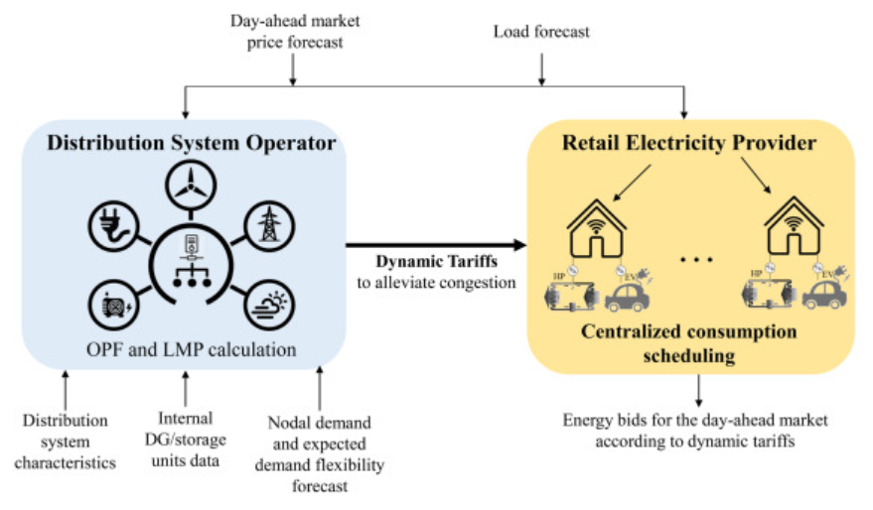
DR in distribution grid congestion management
DSO’s are the entities that have to solve the issues of grid congestion
M. A. F. Ghazvini et al. “Congestion Management in Active Distribution Networks through Demand Response Implementation.” Sustainable Energy, Grids and Networks, vol. 17, Elsevier, 2019, doi:10.1016/j.segan.2018.100185.
Flexible loads such as EV’s and heat pumps provide demand side flexibility to the distribution grid
Coordinated operation is required to take part in DR
With different market-based mechanisms the DSO’s can harness the benefits of demand side flexibility

Slide 8
Market-based mechanisms 1/2
Market-based methods send signals to electricity retailers and consumers to shift loads by offering incentives or tariffs.
Different mechanisms can be combined to alleviate congestion in the grid
Different market-based mechanisms:
Tariffs: dynamic tariffs, daily power-based network tariffs, energy tariffs, capacity tariffs, peak and tier tariffs etc...
Distribution capacity market
Intra-day shadow price
Flexibility service market
Notes:
Intra-day shadow pricing is the marginal pricing of energy delivered for a specific hour.
A flexibility market is a venue where flexibility in consumption is a product and can be traded both by a DSO and a TSO. All the grid operators trying to solve a congestion or imbalance problem and all devices with flexible consumption that could solve grid problems compete against each other in one market.

Slide 9
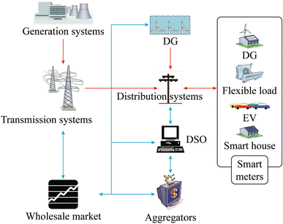
Market-based mechanisms 2/2
There are technical and economical difficulties for DSO’s to directly dispatch numerous dispersed DR resources
Aggregators can take responsibilities of integrating DR resources
actively participate in the electricity markets
managing financial risks of power consumers
Aggregators react to price signals → if all of them do the same trick at the price valley, congestion can occur
system optimisation
Ni A. et al. “Congestion management with demand response considering uncertainties of distributed generation outputs and market prices” Journal of modern power systems and clean energy 5.1 (2017): 66–78.

Slide 10
Case example: Ghazvini et al. (2019)
DSO’s could use market-based mechanisms to alleviate congestion in the distribution grid.
Coordinated HEMS controlled and monitored by retail electricity provider (REP)
DSO implements dynamic tariffs (DT) and daily power-based network tariffs (DPT)
case study reveals that DT’s cannot individually avoid the congestion occurrenced
REP reacts to the DSO’s implemented tariffs (DT & DPT) and adjusts the loads via HEMS

Slide 11
Conclusions
Distribution grid congestion is caused by uncontrolled operation of both distributed generation and controllable electric loads.
With the help of DR, we are able to alleviate the grid congestion without the need of large grid infrastructure projects.
Most effective strategies are market-based mechanisms, as they cause least discomfort to the customers, as well as enable the customers and DG’s to participate in distribution network energy planning.

Slide 12
Source material used
K. P. Swain and M. De, "Congestion Management Using Demand Response in Smart Distribution System," 2019 IEEE Region 10 Symposium (TENSYMP), 2019, pp. 485-490.
M. A. F. Ghazvini et al. “Congestion Management in Active Distribution Networks through Demand Response Implementation.” Sustainable Energy, Grids and Networks, vol. 17, Elsevier, 2019, doi:10.1016/j.segan.2018.100185.
M. H. Albadi and E. F. El-Saadany, "Demand Response in Electricity Markets: An Overview," 2007 IEEE Power Engineering Society General Meeting, 2007, pp. 1-5, doi: 10.1109/PES.2007.385728.
A. Stawska et al. “Demand response: For congestion management or for grid balancing?” Energy Policy, Volume 148, Part A, 2021, doi: 10.1016/j.enpol.2020.111920.
Ni A. et al. “Congestion management with demand response considering uncertainties of distributed generation outputs and market prices” Journal of modern power systems and clean energy 5.1 (2017): 66–78.

