Slide 1
ELEC-E8423 - Smart Grid Monitoring and control in SG, SCADA and NIS
Kimi Railo & Ville Salminen
20.04.2021

Slide 2
Introduction
SCADA overview
SCADA architecture
Network Information System (NIS) and its role in Distribution System Operator's (DSO) context
SCADA in Smart Grids (SG) and Renewable Energy Systems (RES)
Example case: SCADA implementation in aggregated PV production
Conclusions / summary

Slide 3
SCADA overview
Monitoring and Control in Power Systems
SCADA (Supervisory Control and Data Acquisition) systems / DCS (Distributed Control Systems)
The major difference between SCADA and DCS is the spatial reach
SCADA systems are widely used for automation of power sector: generation, transmission and distribution. SCADA does not necessarily have to be vendor specific.
Supervisory control and data acquisition systems (SCADA)​
SCADA is not a specific technology, but rather a set of different equipment and communication protocols to provide control and supervisory functions.
SCADA systems are typically closed-loop control systems that operate with comparatively little human interference.
Implementation involves two major activities: data acquisition (monitoring) of a process or equipment and the supervisory control of the process.
Characteristics of SCADA in Power Systems
SCADA system’s main function is to assist distributed generation, switching procedure, alarming, telemetry, event logging, measurement recording, and remote control of substation equipment.
Based on the data received from the remote substations, automated or operator-driven supervisory commands can be pushed to remotely control the substation equipment.
[7], [8]

Slide 4
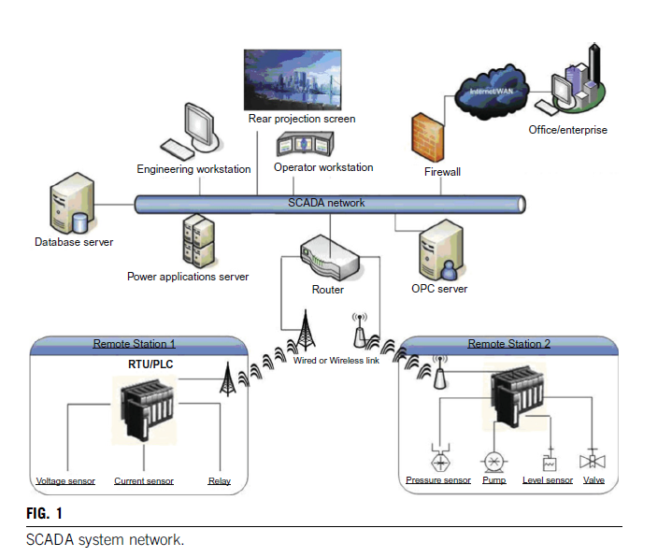
SCADA hardware architecture
RTU = Remote Terminal Unit
PLC = Programmable Logic Controller
[7] , [8]
Notes:
Typical hardware components of SCADA
Substation equipment and digital instruments
Local substation processors (PLC:s, RTU:s, IED:s)
Communications devices
Host computers/servers

Slide 5
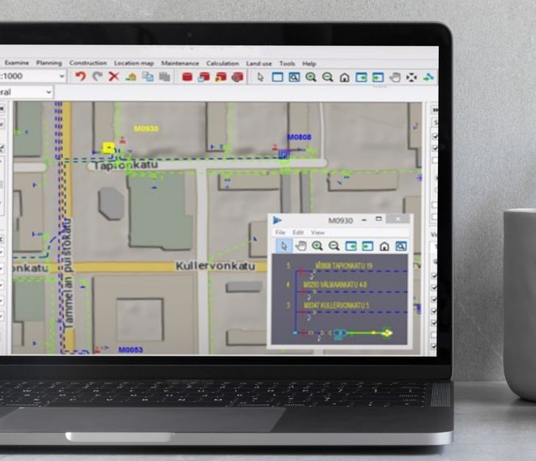
Network Information Systems (NIS’s)
A NIS is an application specialized managing network and its related attributes.
NIS applications available for electricity distribution (DSO & TSO), water & gas & telecom & street light networks
NIS often embeds a GIS system
NIS vs. DMS
NIS may provide following functions: network planning and construction, network reliability analysis, network investment management
Possibility to integrate to ERP systems
-> improved cost management
Example products: Trimble NIS, Barthauer BaSYS, Keypro Water NIS, Keypro Keycom
GIS = Geographic Information System
DMS = Distribution Management System
ERP = Enterprise Resource Planning
[5], [6]

Slide 6
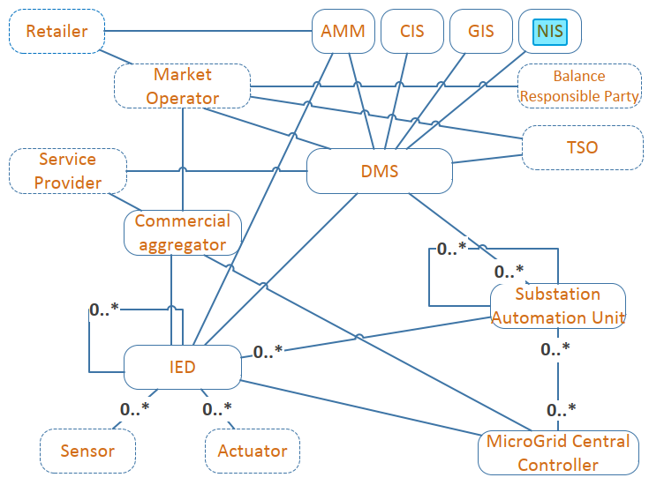
Role of a NIS in DSO’s network and its relation to SCADA
CIS = Customer Information System
NIS & GIS can be a single application
AMM = Automated Meter Management
Information flow
TSO = Transmission System Operator
DMS = Distribution Management System
Typical SCADA components
IED = Intelligent Electrical Device
[1]

Slide 7
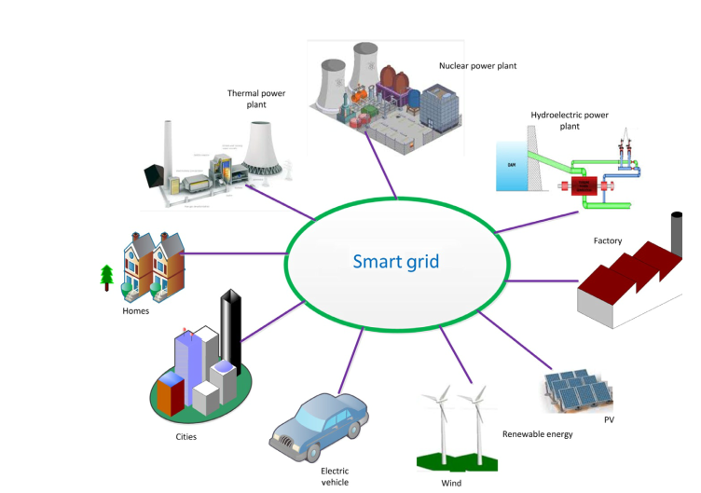
SCADA in RES and SG
SCADA in Renewable Energy Systems
PV-stations
Control and monitor of different PV plant components (maximum power point trackers, inverters, substations, CB, and meters)
Wind-farm
Control the performance of the generator output and optimize the energy conversion efficiency of the wind turbine (e.g control of pitch and yaw angles)
SCADA in Smart Grid functions
Aggregation of information and control over the entire electrical network
Optimize the use of the grid assets
Enables self-healing capabilities of the grid
[7]

Slide 8
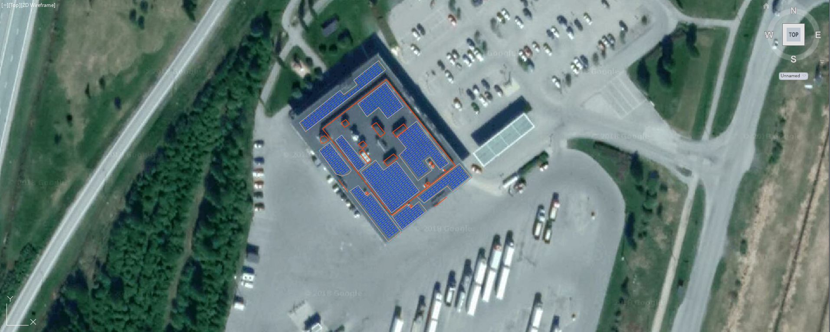
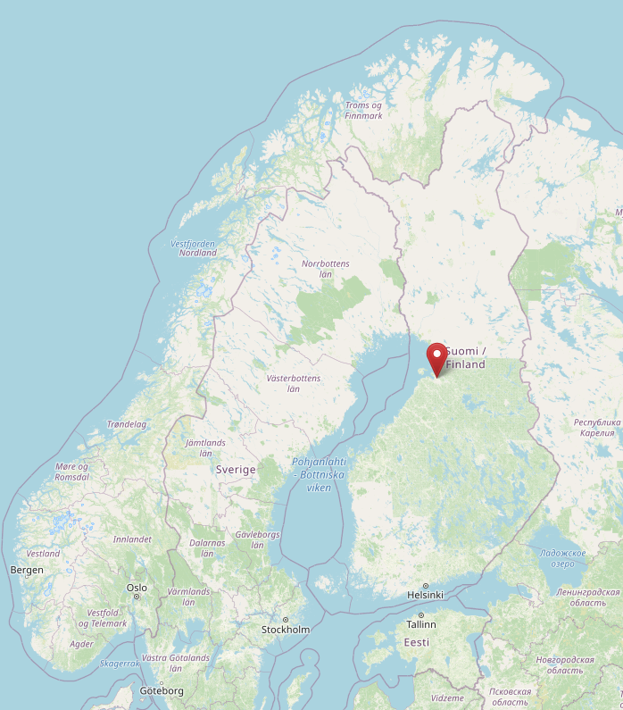
Example case: SCADA implementation in aggregated PV production: Panel layout plan
Tupos, Liminka
[2], [3], [4]

Slide 9
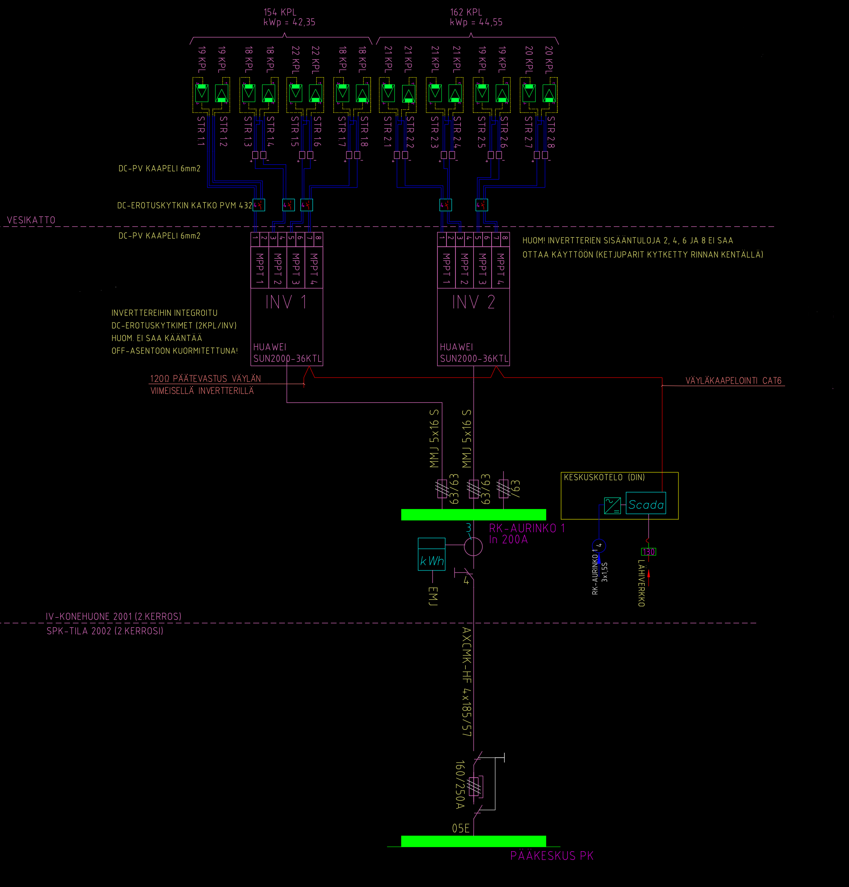
Example case: SCADA implementation in aggregated PV production: System schematic of a local site, part 1
Panel strings
DC switch disconnectors
Inverters, containing multiple MPPTs
Modbus connection
Bus termination
AC connections
[3]
[x]

Slide 10
Example case: SCADA implementation in aggregated PV production: System schematic of a local site, part 2
Auxiliary
Voltage Source
AC Fuses
SCADA control
module
PV Switchboard (AC)
RJ45 socket
Smart meter, connected to M-BUS bus. Bus terminated in Building Automation (VAK)
LAN (VPN tunnel)
Current transformers
Disconnector
AC Fuse Switch Disconnector
[3]
[x]
Building’s Primary Switchboard

Slide 11
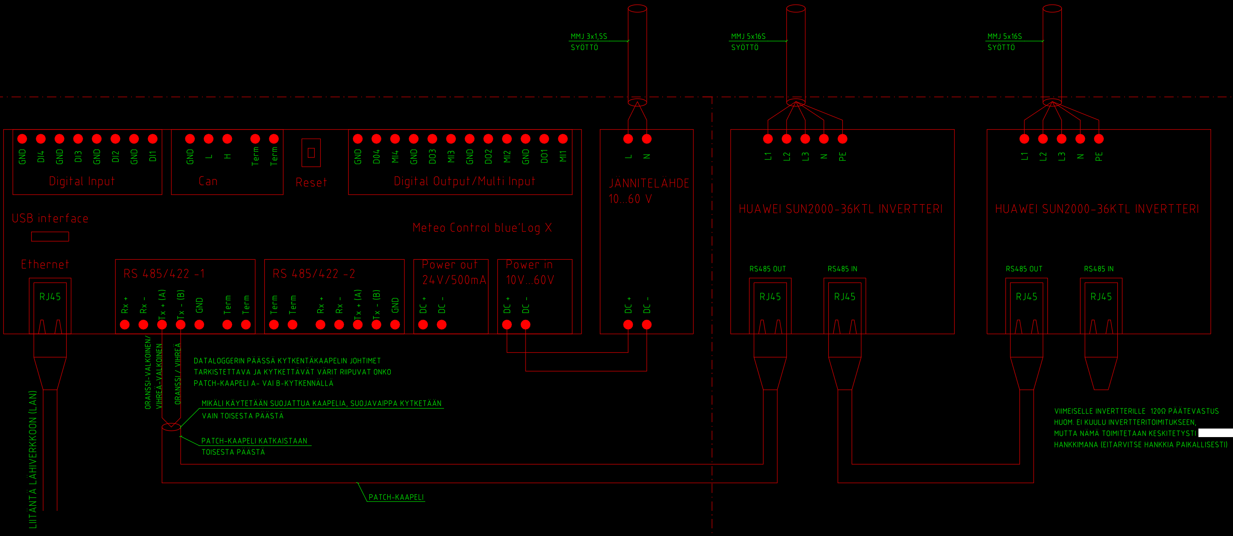
Example case: SCADA implementation in aggregated PV production: the local SCADA part
AC connection
AC connection
AC connection
SCADA (data logging & control)
Auxiliary
Voltage Source
Inverter
Inverter
Modbus bus (CAT6 cabling)
Modbus bus (CAT6 cabling)
LAN connection (VPN tunnel to the Control Room)
[3]
Notes:
SELITYS TÄSTÄ
Here’s an example of a NIS system. I

Slide 12
Conclusions
SCADA control and monitoring functions are required in Renewable Energy Systems, power generation in general and in power transmission system management.
Utilization of SCADA is required
to minimize payback times, to monitor condition of components and
to enable predictive maintenance and
for the safe and optimal usage of grid assets.
In the smart grid, intelligence and control need to exist along the entire power supply chain and across the different grid assets.

Slide 13
Source material used
Tampere University of Technology, 2016. Ideal Grid for All, final report. [online] Tampere University of Technology. Available at: <https://cordis.europa.eu/docs/results/608/608860/final1-ide4l-publisable-summary-30-11-2016.pdf> [Accessed 17 April 2021]
OpenStreetMap contributors, 2021. Openstreetmap.org. Available at <https://www.openstreetmap.org/search?query=tupos#map=5/66.364/26.895> [Accessed 17 April 2021]
Ramboll Finland Oy, 2018. A PV project design data.
Google, 2018. Google Maps.
Trimble, 2021. A Sample of a NIS product. [image] Available at: <https://utilities.trimble.com/uploads/5/4/4/2/54421791/trimble-nis-for-network-design-and-technical-planning1_orig.jpg> [Accessed 18 April 2021].
Trimble, 2021. Trimble NIS for Electricity Utilities. [online] Trimble Utilities - Electricity, Gas, Water & District Heating. Available at: <https://utilities.trimble.com/trimble-nis-electric.html> [Accessed 18 April 2021].
McDonald, J., & Thomas, M., 2015. Power System SCADA and Smart Grids. Boca Raton: CRC Press
Sayed, K., & Gabbar, H., 2017. SCADA and smart energy grid control automation. (pp. 481–514). Available at: https://doi.org/10.1016/B978-0-12-805343-0.00018-8 [Accessed 19 April 2021]

