Slide 1
ELEC-E8423 - Smart Grid Power quality issues in SG
Joona Kukkonen
Luukas Kumpunen
11.5.2021

Slide 2
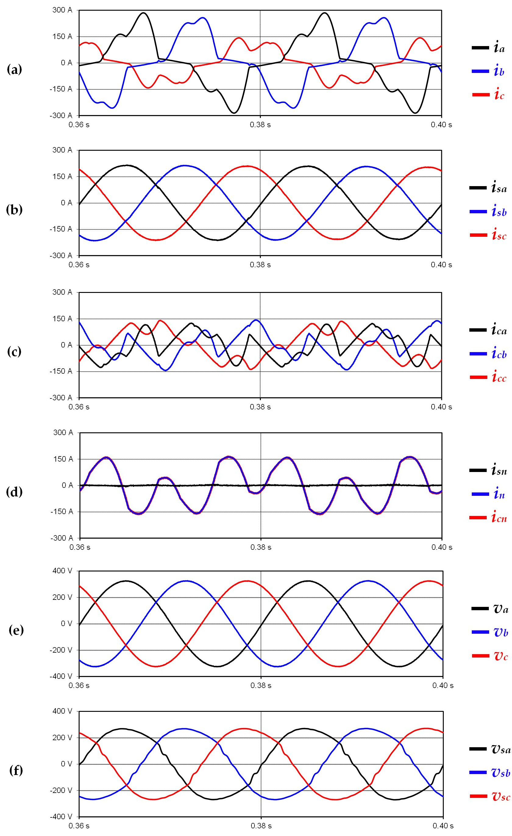
Introduction
Good power quality is considered a basic requirement for any modern power supply system
Measuring power quality consists mainly of three parts:
Voltage
Frequency
Waveform
Good power quality brings reliability, better voltage quality and lower energy price to the consumer
SG power quality flaws often occur as a result of electronic devices added to grid

Slide 3
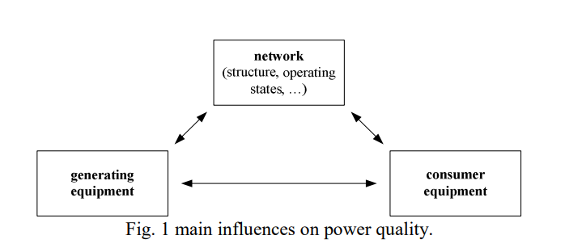
Power quality
The actual power quality results from the interaction between the network and the connected equipment or as compatibility between what comes out of an electric outlet and the load that is plugged into it
Emissions in voltage harmonics
Changes in grid components, mainly due to new devices being added to grid, cause harmonic resonances that affect power quality
What affects the power quality?
Generating equipment
Domestic single-phase micro-generation, charging stations for electric vehicles, expanded high-speed railways, etc.
Consumer equipment
Ongoing change in electricity components
Distribution network
Quality of network components, microgrids and electric load

Slide 4
How to solve quality problems?
Balancing production and consumption
Also mitigates excess harmonic voltages and variation in voltage levels
Storage technologies enables fast response to consumption
Spinning reservers such as wind turbine generators respond to frequency variation
Investments and improvements in grid components

Slide 5
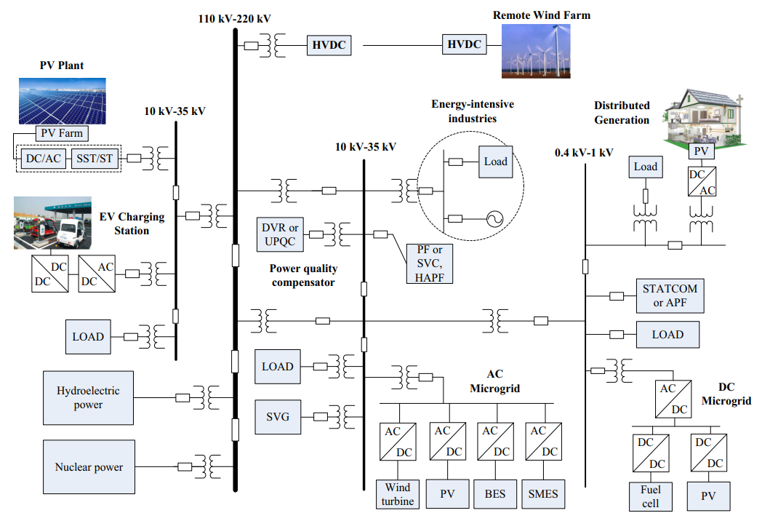
Grid development over the years
Structure diagram of a typical distribution grid system containing microgrid

Slide 6
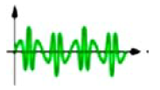
Main issues in the grid
Variating quality issues
Power quality problem | Explanation | Causes | Consequences
Voltage fluctuation | Oscillation of voltage | Repeated starts and stops of electric motors, oscillating loads | Flickering of lighting
Noise | Overlapping of high-frequency signals | Electromagnetic interferences provoked by microwaves or improper grounding | Disturbances on nonlinear loads, data errors or losses
Unbalance | Voltages in three phase system differ in magnitude or phase | Large single phase loads, uneven distribution of loads | Negative sequence, three-phase induction machines most affected
Harmonics | Interference in an AC power signal created by frequency multiples of the sine wave | Nonlinear loads, data processing equipment, high-efficiency lighting | Resonance, overheating of components

Slide 7
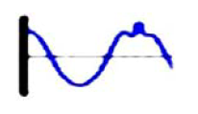
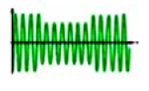
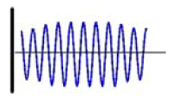
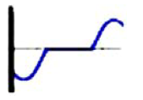
Main issues in the grid
Sudden events
Power quality problem | Explanation | Causes | Consequences
Voltage spikes | Very fast changing of the voltage rate, durations in micro- and milliseconds | Disconnection of heavy loads | Destruction of components or insulation materials, data loss
Voltage sags | Normal voltage level declines from the nominal rms voltage | Faults on the electrical networks, connection of heavy loads | Tripping of relays, disconnection and loss of efficiency in electric rotating machines
Voltage swells | Momentary rise of the voltage | On/Off of heavy loads, badly dimensioned power sources | Stoppage or damage of sensitive equipment, flickering of lighting
Interruptions | Total interruption of electrical supply | Damages from storms, trees or snow in the lines | Stoppage of all equipment connected, loss of data

Slide 8
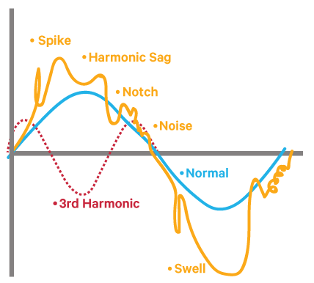
Conclusions
Power quality consists of three parts: voltage, frequency and waveform. Problems occur from changes to these parts.
New technologies connected to the distribution and transmission systems brings its challenges to power quality in the grid
Balancing production and consumption continuously and in fast pace prevents most of the quality problems such as voltage or frequency fluctuations or even interruptions

Slide 9
Source material used
Math H.J. Bollen et al.: Power Quality aspects of Smart Grids (2010). Available from https://www.diva-portal.org/smash/get/diva2:1001359/FULLTEXT01.pdf.
Von Meier, Alexandra (2006). Electric power systems: a conceptual introduction. John Wiley & Sons. p. 1. Energy Storage Association. Available from https://archive.org/details/electricpowersys00meie.
An L. et al. (2015). Overview of power quality analysis and control technology for the smart grid. J. Mod. Power Syst. Clean Energy (2016). Vol. 4. P. 1–9. DOI:10.1007/s40565-016-0185-8
Gandoman F. et al. (2018). Review of FACTS technologies and applications for power quality in smart grids with renewable energy systems. Renewable and Sustainable Energy Reviews. Vol. 82. P. 502-514. DOI: 10.1016/j.rser.2017.09.062

