Slide 1
ELEC-E8423 - Smart Grid Wind farms and their local grids and connections
Iisa Ollila
Jutta Kanerva
5.3.2021

Slide 2
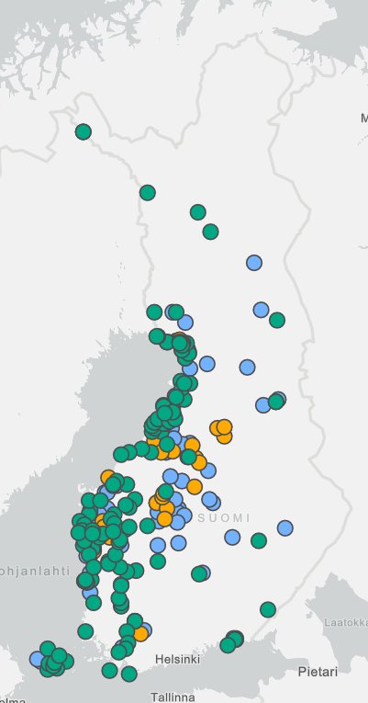
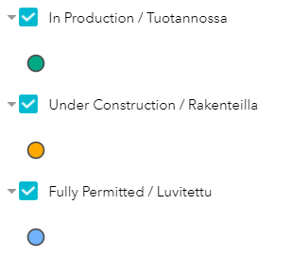
Introduction
Wind production share is rising and wind based power generation systems have become more popular than other renewable energy sources
Wind farms expected to play a primary role in the modern/future generation mix
Nature of wind power generation not stable with traditional grids
This emphasizes the grid connection and grid quality
E.g. in Finland wind generation has grown from 1,5 GW in 2016 to 2,5 GW in 2020 with more on the way
Wind generation is expected to double by 2024
Source: Suomen tuulivoimayhdistys
Notes:
Fluctuations and deviations in power generation from wind energy sources put pressure on grid systems. Fluctuations from a single wind farm are neglible, but combined together, fluctuation patterns become significant.
This can be seen in the picture, the green dots are existing wind power plants and the ones in orange and blue are either under construction or already have permissions and will be constructed.
In Finland, most of the wind production is in the west – this has an effect on what kinds of grids are needed in the area

Slide 3
Wind farms
Wind production
Wind farms: a collection of individual wind turbines, which are connected to an electric power transmission network.
Installed to both offshore and land – modern wind farms may have capacities in the order of hundreds of MW
Modern wind farms are generally connected to the high voltage transmission system
Wind farms and turbines are considered power plants: they have to take responsibility for control, power balance and stability
The technical design of a wind farm also has a big impact on how the wind farm affects to the grid.
Thus, wind farms are required to:
Contribute to the control of voltage, frequency and reactive power needs in the power system
Stay on-line during less critical grid faults
Help maintain the stability of the power system.
Network
HV
100MW
MV
1-20MW
LV
100kW
Notes:
Wind farms are a collection of individual wind turbines, which are connected to an electric power transmission network as a single unit
Wind farms are installed both offshore and on land and may have capacities in the order of hundreds of MW.
Modern wind farms are generally connected to the high voltage transmission system
The picture represents different sizes of wind production (turbines or plants) and their connection to the grid. As modern wind farms are generally large, they are connected to the high voltage network. A larger wind farm requires a more robust network to connect to.
Wind farms are generally considered power plants. This causes them to have responsibilities for control, stability and power balance. The technical design of a wind farm also has a big impact on how the wind farm affects the grid.
Thus, wind farms are required to contribute to the control of voltage, frequency and reactive power needs in the power system and to stay on-line during less critical grid faults, and to help maintain the stability of the power system.

Slide 4
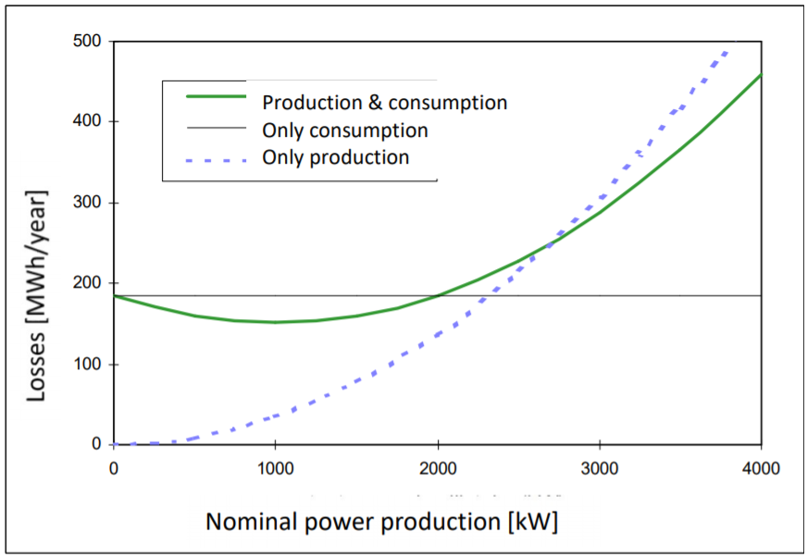
Effects of wind power on grid
Voltage
Variation around the nominal value
Fluctuations in production
Flicker
Reduction from induction machines
Transients caused by switching
Reactive power and voltage control
Induction generators consume reactive power
Asynchronous or full converter control reactive power
Harmonics
Grid losses increase/decrease
Complicated protection at distribution network level
Distributed production influence on network losses
Source: Wind Power Grid Connection 20181012 – Uski. Aalto
Notes:
Wind power causes variance and disturbances to the network voltage
Flux in production: uneven generation because of gusts
Induction generators usually consume reactive power, which have to be compensated
If the wind turbine units are double fed asynchronous generator or full converter generator, reactive power is controllable
transmission losses depending on the location of production and consumption

Slide 5
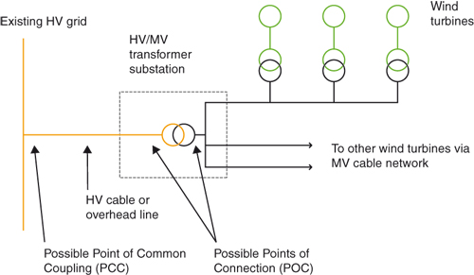
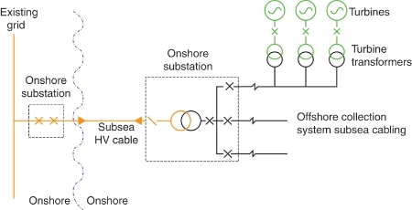
Connection to grid
Turbine Transformer
Responsibility of the plant owner
Low Voltage (<700 V) power is converted into Medium Voltage (20 kV)
Point of Connection (POC)
Responsibility of the public TSO
Conversion into High Voltage or Medium Voltage in substations
Point of Common Coupling (PCC)
Power sent to the grid
Effects on grid stability are evaluated here: Grid Code
Sources:
https://www.wind-energy-the-facts.org/electrical-system.html
Wind Farm Design: Planning, Research and Commissioning - Renewable Energy World, 2020
https://www.renewableenergyworld.com/wind-power/wind-farm-design-planning-research-and-commissioning/
DC
Notes:
If wind farm has some auxiliary technology like reactors or SVCs for compensating reactive power or voltage: connect to POC
Transmission service provider TSO

Slide 6
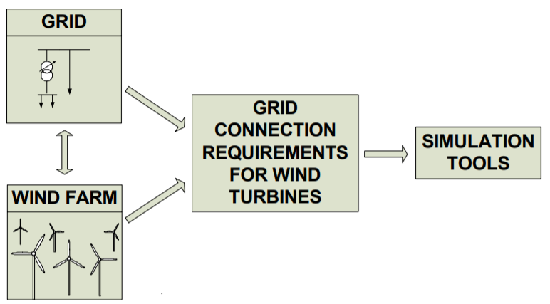
Grid connection requirements - Grid code
Wind farm compatibility is measured through operations simulation
Local network characteristics
Turbine technical features
Grid code
General and special for wind
Local TSO and national
Main topics in all Grid Codes
Voltage and frequency operating range
Active power / frequency control
Reactive power capability
Voltage / reactive power control
Voltage disturbance events (LVRT/HVRT)
Power quality
Protection, communications etc.
Simulation models
Grid code compliance testing
Compliance process
Notes:
Grid code includes general requirements for all generation and special requirements for wind generation because of its variability
LVRT/HVRT Low/High Voltage Ride Through
With more wind there is a requirment for wind farms to stay conncted durinf faults and participate in network recovery

Slide 7
Challenges of wind power integration
Problems | Causes
Steady state voltage rise | Wind speed variation
Over-current | Peaks of wind speed
Protection error action | Peaks of wind speed
Flicker emission during continuous operation | Dynamic operation of wind turbines
Flicker emission during switching operation | Switching/start-up operation of generators
Voltage drop | In rush current due to switching operation of generators
Harmonics | Power electronic converters
Power system oscillations | Inability of the power system controllers to cope with the power variations from the wind farm and loads
Voltage stability | Reactive power limitations and excessive reactive power demand from the power system
Key technical challenges for power quality in the network:
Voltage fluctuation
Reactive power compensation
Low power factor
Harmonic distortion
Efficient power converters mitigate voltage fluctuations, reactive power consumption, harmonic distortion and ensure adequate power quality
Energy storage systems essential for power delivery
Reactive power can be regulated with doubly-fed induction generators
Table: Potential challenges of integration of wind energy with the smart power grid
Notes:
With increased penetration of wind energy to the grid, the key potential technical challenges that affect quality of power include: voltage fluctuation, Reactive power compensation, Low power factor and harmonic distortion
Wind turbine technologies with efficient power converters mitigate coltage fluctuations, reactive power consumtions, harmonic distortion and ensure adequate power quality
Energy storage essential in ensuring the reliability of power delivery and they also improve voltage and power system stability
Reactive power can be regulated with doubly-fed induction generators

Slide 8
Conclusions
Wind power production is increasing steadily
Higher levels of penetration cause problems for power stability
Wind farms require careful technical design to comply to generation and operation requirements of networks
Grid code
Grid integration requires detailed simulation of the operation of the wind farm
Supportive technology is useful near the connections points
Auxiliary technology for additional controls
Energy storages

Slide 9
Source material used
Cleveland, C., Morris, C. (2015). Dictionary of Energy. Available at: https://www.sciencedirect.com/science/book/9780080968117
Colak, I., Fulli, G., Bayhan, S., Chondrogiannis, S., Demirbas, S. (2015). Critical aspects of wind energy systems in smart grid applications, Renewable and Sustainable Energy Reviews, Volume 52, 2015, p. 155-171. Available at: https://doi.org/10.1016/j.rser.2015.07.062.
Rona, B., Güler, Ö. (2015). Power system integration of wind farms and analysis of grid code requirements, Renewable and Sustainable Energy Reviews, Volume 49, 2015, p.100-107
Shafiullah, G., Amanullah, M., Shawkat Ali, A., Wolfs, P. (2013). Potential challenges of integrating large-scale wind energy into the power grid–A review, Renewable and Sustainable Energy Reviews,Volume 20, 2013, p. 306-321, Available at: https://doi.org/10.1016/j.rser.2012.11.057.
Sorensen, P. (2016). Grid connection of wind. Available at: https://www.youtube.com/watch?v=-HljEywnEf0
Sudria, A., Chindris, M., Sumper, A., Gross, G. & Ferrer, F. (2005). Wind Turbine Operation in Power Systems and Grid Connection Requirements, Electrical Power System Department, March 2005. Available: http://www.icrepq.com/full-paper-icrep/309-SUMPER.pdf
Suomen tuulivoimayhdistys ry. (2020). Tuulivoima Suomessa 2020. Available at: https://tuulivoimayhdistys.fi/media/tuulivoima_vuositilastot_2020_julkaisuun-10.2.pdf
Uski, S. (2018). Wind Power Grid Connection. Aalto University.

