Slide 1
ELEC-E8423 - Smart Grid Role of DR, storages and hydrogen in future energy systems
Yuchen Ju, Tianchen Xue
06.04.2021

Slide 2
Introduction
In order to realize the vision of climate neutrality, the proportion of renewable sources is increasing in the energy system. It makes the energy supply unstable which causes a dismatch of energy supply and demand. Demand Response (DR) and Energy Storage Systems are key enablers in the ongoing transformation of energy systems into adaptible, renewable and energy secure systems. DR and ESS are used to compensate the spatial and temporal imbalances in energy demand and production, offsetting the need for on-demand fossil fuel generation.
Presentation Contents:
Demand Response in Smart Grids
Demand response technology with storages
Demand response benefits
Hydrogen energy in Smart Grids
Conclusions
Source material used

Slide 3
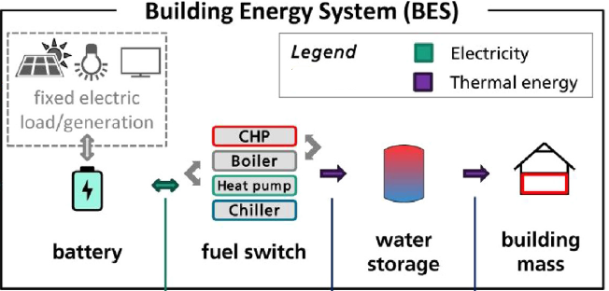
Demand Response in Smart Grids
DR refers to “changes in energy usage by prosumers from their normal consumption patterns in response to changes in dynamic energy prices, or to incentive payments designed to induce lower energy consumption at times of high wholesale market prices or when system reliability is jeopardized” .
DR takes advantage of storages.
Water storage: integrated into
energy system to manage
the generation more flexible
Building mass: preheating
technology which can get
benefits both for
prosumers and producers.

Slide 4
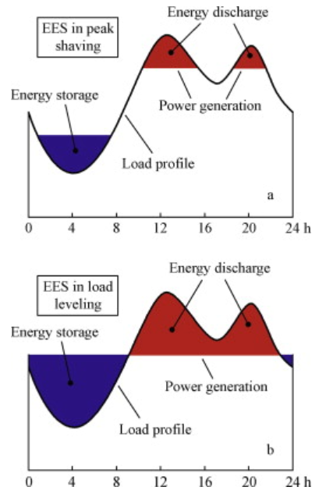
Demand response technology with storages
Energy transfer
The intermediary energy obtained by renewable sources will be stored and utilized at an appropriate time as a substitute for the expensive primary power used in peak-load power stations.
Heating/ cooling system, DHW, electrical appliances, buildings.

Slide 5
Demand Response benefits
Prosumers can take part in demand response programs with pre-set tariffs or react to changes in dynamic energy prices.
Preheating technology can shift energy demand from high price periods to low price periods and decrease peak power demand.
Envisioned benefits of DR:
Participant bill savings – consumption at a lower price
Market performance – more efficient market, more users can be added into the energy system because of peak power reduction.
Reliability benefits and system security – provides support in contingency
CO₂ emission reduction: decrease the CO₂ emission price for producers.

Slide 6
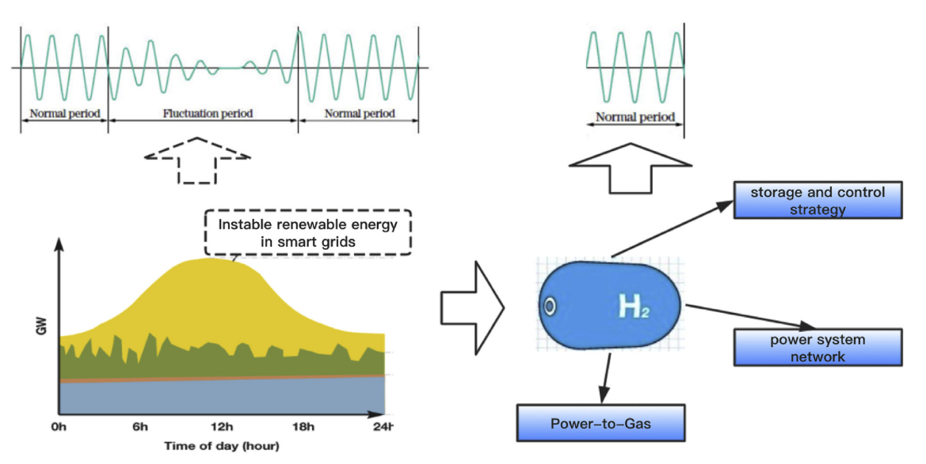
Hydrogen energy in Smart Grid
Role of hydrogen energy in smart grid:
Different sources of energy can be stored in the form of hydrogen when renewable energies are excess, which satisfys the users' needs on peak usage.
Hydrogen and hydrogen-rich fuels (natural gas and biogas) can be used in natural gas pipeline systems as well as in marine and land transportation as fuel, which contributes to lower consumption of conventional fossil fuels.
Usage of hydrogen:
Fuel cell electric vehicles,
Fuel cell forklifts,
Range-extenders for battery electric vehicles,
Backup power supply,
Feedstock supply to multiple industrial processes (e.g. biorefineries)

Slide 7
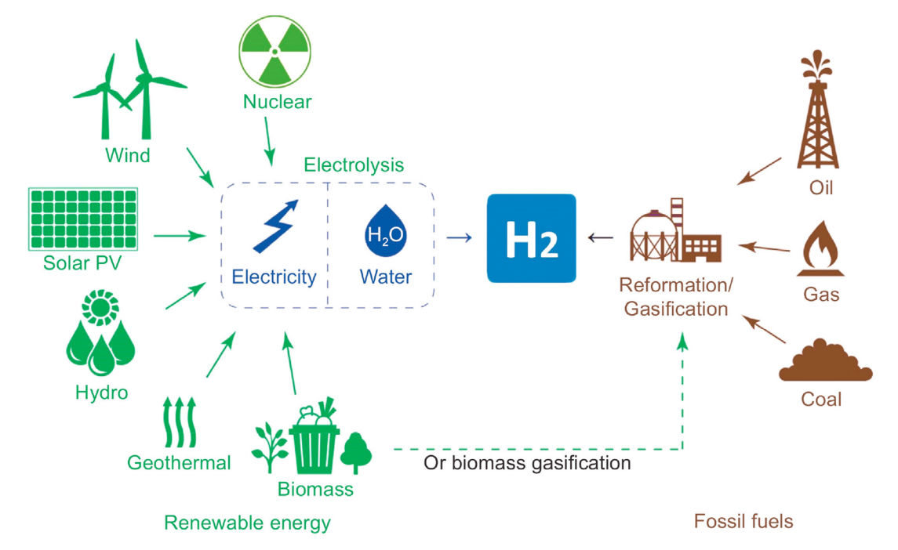
Hydrogen Generation
Sources:
Fossil fuel, water or biomass.
Methods:
Steam reforming,
Gasification,
Water electrolysis,
Microbial fermentation,
Photocatalysis (PC),
Other conversion methods involving fossil fuels or biomass

Slide 8
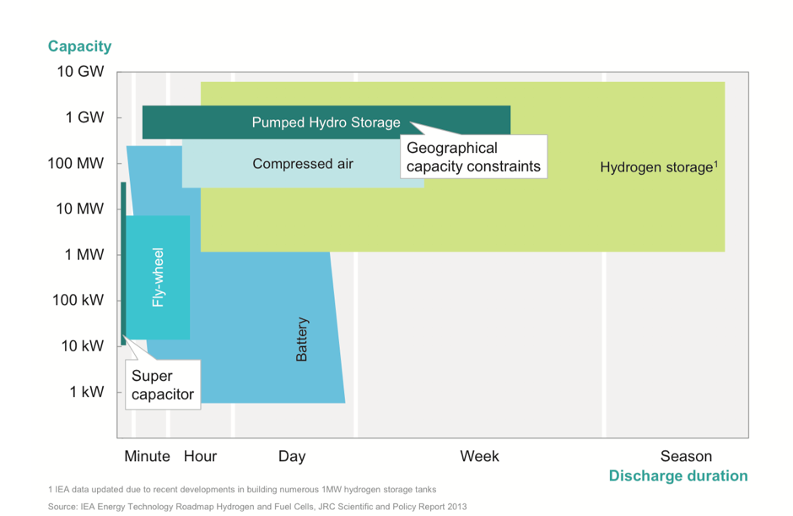
Hydrogen Energy Storage Systems (HES)
Methods of storage:
High-pressure gas cylinders (up to 800 bar),
Liquid hydrogen in cryogenic tanks (at 21 K),
Adsorbed hydrogen on materials with a large specific surface area (at T<100 K),
Absorbed on interstitial sites in a host metal (at ambient pressure and temperature),
Chemically bonded in covalent and ionic compounds (at ambient pressure),
Through oxidation of reactive metals, e.g. Li, Na, Mg, Al, Zn with water.

Slide 9
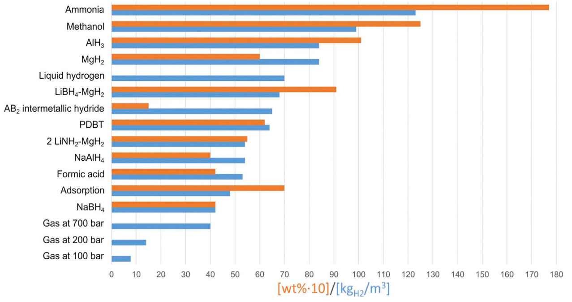
Hydrogen Energy Storage Systems (HES)
Most of these techniques are still in the development stage.
One disadvantage of these methods is significant energy loss.
The most promising hydrogen storage routes are in solid materials (e.g. LiBH₄) that chemically bind or physically adsorb hydrogen at volume densities greater than that of liquid hydrogen.

Slide 10
Hydrogen Transportation
Pipelines for gaseous hydrogen
Piping systems are usually several miles long, and in some cases may be hundreds of miles long.
A slight change in the operating pressure of a pipeline system can result in a large change in the amount of gas contained within the piping network due to excessive volume of these piping systems.
Trucks, trains, or ships for either compressed gas tube trailers or liquefied hydrogen
The main drawback of using hydrogen as a transportation fuel is associated with its huge on-board storage tank because of extremely low density of hydrogen.

Slide 11
Cost Challenges for Hydrogen Storage
Most importantly, cost of efficient and sustainable hydrogen production and delivery must considerably be reduced.
New generations of hydrogen storage systems for both vehicular and stationary applications must be developed.
The cost of fuel-cell and other hydrogen-based systems must also be reduced.

Slide 12
Conclusions
The increase in variable renewable technologies induce imbalance pressure to energy systems, which creates an increasing demand for balancing technologies, such as Energy Storages and Demand Response.
Demand Response with storages can decrease costs for prosumers and improve market performance for producers.
Electricity conversion to hydrogen and usage of hydrogen as an energy storage medium, fuel can productively utilize excess of renewable energy in smart grids.
It is vital to improve hydrogen storage technique and keep the costs of hydrogen generation, storage and usage on the acceptable level.

Slide 13
Source material used
Siano, P. (2014). Demand response and smart grids—A survey. Renewable and Sustainable Energy Reviews, 30, 461–478. doi: 10.1016/j.rser.2013.10.022
DoE (2006) Benefits of Demand Response in Electricity Markets and Recommendations for Achieving Them. A report to the United States Congress Pursuant to Section 1252 of the Energy Policy Act of 2005
Dominković, D. F., Gianniou, P., Münster, M., Heller, A., & Rode, C. (2018). Utilizing thermal building mass for storage in district heating systems: Combined building level simulations and system level optimization. Energy, 153, 949-966.
Kontu, K., Vimpari, J., Penttinen, P., & Junnila, S. (2018). City scale demand side management in three different-sized district heating systems. Energies, 11(12), 3370.
European Commission, 2050 long-term strategy. (2020). Available at: https://ec.europa.eu/clima/policies/strategies/2050_en (accessed on 19 Mar. 2021).
Chen, H., Cong, T. N., Yang, W., Tan, C., Li, Y., & Ding, Y. (2009). Progress in electrical energy storage system: A critical review. Progress in natural science, 19(3), 291-312.
Lin, R. H., Zhao, Y. Y., & Wu, B. D. (2020). Toward a hydrogen society: Hydrogen and smart grid integration. International Journal of Hydrogen Energy, 45(39), 20164–20175. https://doi.org/10.1016/j.ijhydene.2020.01.047

Slide 14
Source material used
Sharma, S., & Ghoshal, S. K. (2015). Hydrogen the future transportation fuel: From production to applications. Renewable and Sustainable Energy Reviews, 43, 1151–1158. https://doi.org/10.1016/j.rser.2014.11.093
Widera, B. (2020). Renewable hydrogen implementations for combined energy storage, transportation and stationary applications. Thermal Science and Engineering Progress, 16(September 2019), 100460. https://doi.org/10.1016/j.tsep.2019.100460
Wang, M., Wang, G., Sun, Z., Zhang, Y., & Xu, D. (2019). Review of renewable energy-based hydrogen production processes for sustainable energy innovation. Global Energy Interconnection, 2(5), 436–443. https://doi.org/10.1016/j.gloei.2019.11.019

