Slide 1
ELEC-E8423 - Smart Grid Solar farms, their local grids and connection to the power system
Marianne Jyrälä
Sivi Kivivirta
04.05.2021

Slide 2
Introduction
Solar Farms
Installed Capacity and Energy Market Share
Future Trends in Solar
Grid Connected PV System
Plant Control System
Effects of PV Grid Connected Systems on a Distribution Network
Challenges
Conclusions

Slide 3
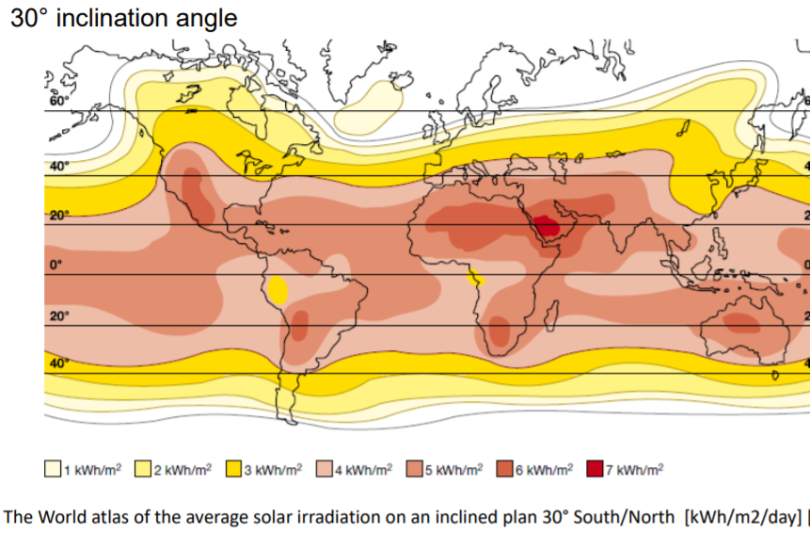
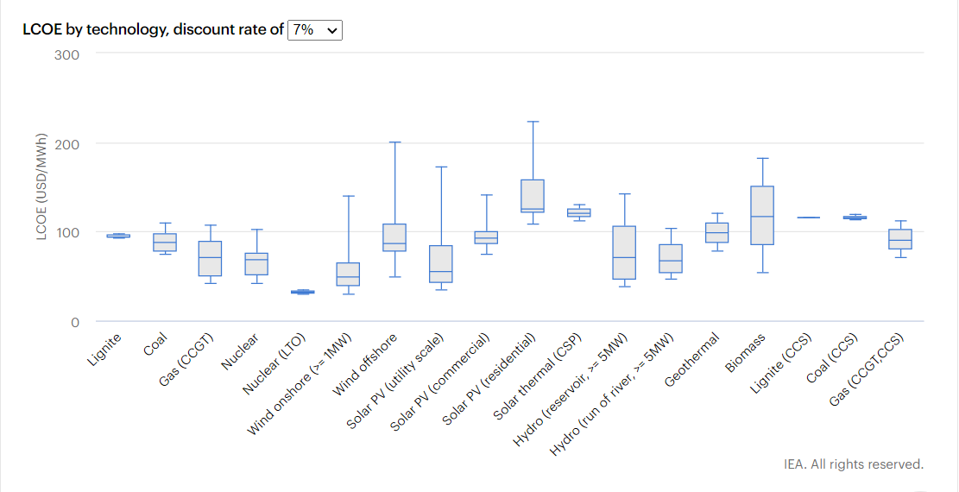
Solar Farms
Solar Farm:
Collection of solar panels in order to generate electricity.
Traditional commercial PV efficiency is around 20%, and with concentrated systems around 30%.
Produced energy is highly dependent on the geographical position
Areas of solar farms:
1,6*10⁴ m² 1 MW crystalline solar panels without trackers
2,4*10⁴ m² 1 MW thin film solar panels without trackers
Installation Cost:
Utility-scale solar around $0.80-$1 per Watt
Residential solar around $3-$4 per Watt
Notes:
Solar Farm- Collection of solar panels on land or on water in order to generate electricity to feed into the grid.
No standardized definition for solar farms
solar farms = utility-scale solar
the utility scale typically at least 1 megawatt (MW)
capable of supplying 200 households.
Area of Solar Farm:
16-24000 m2 depending on the type
tracker is a device that orients a panel toward the sun
LCOE:
utility scale: low
Residental: high
Kuva 1: World Solat Atlas
Kuva:2 https://www.iea.org/reports/projected-costs-of-generating-electricity-2020

Slide 4
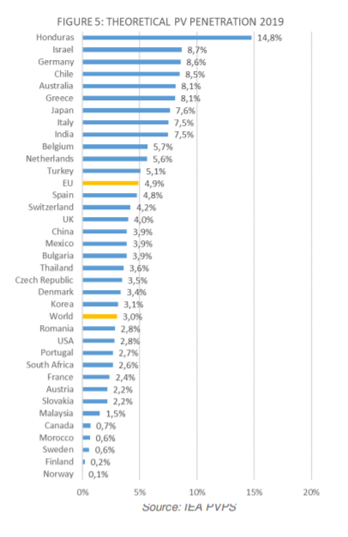
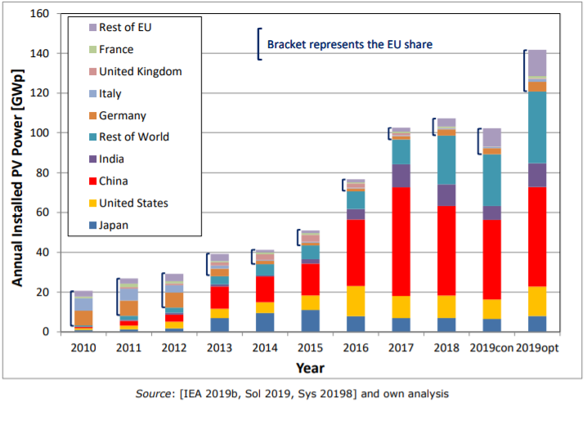
Installed Capacity And Energy Market Share
Installed PV capacity has grown from 40 GW to over 600 GW from 2010
The growth has slowed down in Europe but the growth in China, Asia-Pacific and North America is increasing the global capacity
Share of PV is 3% of all the produced energy
Share of renewables in total is 26% of all produced energy
Estimated total percentage of the total PV production per total electricity demand
Annual PV installations from 2010 to 2019 estimates
Notes:
Last 10 years: price –80% and capacity 40 GW to 600 GW
Germany was dominating in the beginning of 2000
Top 3: China, India, US
Even China is building new capacity – less than 4%
EU 4,9%
Finland 0,2%
https://ec.europa.eu/jrc/sites/jrcsh/files/kjna29938enn_1.pdf
https://iea-pvps.org/wp-content/uploads/2020/04/IEA_PVPS_Snapshot_2020.pdf

Slide 5
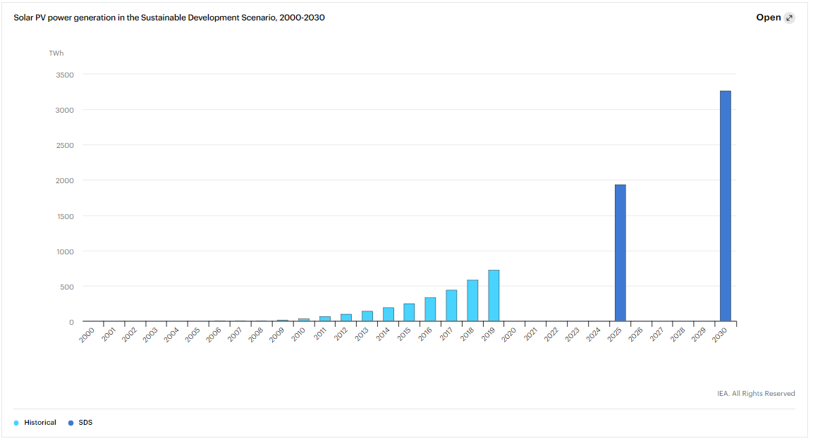
Future Trends in Solar
The amount of PV is expected to increase in order to reduce emissions
Material development
Higher efficiency
Floating solar farms
Solar & storage in small and medium sized PV systems: Increased self-consumption rates for smart solar & storage prosumers
Large-scale solar & storage with grid intelligence: Flexibility services to the grid.
BIPV: 3rd generation of Building Integrated PV is ready for the mass market
Solar PV power generation in the Sustainable Development Scenario, 2000-2030
Notes:
IEA: solar power continues to grow
solar exceeds wind power??
some bigger innovations that have lately been introduced or under development
floating solar farms are farms build on water
Singapore
BIPV
2020:
BIPV – THE NEXT GENERATION IS READY FOR THE MASS MARKET
Building integrated PV (BIPV)
The next-gen BIPV products are based on basically any solar cell technology available. While many use dominating crystalline silicon, there are also BIPV
products, such as solar roof tiles using naturally black CIGS thin-film technology. Some startups also develop lightweight and flexible organic PV solutions,
anticipating “connected and integrated buildings” (with smart lighting, smart windows, canopies in parks, shading infrastructures, agriculture-related buildings)
will fuel the growth of the global BIPV market
Kuva: https://www.iea.org/reports/solar-pv

Slide 6
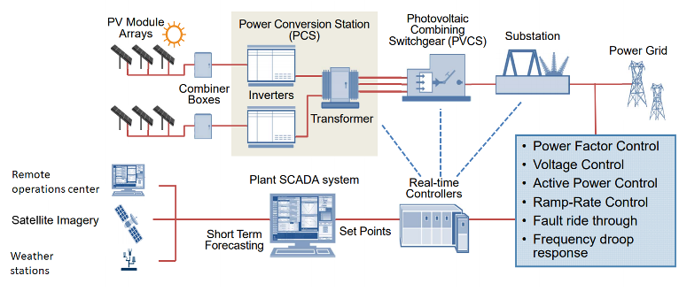
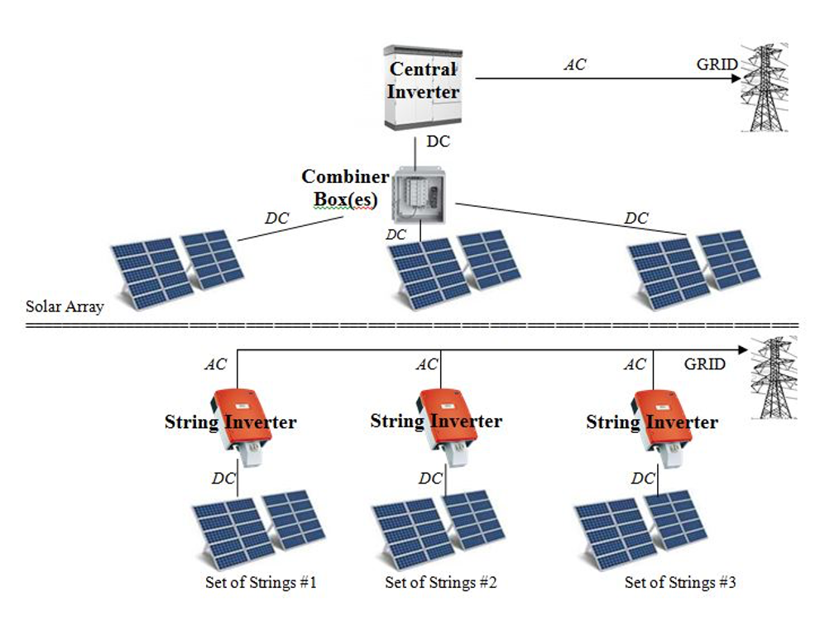
Grid Connected PV System
PV System
Central or String Inverters
Small and intermediate systems (<500 kW) are usually connected to the distribution system​
Large systems (>500 kW) are connected to the transmission system
Inverter: One of the most important part of the solar power system. Converts direct current (DC) output of PV solar panel into alternating current (AC).
Notes:
Inverters do:
1. Convert DC to AC power
2. Maximize power output
3. Interface with grid
4. Report on power production
5. Ensure safe system operation
Central Inverter
- Less expensive
- Large scale systems

Slide 7
Plant control system
Supervisory control and data acquisition (SCADA) System:
Used in solar farms as they need fast sampling pace for the data gathered to optimize the power output as efficiently as possible.
Provides information to determine solar plant functioning.
SCADA is used to minimize the operation and maintenance costs of a power plant by triggering alarms when oddities are detected.
Data is gathered from the inverters, panels and other components of the system to calculate and compare to the optimum performance.
Real time controller Collect remote data from inverter and current PV from the combiner box
Notes:
Plant controller control inverters and devices at a solar PV plant.
It can regulate these parameters:
- power factor Control
- voltage control
- Active power control
- Ramp-rate control
- Fault ride control
- Frequency droop response

Slide 8
Effects of PV Grid connected systems on a Distribution network
Reverse power flow: Net production > Net demand
Overvoltage along distrubution feeder: Reverse power flow leads to overvoltage along distribution feeder.
Voltage fluctuation: PV power output changes due to irradiation dependency.
Voltage control difficulty: Due multiply supply point.
Power Losses: If plant is long distance from load.
Electromagnetic interference(EMI) issues: Due the high frequency converters.
Increased reactive power in grid: In PV system, inverters are openly operating at unity power factor to maximize active power generation. This reduce active power supply by the utility. However, reactive power is still same, thus, distribution transformer operate at low power factor, and it reduces overall system efficiency.
PV-STATCOM: functionality, reactive power feed into the grid during night time.

Slide 9
Challenges
Securing energy supply and transition to sustainable and low carbon energy system
Intermittent nature and location
Power quality problems
Harmonic problems
No inertial power generation
Variability of isolation
Environmental issues
Land degradation
Habitat loss
Hazardous materials

Slide 10
Conclusions
The amount of solar power will increase in order to reduce emissions
Inverter is the most important part of the solar power system. There are two main inverter options, and optimal device depends on several factors. Plant control system analyze operations of the solar plant.
There are technical, economic and environmental challenges when connecting solar farms to the grid. However, developing methods are increasing the amount of solar systems installation.

Slide 11
Source material used
PV Status Report 2019, Jäger-Waldau, A. https://ec.europa.eu/jrc/sites/jrcsh/files/kjna29938enn_1.pdf
Snapshot of Global PV Markets 2020, https://iea-pvps.org/wp-content/uploads/2020/04/IEA_PVPS_Snapshot_2020.pdf
EU Market Outlook For Solar Power 2020 – 2024, https://www.solarpowereurope.org/wp-content/uploads/2020/12/3520-SPE-EMO-2020-report-11-mr.pdf?cf_id=31069
IEA: Renewables 2020, Analysis and forecast to 2025: Solar PV, https://www.iea.org/reports/renewables-2020/solar-pv
ElNozahy, M. S., & Salama, M. M. A. (2013). Technical impacts of grid-connected photovoltaic systems on electrical networks—A review. Journal of Renewable and Sustainable Energy, 5(3), 032702. https://doi.org/10.1063/1.4808264.
Nwaigwe, K. N., Mutabilwa, P., & Dintwa, E. (2019). An overview of solar power (PV systems) integration into electricity grids. Materials Science for Energy Technologies, 2(3), 629–633. https://doi.org/10.1016/j.mset.2019.07.002
Patel, V., & Patel, J. J. (2017). Power quality improvement of grid using solar photovoltaic farm. 2017 Innovations in Power and Advanced Computing Technologies, i-PACT 2017, 2017-January, 1–6. https://doi.org/10.1109/IPACT.2017.8245113
Solar Power World. Advanced SCADA functionality helps solar operators manage the future. 2019. SPW. Available: https://www.solarpowerworldonline.com/2019/08/advanced-scada-functionality-solar-trimark/
Solar Power World. What does a solar inverter do? Available: https://www.solarpowerworldonline.com/2019/06/what-does-a-solar-inverter-do/
Varma, R. K., & Siavashi, E. M. (2018). PV-STATCOM: A New Smart Inverter for Voltage Control in Distribution Systems. IEEE Transactions on Sustainable Energy, 9(4), 1681–1691. https://doi.org/10.1109/TSTE.2018.2808601

