Slide 1
ELEC-E8423 - Smart Grid Supergrids
Juliët Quint and Guido Janssen
11.05.2021

Slide 2
Introduction
What are supergrids?
Topology
Benefits
Challenges
Ongoing projects
Conclusions

Slide 3
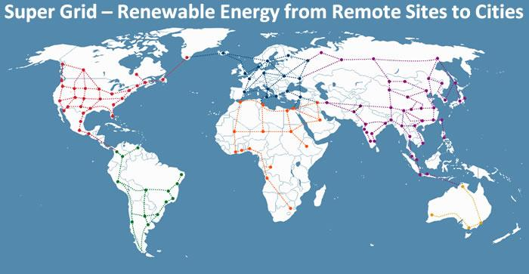
What are supergrids?
Wide-area transmission network for trade of high volumes of electricity over large distances
Large infrastructure necessary for interconnection
HVDC (+500 kV) or UHVDC (+800 kV) required for long-distance electricity transmission
Increased controllability and lower losses (1.6% per 1,000km)

Slide 4
Topology
The DC supergrid is independent of the conventional AC grid and does not replace it
There are various topologies possible for supergrids
The third topology is the most complex and expensive due to the extra conversions at the terminals
Example: link between Continental Europe and Scandinavia

Slide 5
Benefits of supergrids (1/2)
Overarching benefit:
Supergrids allow for a more efficient electrification of infrastructure and society
Complementary benefits:
Increased flexibility and reliability in grids
Reduced congestion in existing grids
Decreased costs of electricity across regions

Slide 6
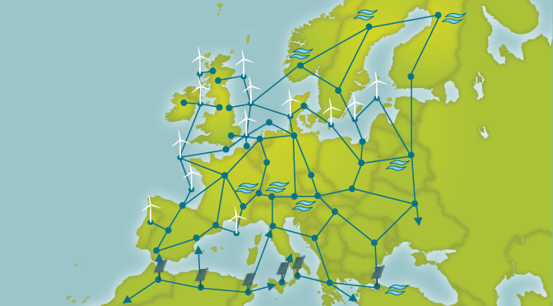
Benefits of supergrids (2/2)
Transmission of renewable energy from resource-rich areas to distant demand centres

Slide 7
Challenges of supergrids
High investment costs: who pays for it?
For example: does a country pay for a connection between other countries when it could benefit from that connection?
International political collaboration on grid ownership, rights and revenue allocation
Many countries involved makes it a big challenge
The parties must comply on the technical specifications of the system
Different current specifications could make this difficult
Coordination among system operators to ensure power balance is kept
Large amount of data about production and consumption

Slide 8
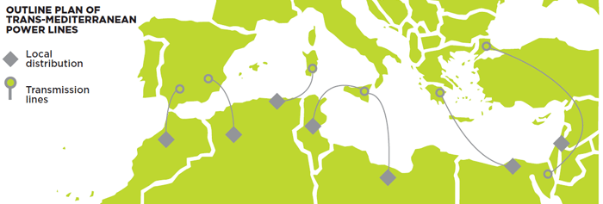
Ongoing supergrid projects
There are individual HVDC lines between countries and more projects are planned
Medgrid: set up in 2010
Goal: create a sustainable electricity highway between North Africa and Europe
Investment: 38 - 46 billion Euros
Desertec: set up in 2003
In 6 hours, the world's deserts receive more solar energy than humans consume in 1 year
Goal: large scale production of wind and solar power in desert regions across the world
With transmission to Europe, investment: 10 billion Euros/GW

Slide 9
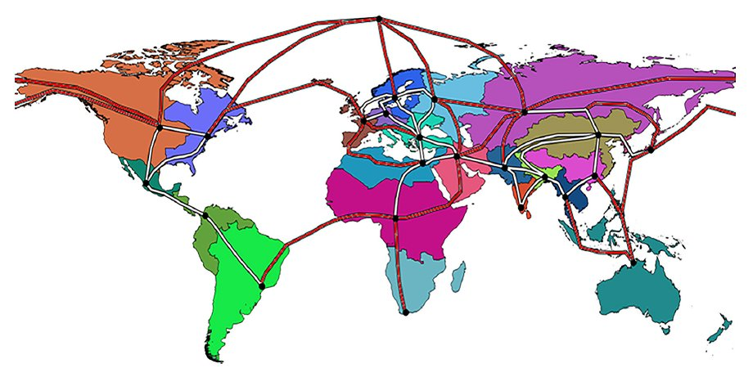
Conclusions
HVDC supergrids have the potential to make electrification of society with renewable energy more efficient
There are many challenges that make large-scale implementation difficult
Smaller-scale projects between countries are already happening, but worldwide implementation still seems far away

Slide 10
Source material used
Ahmed, Noman & Haider, Arif & Van Hertem, Dirk & Nee, H.-P. (2011). Prospects and challenges of future HVDC. SuperGrids with modular multilevel converters. Proceedings of the 2011 14th European Conference on Power Electronics and Applications, EPE 2011. 1 - 10.
Bellini, E. (2020). Global supergrid vs. regional supergrids. Available at https://www.pv-magazine.com/2020/04/23/global-supergrid-vs-regional-supergrids/ (Accessed: 7 May 2021)
Energy futures lab (2015). What will European Electricity look like in 2050? Changes in 2050 Electricity Use. Available at https://energyfutureslab.blog/2015/08/07/what-will-european-electricity-look-like-in-2050-changes-in-2050-electricity-use/ (Accessed: 7 May 2021)
IRENA (2019), Innovation landscape brief: Supergrids, International Renewable Energy Agency, Abu Dhabi.
Medgrid (n.d.) Our vision. Available at http://www.medgrid-psm.com/en/project/the-vision/ (Accessed: 7 May 2021)
Lei, H., & Qiankun, W. (2020). Global Energy Interconnection: A Bold Initiative for A Sustainable Energy Future. Horizons: Journal of International Relations and Sustainable Development, (17), 268-281. Retrieved May 7, 2021, from https://www.jstor.org/stable/48590579
Panciatici, P. (2015). Super grids, Benefits and Challenges. Available at http://www.epcc-workshop.net/archive/2015/Presentations/EPCC2015-Presentation_S2-1-Panciatici.pdf (Accessed: 7 May 2021)
Desertec (n.d.) Technology. Available at https://www.desertec.org/technology/ (Accessed: 7 May 2021)

