Slide 1
ELEC-E8423 - Smart Grid Future street lights
Amanda Laakkonen
Hanako Olmedilla
18.05.2021

Slide 2
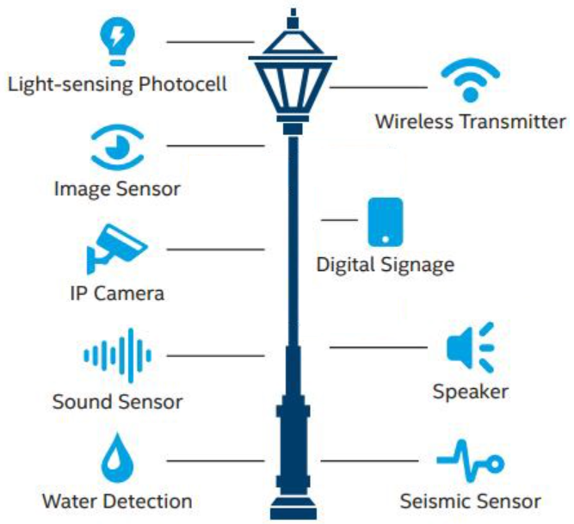
Introduction
The goal is to increase energy efficiency and utilize the street lightning better.
Street light system consume 35% of electricity during nights
90% of electricity wasted in low traffic areas after 12:00 am
Quite expensive and contributor to CO₂ emissions
Street lightning serves as a major information gateway
Energy efficient LED lamps
What can we do to make the system more useful?
IoT = Internet of Things
ISLS = Intelligent street light system
Notes:
Hanako:

Slide 3
Real-time control
Connected to a mobile network
controlled remotely as an IoT device
dimmed outside of peak hours
turned on or off as needed
faults identified quickly
Maintenance costs and energy costs can be reduced significantly
Data continuously monitored and collected to give insights into the efficiency of the system across an entire city
Urban and rural areas may require different approaches.
Solar street lighting may not be useful in some locations.
Notes:
Hanako:

Slide 4
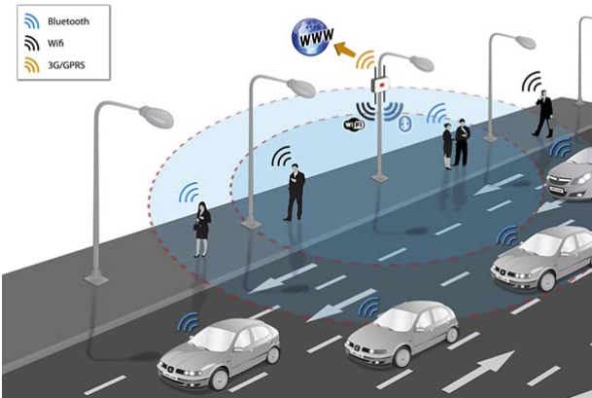
IoT in smart lighting
Notes:
Hanako:
This picture describes the connections running through smart cities and smart grid. And as you can see the luminaires works perfeclty as a host for sensors to strenghtn the grid and convey information. They can collect a wide range of data from across an urban area, much of which is relevant to the planning, utilisation and operation of city services. A dense network of small base stations is generally better suited to meeting users’ bandwidth requirements than a traditional macro network.
And because everything runs around money, as a bonus to the systems lower running and maintenance costs, through data analytics, mobile operators can also improve existing services and generate new revenue streams using the data collected by sensors hosted throughout a city, making mobile operators a strong partner for cities deploying connected streetlights.

Slide 5
Devices and System
Street cameras
Air quality meters
Weather condition sensors
Cell base station
Travel
Process, analyze, and present data
Use
Notes:
Amanda:
Street cameras
Air quality meters
Weather condition sensors
Cell base station
///Light poles provide a natural host for the new generation of small air quality sensors. They can be placed alongside roadways, and can be spread uniformly throughout a city. As the sensor can draw power from the light pole and use the communications equipment embedded in the smart street light, implementation of these sensors can cost much less than finding and allocating dedicated sites to these measuring equipment. There is also a growing trend towards using light poles to host small cell base stations to meet consumers’ growing bandwidth requirements and to support the 5G networks of the future. A dense network of small base stations is generally better suited to meeting users’ bandwidth requirements than a traditional macro network. ///
Travel ///Data form the sensors travels through local or wide area networks, wireless transmissions, or anything designated as a route of transmission, back to a central point for processing and storage.///
Process, analyze, and present data ///This can enable the development of adaptive services, and the introduction of predictive and planning tools that allow the city to adapt over time based on forecasts derived from real-time environmental, traffic, and other related data.///
Use /// Use the data for example to minimize maintenance costs and to create better living and environmental conditions ///

Slide 6
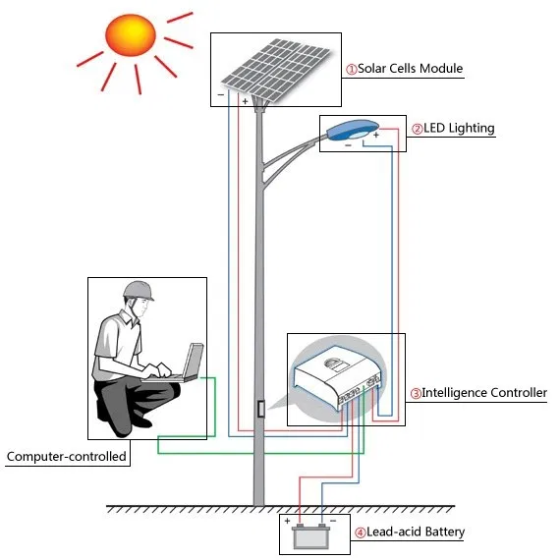
Smart solar street lighting
+ Operation cost is low
+ Require less maintenance
+ Pollution free source of producing Electricity
- Setup cost is high
- Doesn´t work on cloudy or rainy days
Notes:
Amanda:
Photo voltaic solar cells convert the radiation of sun light into electrical energy.
-
A controller is that circuit which decides when to switch on /off charging and lighting.
The Rechargeable Battery stores the electricity from solar panel during the day and provides power to the fixture during night.

Slide 7
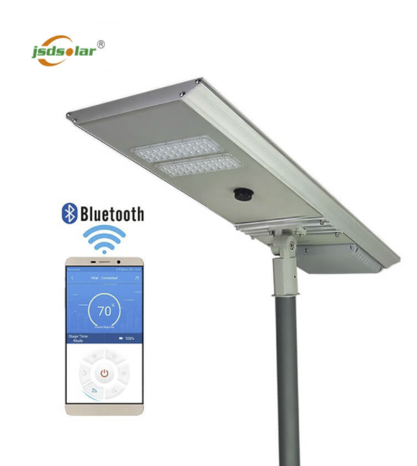
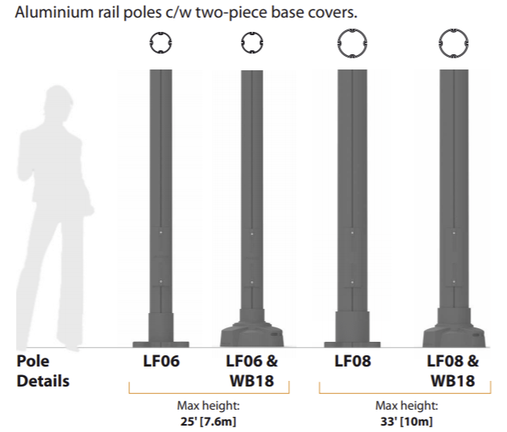
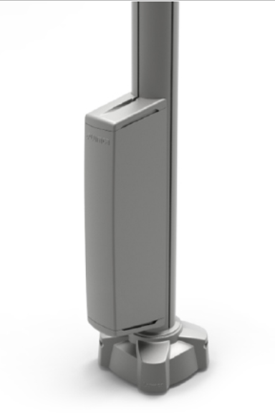
Products
solar panel, Charging efficiency:＞18%
lifepo4 battery
led light
Intelligent system with
MPPT charge controller
microwave sensor
APP control
Lumca’s Smart Pole
The rail system where you can add
Luminaires
Cameras
WIFI hotspots
Sensors
ESB and WBS boxes
Notes:
Amanda:
There are various products on the market nowdays, here is highlited two diferent product ranges that are available. First on left there is a complete product that includes everyhtin on the luminaire itself, such as different sensors and solar panel to charge the luminaire.
On the right there is a rail system that works as a power distributer and you can add several different modules on to the rail. Luminaires often goes to the top and under that you can add for example cameras to monito the traffic, WIFI hotspot to streghten the citys wifi network and on the bottom is ESB or WSB bow where the electrical supply cable is brought.

Slide 8
Conclusions
Major information source and important member of the smart grid
Sensing for example traffic patterns, air quality and weather
Reporting for example provide video surveillance for security, issue traffic tickets and advice for parking
Big data
Reduction in energy cost
Adding solar panels on the luminaires --> the largest markets for solar streetlights are China and India
surplus supply to the municipal network
Improvement in LED lighting and better connectivity
Less installation, maintenance and management costs
New services can be introduced without any further disruption
Notes:
Major information source and important member of the smart grid
Sensing for example traffic patterns, air quality and weather //// This helps to reduce the amount of electrical sensors individually And helps the communication inside the smart grid due to the fact that the sensors are located eavenly in the luminaires ( assuming that all devices are able to communicate with each other )
Reporting for example provide video surveillance for security, issue traffic tickets and advice for parking
Big data ////By combining multiple sources of data, such as air quality and traffic information, complex analysis can be undertaken and data can give many insights into a city’s status, how planning can meet citizens’ needs, and what information can be shared with citizens to enhance their quality of life. integration of data from streetlights with data from other city sources, such as transport networks, can be used to inform the dynamic control of the infrastructure, so street lights around a bus stop can be set to be brighter than those further away
Reduction in energy cost
Adding solar panels on the luminaires --> the largest markets for solar streetlights are China and India //// Use of solar-powered lighting is also growing quickly in the UK and Germany, driven by the significant cost savings these lights generate in hard to reach areas. To summarize, these are the best option in places where the electrical cabling is hard to reach and the usage is less so.
surplus supply to the municipal network //// The possibility to send the surplus to the municipal network creates elasticity of demand and helps the city to respond the energy needs better.
Improvement in LED lighting and better connectivity
Less installation, maintenance and management costs
New services can be introduced without any further disruption

Slide 9
Source material used
https://www.smart-energy.com/industry-sectors/smart-energy/street-lighting-illuminating-smart-cities-and-society/
Energy efficiency and pay-back calculation on street lighting systems. C. Subramani et al. AIP Conference Proceedings 2112, 020082 (2019); (https://doi.org/10.1063/1.5112267).
https://www.gsma.com/iot/wp-content/uploads/2017/03/Smart-Street-Lighting-Case-study-webv1.pdf
http://www.aeslight.com/smart-city-lighting/
https://www.zgsmlightings.com/info/smart-street-lights-46086111.html
https://www.lumenova.net/sales-products/street-light-control-system.html

