Slide 1
ELEC-E8423 - Smart Grid Smart Meters and their Security Issues
Emmaleena Ahonen
Jonna Tammikivi

Slide 2
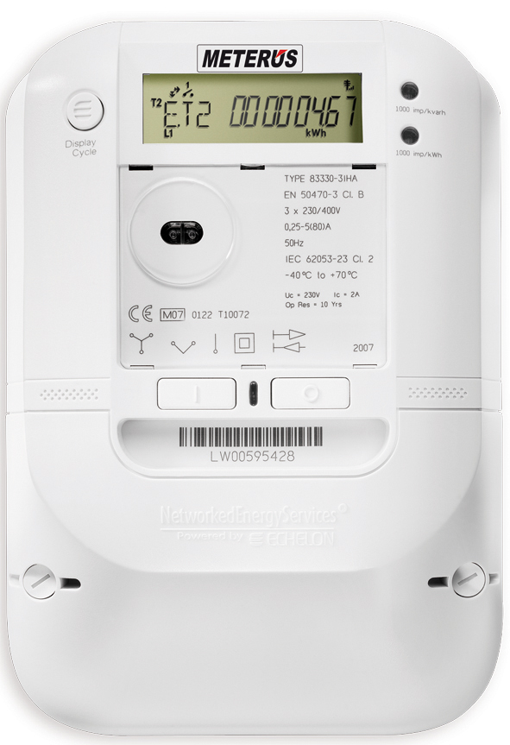
Introduction
Overview
Technology
Benefits
Privacy and security
Smart meters in Finland
Conclusions

Slide 3
Smart meters
Smart meters are used for the measuring and the communication of some information. For example:
Consumption of energy
Voltage levels
Current
Communication is two-wayed. Both the customer (electricity consumer) and the electricity provider are kept informed constantly (almost in real time).

Slide 4
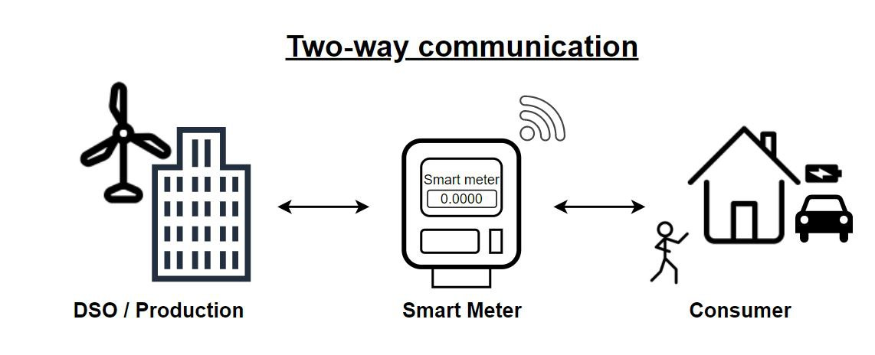
Technology
Two types of smart meter technology
AMR, Automatic meter reading
AMI, Advanced metering infrastructure
Communication
There are many different communication methods that vary
Usually, Wi-Fi or radio frequency

Slide 5
Benefits
Balance between production and consumption
Enables fluctuations of electricity prices based on for example the time of the usage of electricity
Beneficial for both the electricity provider and consumer
Smart meters have also been praised for quick findings of faults

Slide 6
Security and privacy
Cyber security issues
Possibility of distorting data, overloading the network, power outages
It is though possible to protect data with encryptions, authentications, legislations, standards...
Any attack would require a vast amount of resources
Privacy issues
Based on the data received from the smart meters, daily/weekly/... routines can be detected
Smart meter data could be used illegitimately by the electricity provider for example through selling data or selling customers intentionally poor contracts
There have been cases of misuse of smart meter data. For example, by debt collectors and the police
Solution from energy storages?

Slide 7
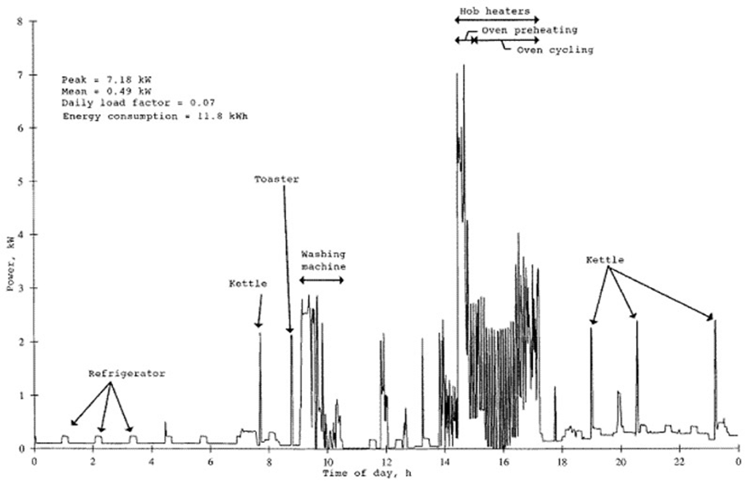

Slide 8
Smart meters in Finland
Finland is one of the leading countries with smart meter installations
Government regulation: 80 % of households should have smart meters by 2014
In 2020 over 99 % of metering points are covered by smart meters
New wave of installations in the future
Smart meters technical life cycle is 15 years
15-minute imbalance settlement period

Slide 9
Conclusions
Smart meters ensure better balance between production and consumption.
Cyber security attacks or misuse of private data is possible but highly unlikely.
Finland excelled in the smart meter roll-outs before 2014 and now SM coverage is close to 100 %

Slide 10
Source material used
(1) D. Kathan et al. "Assessment of Demand Response and Advanced Metering", Federal Energy Regulatory Commission (2008). Found at:
https://www.ferc.gov/sites/default/files/2020-05/12-08-demand-response.pdf
(2) O. Pauzet. "Cellular Communications and the Future of Smart Metering", Sierra Wireless (2010). Found at: https://www.gsma.com/iot/wp-content/uploads/2012/03/energy20cellular20communications20and20the20future20of20smart20metering.pdf
(3) C. McKerracher et al. "Energy consumption feedback in perspective: integrating Australian data to meta-analyses on in-home displays." Energy Efficiency, Volume 6 (2).
(2013)
(4) J. Ming, et al. "PresenceSense: Zero-training algorithm for individual presence detection based on power monitoring". ACM BuildSys. (2014). Found at: https://dl.acm.org/doi/10.1145/2674061.2674073
(5) R. Anderson, et al. "Who controls the off switch?". Cambridge University, England. Available at: https://www.cl.cam.ac.uk/~rja14/Papers/meters-offswitch.pdf
(6) Commission Regulation (EU) 2017/2195 of 23 November 2017 establishing a guideline on electricity balancing. (2017). Found at: http://data.europa.eu/eli/reg/2017/2195/oj
(7) Energiateollisuus. "Energiateollisuus ry:n (ET) näkemys varttimittaukseen siirtymisen aikataulusta jakeluverkoissa.", (2019). Found at: https://energia.fi/files/3526/Varttimittaus_kantapaperi_20190213_FINAL.pdf
(8) A. Bleicher. "Privacy on the Smart Grid; Are smart meters spies? They don’t have to be". IEEE Spectrum. (2010) Found at: https://spectrum.ieee.org/energy/the-smarter-grid/privacy-on-the-smart-grid

