Slide 1
ELEC-E8423 - Smart Grid Smart Grid and Electrical Safety
Mikael Liimatainen
Erna Virtanen
18.5.2020

Slide 2
Content
Introduction
Finnish Legislations
Finnish Standards
Examples of current standards

Slide 3
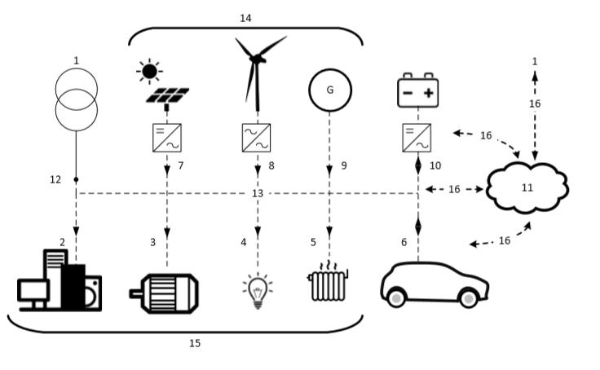
Introduction
Electrical Safety
More smart grids, more electrical installations
Ensuring safety with legislation and standards
Example of prosumer’s low-voltage electrical installation. (General principles of the prosumer's electrical installations (PEI), (IEC 60364-8-2: 5))
Note! In this presentation we are
interested only in key points 6, 7 and 9-10.
Notes:
Electrical safety is a system of organizational measures and technical means to prevent harmful and dangerous effects on workers from electric current, electromagnetic fields and static electricity
Prosuming is increasing -> electrical installations are made at households

Slide 4
Electricity Legislation
In Finland 1135/2016 “Electrical Safety Act”
§6 demands, that electrical installations and equipment must not endanger:
Life, Health and Property
Electrical equipment must be designed in such a way that the essential safety requirements are fulfilled
The requirements of the legislation are considered to be fulfilled if the mentioned standards have been followed.
Notes:
- §6 also includes requirements for Electromagnetic Compatibility (EMC)

Slide 5
Standards
Most of SFS are based on IEC or CENELEC standards
Standardized guidance must follow the law (1135/2016)
Standards in the electrical and electronics industry are prepared and confirmed by SESKO ry
Smart Grid and private or distributed production bring more standards into picture
New standard SFS 6008-2
Based on standard IEC 60364-8-2: ”Low-Voltage electrical installations: Prosumer’s low-voltage electrical installations”
SFS 6000 series must still be followed for safety reasons
Also, there are more system-specific standards.
Notes:
International Electrotechnical Commission and European Committee for Electrotechnical Standardization
A Finnish standard proposal SFS 6008-2 is based on international standard IEC 60364-8-2. This ”Low-Voltage electrical installations: Prosumer’s low-voltage electrical installations” –standard is more about prosumer system functionality than protection or safety.
SFS 6000 and SFS 6002 standard series still defines the electrical safety aspects of electrical systems and installation work principles. From the point of view of Smart Grid and prosumers, the following parts of SFS 6000 are important:
Photovoltaic power supply systems (SFS 6000-7-712)
Charging of Electric Vehicles (SFS 6000-7-722)
Selection and installation of electrical equipment. Other electrical equipment (e.g. PV panels and integrated batteries) (SFS 6000-5-55)
Applying of standards is only an “recommendation”. It is allowed not to follow standards, if legislation is fully met and it can be proven.

Slide 6
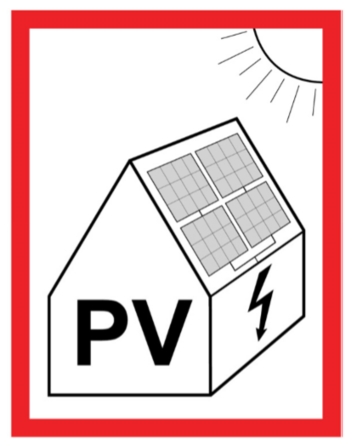
Photovoltaic production
Solar PV production must follow the standard SFS 6000-7-712
Traditional protection methods
Selection of Electrical Equipment
Rated for DC use
Suitable voltage and current ratings
Appropriate temperature rating
Smart Grid & Prosumer protection methods
demand an informing warning of the
photovoltaic system on site
A warning of a photovoltaic system in a building
Notes:
Traditional protection methods demand protection against:
Electric shocks, Heat, Overcurrents and Overvoltages
Smart Grid / Prosumer protection methods
demand also an informing warning of the
photovoltaic system on site
This ensures the safety of maintenance personnel,
inspectors, rescue personnel, etc.

Slide 7
Electric vehicles
The electric vehicle charging standard SFS 6000-7-722 is applied for protection and charging systems, if electricity can be supplied from the car back to the private or public distribution network.
Traditional protection methods:
Short circuit- and overcurrent protection
Protection with enclosuring
(IP code)
Protection from mechanical impact (IK code)
The power supply from an electric vehicle to the installation is considered as a voltage generator.
Allowed only in charging stations equipped with a socket or plug-in accordance with SFS-EN 62196

Slide 8
Other devices
A standard for "the other electric devices“ SFS 6000-5-55 is applied, for example, for the installations of PV panels and electrochemical batteries
Traditional protection methods for electric shock and overcurrent:
Fault protection
Isolating devices on either side of the static inverter
Limiting the effects of harmonic currents.
If the generator set operates in parallel with the public distribution network:
It must not interfere with the public distribution network
Protection devices must prevent it from being connected to the grid in case of distribution failure
Only qualified or instructed persons have access to system batteries
Battery connections must be touch-protected.
Notes:
These systems might be feeding equipment, that are connected to distribution network
(e.g. automatic switch-off of supply)

Slide 9
Conclusions
Electrical installations and equipment must not endanger Life, Health and Property
SFS 6000 series must be followed for safety reasons
Unqualified persons in a homelike environment must be assisted to use and maintain new prosumer technologies such as batteries and charging electric vehicles.

Slide 10
References
Electrical Safety Act 1135/2016
International standard, IEC 60364-8-2, Edition 1.0, 2018-10, Low-Voltage electrical installations – Part 8-2: Prosumer´s low-voltage electrical installations
Pienjännitesähköasennukset SFS 6000-5-55:2017, Sähkölaitteiden valinta ja asentaminen. Muut sähkölaitteet
Pienjännitesähköasennukset SFS 6000-7-712:2017, Erikoistilojen ja –asennusten vaatimukset. Aurinkosähköjärjestelmät
Pienjännitesähköasennukset SFS 6000-7-722:2017, Erikoistilojen ja –asennusten vaatimukset. Sähköajoneuvojen syöttö
Pienjännitesähköasennukset SFS 6008-2, Osa 8-2: Toiminnallisuus. Tuottaja-kuluttajan pienjännitesähköasennukset Standardiehdotus E605, 2020-02-03.
Sähkölaitteistojen turvallisuutta ja sähkötyöturvallisuutta koskevat standardit, Luettelo S10-2019, Turvallisuus- ja kemikaalivirasto
Valtioneuvoston asetus sähkölaitteistoista 1434/2016

