Slide 1
ELEC-E8423 - Smart Grid Concentrating solar power and its comparison to photovoltaics
Elena Benedetti
Essi Tallavaara
11.05.2021

Slide 2
Introduction
Technical Overview
CSP Potential
CSP vs. PV
Cost Comparison
Environmental Impact
Innovations
Conclusions

Slide 3
Technical Overview
CSP plants produce electricity from solar radiation
The solar energy is transformed into heat and generates electricity by using turbines that drive a generator
Different heat transfer fluids are used: thermo oil, molten salt, air or water
4 main types of CSP plant technology

Slide 4
CSP Potential
Capacity worldwide 6450 MW (2019)
Spain, USA, Morocco, South Africa,
China
Hybrid systems
CHP
Desalination
Solar PV
TES – Thermal Energy Storage
Gemasolar 20 MW, Spain
15 h storage capacity

Slide 5
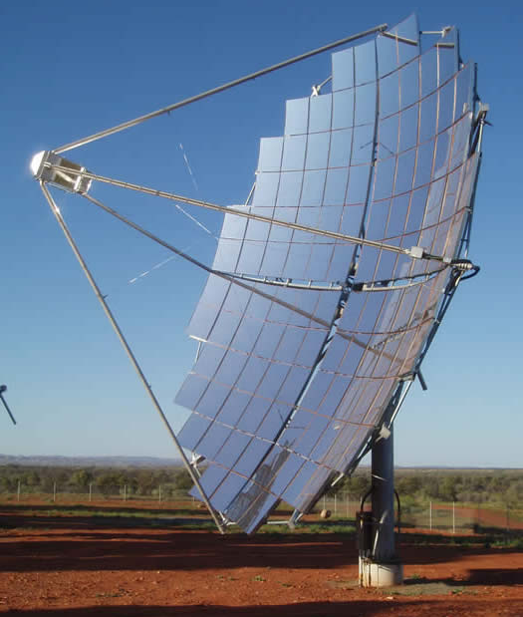
CSP vs. PV
+ Excess energy storage
+ Hybrid systems
+ Energy flexibility
+ Cost
+ Integrated systems
+ Established

Slide 6
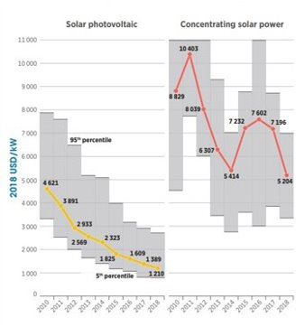
Cost Comparison
CSP plants are still 5 times more
expensive than PV plants
The price of both technologies will
continue to decline
PV will remain a preferable solution
over CSP for energy investors
The average cost of electricity
generated from CSP with TES is
expected to remain cheaper

Slide 7
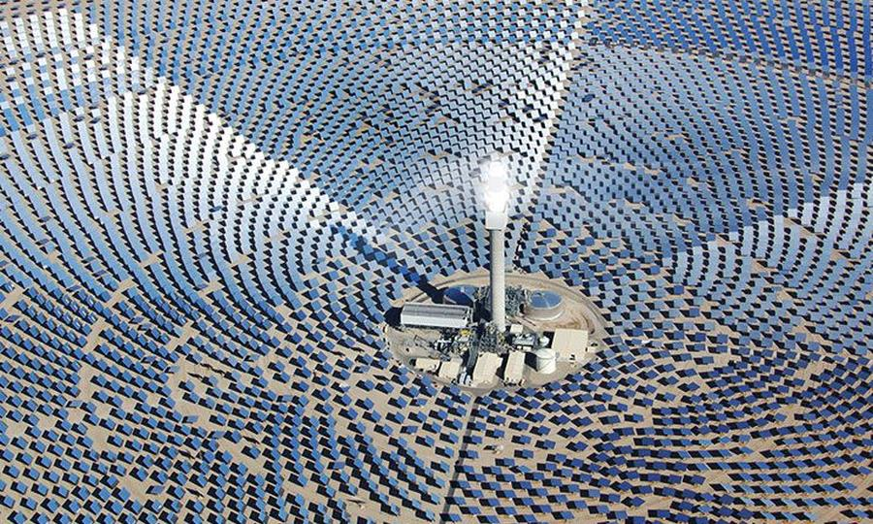
Environmental Impact
Water issues
HTF issues
Land use and visual impact
Energy and materials use
Impacts on flora and fauna

Slide 8
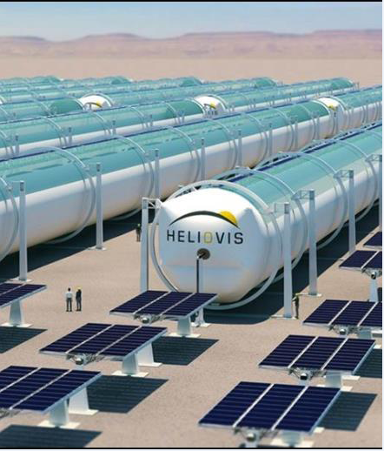
Innovations
Heliovis
Inflatable tube
Concentrating mirror channel
Desalination plants
Multiple-Effect Distillation
Reverse Osmosis
Supercritical CO2
Brayton cycle
Packed bed TES
Notes:
The HELIOtube® technology is an inflatable cylindrical concentrator made of three industry-proven plastic films, namely a base film, transparent film and mirror film. The mirror film divides the concentrator into two air-tight chambers running lengthwise through the tube. Small pressure differences between the top and bottom chambers arch the mirror film downward. Thus, a mirror channel is created that concentrates the sun rays onto a thermal receiver in the upper chamber.
Multiple-Effect Distillation
Reverse Osmosis

Slide 9
Conclusions
High cost
Research & Development
Innovations
Hybrid Systems
Solar PV
CHP
Desalination
Environmental issues
Water and land use

Slide 10
Source material used
Burgaleta, J. I. & Arias, S. & Ramirez, D. (2011). Gemasolar, the first thermosolar commercial plant with molten salt storage. ResearchGate GmbH. Available: https://www.researchgate.net/publication/264855919_Gemasolar_the_first_tower_thermosolar
_commercial_plant_with_molten_salt_storage
Gauche, P. & Rudman, J. & Mabaso, M. & Landman, W. A. & Backström, T. W. & Brent, A. C. (2019). Solar Energy. V. 152. P. 106-139. Available: DOI 10.1016/j.solener.2017.03.072
He, Y. & Qiu, Y. & Wank, K. & Yuan, F. & Wang, W. & Li, M. & Guo, J. (2020). Perspective of concentrating solar power. Energy. Vol. 198. P. 117373. Available: DOI 10.1016/j-energy.2020.117373
IEA 2021. Concentrating Solar Power (CSP). (2020). [Referenced 10.05.2021] Available: https://www.iea.org/reports/concentrating-solar-power-csp
Palenzuela, P. & Ortega-Delgado, B. & Alarcon-Padilla, D. (2020). Comparative assessment of the annual electricity and water production by concentrating solar power and desalination plants: A case study. Applied Thermal Engineering. V. 177. P. 115485. Available: DOI 10.1016/j.applthermaleng.2020.115485
Trevisan, S. & Guedez, R. & Laumert, B. (2020). Thermo-economic optimization of an air driven supercritical CO₂ Brayton power cycle for concentrating solar power plant with packed bed thermal energy storage. Solar Energy. Vol. 211. P. 1373–1391. Available: DOI 10.1016/j.solener.2020.20.069
Viebahn, P &Lechon, Y & Trieb, F. (2011). The potential role of concentrated solar power in Africa and Europe. Energy Policy. V. 39. P. 4420–4430. Available: DOI 10.1016/j.enpol.2010.09.026

Slide 11
Source material used continues
Bermadinger, S. & Steinmair, M. & Tiefenbacher, F. (2019). HELIOtube: An industrially realized reinvention of a CSP collector. AIP Conference Proceedings 2126. Available: DOI 10.1063/1.5117621
Fabrizio Fabrizi "Environmental impact: CSP TECHNOLOGIES". Renewable energy training program, module 7 2012
Hardy, Z. (2020). Solar Power and Western Australia: How it can be the Future of Energy for the State. 2021 Easy Solar. [Referenced 10.05.2021] Available: https://www.easysolar.com.au/solar-power-western-australia-future/
IRENA. Solar Power. [Referenced 10.05.2021] Available: https://www.irena.org/costs/Power-Generation-Costs/SolarPower
PROTERMOSOLAR. (2019). Concentrated Solar Power (CSP) Vs Photovoltaic (PV). Helioscsp. [Referenced 10.05.2021] Available: https://helioscsp.com/concentrated-solar-power-csp-vs-photovoltaic-pv/

