Slide 1
ELEC-E8423 - Smart Grid Sector Coupling of Power and Heat
Anni Niemi
Sara Kasanen
07.02.2018

Slide 2
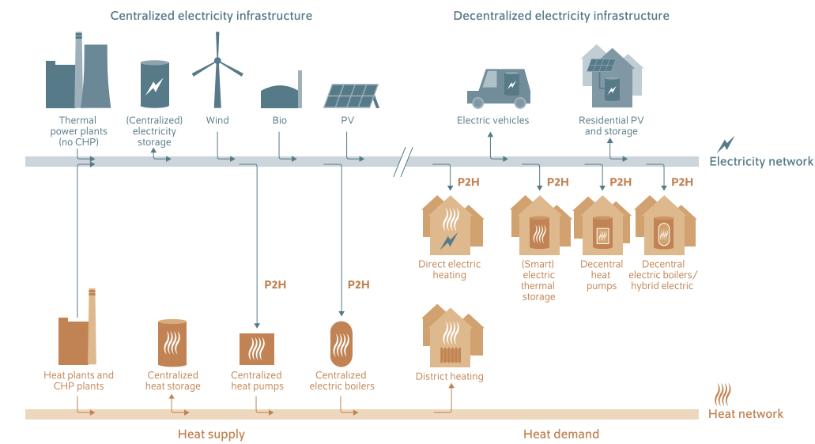
Introduction
Combining the use of electricity and heat for a sustainable energy system

Slide 3
Background
Twice as much energy is consumed as heat compared to electricity
In Helsinki, 57% of emissions are produced by heating
The current scheme for producing heat highly depends on fossil fuel​
Decarbonisation of heating is needed as much as decarbonisation of electricity
Increasing the percentage of electricity production from variable renewable
energy sources (VRE) demands more flexibility from the grid​
Weather dependent VRE production could be balanced and its increased integration enabled by using the VRE surplus power in heating sector
Sector coupling thus would add flexibility, storage and distribution options to the use of VRE
Getting rid of expensive and polluting peak power plants
Balance the supply and demand

Slide 4
Implementation
Thermal loads have higher inertia and more flexibility than the electric loads
The excess electricity from VRE can be used to produce heat​
The produced heat can be used directly, or stored for later when the demand exists​
Key technologies include heat pumps, combined heat and power, power to gas, power to heat, power to liquid, and electric and thermal storage.
Heat pumps use electricity to circulate hot/cold liquids using the heat from air, geothermal heat, or ground water
Electricity can be used to heat substantial amounts of water, which are then circulated in district heating networks
Power-to-X allows excess power to be channeled into other forms of energy, like energy efficient heat pumps or electric boilers for heating.
Excess heat from biogas plants can also be used in such heating networks

Slide 5
Benefits
Increases the electrification of the heating sector, resulting in less GHG emissions
Assuming that the electricity is produced using RESs
Increases the renewable share of electricity production
Decreases the need for VRE curtailment during peak production which increases their revenue
Decreases the need for expensive peak power plants & electric storage
A relatively cost-effective solution for mitigating carbon emissions in energy systems
P2H solutions can be paired with thermal energy storages to provide increased flexibility

Slide 6
Challenges & barriers
Requires a large amount of excess renewable energy
Increased electrification may have negative impacts to the stability of power grids
Large-scale implementation of heat pumps may increase the peak power demand substantially
Full electrification of buildings and industrial loads may require upgrades of transmission & distribution networks
Can be mitigated by flexible operation & demand-side management
COP of heat pumps is much lower with low source temperatures and high output temperatures
A limiting factor especially for industrial use with high output temperature requirements, but also relevant for DH and domestic water use
Low cost of current heating technologies decreases the willingness to invest in new solutions
Regulatory barriers: lack of incentives for demand side flexibility, electricity taxes etc.

Slide 7
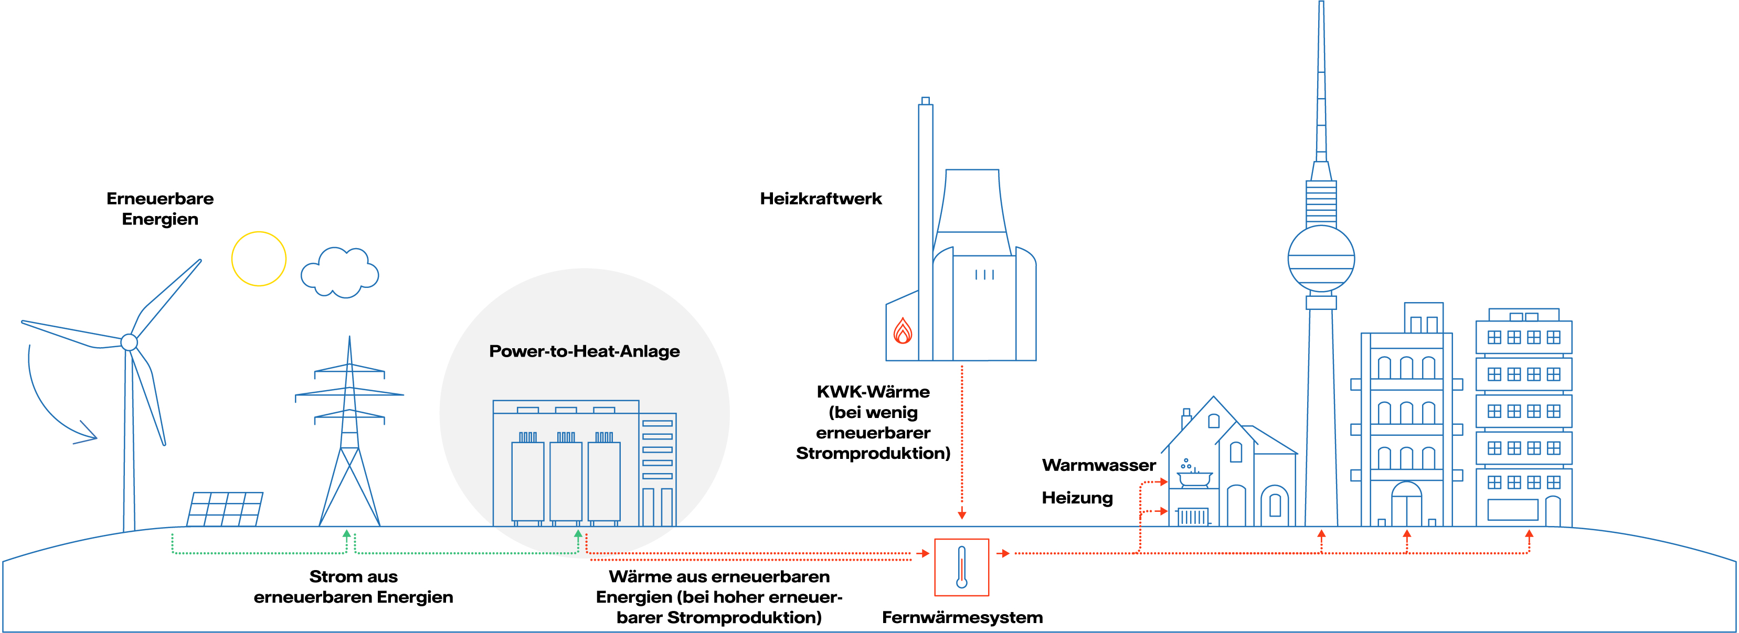
Example: Reuter West (Berlin, Germany)
Europe’s largest P2H unit (120 MW), connected to the DH grid at the end of 2019
Operates at the site of a CHP plant, replacing one of its three coal-fired heating units
Picture: https://group.vattenfall.com/de/zukunft/speichertechnologie/power-to-heat

Slide 8
Conclusions
Heat production is currently largely dependent on fossil fuels
Sector coupling is a possible solution to help decarbonise the heating sector & to introduce a larger renewable share of electricity production
Large-scale implementation demands flexibility from the energy system (e.g. demand-side management)

Slide 9
Sources
Bashir, Lund, Pourakbari-Kasmaei & Lehtonen. (2020). Minimizing Wind Power Curtailment and Carbon Emissions by Power to Heat Sector Coupling—A Stackelberg Game Approach. DOI 10.1109/ACCESS.2020.3039041.
Bloess,Schill & Zerrahn, (2018). Power-to-heat for renewable energy integration: A review of technologies, modeling approaches, and flexibility potentials. https://doi.org/10.1016/j.apenergy.2017.12.073.
Fridgen, Keller, Körner, Schöpf. (2020). A holistic view on sector coupling. https://doi.org/10.1016/j.enpol.2020.111913.
International Renewable Energy Agency. (2020). Renewable Energy Policies in a Time of Transition: Heating and Cooling. Pp. 51-52. ISBN 978-92-9260-289-5.
Jimenez-Navarro, Kavvadias, Filippidou, Pavičević, Quoilin. (2020). Coupling the heating and power sectors: The role of centralised combined heat and power plants and district heat in a European decarbonised power system. https://doi.org/10.1016/j.apenergy.2020.115134
Munster et al. (2020). Sector Coupling: Concepts, Potentials and Barriers. DOI: 10.23919/AEIT50178.2020.9241201.
Salpakari, Mikkola & Lund. (2016). Improved flexibility with large.scale variable renewable power in cities through optimal demand side management and power-to-heat conversion. http://dx.doi.org/10.1016/j.enconman.2016.08.041
Vattenfall. Power-to-Heat. Accessed 29.3.2021. Available: https://group.vattenfall.com/de/zukunft/speichertechnologie/power-to-heat

