Slide 1
ELEC-E8423 - Smart Grid Battery Energy Storage Systems
Basit Ali Khan
Sami Leppälä
23.03.2021

Slide 2
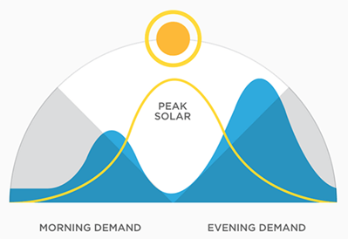
INTRODUCTION
Electrical power generation is changing significantly around the word due to addition and variable nature of renewable energy resources.
The electricity grid is a complex system in which production and consumption must be equal at any given moment.
Production and consumption do not match. The mismatch possess a threat to the stability of the system.
Energy storage plays an important role in this balancing act and helps to create a more flexible and reliable grid system.
Energy storage can provide a rich spectrum of benefits to;
the generation. (covering mismatch).
to end-users. (covering mismatch).
to society as a whole. (green house reduction)

Slide 3
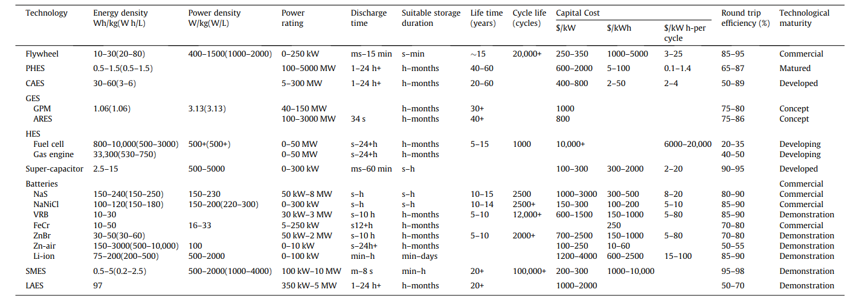
TYPES OF STORAGE SYSTEMS

Slide 4
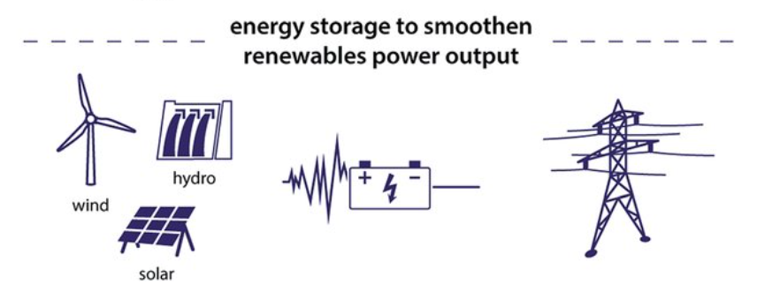
ROLE OF BESS WITH RENEWABLE ENERGY
Renewable integration:
Balances the instability in the power system caused by the intermittent nature of wind and solar, allowing better utilization of RES.
Load shifting:
On-peak energy usage is delivered from energy that has been stored in off-peak periods.
Emergency backup:
Keeping vital operations running during power outages.
Smart Grid:
Smoothing renewable energy output
Transient support
Frequency regulation
Voltage regulation
Load following

Slide 5
TYPES OF BESS
Battery Technology | Energy Density (Wh/kg) | Efficiency (%) | Capital Cost E/kW | Cycle Life | Advantages | Disadvantages
Lithium | 80-150 | 90-99 | 150-250 | 1000-20000 | High power density, efficiency and long cycle life. | High initial cost and safety issues.
Lead | 24-45 | 60-95 | 50-150 | 500-1800 | Low capital cost. | Low cycle life and leakage of acid if breached.
Zinc | 37 | 75 | 900 | 2000+ | High capacity. | Very low energy density.
Vanadium Flow | 10-30 | 85 | 1280 | 12000+ | High capacity and no self-discharge. | Very low energy density.
Sodium Sulphur | 150-240 | >86 | 170 | 2500-4500 | High energy density and good efficiency | High production cost.

Slide 6
BENEFITS OF BESS
System efficiency (stored when not needed, used when needed)
Less wasted energy
Less emissions
Fast and reliable reserve
Traditional reserve power: reaction time can be tens of seconds
BESS: achieves full power in a few hundred milliseconds
Improves power quality in the grid
Self-reliance
Cutting energy bills
Backup energy

Slide 7
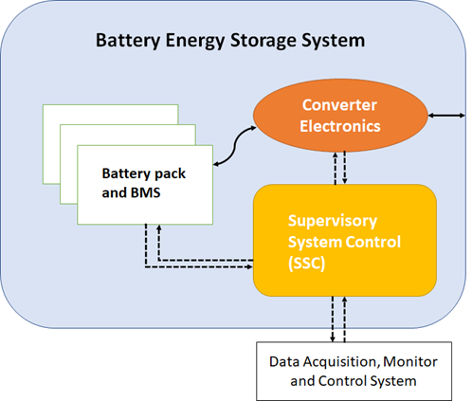
BESS ARCHITECTURE
Battery pack:
Composition of several battery packs.
Multiple batteries interconnected to reach the target V & I.
Battery Management System (BMS):
Controls the proper operation of each cell.
Let the system work within a voltage, current, and
temperature that is not dangerous for the system itself.
System Supervisory Control (SSC):
Usually included in the SCADA system.
The energy management system has the specific purpose
of monitoring the power flow according to the specific applications.
Converter Electronics
The battery system is connected to the inverters, in order to convert the power in AC.

Slide 8
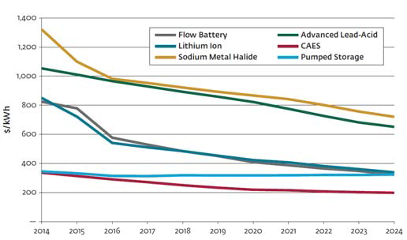
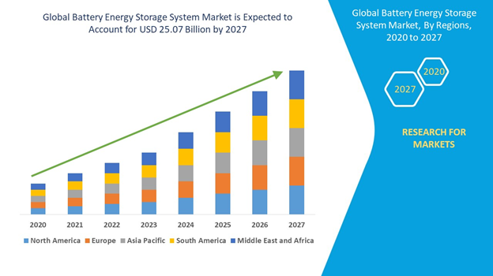
DEVELOPMENT IN BESS
Battery energy storage system market is valued at USD 25.07 billion by 2027.
Market growth at a rate of 31.06% over the forecast period of 2020 to 2027.
The growth of battery energy storage system market is attributed due to the growing demand for grid-connected solutions.
Battery energy storage costs are decreasing (Figure on left).
Energy densities in all types are still increasing.

Slide 9
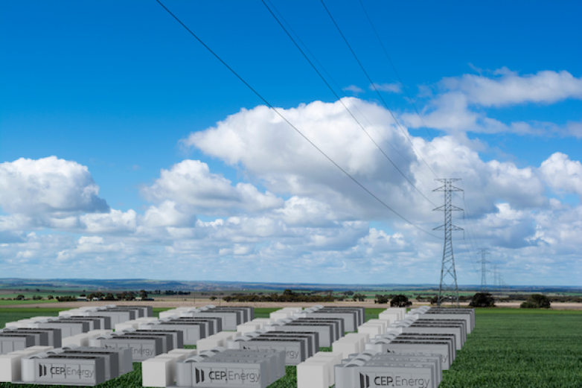
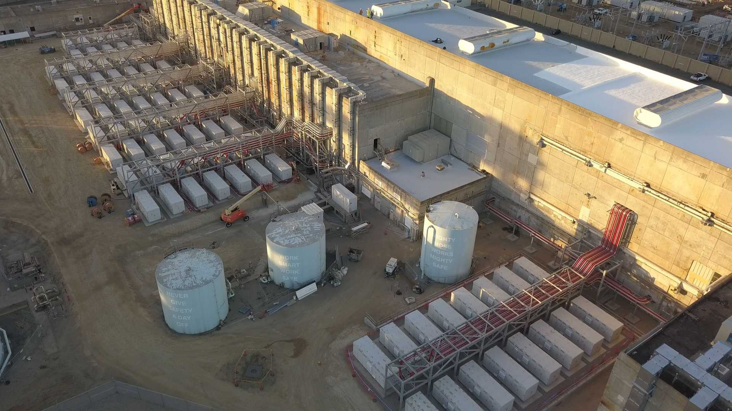
WORLDWIDE APPLICATIONS
World’s biggest battery storage project announced by
Australian renewables fund
Located 150km north of Sydney.
Grid-scale battery project with up to 1,200MW rated
output.
Begin in early 2022 for completion in 2023.
Vistra: Moss Landing Energy Storage Facility (California)
Phase 1 completed 11 December 2020
Currently 300MW / 1200MWh (world’s largest BESS
so far)
Can be expanded up to 1.5GW / 6GWh
Over 4500 battery racks, 22 li-ion battery modules/rack.

Slide 10
CONCLUSIONS
It is important to make use of storage technologies to incorporate the increasing demand of load.
BESS is a solution to deal with the intermittent nature of RES
BESS prices are decreasing while the use of these systems are increasing with time as they have high energy density and efficiency.
BESS have fast response time and is a reliable source which can act as a reserve plant.
BESS are very useful to overcome the stability issues.

Slide 11
REFERENCES
Cheng, M., Sami, S. S., & Wu, J. (2017). Benefits of using virtual energy storage system for power system frequency response. Applied energy, 194, 376-385.
Aneke, M., & Wang, M. (2016). Energy storage technologies and real-life applications–A state of the art review. Applied Energy, 179, 350-377.
Sparacino, A. R., Reed, G. F., Kerestes, R. J., Grainger, B. M., & Smith, Z. T. (2012, July). Survey of battery energy storage systems and modeling techniques. In 2012 IEEE Power and Energy Society General Meeting (pp. 1-8). IEEE.
Mahlia, T. M. I., Saktisahdan, T. J., Jannifar, A., Hasan, M. H., & Matseelar, H. S. C. (2014). A review of available methods and development on energy storage; technology update. Renewable and sustainable energy reviews, 33, 532-545.
https://www.ucsusa.org/resources/how-energy-storage-works#:~:text=Energy%20storage%20plays%20an%20important,used%20to%20power%20storage%20devices.
https://energystorage.org/why-energy-storage/
https://energystorage.org/why-energy-storage/benefits/
https://www.cedgreentech.com/article/why-energy-storage-such-important-part-renewables-mix

Slide 12
REFERENCES
https://www.ee.co.za/article/eskoms-flagship-battery-energy-storage-systems-bess-project.html
https://library.e.abb.com/public/9b718fcc8a5623b3852579680075d238/Battery%20Energy%20Storage%20%20optimize%20integration%20of%20renewable%20energy%20to%20the%20grid%20(2).pdf
https://insideevs.com/news/489894/vistra-moss-landing-energy-storage-world-largest/
https://sandbarsc.com/news/benefits-solar-battery-storage/
https://www.idealenergysolar.com/how-battery-energy-storage-works/
https://www.cartersullivan.co.uk/blog/advantages-of-battery-energy-storage-systems/
https://www.databridgemarketresearch.com/reports/global-battery-energy-storage-system-market
https://www.energy-storage.news/news/worlds-biggest-battery-storage-project-announced-by-australian-renewables-f

