Slide 1
ELEC-E8423 - Smart Grid ENERGY COMMUNITIES
Jasmin Jaanto, Nina McDougall
30.3.2021

Slide 2
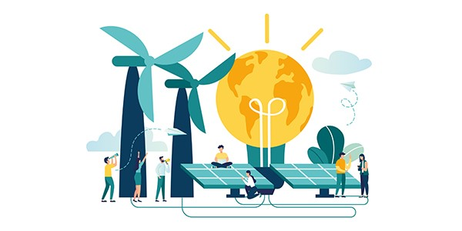
Introduction
An energy community (Community Energy) can be seen as a form of sharing economy
The members of the community can share the benefits of production and acquisition of energy
The community provides an opportunity to make sustainable energy production and consumption choices
Energy communities can offer better security of energy supply
Participation can provide financial benefits to the members
Participants eligible to join include natural persons, local authorities and micro, small, medium and large enterprises
Participation must be open and voluntary
https://urly.fi/1Yt9
Notes:
Nina

Slide 3
Background
The possibility to form an energy community has been there already, but all the benefits have not
Change in law 1.1.2021
New term in law: “energy community”
Condominiums and their shareholders are able to utilize small-scale production according to the same rules and principles as individual small producers so far
Energy community will provide financial benefits to its members
The production is shared among the members in accordance with the distribution ratios dediced by the condominimum (e.g., by property ownership shares)
On the side of the energy company, this will be enabled with the compensation model (=hyvityslaskentamalli)
The schedule for the compensation model depends on the energy companies, for example:
As soon as possible: Caruna Oy (1.1.2021), EleniaVerkko Oy (in year 2021)
At the same time with Datahub (1.1.2023): Pori Energia Sähköverkot Oy, Turku Energia Sähköverkot Oy, Vatajankosken Sähkö Oy, Paneliankosken Voima Oy, Sallilan Sähkönsiirto Oy (Query by YLE 7.2.2021)
Notes:
Jasu

Slide 4
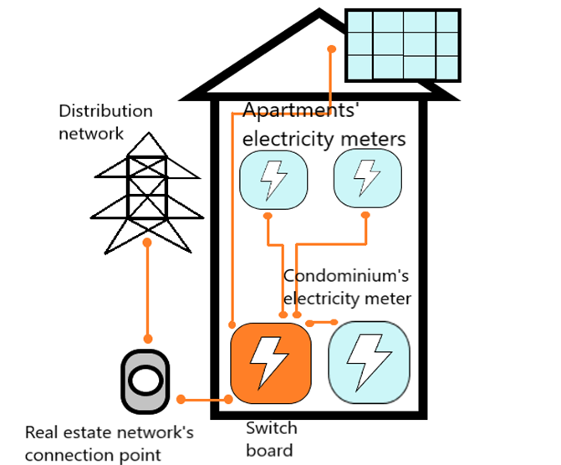
Centralized energy communities
Internal energy community of the property
As the energy produced (e.g., solar panels on the roof) is consumed in the property, it does not have to circulate through the distribution network and therefore, there is no need to pay a network service charge to the DSO
There is no need to pay electricity tax or strategic stockpile fee (=sähkövero + huoltovarmuusmaksu) on the produced energy with small-scale production plants
Notes:
Nina

Slide 5
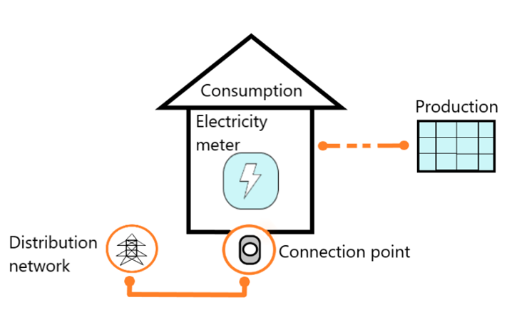
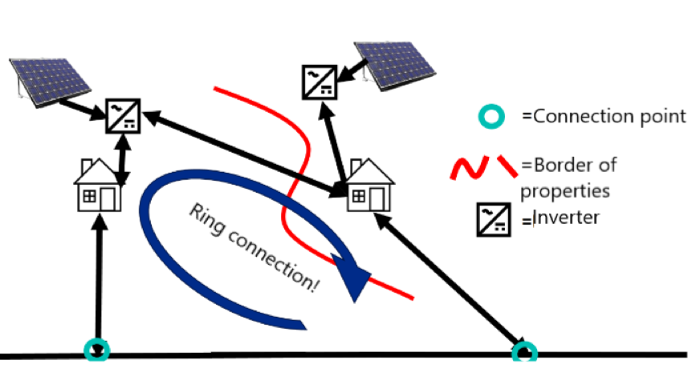
Centralized energy communities
Cross border energy community
If a suitable production place is not available at consumer’s own property, but is found in neighbour’s property, the neighbors can build their own mutual electricity network, in which small-scale production built together would be utilized and the benefits would be shared among the neighbors
The energy community is responsible for the electricity quality and electrical safety behind the connection point
The connection line shall not connect the electricity supply points and shall not form a ring connection alongside the distribution network in order to ensure electrical safety and fair treatment of customers
Notes:
Nina

Slide 6
Decentralized energy communities
Allows energy production to be placed in a more convenient location
The existing distribution and transmission network transfers the energy production to the consumption locations
Electricity generation equipment, electricity storage and consumption items are measured separately by place of use or by location, and the distribution of energy between places of use is calculated
Each production or consumption site in a decentralized energy community requires its own network service agreement with a local distribution network company
Datahub: A shared system called Datahub has been developed to clarify and speed up exchange of information between different electricity accounting points
Notes:
Jasu
As these entities use the public electricity network, they must pay for the use of the network in accordance with general principles
Similarly, electricity taxation is carried out in accordance with current tax practice

Slide 7
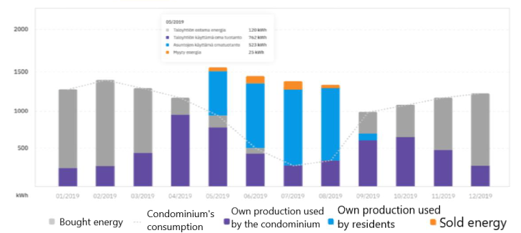
The benefits of the energy community
Case example: Energy community in a condominium: Shared solar panel system
With the compensation model, the residents can additionally use solar energy in their own apartments (blue column)
Only small amount of energy sold to the grid (not financially the most optimal situation)
Notes:
Jasu

Slide 8
Conclusions
Energy community is a form of sharing economy
Different types of energy communities
Centralized: Internal energy community of the property & Cross border energy community
Decentralized energy communities
Change in law (1.1.2021) enabled the financial benefits of the energy community
Compensation model (=hyvityslaskentamalli) is needed
at latest 1.1.2023 at the same time with DataHub
Notes:
Jasu

Slide 9
Source material used
Fingrid web-page. Available from: https://www.fingrid.fi/en/electricity-market/datahub/
Juuti, P. 2021. Aurinkosähkön kannattavuus paranee omakotitaloissa ja taloyhtiöissä – katso kartalta, milloin säästöt kasvavat omalla paikkakunnallasi. Available from: https://yle.fi/uutiset/3-11767604
Pahkala, T. 2019. Energiayhteisöt TEM:n mittauksen taustaryhmässä. Älyverkkoforum. Available from: https://urly.fi/1YFm
Pahkala, T., Uimonen, T., Väre, V. Työ- ja elinkeinoministeriön julkaisuja. Energia 33/2018. Available from: https://urly.fi/1YCo

Slide 10
Thank you!
Any questions?

