Slide 1
ELEC-E8423 - Smart Grid Compressed Air Energy Storage
Teemu Soukki
Laura Öysti
20.04.2021

Slide 2
Introduction
What is CAES? - Compressed Air Energy Storage
Concept
The different types of CAES
Potential of CAES
Projects currently in operation
Conclusions

Slide 3
Concept
- A way to store excess energy.
- Most closely related to pumped hydro storage.
- No need for expensive and potentially harmful materials such as battery systems use.
- Ambient air is compressed to a reservoir, most commonly underground salt reservoirs. Overground tanks for smaller systems.
- When needed, that energy is released through a turbine, generating electricity.
- The air heats up as it is compressed and cools down as it is released.

Slide 4
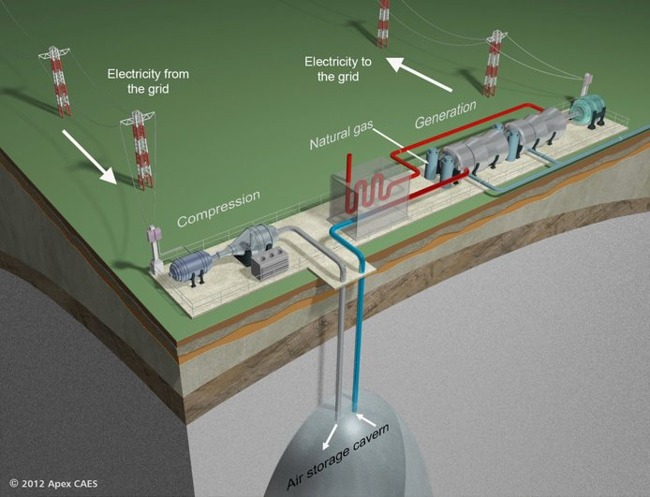
Concept

Slide 5
Different types of CAES
Diabatic
Heat from compression is dissipated
External energy is used to heat the expanding air
Efficiency = 42-55%, depending on if waste heat is utilized
Adiabatic
Heat from compression is stored
Stored heat is used to heat up the expanding air
Efficiency ≈ 70%
Isothermal
The transformations are done slower, to keep the temperature (near)constant
Efficiency ≈ 70%

Slide 6
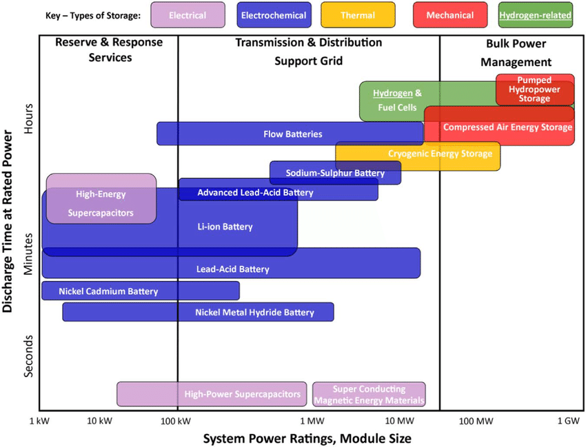
Potential of CAES
CAES can store energy in a large scale like PHS. It has high capacity and long-duration storage
Currently the biggest energy storage is pumped hydro, but CAES is a realistic alternative
PHS is becoming exhausted as an
energy storage system due to the
lack of available geographical sites
The future technology development
is currently focusing on improving
CAES efficiency and especially on the
development of AA-CAES
The greatest limitation of CAES is
low energy storage density

Slide 7
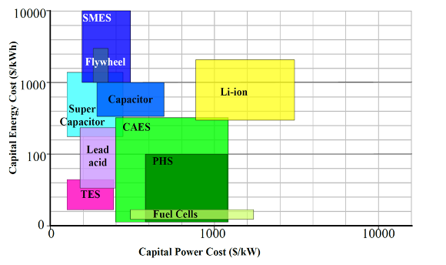
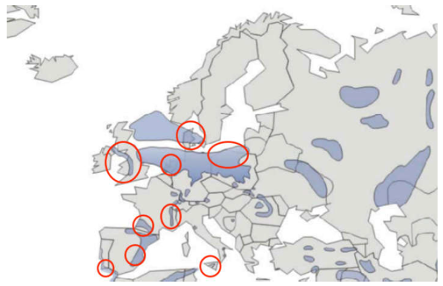
Potential of CAES
CAES costs are similar to PHS costs
- around 1000$/kW for diabatic and 1300$/kW for adiabatic
Suitable geological locations include underground salt caverns, underground hard rock layers and underground porous rock layers
Potential also in existing underground infrastructure: oil and gas reservoirs and coal mines
Potential salt caverns in Europe

Slide 8
Projects in operation
Location | Type | Power | Year | Accumulator
Huntorf, Germany | Diabatic | 290 MW, >2h | 1978 | Salt cavern
McIntosh, USA | Diabatic | 11 MW, >26h | 1991 | Salt cavern
Ontario, Canada | Adiabatic | 1 MW | 2015 | Underwater balloons
Goderich, Canada | Adiabatic | 1,75 MW | 2019 | Salt cavern
Feicheng, China | Adiabatic | 1250 MW | 2019 | Salt & coal mine caverns

Slide 9
Conclusions
Compressed Air Energy Storage (CAES) is an excess energy storing method which stores compressed air into a reservoir and later released through a turbine to generate electricity
Lots of promise and development on Adiabatic CAES which does not require any fossil fuels
CAES has the potential to be an equivalent technology to PHS because it can store large amount of energy for long periods of time

Slide 10
Source material used
Wang, J. et al. 2017. Overview of Compressed Air Energy Storage and Technology Development. Energies. Vol.10:7. p. 1-22. doi: 10.3390/en10070991
Energy Storage Association: https://energystorage.org/why-energy-storage/technologies/compressed-air-energy-storage-caes/ and https://energystorage.org/why-energy-storage/technologies/isothermal-caes/
https://www.researchgate.net/figure/Comparison-of-key-type-energy-storage-technologies-in-sense-of-storage-capacity-and_fig1_312870399
Sternberg & Bardow 2014. Power-to-What? – Environmental assessment of energy storage systems. Energy Environ. Sci., 2015, 8, 389. DOI: 10.1039/c4ee03051f
Chen, H. & Zhang, X. & Liu, J. & Tan, C. 2013. Compressed Air Energy Storage, Energy Storage - Technologies and Applications. IntechOpen. ISBN: 978-953-51-0951-8.
Marcus King, Anjali Jain, Rohit Bhakar, Jyotirmay Mathur, Jihong Wang, Overview of current compressed air energy storage projects and analysis of the potential underground storage capacity in India and the UK, Renewable and Sustainable Energy Reviews, volume 139, 2021, 110705, ISSN 1364-0321, https://doi.org/10.1016/j.rser.2021.110705.
Interesting Engineering: https://interestingengineering.com/compressed-air-energy-storage-caes-systems
The Green Age: https://www.thegreenage.co.uk/tech/compressed-air-energy-storage/

