Slide 1
ELEC-E8423 - Smart Grid
Pumped Hydro Energy Storages
Juuso Kortelainen & Rasmus Hietanen

Slide 2
Introduction
Pumped hydro energy storages store energy in the form of gravitational potential energy of water
Energy efficiency 70-80 %
About 180 GW of announced and operational facilities
About 95 % of all storages are pumped hydro energy storages
Technology | Rated Power (GW) | Share of storages
Pumped Hydro Storage | 181,80 | 94,81 %
Electro-chemical | 3,28 | 1,71 %
Thermal Storage | 3,28 | 1,71 %
Electro-mechanical | 2,60 | 1,36 %
Lithium Ion Battery | 0,75 | 0,39 %
Hydrogen Storage | 0,02 | 0,01 %
Compressed Air Energy Storage | 0,01 | 0,00 %
Liquid Air Energy Storage | 0,01 | 0,00 %
Lead-Carbon | 0,00 | 0,00 %
Department of Energy (2020)
Notes:
Single unit between 100 and 2000 MW

Slide 3
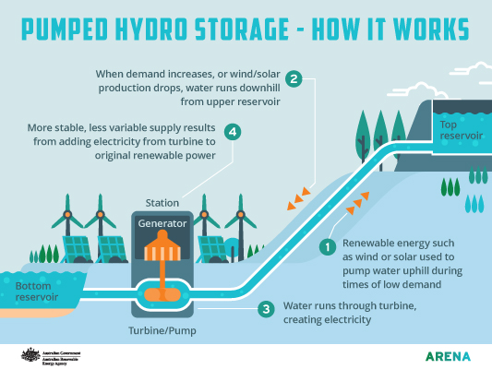
How it works?

Slide 4
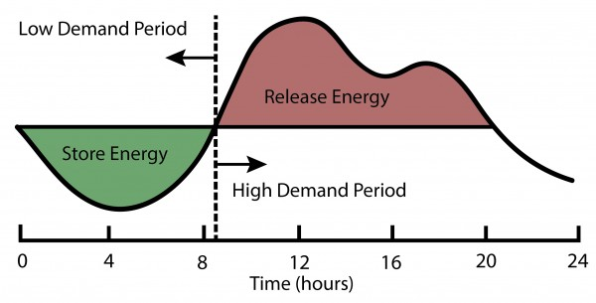
Applications
Energy balancing
Storages can be used when the renewable production is low
Load leveling
Storages can be loaded in night hours to balance the load peaks
Large emergency reserve

Slide 5
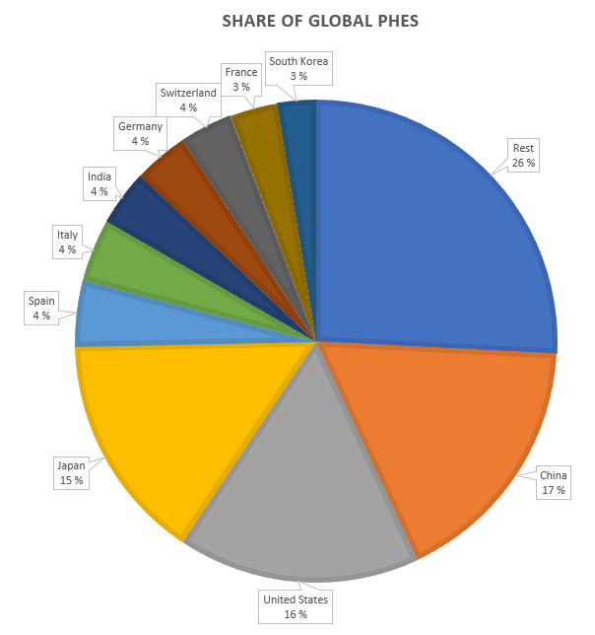
Potential of pumped hydro energy storage
Worldwide:
China, Japan and US are the largest producers
Conventional projects are limited mostly to mountainous regions
In Finland:
Elevation differences are usually just tens of meters in the hydropower plants
An underground pump plant and energy storage test facility is planned to be built at the Pyhäsalmi mine
The deepest mine in Europe
Could produce 70 MW
Offshore storages could be a possibility
Department of Energy (2020)

Slide 6
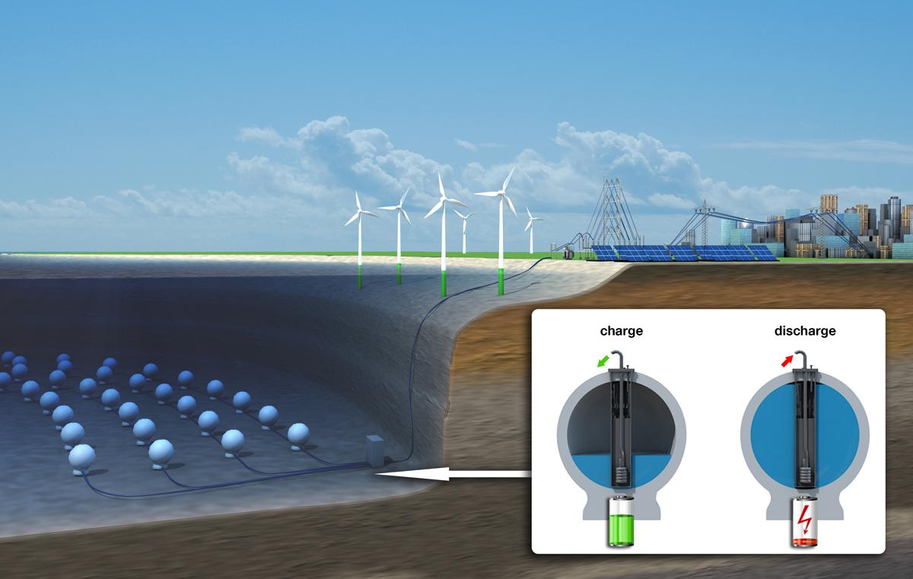
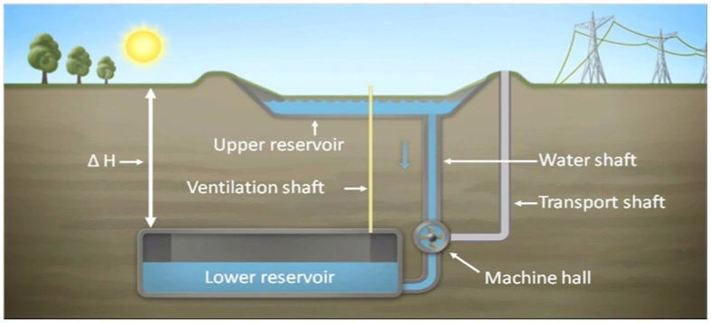
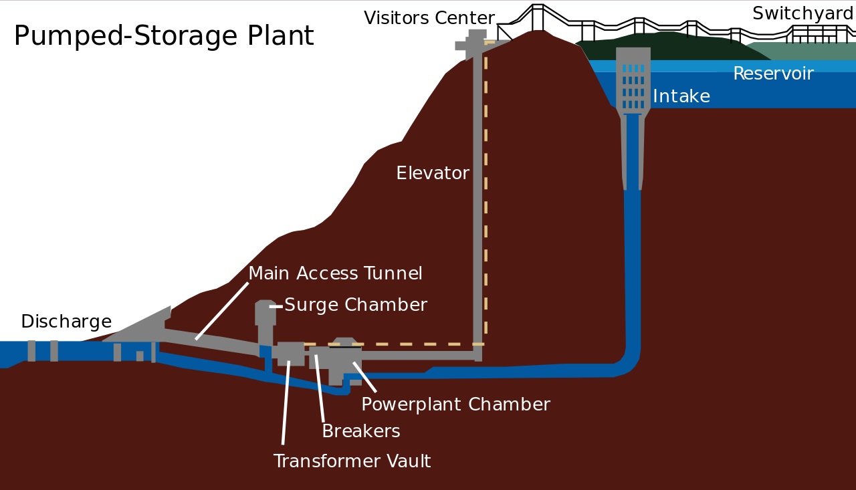
Different types of pumped energy storage
Pumped storage plant on surface
The most common in use
Requires high elevation difference
Underground reservoirs
One or more reservoirs underground
Can be used in old mines
Usable in flat regions
Underwater reservoirs
Usage of pressure at the sea bottom
When power is needed, water is let in
When there is electricity surplus, water is pumped out

Slide 7
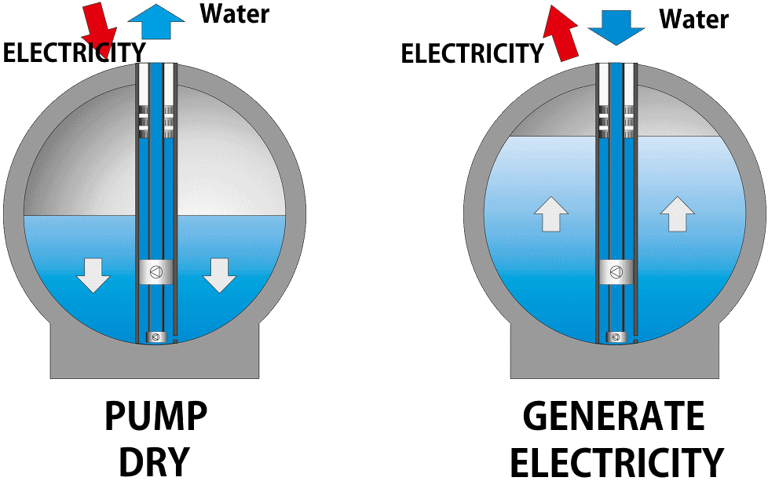
Offshore pumped storage
In many industrialized countries, the potential of regular pumped hydro storages has been largely exhausted
Storing energy at sea
Parameters:
Water depth 600-800m
Slope <= 1 degree
Distance to the electrical grid <= 100km
Distance to installation and maintenance bases <= 500km
Benefits: No need for landuse.
Handicaps: High fabrication costs and presence of harsh maritime

Slide 8
+ Advantages
Helps integrate renewables into power system
Easy energy balancing
Reliable and simple technology
Long lifetime
- Disadvantages
High investment costs
Only possible in specific locations
PHS on surface:
Large use of land
Environmental and social issues

Slide 9
Conclusions
Pumped hydro energy storage accounts for 95 percent of installed global energy storage capacity
New technology brings great potential for new installations especially in non-mountainous regions
Helps integrate renewables into the energy system with load-shifting and balancing inflexible sources of power generation

Slide 10
Source material used
Arena Wire. (2017). What is pumped hydro and how does it work?. [online] Available at: https://arena.gov.au/blog/what-is-pumped-hydro-and-how-does-it-work/ [Accessed 11.4.2021].
Department of Energy: Office of Electricity. (2020). Global Energy Storage Database. [online] Available at: https://www.sandia.gov/ess-ssl/global-energy-storage-database-home/ [Accessed 11.4.2021].
Dubbers, D. (2021). Comparison of underwater with conventional pumped hydro-energy storage systems. Journal of Energy Storage, 35. https://doi.org/10.1016/j.est.2021.102283
Hunt, J.D., Byers, E., Wada, Y. et al. (2020). Global resource potential of seasonal pumped hydropower storage for energy and water storage. Nat Commun, 11, 947. https://doi.org/10.1038/s41467-020-14555-y
Kougias, I., Aggidis, G., Avellan, F. et al (2019). Analysis of emerging technologies in the hydropower sector. Renewable and Sustainable Energy Reviews, 113. https://doi.org/10.1016/j.rser.2019.109257
Muelaner, J. (2019). New experimental energy storage system may be the key to a zero-carbon future. [online]. Available: https://www.engineering.com/story/harnessing-seabed-pressure-to-store-renewable-energy [Accessed 11.4.2021].
Puchta, M., et al. (2017) Development and testing of a novel offshore pumped storage concept for storing energy at sea. Elsevier Ltd. DOI: 10.1016/j.est.2017.06.004
Rahman, M., Olufemi Oni, A., Gemechu, E. & Kumar, A. (2020). Assessment of energy storage technologies: A review. Energy Conversion and Management. 223. https://doi.org/10.1016/j.enconman.2020.113295.
Sabihuddin, S., Kiprakis, A. & Mueller, M. (2015). A Numerical and Graphical Review of Energy Storage Technologies. Energies. Volume 8. 172-216. DOI: 10.3390/en8010172.
Slocum, A.H., et al. Ocean renewable energy storage (ORES) system: Analysis of an undersea energy storage concept. (2013). Institute of Electrical and Electronics Engineers Inc. DOI: 10.1109/JPROC.2013.2242411
Yle Uutiset. (2019). Pyhäsalmen kaivokseen rakennetaan pumppuvoimalan ja energiavaraston testilaitos. [online] Available at: https://yle.fi/uutiset/3-11099952 [Accessed 11.4.2021].

