Slide 1
ELEC-E8423 - Smart Grid Power to Gas
Ilpo Lehtoranta & Tero Sohlman
2021

Slide 2
Introduction
Power to Gas (P2G) is an energy management system, which uses electrolysis to turn electrical energy into hydrogen.
The most common method of P2G is called methanation, which converts COs, (Usually CO2) and hydrogen into natural gas such as Methane.
These applications enable to store these gases for longer periods. In addition, these gases can be moved across the globe in LNG carriers and pipeline.
P2G applications can be used for climate friendly fuels, for energy applications and for industry use. This method helps to balance out seasonal changes in supply and demand in power grids.

Slide 3
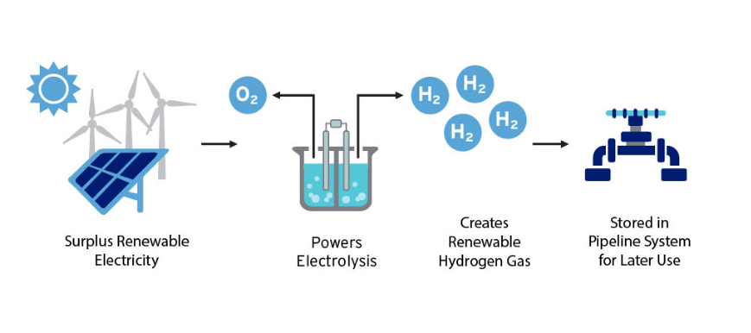
Systems
Surplus of electricity production goes to the process of electrolysis.
Electrolysis: Electricity splits water into hydrogen oxygen.
These products can be stored or injected to the grid.
Minimum cell voltage needed U_rev=1.23V (ΔG_R=237,2 kJ∕mol)
Max. theoretical system efficiency:
78,67 % (based on heat of combustion)
Photo: https://www.socalgas.com/clean-energy/renewable-gas/power-to-gas

Slide 4
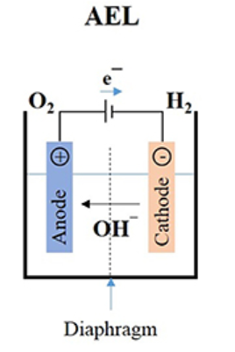
Electrolysis technologies
Alkaline electrolysis (AEL)
Advantages
The most mature and well understood technology
Low investment costs
Extremely low hydrogen impurity
Lifetime up to 30 year
Disadvantages
Corrosive electrolyte deteriorates when not operating nominally
High maintenance intensity
Stacks < 250 kW require unusual AC/DC converters

Slide 5
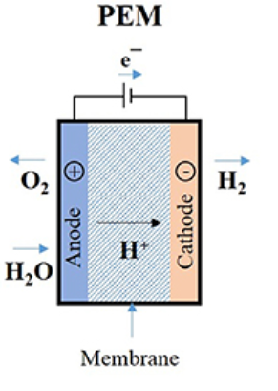
Electrolysis technologies
Proton Exchange Membrane (PEM) Electrolysis
Advantages
Reliable technology and simple, compact design
Cost reduction potential (modular design)
Very fast response time
Disadvantages
High investment costs
Limited lifetime of membranes
Requires high water purity

Slide 6
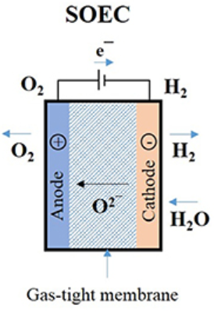
Electrolysis technologies
Solid Oxide Electrolysis Cell (SOEC)
Advantages
Highest electrolysis efficiency
Low capital costs
Possibilities for integration with chemical methanation (heat recycling)
Disadvantages
Very low technology readiness level
Poor lifetime because of high temperature and affected material stability
Limited flexibility; constant load required

Slide 7
Applications
Roughly 0.1 % of global hydrogen production today comes from water electrolysis but with decreasing costs of renewable electricity, there is a growing interest towards electrolytic hydrogen.
IEA analysis finds that the cost of producing hydrogen from renewable electricity could fall 30% by 2030. This could result in increased interest towards renewable energy sources (even in countries that are fully coal dependent).
Renewable hydrogen is under a momentum and numerous policies and projects are happening in every continent.
P2G
Industry applications
Energy applications
Methanation
Ammonia production, steel production, oil refining
Transport, electricity, storage, natural gas

Slide 8
Conclusions
Electrolysis is a process which converts surplus electricity into gases, which can be transported, injected to gas grids or converted back to electricity.
Power to Gas energy system provides methods to use more renewable energy sources due the decreasing renewable electricity prices.
The methods (AEL, PEM & SOEC) vary and are not fully viable but that should change in the future.

Slide 9
Source material used
Sawas, Abdullah (2019): Optimal Sizing of Power–to–Gas Units toward Elevated Renewable Power Penetration IEEE
Robles, J (2018): Hydrogen as a Pillar of the Energy Transition.
Fatih Birol (2018): The Future of Hydrogen: https://www.iea.org/reports/the-future-of-hydrogen
https://www.socalgas.com/clean-energy/renewable-gas/power-to-gas
Götz, M et al. (2016): Renewable Power-to-Gas: A technological and economic review: https://www.sciencedirect.com/science/article/pii/S0960148115301610
Vasconcelos, B & Lavoie, J (2019); Recent Advances in Power-to-X Technology for the Production of Fuels and Chemicals. https://www.frontiersin.org/articles/10.3389/fchem.2019.00392/full?&field&journalName=Frontiers_in_Chemistry&id=454241

