Slide 1
ELEC-E8423 - Smart Grid 8. Thermal heat storages for daily and seasonal use
Siiri Lapila & Maria Wimmer

Slide 2
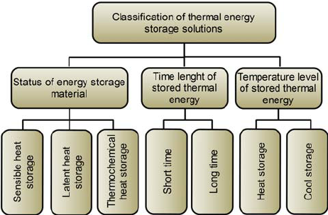
Introduction
Why is thermal storage needed?
Increasing utilization of renewables
Surplus energy can be stored for later use
More flexible energy systems
Flatten demand and price peaks
In gold climates, less expensive option than electrical storages
The benefits when implementing thermal storage in energy system:
better efficiency: achieving a more efficient use of energy
less pollution of the environment and less CO2 emissions
better system performance and reliability.
Definition:
Thermal Energy Storage is the system of
storing heat (cooling) energy for later usage.​

Slide 3
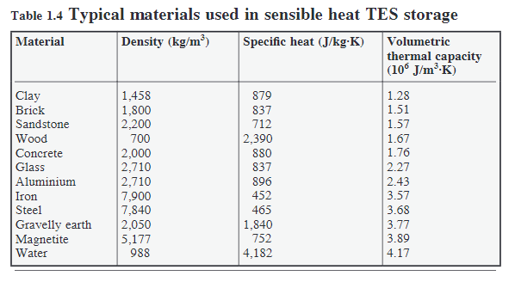
Sensible Heat Storage (SHS)
Sensible heat storage is based on raising temperature of liquid or solid (water, sand, molten salts) to store heat and releasing it when it is required​.
The ability to store sensible heat for a given material strongly depends on the value of its energy density.
→ Thus, high density and heat capacity values are desired. Other important parameters for sensible heat storage materials, are high volumetric thermal capacity, good thermal conductivity, and inexpensive price.

Slide 4
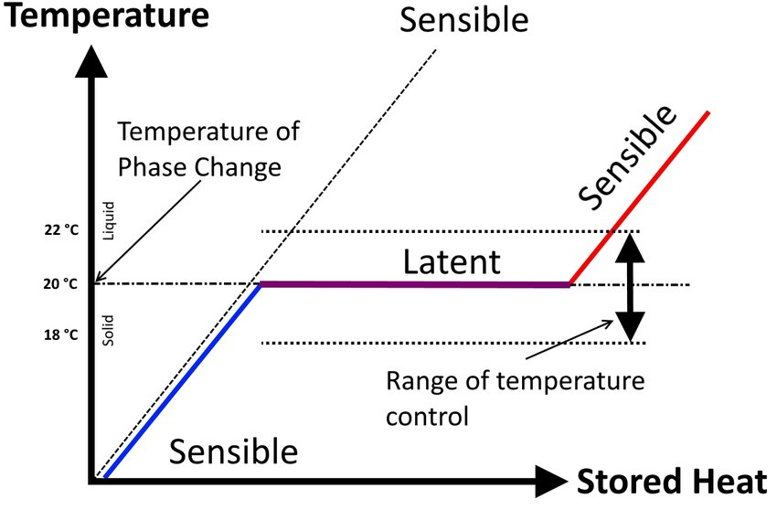
Latent Heat Storage (LHS)
Latent heat storage uses the phase transition of a material. Usually solid–liquid phase change is used, by melting and solidification of a material. Upon melting heat is transferred to the material, storing large amounts of heat at constant temperature. The heat is released when the material solidifies. Materials used for latent heat storage are called Phase Change Materials (PCM).
Phase Change Materials are selected based on suitable phase transition temperature, good heat transfer, small volume change, long-term chemical stability, availability and price.
Notes:
https://www.researchgate.net/figure/Sensible-heat-vs-latent-heat-and-temperature-control-during-the-phase-change-7_fig1_312868057

Slide 5
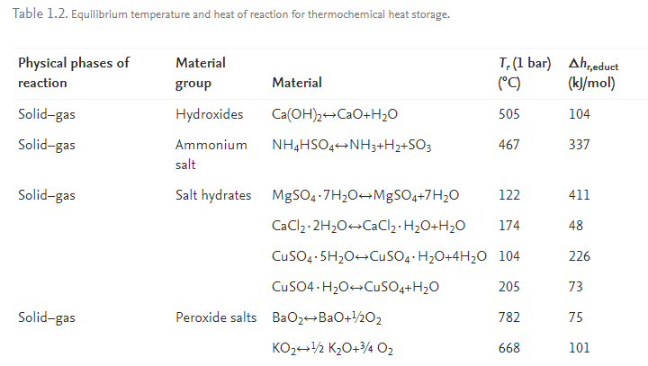
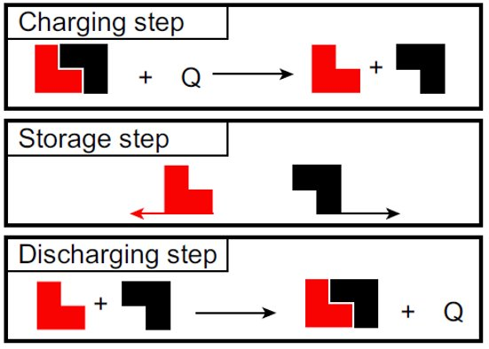
Thermochemical Heat Storage (THS)
Thermochemical heat storage uses thermochemical materials (TCMs) that store and release heat by a reversible endothermic/exothermic reaction process.​
Thermochemical storage is divided between chemical reactions and sorption systems
During the charging process, heat is applied to the material A, which results to a separation of two parts B + C.​
Product B and C are stored separately​
When energy is needed, product B and C are combined

Slide 6
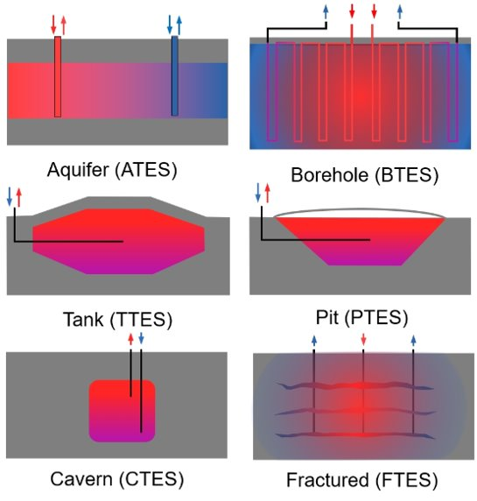
Daily and Seasonal Storage
Seasonal Storage technologies
Charging during summer, discharging during winter
Underground thermal storage (boreholes, cavern storage, construction based technologies )(sensible)
Surface and above (pit storage, earth-bermed buildings, large-scake thermal storage with water)
Daily Storage technologies
- Water tanks (sensible)
Heat pumps
Molten Salt (sensible)
Notes:
Selitys ja esimerkit

Slide 7
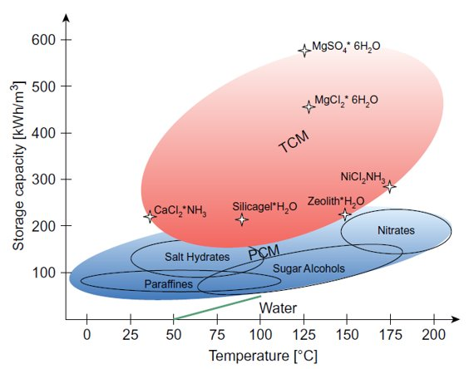
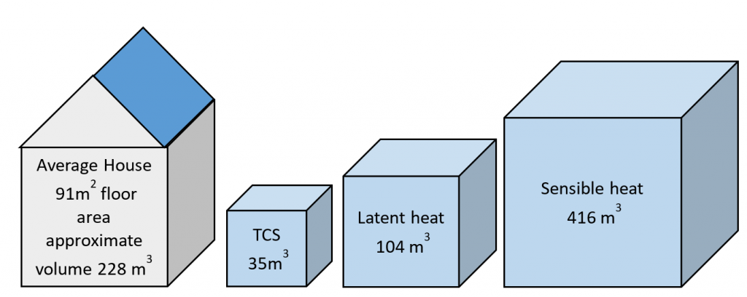
Characterics of Storage Systems
Sensible heat storage
Pros:
Low costs, 0,1-10 €/kWh
High temperature ranges
Thermally stable
Daily and seasonal storage
Cons:
Large volumes required
Mostly low efficiencies
Latent heat storage
Pros:
10-50 €/kWh
Daily and seasonal storage
Storage occurs in small temperature variation
Cons:
High risk of leakage
Organic PMC flammable
Inorganic PMC corrosive
Low thermal conductivity
Thermochemical heat storage
Pros:
High storage capacity
High temperatures
Low heat loss
Mainly seasonal storage
Cons:
High costs, 8-100 €/kWh
Low reliability
Potential toxicity
Issues about recyclability
Storage capacities of PCM and TCM compared to water
Storage density

Slide 8
Thermal Heat Storages and Smart Grid
Energy storages have an impact to smart grids function
Flexible energy storing
Smart grid is precondition for decentralised generation
Thermal heat storages are needed to integrate renewables into power system
Demand and electricity peaks reduction
Enhanching the efficiency of energy system

Slide 9
Conclusions
Thermal energy storages have a key role when ….
Thermal energy storages can be divided to sensible, latent and thermochemical technologies
Storages can be daily or seasonal
Energy storages are requirement to further utilization of RES
More efficient energy system
Demand and price peak reduction

Slide 10
Source Material Used
https://www.researchgate.net/figure/Classification-of-thermal-energy-storage-technology-based-on-the-criterion-of-the-state_fig2_272179305
https://www.sciencedirect.com/topics/engineering/latent-heat-storage
http://energystoragehub.org/technologies/thermal/thermal-storage/
https://www.researchgate.net/figure/Sensible-heat-vs-latent-heat-and-temperature-control-during-the-phase-change-7_fig1_312868057
A Comprehensive Review of Thermal Energy Storage
https://www.rakennaoikein.fi/aalto-yliopisto-kaukolampo-voidaan-tuottaa-taysin-ilman-fossiilisia-130078/uutiset.html
https://www.sciencedirect.com/topics/engineering/thermochemical-energy-storage
Thermal Energy Storage for Grid Applications: Current Status and Emerging Trends
Presentations from previous years (2019/2020)

