Slide 1
ELEC-E8423 - Smart Grid Fuel cells as a part of power system
Jens Sandvik & Miika Kokkonen
31.03.2020

Slide 2
Introduction
What are fuel cells and how do they work
Fuel cell technologies
Hydrogen
Fuel cell use cases
Pros and Cons
Outlook of the industry

Slide 3
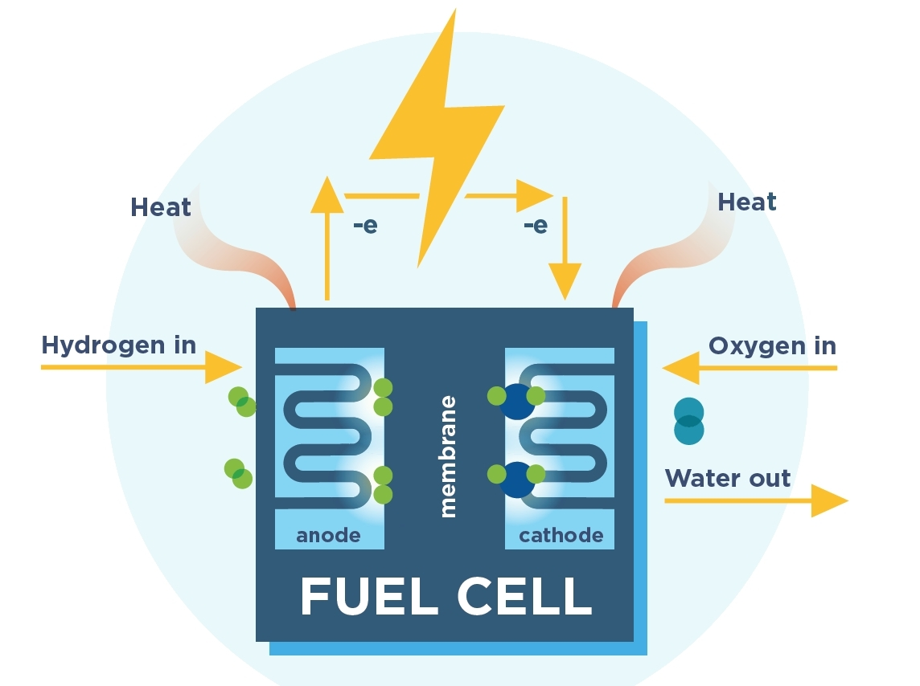
Fuel Cell
Uses the chemical energy of a fuel to produce electricity
No emissions or air pollutants
Have very few moving parts
Can be made almost infinitely small

Slide 4
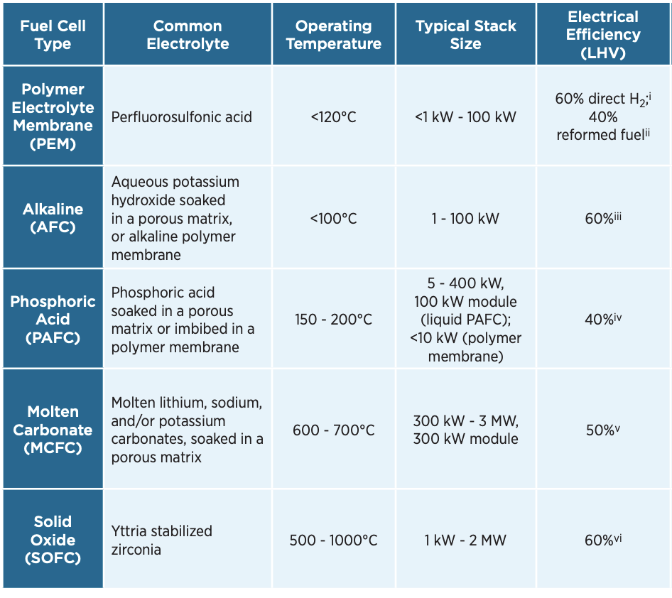
Fuel Cell Technology
Efficiency around 40 to 60 %
Operating temperatures differ a lot
Cells can be stacked
PEMFC and SOFC are most commonly used

Slide 5
Hydrogen Production
Steam reforming and coal gasification
70-85% efficiency
1-3 $/kg price range
Electrolysis
70-80% efficiency
6-8 $/kg price range
70 million tonnes of hydrogen produced annually
95% comes from fossil fuels

Slide 6
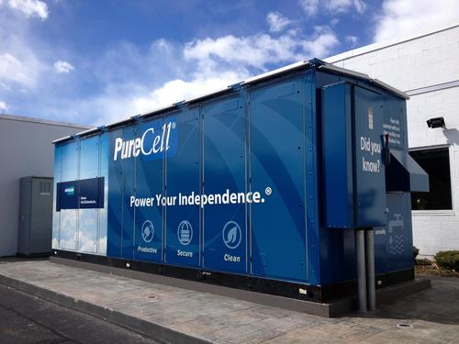
Use cases
Transportation
Stationary power
Primary power, backup power, or CHP
Other application
Portable power
Unmanned aerial vehicles UAVs

Slide 7
Pros
"Emission free"
Long term storage capabilities
Small-scale applications

Slide 8
Cons
Infrastructure
Expensive production
Regulatory support

Slide 9
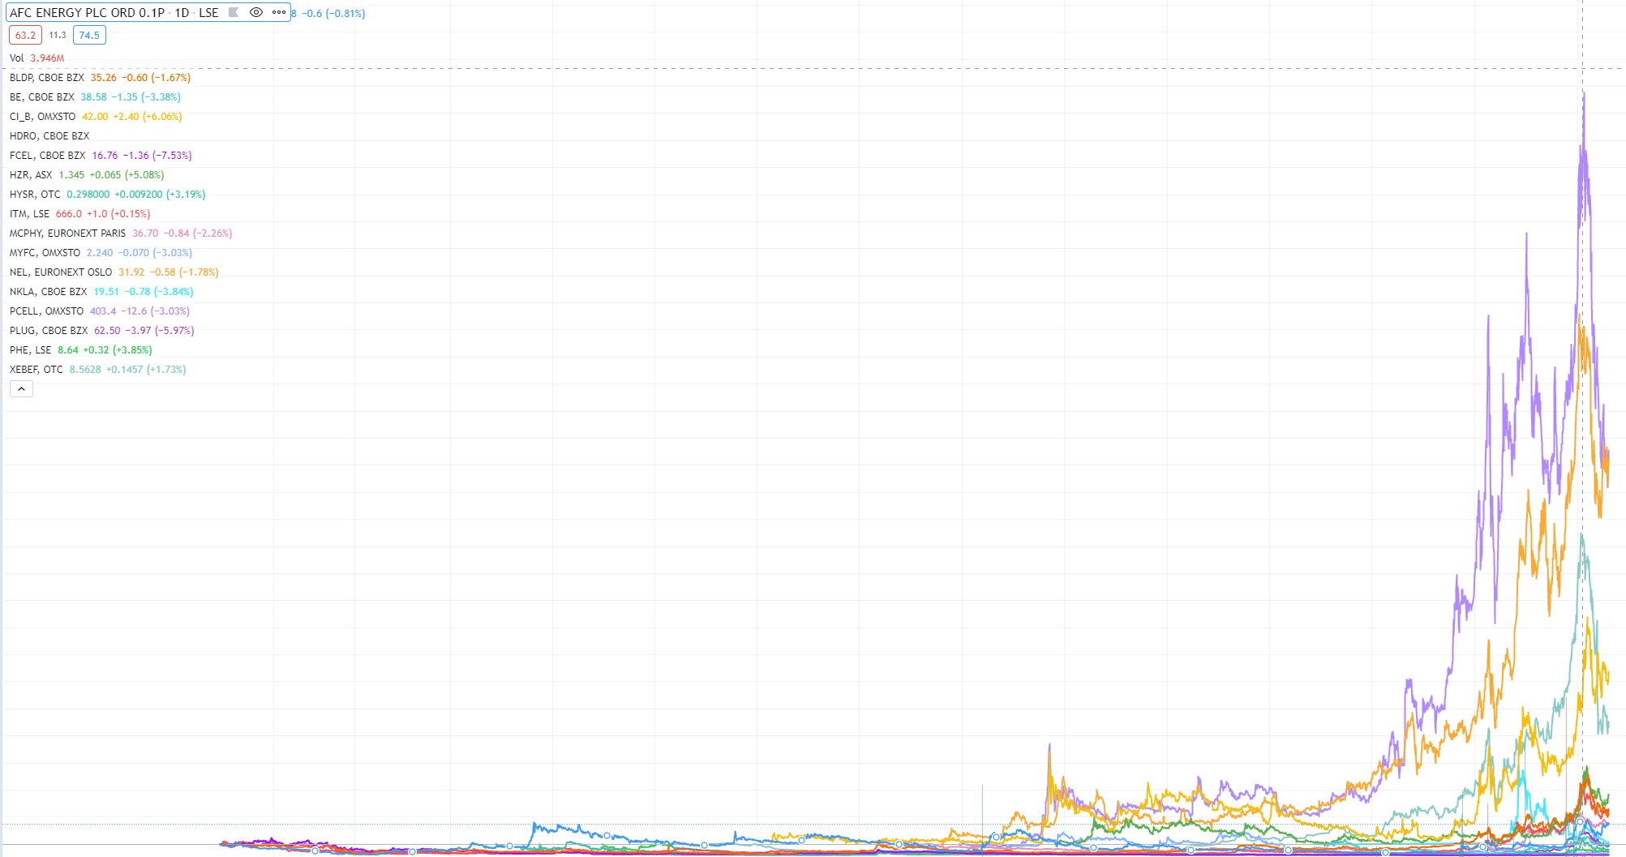
Fuel cell industry picking up interest

Slide 10
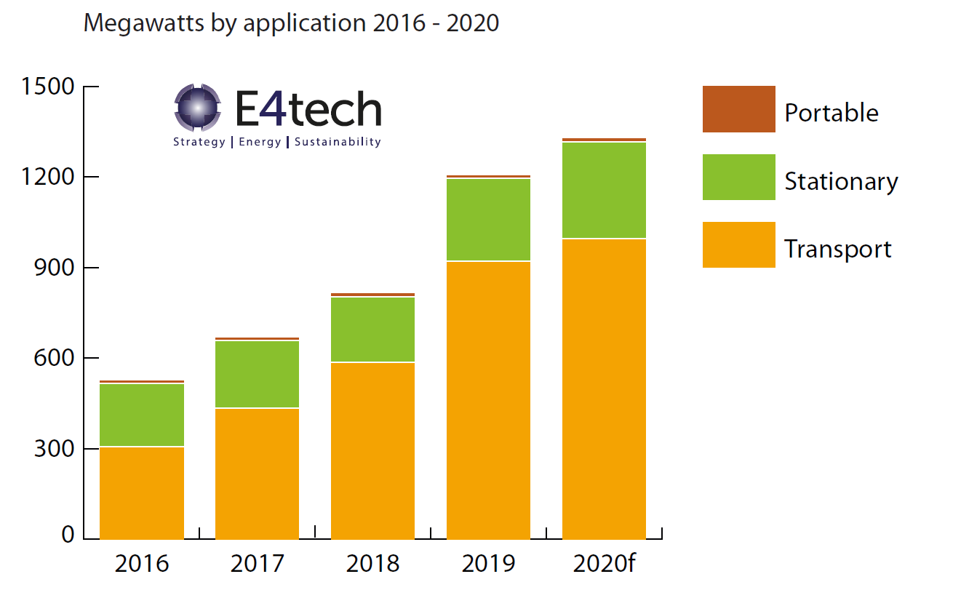
Adaptation by application

Slide 11
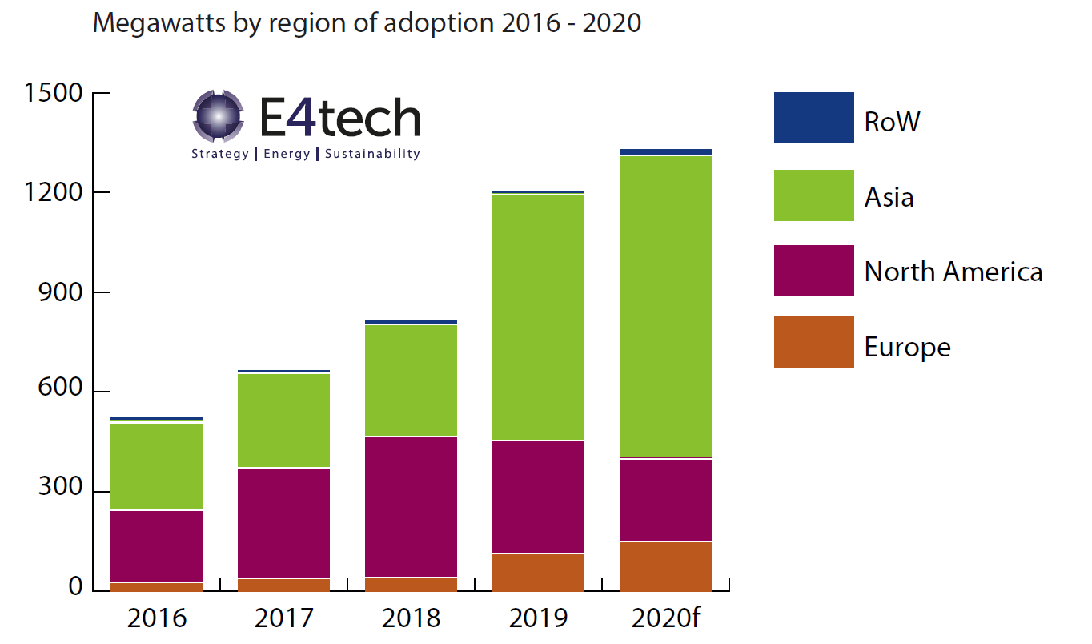
Adaptation by region

Slide 12
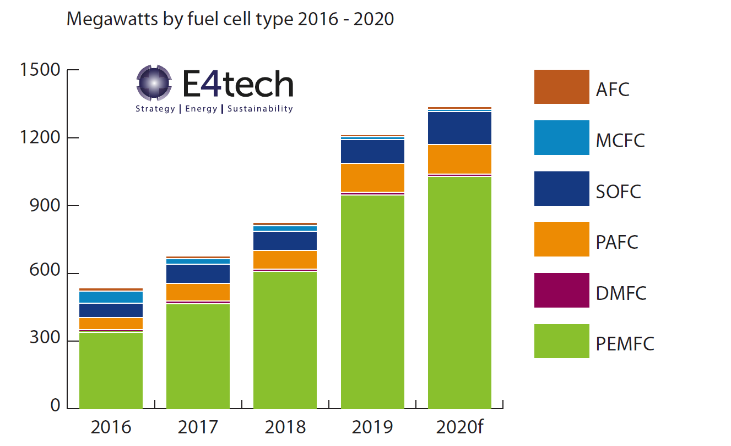
Adaptation by type

Slide 13
Closer look at transportation
Refuelling stations | FC Buses
Region | Current | Targets | Estimates / Targets
South Korea | 43 | 2020 – 310 | 2020 – 2,000 2040 – 40,000
Japan | 133 | 2020 – 160 2025 – 320 | 2030 – 1200
China | 37 | 2020 – 100 | 2020 – +3600
California | 42 | 2020 – 64 2025 – 200 | 2020 – 65 (whole NA)
Germany | ~81 | 2020 – 100 | -
Europe | ~160 | - | 2021 – 350 2030 – 8,000-17,000

Slide 14
Conclusions
Fuel cells are still in early stages where infrastructure, cost reductions and cleaner hydrogen production are needed. Solving them have the potential to push fuel cell technology from early adoption phase to maturity.
Transportation is the leading fuel cell application and Asia the leading region.
Net-zero targets globally have boosted fuel cell adoption.

Slide 15
Source material used
https://fuelcellindustryreview.com/ https://www.iea.org/events/power-system-flexibility-campaign-hydrogen-and-the-role-of-synthetic-fuels-in-power-system-flexibility
https://www.energy.gov/sites/default/files/2017/05/f34/fcto_myrdd_fuel_cells.pdf
https://fuelcellsworks.com/knowledge/applications/
https://www.energy.gov/eere/fuelcells/fuel-cells
https://www.fchea.org/fuelcells

