Slide 1

Sulforaphane (1-isothiocyanato-4-methylsulfinylbutane) and its derivatives

Slide 2
Motivation
Review from March 2021.
KEAP1/NRF2
Alzheimer, Parkinson and Huntigton diseases, traumatic brain and spinal cord contusion injury, stroke, depression and multiple sclerosis.

Slide 3
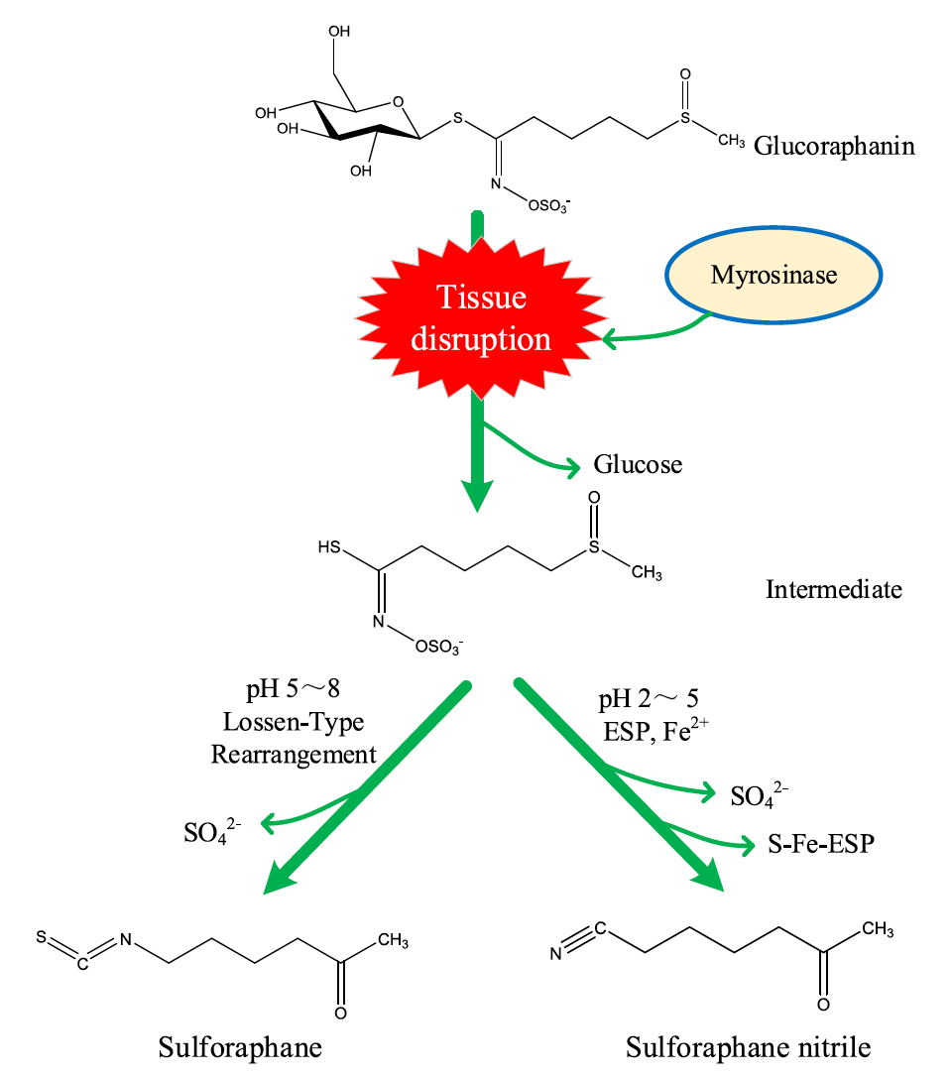
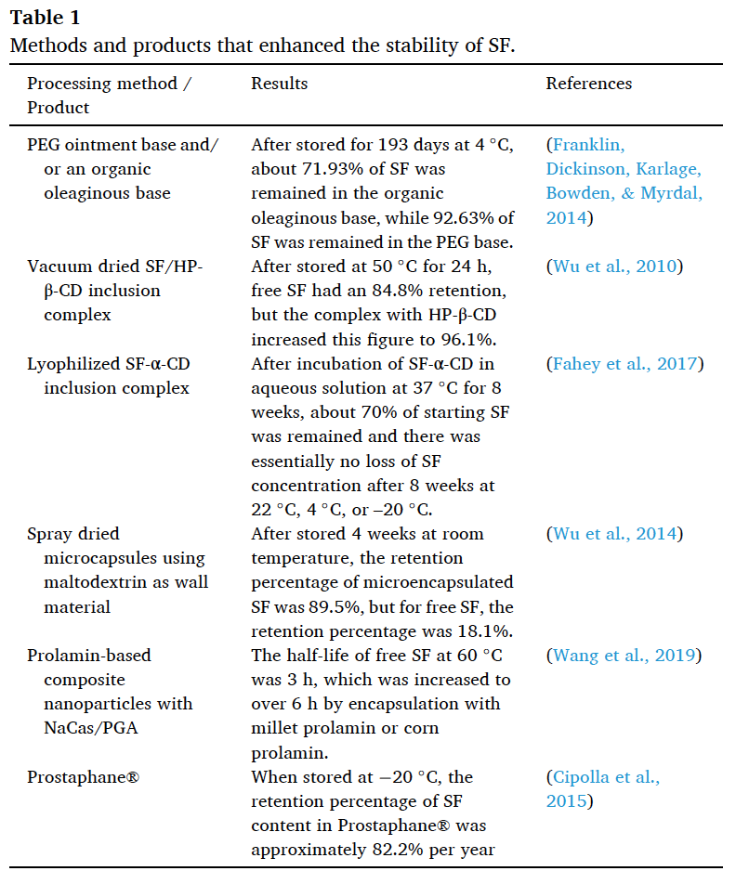

Slide 4

SFX-01
α- cyclodextrin complex of sulforaphane - Evgen Pharma
  Dry powder -
  Breast cancer and subarachnoid haemorrhage
  COVID-19

Slide 5
Functionalities
Most studied.
Central S connected to isothicyanato group with unbranched alkyl chain.
Need two functional groups to work.
Replacing sulfoxide with phosphonate gave almost equal activity.

Slide 6
Staudinger and aza-Wittig

Slide 7
Staudinger and aza-Wittig

Slide 9
Further studies with phosphor

Slide 10
Best activity

Slide 11
Best yield

