Slide 1
Marketing Analytics
Prof. Robert Kreuzbauer
Assoc. professor in marketing
Surrey business school
19_april_2021
Notes:
Robert

Slide 2
Teaching team
Prof. Robert Kreuzbauer
Course instructor
Contact (use this email!!!!!): robert.kreuzbauer@gmail.com
Anna Denisova
Teaching assistant
Contact: anna.denisova@aalto.fi
Valeriy Neznakhin
Teaching assistant
Contact: valeriy.neznakhin@aalto.fi

Slide 3
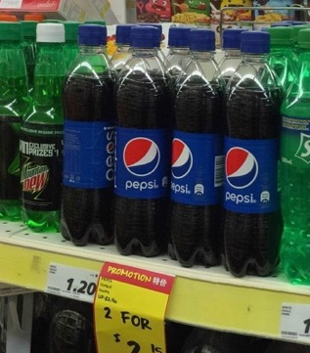
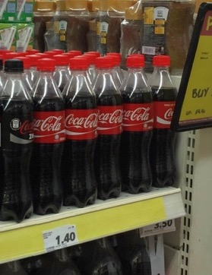
Can you really taste the difference?
S$ 1.20
S$ 1.40

Slide 4
What about competition?

Slide 5
Good old-fashioned Price-Value Ratios
Price
1.70c
1.60c
0.90c
Value

Slide 6
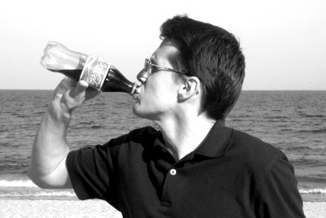
Don’t think like a consumer
Happy ☺
A lot of cool advertising
Company
Products

Slide 7
Think like a manager!
Costs/Benefits
Search costs
=
Price
Benefit
(thirst-quenching, experience, etc.)
Costs

Slide 8
Marketing Mix = 4Ps (Product, Price, Promotion, Place (i.e. Distribution)

Slide 9
Technology
Collaborators
Resources
4Ps + STP
Competitor(s)
dynamic
WTP
Customers
A marketing strategy is an integrated set of choices about how we will create and capture value, over long periods of time.

Slide 10
Four Cs of marketing strategy
Customer Value: What your customers want?
Competition: How your competitors react?
Collaborators: Will your collaborators collaborate?
Costs: Do I have the money for all this?

Slide 11
Consumer Research Study

Slide 12
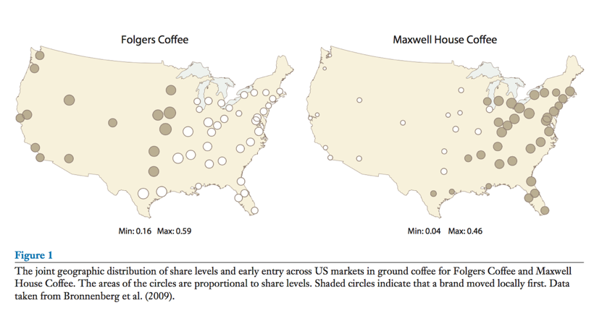
Consumer Research Study
Bronnenberg & Dube, 2017

Slide 13
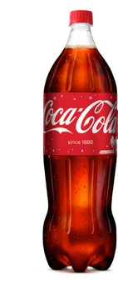
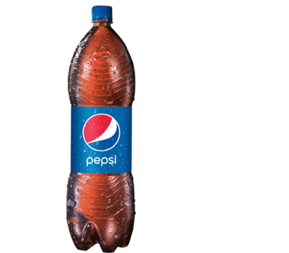
Game-theoretic mindset

Slide 14
Marketing Analytics is mainly about finding out…
…what your customers want
…how to most efficiently deliver it to them
Examples:
Which ice cream?
Which movie?
Examples:
Features for an action camera
How to price Pampers diapers
Sell Canada Goose jackets online or in shops
How much ads on FB or radio?

Slide 15
Marketing Analytics is mainly about finding out…
…what your customers want
…how to most efficiently deliver it to them
Main method: Cluster analysis
Individual analysis
Machine learning
Statistical modeling
(mainly regression)
Mathematical modeling

Slide 16
Pedagogical philosophy
Teach marketing analytics as a tool-box to solve practical problems not as a form of rocket science
Focus on main analytical tools
Hand-calculation (Excel and not R!!!)
Basis for future self-teaching

Slide 17
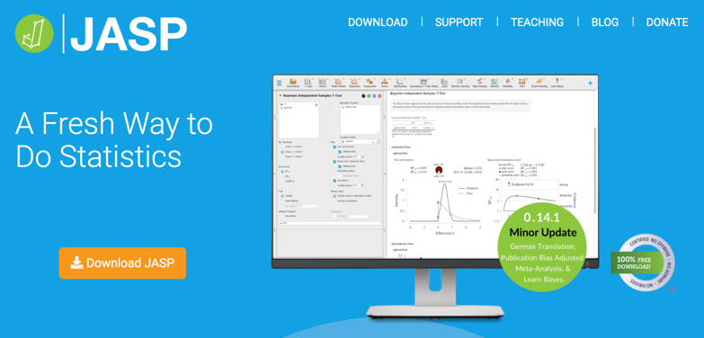
Free Software
https://www.youtube.com/watch?v=HxqB7CUA-XI&t=231s
https://www.youtube.com/watch?v=bVR3LrmfNYA

Slide 18
Recommended textbooks
Better for theory
Better for analysis

Slide 19
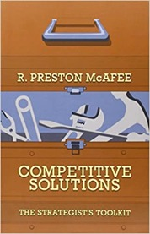
Other recommended readings

Slide 20
Learning objectives
Will you learn skills…
…to become a better marketer?
…to be equipped to work as a marketing research consultant?
…to perform the marketing analytics for your own company?
…to create the most sophisticated recommender Netflix-algorithm?

Slide 21
Expectations
100% focus & attention
Active participation
Basic knowledge in statistics (p-value, correlation, R²…)

Slide 22
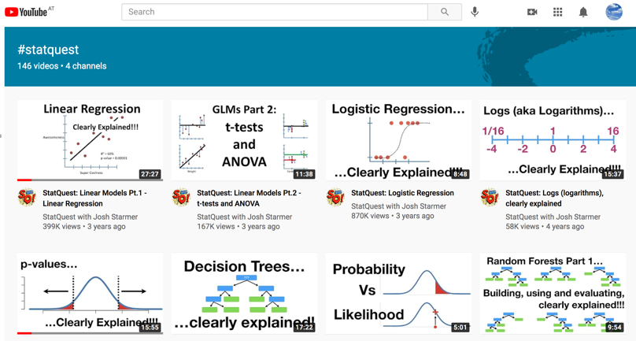
Recommended Tutorials for Basic Statistics
https://www.youtube.com/watch?v=5Z9OIYA8He8

Slide 23
Assignments (small changes may occur)
Exercises (50)
Groups of 4-5 students will have to submit 3-5 exercises
Students can work on the exercises during exercise classes
Deadline: 2 weeks after handed out to students
Two max 1.5hs exams (50)
Exam 1:
Date: 3. May 2021 (exact time tbd.)
Format: Short answer questions, MCQs, calculations
Cluster analysis
Exam 2:
Date: 17. May 2021 (exact time tbd.)
Format: Short answer questions, MCQs, calculations
Regression analysis

Slide 24
Schedule (small changes may occur)
Class (19. April 2021): Cluster analysis I
Class (19. April 2021): Cluster analysis II
Class (19. April 2021): Regression analysis I (Conjoint analysis)
Class (19. April 2021): Regression analysis I (Pricing and advertising strategies)
Class (19. April 2021): Forecasting (Bass-model of Diffusion; Recommender systems)

Slide 25
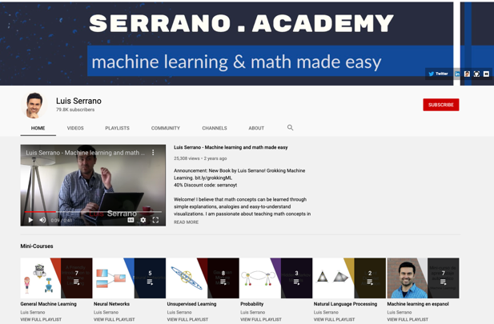
Customer Segmentation & Targeting
https://www.youtube.com/watch?v=QXOkPvFM6NU&list=RDCMUCgBncpylJ1kiVaPyP-PZauQ&index=1

