Slide 1
Marketing Analytics
Prof. Robert Kreuzbauer
Assoc. professor in marketing
Surrey business school
19_april_2021
Notes:
Robert

Slide 2
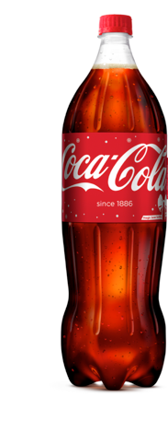
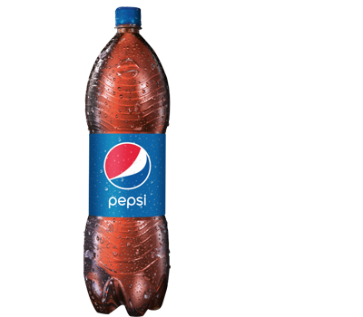
Can you really taste the difference?

Slide 3
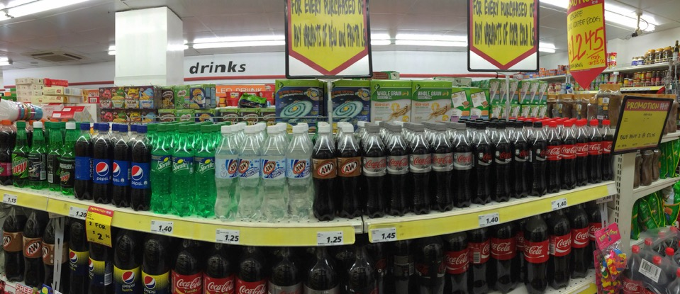
Can you really taste the difference?

Slide 4
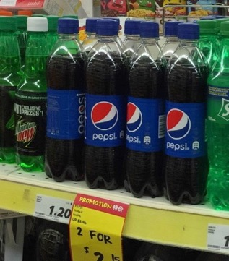
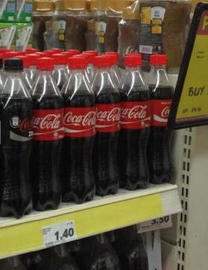
Can you really taste the difference?
S$ 1.20
S$ 1.40

Slide 5
Which one would you buy?
£1
£1.6

Slide 6
Which one would you buy?
£1
£1

Slide 7
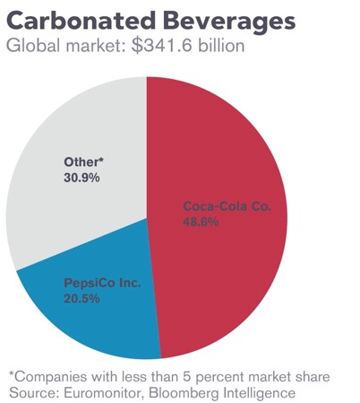
Which one would you buy?

Slide 8
How does this all make sense?
Coke tastes similar to Pepsi
Coke costs more
Coke has higher market share
Coke must be “special” ☺

Slide 9
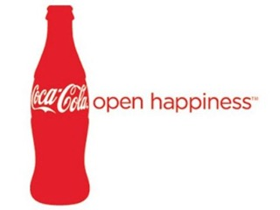
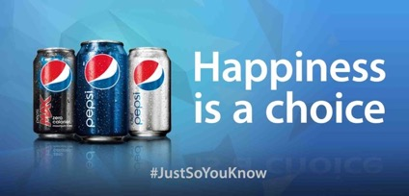
Let’s look at some examples

Slide 10
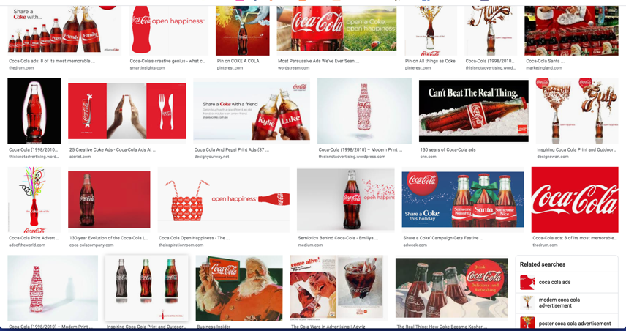
Let’s look at some examples

Slide 11
What about competition?
There is one ice cream shop on the beach
Sells vanilla ice cream for EUR 2
Should you open another one?
Which price? (cost = EUR 1.4)

Slide 12
Some illustrative examples
+30%
4Cs (Color, Clarity, Cut, Carat)

Slide 13
Good old-fashioned Price-Value Ratios
Price
1.70c
1.60c
0.90c
Value

Slide 14
Good old-fashioned Price-Value Ratios
Price
1.70c
1.60c
Level of uncertainty to get a particular quality
Value

Slide 15
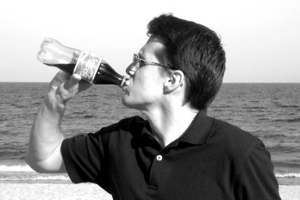
Don’t think like a consumer
Happy ☺
A lot of cool advertising
Company
Products

Slide 16
Think like a manager!
Costs/Benefits
Search costs
=
Price
Benefit
(thirst-quenching, experience, etc.)
Costs

Slide 17
Marketing Mix = 4Ps (Product, Price, Promotion, Place (i.e. Distribution)

Slide 18
Technology
Collaborators
Resources
4Ps + STP
Competitor(s)
dynamic
WTP
Customers
A marketing strategy is an integrated set of choices about how we will create and capture value, over long periods of time.

Slide 19
Four Cs of marketing strategy
Customer Value: What your customers want?
Competition: How your competitors react?
Collaborators: Will your collaborators collaborate?
Costs: Do I have the money for all this?

Slide 20
Consumer Research Study

Slide 21
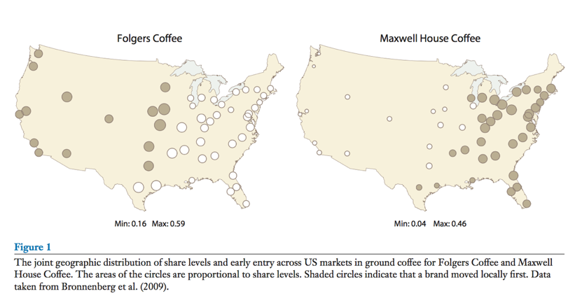
Consumer Research Study
Bronnenberg & Dube, 2017

Slide 22
Game-theoretic mindset

Slide 23
Marketing Analytics is mainly about finding out…
…what your customers want
…how to most efficiently deliver it to them
Examples:
Which ice cream?
Which movie?
Examples:
Features for an action camera
How to price Pampers diapers
Sell Canada Goose jackets online or in shops
How much ads on FB or radio?

Slide 24
Marketing Analytics is mainly about finding out…
…what your customers want
…how to most efficiently deliver it to them
Main method: Cluster analysis
Individual analysis
Machine learning
Statistical modeling
(mainly regression)
Mathematical modeling

Slide 25
Pedagogical philosophy
Teach marketing analytics as a tool-box to solve practical problems not as a form of rocket science
Focus on main analytical tools
Hand-calculation (Excel and not R!!!)
Basis for future self-teaching

Slide 26
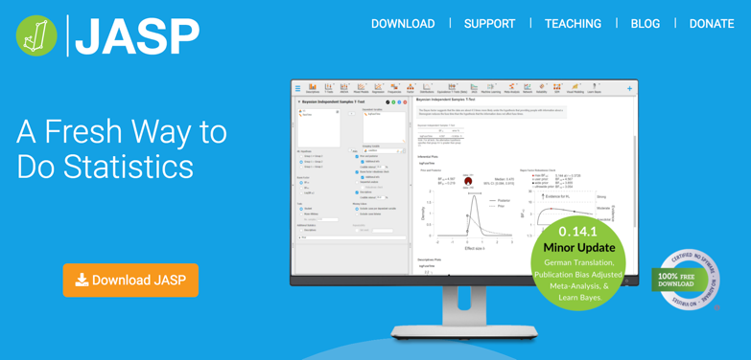
Free Software
https://www.youtube.com/watch?v=HxqB7CUA-XI&t=231s
https://www.youtube.com/watch?v=bVR3LrmfNYA

Slide 27
Recommended textbooks
Better for theory
Better for analysis

Slide 28
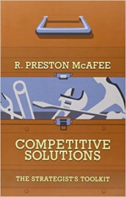
Other recommended readings

Slide 29
Expectations
100% focus & attention (attendance is mandatory)
Active participation
Basic knowledge in statistics (p-value, correlation, R²…)

Slide 30
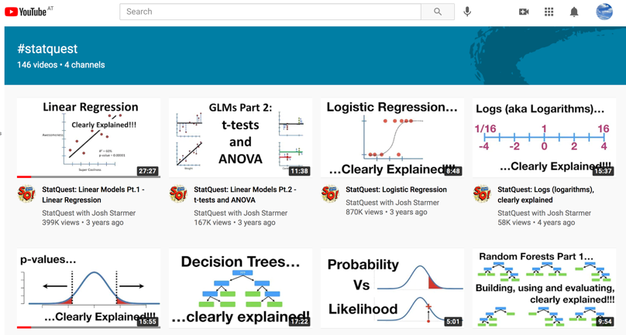
Recommended Tutorials for Basic Statistics
https://www.youtube.com/watch?v=5Z9OIYA8He8

Slide 31
Assignments (small changes may occur)
Exercises (50)
Groups of 4-5 students will have to submit 3-5 exercises
Students can work on the exercises during exercise classes
Deadline: 2 weeks after handed out to students
Two max 1.5hs exams (50)
Exam 1:
Date: 3. May 2021 (exact time tbd.)
Format: Short answer questions, MCQs, calculations
Cluster analysis
Exam 2:
Date: 17. May 2021 (exact time tbd.)
Format: Short answer questions, MCQs, calculations
Regression analysis

Slide 32
Schedule (small changes may occur)
Class (19. April 2021): Cluster analysis I
Class (19. April 2021): Cluster analysis II
Class (19. April 2021): Regression analysis I (Conjoint analysis)
Class (19. April 2021): Regression analysis I (Pricing and advertising strategies)
Class (19. April 2021): Forecasting (Bass-model of Diffusion; Recommender systems)

Slide 33
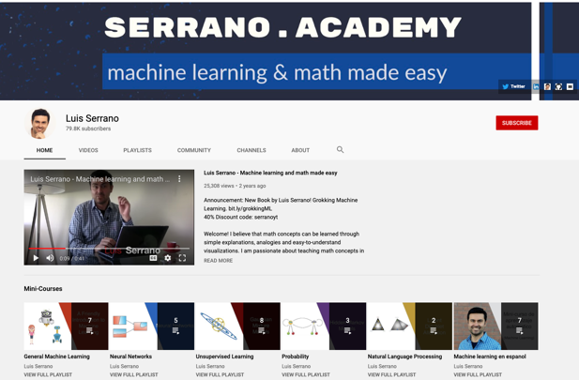
Customer Segmentation & Targeting
https://www.youtube.com/watch?v=QXOkPvFM6NU&list=RDCMUCgBncpylJ1kiVaPyP-PZauQ&index=1

Slide 34
Customer Segmentation & Targeting
Goal: Company (Netflix) wants to understand what are their main consumer segments
Let’s assume we have only two kinds of information (variables): Age & Days per week spent to watch Netflix videos
Age: 42
Time: 7
Age: 18
Time: 3
Age: 23
Time: 2
Age: 49
Time: 1
Age: 37
Time: 7
Age: 51
Time: 1
Age: 40
Time: 6
Age: 20
Time: 4
Source: Serrano, 2019

Slide 35
Customer Segmentation & Targeting
Days per week watching Netflix
Segment 2
7
Age: 37
Time: 7
Age: 42
Time: 7
6
Segment 1
5
Age: 40
Time: 6
4
3
Age: 20
Time: 4
Segment 3
2
Age: 18
Time: 3
Age: 23
Time: 2
1
Age: 49
Time: 1
Age: 51
Time: 1
Age
20
30
40
50
Source: Serrano, 2019

Slide 36
Customer Segmentation & Targeting
Y
v
v
v
X
Source: Serrano, 2019

Slide 37
Customer Segmentation & Targeting
Y
v
v
v
X
Source: Serrano, 2019

Slide 38
Customer Segmentation & Targeting
Y
v
v
v
X
Source: Serrano, 2019

Slide 39
Customer Segmentation & Targeting
Y
v
v
v
X
Source: Serrano, 2019

Slide 40
Customer Segmentation & Targeting
Y
v
v
v
X
Source: Serrano, 2019

Slide 41
Customer Segmentation & Targeting
How do we know the right number and size of segments (clusters)
Cluster analysis:
K-Means clustering method
Hierarchical clustering method

Slide 42
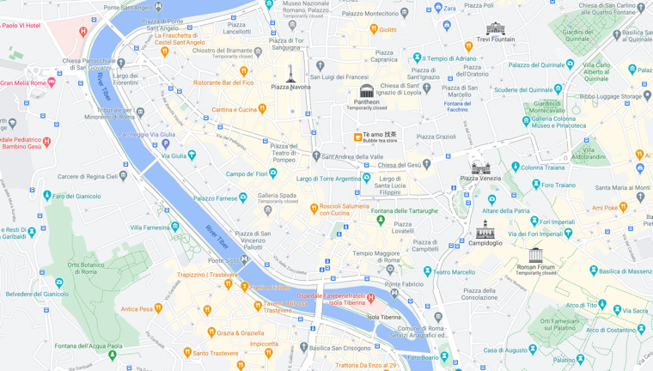
K-means clustering method
Assume you want to place 3 ice-cream shops in a city
v
v
v
Source: Serrano, 2019

Slide 43
K-means clustering method
Assume you want to place 3 ice-cream shops in a city
v
v
v
Source: Serrano, 2019

Slide 44
K-means clustering method
Assume you want to place 3 ice-cream shops in a city
v
v
v
Source: Serrano, 2019

Slide 45
K-means clustering method
Assume you want to place 3 ice-cream shops in a city
v
v
v
Source: Serrano, 2019

Slide 46
K-means clustering method
Assume you want to place 3 ice-cream shops in a city
v
v
v
Source: Serrano, 2019

Slide 47
K-means clustering method
Assume you want to place 3 ice-cream shops in a city
v
v
v
Source: Serrano, 2019

Slide 48
K-means clustering method
Assume you want to place 3 ice-cream shops in a city
v
v
v
Source: Serrano, 2019

Slide 49
K-means clustering method
Assume you want to place 3 ice-cream shops in a city
v
v
v
Source: Serrano, 2019

Slide 50
K-means clustering method
Assume you want to place 3 ice-cream shops in a city
v
v
v
Source: Serrano, 2019

Slide 51
K-means clustering method
Assume you want to place 3 ice-cream shops in a city
v
v
v
Source: Serrano, 2019

Slide 52
K-means clustering method
Assume you want to place 3 ice-cream shops in a city
v
v
v
Source: Serrano, 2019

Slide 53
K-means clustering method
How do we know how many clusters?
→ Elbow-method

Slide 54
K-means clustering method
1 cluster
2 cluster
3 cluster
v
v
v
v
v
v
v
v
v
4 cluster
5 cluster
6 cluster
v
v
v
v
v
v
v
v
v
Source: Serrano, 2019

Slide 55
K-means clustering method
1 cluster
2 cluster
3 cluster
v
v
v
v
v
v
v
v
v
4 cluster
5 cluster
6 cluster
v
v
v
v
v
v
v
v
v
Source: Serrano, 2019

Slide 56
K-means clustering method
Distance
3 cluster
v
v
v
Clusters
1
2
3
4
5
6
Source: Serrano, 2019

Slide 57
Customer Segmentation & Targeting
How do we know the right number and size of segments (clusters)
Cluster analysis:
K-Means clustering method
Hierarchical clustering method

Slide 58
Hierarchical clustering method
Assume you want to place 3 ice-cream shops in a city
v
Source: Serrano, 2019

Slide 59
Hierarchical clustering method
Assume you want to place 3 ice-cream shops in a city
v
Source: Serrano, 2019

Slide 60
Hierarchical clustering method
Assume you want to place 3 ice-cream shops in a city
v
Source: Serrano, 2019

Slide 61
Hierarchical clustering method
Assume you want to place 3 ice-cream shops in a city
v
Source: Serrano, 2019

Slide 62
Hierarchical clustering method
Assume you want to place 3 ice-cream shops in a city
v
Source: Serrano, 2019

Slide 63
Hierarchical clustering method
Assume you want to place 3 ice-cream shops in a city
v
Source: Serrano, 2019

Slide 64
Hierarchical clustering method
Assume you want to place 3 ice-cream shops in a city
v
Source: Serrano, 2019

Slide 65
Hierarchical clustering method
Assume you want to place 3 ice-cream shops in a city
v
Source: Serrano, 2019

Slide 66
Hierarchical clustering method
Assume you want to place 3 ice-cream shops in a city
v
Source: Serrano, 2019

Slide 67
Hierarchical clustering method
Assume you want to place 3 ice-cream shops in a city
v
Source: Serrano, 2019

Slide 68
Hierarchical clustering method
Assume you want to place 3 ice-cream shops in a city
v
Source: Serrano, 2019

Slide 69
Hierarchical clustering method
Assume you want to place 3 ice-cream shops in a city
v
Source: Serrano, 2019

Slide 70
Hierarchical clustering method
Assume you want to place 3 ice-cream shops in a city
v
Source: Serrano, 2019

Slide 71
Hierarchical clustering method
Assume you want to place 3 ice-cream shops in a city
v
Source: Serrano, 2019

Slide 72
Hierarchical clustering method
How do we know how many clusters?
→ Dendrogram-method

Slide 73
Dendrogram
Distance
8
v
3
6
7
1
2
4
5
1
2
3
4
5
6
7
8
Source: Serrano, 2019

Slide 74
Dendrogram
Distance
8
v
3
6
7
1
2
4
5
1
2
3
4
5
6
7
8
Source: Serrano, 2019

Slide 75
Dendrogram
Distance
8
v
3
6
7
1
2
4
5
1
2
3
4
5
6
7
8
Source: Serrano, 2019

Slide 76
Dendrogram
Distance
8
v
3
6
7
1
2
4
5
1
2
3
4
5
6
7
8
Source: Serrano, 2019

Slide 77
Dendrogram
Distance
8
v
3
6
7
1
2
4
5
1
2
3
4
5
6
7
8
Source: Serrano, 2019

Slide 78
Dendrogram
Distance
8
v
3
6
7
1
2
4
5
1
2
3
4
5
6
7
8
Source: Serrano, 2019

Slide 79
Dendrogram
Distance
8
v
3
6
7
1
2
4
5
1
2
3
4
5
6
7
8
Source: Serrano, 2019

Slide 80
Dendrogram
Distance
8
v
3
6
7
1
2
4
5
1
2
3
4
5
6
7
8
Source: Serrano, 2019

Slide 81
Dendrogram
Distance
8
v
3
6
7
1
2
4
5
1
2
3
4
5
6
7
8
Source: Serrano, 2019

Slide 82
Dendrogram
Distance
8
v
3
6
7
1
2
4
5
1
2
3
4
5
6
7
8
Source: Serrano, 2019

Slide 83
Dendrogram
Distance
8
v
3
6
7
1
2
4
5
1
2
3
4
5
6
7
8
Source: Serrano, 2019

Slide 84
Dendrogram
Distance
8
v
3
6
7
1
2
4
5
1
2
3
4
5
6
7
8
Source: Serrano, 2019

Slide 85
Dendrogram
Distance
8
v
3
6
7
1
2
4
5
1
2
3
4
5
6
7
8
Source: Serrano, 2019

Slide 86
Dendrogram
Distance
8
v
3
6
7
1
2
4
5
1
2
3
4
5
6
7
8
Source: Serrano, 2019

