Slide 1
Marketing Analytics
Prof. Robert Kreuzbauer
Assoc. professor in marketing
Surrey business school
3_may_2021
Notes:
Robert

Slide 2
Today’s class
How to estimate demand functions
How to design pricing strategies

Slide 3
Importance of pricing
Question: Assume you grant a 10% discount. How much more products do you have to sell (in our example) to achieve the same profit?
Price, Costs
price 100
price 90
costs 80
Profit
0
q1
Sales

Slide 4
Importance of pricing
Question: Assume you grant a 10% discount. How much more products do you have to sell (in our example) to achieve the same profit?
Price, Costs
price 100
100%
price 90
costs 80
Profit
0
q1
2 x q1
Sales

Slide 5
Let’s begin with a simple example
Price 75 EUR
Demand 5000 per year
Cost per unit 59 EUR
Price elasticity 2%

Slide 6
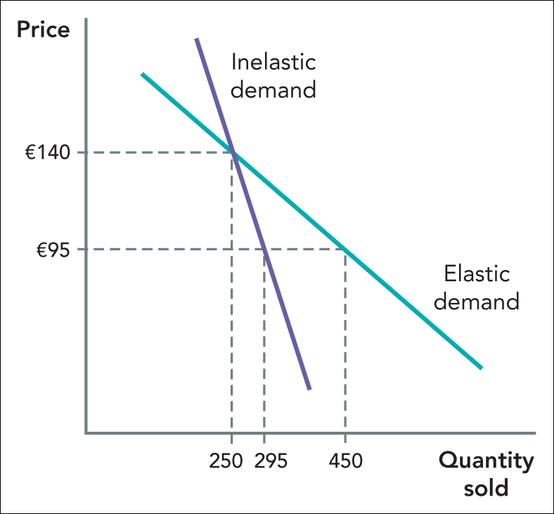
Price elasticity

Slide 7
Price elasticity

Slide 8
Price discrimination

Slide 9
Price discrimination
Different levels of price sensitivity

Slide 10
Price discrimination
P
p2
p1
D
Q
q2
q1
Total revenue = p1*q1 + p2*q2 – p1*q2

Slide 11
Price Bundling

