Slide 1
Marketing Analytics
Prof. Robert Kreuzbauer
Assoc. professor in marketing
Surrey business school
10_may_2021
Notes:
Robert

Slide 2
Today’s class
Linear regression refresher
Conjoint Analysis: A Tool for Estimating Consumer Value

Slide 3
Regression refresher
https://www.youtube.com/watch?v=nk2CQITm_eo
y dependent variable (mouse weight)
y dependent variable (mouse weight)
R² = 0.82
R² = 0.62
x independent variable (mouse size)
x independent variable (mouse size)

Slide 4
Regression refresher
y dependent variable (mouse weight)
y dependent variable (mouse weight)
p = < 0.05
p = < 0.25
x independent variable (mouse size)
x independent variable (mouse size)

Slide 5
Regression refresher
y dependent variable (mouse weight)
slope of the trend line
y = 0.1 + 0.24x
y-intercept when trend line has x = 0
x independent variable (mouse size)

Slide 6
Regression refresher
y dependent variable (mouse weight)
z independent variable (mouse tail length)
y = 0.1 + 0.24x + 1.03z
x independent variable (mouse size)
R² = 0.85

Slide 7
Products, product attributes, and attribute levels
Product
Attribute
Attribute
Attribute
Level
Level
Level
Level
Level
Level
Level

Slide 8

Products, product attributes, and attribute levels
Your next vacations
Transportation
Destination
Budget
Plane
Bus
Beach
Mountain
450 €
600 €
800 €

Slide 9
Example of attributes, levels
Color
  Red
  Blue
  Green
  Black
Warranty
  No warranty
  1-year warranty
  3-year warranty
Brand
  Samsung
  Acer
  HP
Number of stops
  Non-stop flight
  1 stop
  2 stops or more
Meat cooking
  Rare
  Medium-rare
  Medium
  Well done
Customer ratings
  5 stars
  4 stars
  …

Slide 10
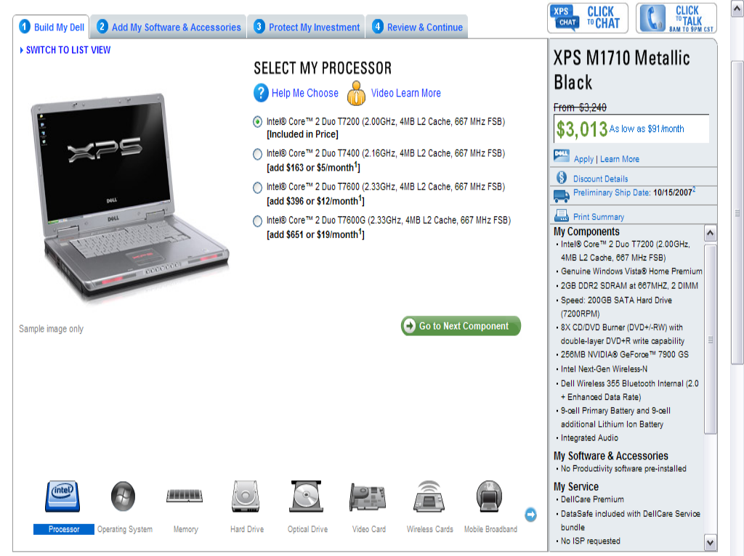
Example of attributes, levels
ATTRIBUTE LEVELS FOR THE
“PROCESSOR”
ATTRIBUTE

Slide 11
Products are bundles of attribute levels
A product is simply a bundle of attribute levels
Product 1 Beach, by Plane, for 450 €
Product 2 Mountain, by Plane, for 600 €
Product 3 Beach, by Bus, for 800 €
Etc.
2 × 2 × 3 = 12 different products (and nothing more!)
Transportation
Destination
Budget
Plane
Bus
Beach
Mountain
450 €
600 €
800 €
Notes:
Here, it is important to insist on the fact that any factor that is not “coded” into an attribute is irrelevant.
For instance, whether the vacation is sold by JetAir or Air France doesn’t matter, because “Brand” is not an attribute. People are indifferent between the two.
It’s hence very important to well define the correct attributes and attribute levels when you design a conjoint study, if you want to correctly capture preferences.

Slide 12
Preference partworths
A value is associated with each level to indicate preference
Transportation
Destination
Budget
Plane
Bus
Beach
Mountain
450 €
600 €
800 €
25
0
20
0
55
20
0
Notes:
Here, insist on the fact that to get reliable estimates of these numbers is the real trick… And we will get there later.
A few questions to ask here:
Do this customer prefer the Beach or the Mountain?
Do this customer prefer Plane or Bus?
What’s most important for this customer? Transportation or Destination? (transportation)
If the trip in bus costs 600 €, is this customer willing to pay 200 € more to go by plane? (yes, gains 5 preference points in the process)
If vacations to Mountain costs 600 €, is this customer willing to pay 200 € more to go to the Beach? (he’s indifferent)

Slide 13
From preference partworths to product preferences
The preference score for a product becomes the sum of the preference scores of the levels of that product
Product 1 Beach (20), by Plane (25), for 450 € (55) = 100
Product 2 Mountain (0), by Plane (25), for 600 € (20) = 45
Product 3 Mountain (0), by Bus (0), for 800 € (0) = 0
Since Product 1 is preferred to Product 2, it is “more likely”
to be purchased.
(later, we will see exactly how preferences are translated into choices)
Notes:
Clearly insist that most preferred items are not always bought, for various reasons (randomness, variety seeking) – we’ll talk about that in details later.

Slide 14
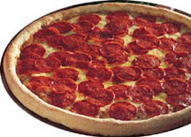

Conjoint Analysis
Technique to study trade-off decisions between certain levels of product attributes
Example:
Which product do you prefer?
Thin crust
Pepperoni
Mixed cheese
2 oz. cheese
$ 8.99
Pan Pizza
Pineapple
Romano cheese
2 oz. cheese
$ 9.99

Slide 15
Conjoint Analysis
Steps to develop a conjoint study: Car example
Step: Choose Attributes
  Brand name
  Engine power
  Fuel consumption
  Environmental performance
  Price

Slide 16
Conjoint Analysis
Steps to develop a conjoint study: Car example
Step: Choose Relevant Levels of Attributes
Brand Name
“Lion”
“German”
“Japanese”
Engine Power
150 HP
200 HP
250 HP
Fuel consumption
12 l/100km
14 l/100km
16 l/100km
Environmental performance
Fulfills min. requirements
Exceeds min. requirements
Sets new standards
Price
50.000
60.000
70.000

Slide 17
Conjoint Analysis
Steps to develop a conjoint study: Car example
Step: Choose a Sample Size and Respondent Type
Choose Response Task
Which product do you prefer?
Lion Brand
Fulfills minimum environmental requirements
16 l/km
250 HP
Price: 60.000
Japanese Brand
Exceeds minimum environmental requirements
12 l/km
150 HP
Price: 50.000
1 2 3 4 5 6 7 8 9 10

Slide 18
Conjoint Analysis
Steps to develop a conjoint study: Car example
Step: Choose a Sample Size and Respondent Type
Choose Response Task
  There are 5 attributes with each 3 levels
  Theoretically there would be 3x3x3x3x3 (243) possible product versions
  Several mathematical algorithms have been developed to reduce them to a reasonable size.
  Depending on the conjoint technique, there should not be more than 25 product versions to be evaluated (compared)
  Powerful & inexpensive software solves this problem for you:
www.spss.com SPSS Conjoint™
www.sawtoothsoftware.com (market leader)

Slide 19
Conjoint Analysis
3 attributes with 3 levels = 3x3x3 = 27 possible bundles
A1 | B1 | C1 |  | A2 | B1 | C1 |  | A3 | B1 | C1
A1 | B2 | C1 |  | A2 | B2 | C1 |  | A3 | B2 | C1
A1 | B3 | C1 |  | A2 | B3 | C1 |  | A3 | B3 | C1
A1 | B1 | C2 |  | A2 | B1 | C2 |  | A3 | B1 | C2
A1 | B2 | C2 |  | A2 | B2 | C2 |  | A3 | B2 | C2
A1 | B3 | C2 |  | A2 | B3 | C2 |  | A3 | B3 | C2
A1 | B1 | C3 |  | A2 | B1 | C3 |  | A3 | B1 | C3
A1 | B2 | C3 |  | A2 | B2 | C3 |  | A3 | B2 | C3
A1 | B3 | C3 |  | A2 | B3 | C3 |  | A3 | B3 | C3

Slide 20
Conjoint Analysis
Latin scare reduction: 3+3+3 = 9 bundles
Every level of one attribute is only once mixed with each level of the other attributes
A1 | B1 | C1 |  | A2 | B1 | C1 |  | A3 | B1 | C1
A1 | B2 | C1 |  | A2 | B2 | C1 |  | A3 | B2 | C1
A1 | B3 | C1 |  | A2 | B3 | C1 |  | A3 | B3 | C1
A1 | B1 | C2 |  | A2 | B1 | C2 |  | A3 | B1 | C2
A1 | B2 | C2 |  | A2 | B2 | C2 |  | A3 | B2 | C2
A1 | B3 | C2 |  | A2 | B3 | C2 |  | A3 | B3 | C2
A1 | B1 | C3 |  | A2 | B1 | C3 |  | A3 | B1 | C3
A1 | B2 | C3 |  | A2 | B2 | C3 |  | A3 | B2 | C3
A1 | B3 | C3 |  | A2 | B3 | C3 |  | A3 | B3 | C3

Slide 21
Conjoint Analysis
Steps to develop a conjoint study: Car example
Step: Compute Individual Customer Value Systems (Data collection)
Analyze Data

Slide 22
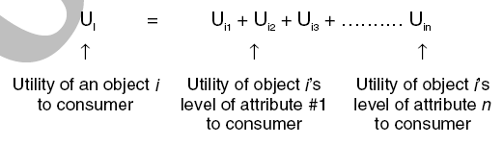
Conjoint Analysis
Conjoint analysis is based on a part-worth utility model (the more you get the better it is)
Do you think that this applies to every consumption decision?

Slide 23
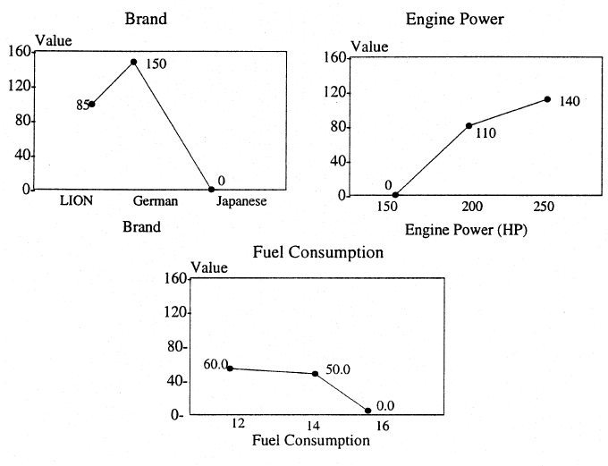
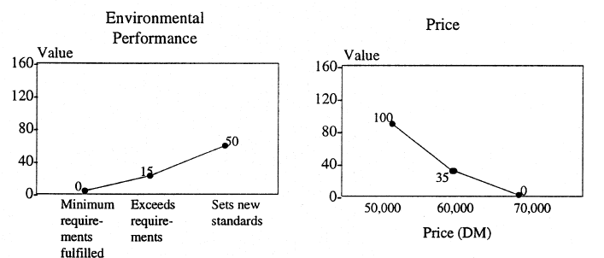
Conjoint Analysis

Slide 24
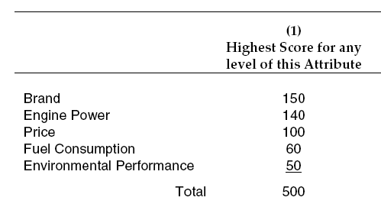
Conjoint Analysis
One can calculate the relative importance of each individual attribute

Slide 25
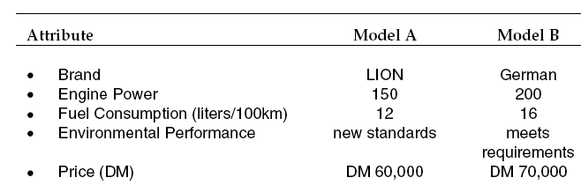
Conjoint Analysis
Since every part-worth (i.e. how much values each individual brand name, engine power, etc.) is determined it is possible to simulate different product versions
Total value:
230
260

Slide 26
Conjoint Analysis
Some guidelines
There exist several forms of conjoint analysis (e.g. ACA adaptive conj. a.)
Be careful with inter-correlations (e.g. horse power and fuel consumption)
The range of attribute-levels must be realistic
Use as few attribute-levels as possible & try to use the same amount of attribute-levels
Test person must be able to ‘understand’ each attribute-level (e.g. what really means “exceeds environmental requirements”???)

