Slide 1
Marketing Analytics
Prof. Robert Kreuzbauer
Assoc. professor in marketing
Surrey business school
17_may_2021
Notes:
Robert

Slide 2
Today’s class
Forecasting
Bass Model

Slide 3
Forecasting
Testing Validity of Multiple Regression (chapter 10, pp. 195)
  Normally distributed error term
  Heteroscedasticity (nonconstant variance error term)
  Autocorrelation (nonindependence of erros)
  Multicollineality (noncorrelation of independent variables)
  Overfitting

Slide 4
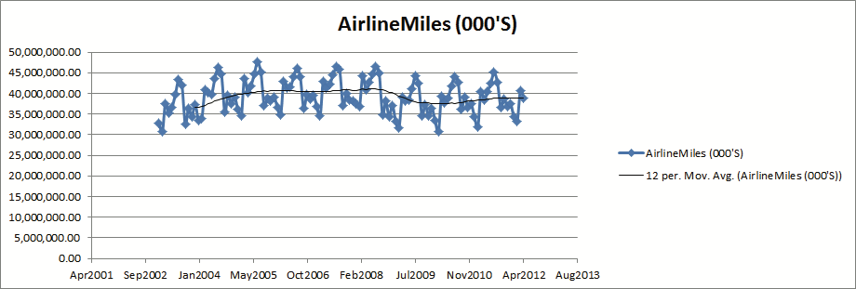
Forecasting
Trend and Seasonality (chapter 12)

Slide 5

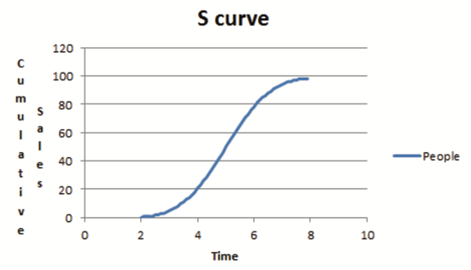
Forecasting
S-curve forecasting (chapter 26)

Slide 6

In-class exercise
How many Tesla cars will be driving in Norway in 5 years?
Population: 5.4 million
Passenger cars: 2.8 million
Electric cars: 350k

Slide 7
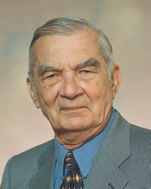

The Bass Story
Frank Bass
Notes:
7

Slide 8
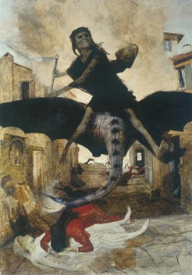
The Bass Story
Black Death of Europe
1348 - 1350
Killed 30% to 60% of Europe's population
Population growth, harsher winters, disadvantaged soil conditions, great famine, monarchs increased fines and rents
Notes:
8

Slide 9
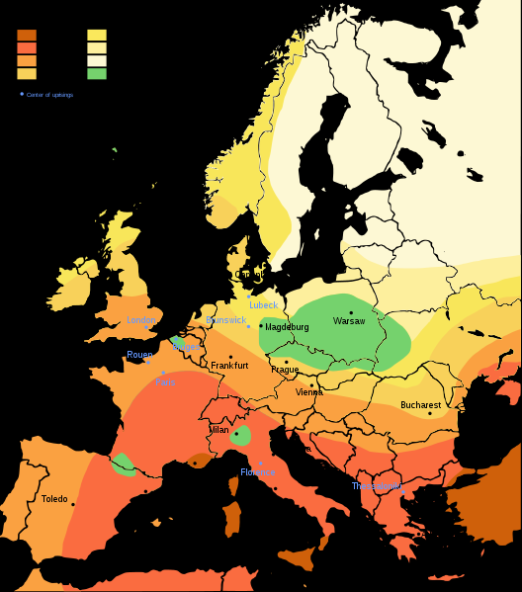
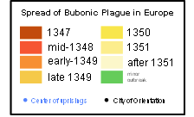
The Bass Story
Black Death of Europe
1348 - 1350
Central Asia it was carried east and west along the Silk Road, by Mongol armies and traders
Trading city of Caffa in the Crimea in 1347; protracted siege by Genoese;
Notes:
9

Slide 10
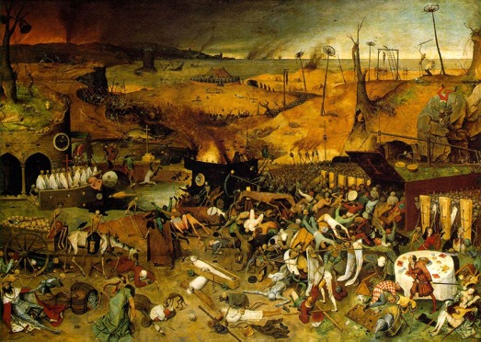
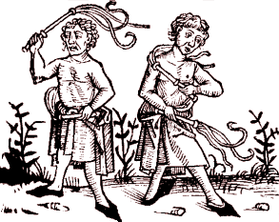
The Bass Story
Black Death of Europe
1348 - 1350
self-flogging
(whipping of oneself)
Notes:
10

Slide 11
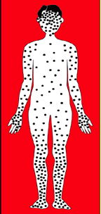
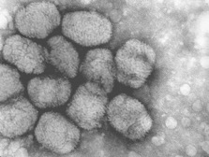
The Bass Story
Smallpox
Europe: 18th century
Up to 60 million died
Up to 30% of those infected, including 80% of the children under 5 years of age, died from the disease, and one third of the survivors went blind
WHO certified the eradication of smallpox in December 1979
Notes:
11

Slide 12
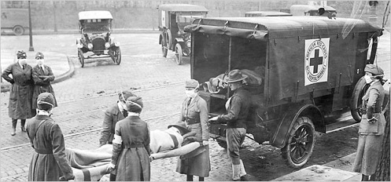
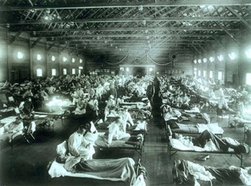
The Bass Story
Spanish Flu
1918-1920
Up to 70 million died
Notes:
12

Slide 13
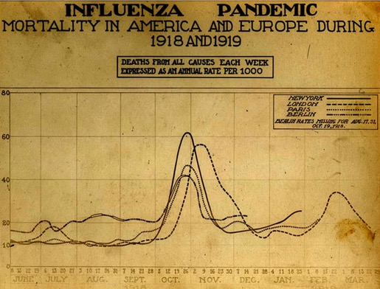

How does an epidemic spread?
Notes:
33
33

Slide 14
How does an epidemic spread?
not yet infected
people
already infected
people
not yet infected
people
n_{t} = p ×
+ q × ×
External infection effect
Internal infection effect
n_{t} = number of people who will get infected at time t
p = strength of external infection (e.g. through fowl, flee, birds, etc.)
q = virulence of the disease - how likely one person is to infect another (internal effect)
Notes:
33
33

Slide 15
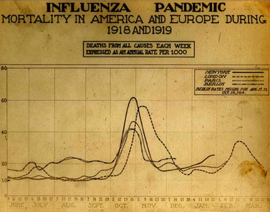
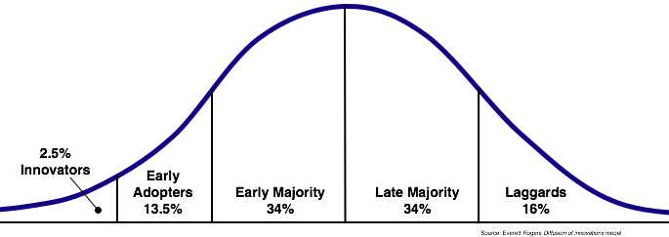
Similar shapes between the spread of a disease and diffusion of innovations
Notes:
15

Slide 16
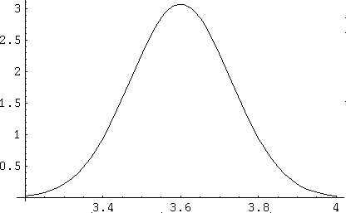
The Bass Diffusion Model for Durables
n_{t} = p × Remaining + q × Adopter Proportion × Remaining Potential
Potential
Innovation Imitation
Effect Effect
n_{t} = p × (N - N(t))
N = total market
N(t) = cumulative number of people who have adopted at time t
N-N(t) = remaining potential for adoption
t
Notes:
33
33

Slide 17
The Bass Diffusion Model for Durables
n_{t} = p × Remaining + q × Adopter Proportion × Remaining Potential
Potential
Innovation Imitation
Effect Effect
n_{t} = p × (N - N(t)) + q × (N(t) / N) × (N - N(t))
n_{t} = number of adopters at time t (Sales)
p = “coefficient of innovation” (External influence)
q = “coefficient of imitation” (“internal” to the society in which the diffusion spreads)
Notes:
33
33

Slide 18
The Bass Diffusion Model for Durables

Slide 19
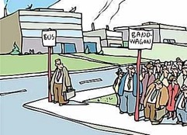
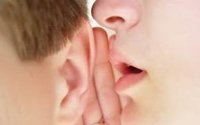
How do p and q shape the adoption curve?
p = Strength of the innovation (regardless of word of mouth)
Typical range for p: 0.01-0.05
Average: 0.035
q = Word of mouth effect (1 means that new adopter purchases product, when one person tells him/her about it)
Typical range for q: 0.01-1
Average: 0.4

Slide 20



How do p and q shape the adoption curve?
Inverted U-shape: Innovation is good by itself – person buys it when hears about it, no word-of-mouth needed
p > q

Slide 21

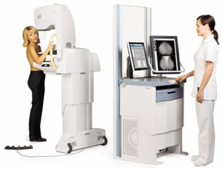
How do p and q shape the adoption curve?
S-curve: People convinced through word-of-mouth or need other people to use it
p < q

Slide 22


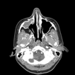
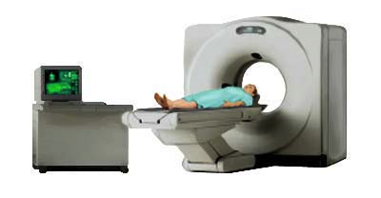
How do p and q shape the adoption curve?
p and q are both high
Very steep S-curve: Quick hype

Slide 23
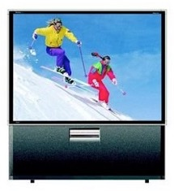

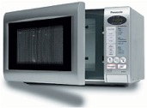
How do p and q shape the adoption curve?
p and q are both low
Curve is more flat (see bold line), because consumers are generally not excited about product. Neither the innovation itself nor word-of-mouth makes people purchase the product

Slide 24
How do p and q shape the adoption curve?

Slide 25
Main take home
How innovations spread is largely determined by two simple parameters (importance of the innovation & word-of-mouth)
Analogies (e.g. CD-player) can be very useful estimates

Slide 26
Tools we will still cover
Customer-Lifetime-Value
Recommender System (e.g. Netflix)
Resource Allocation Models (promotions, displays, distributions, sales reps, ads, media)

Slide 27
Tools you can teach yourself
Text-mining and Sentiment Analysis

Slide 28
Digital versus Good-Old-Fashioned Massmedia
Source: Karen Nelson-Field “Viral Marketing – The Science of Sharing”

Slide 29
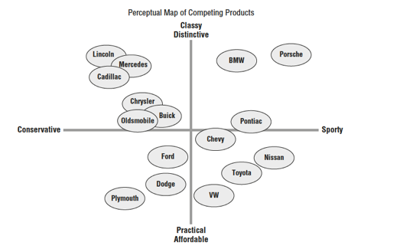

Tools you can teach yourself
Perceptual Mapping (Winston, chapter 38)
Discriminant Analysis (Cluster Analysis & Regression)

Slide 30
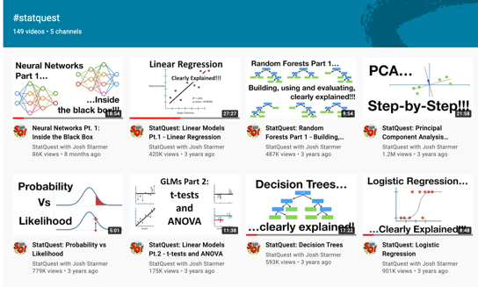
Tools you can teach yourself (more advanced)
Logistic Regression
Neural Networks

Slide 31

Tools you can teach yourself

Slide 32
Big vs. Small Data
Big Data
  Cluster analysis
  Forecasting
  Text-mining
  …
Small data
  Pricing optimization
  Conjoint analysis
  Bass model
  Resource allocation
  …

Slide 33

Let’s keep in touch
Share your future marketing analytics experience with me
Best of Luck!!!
robert.kreuzbauer@gmail.com

