Slide 1
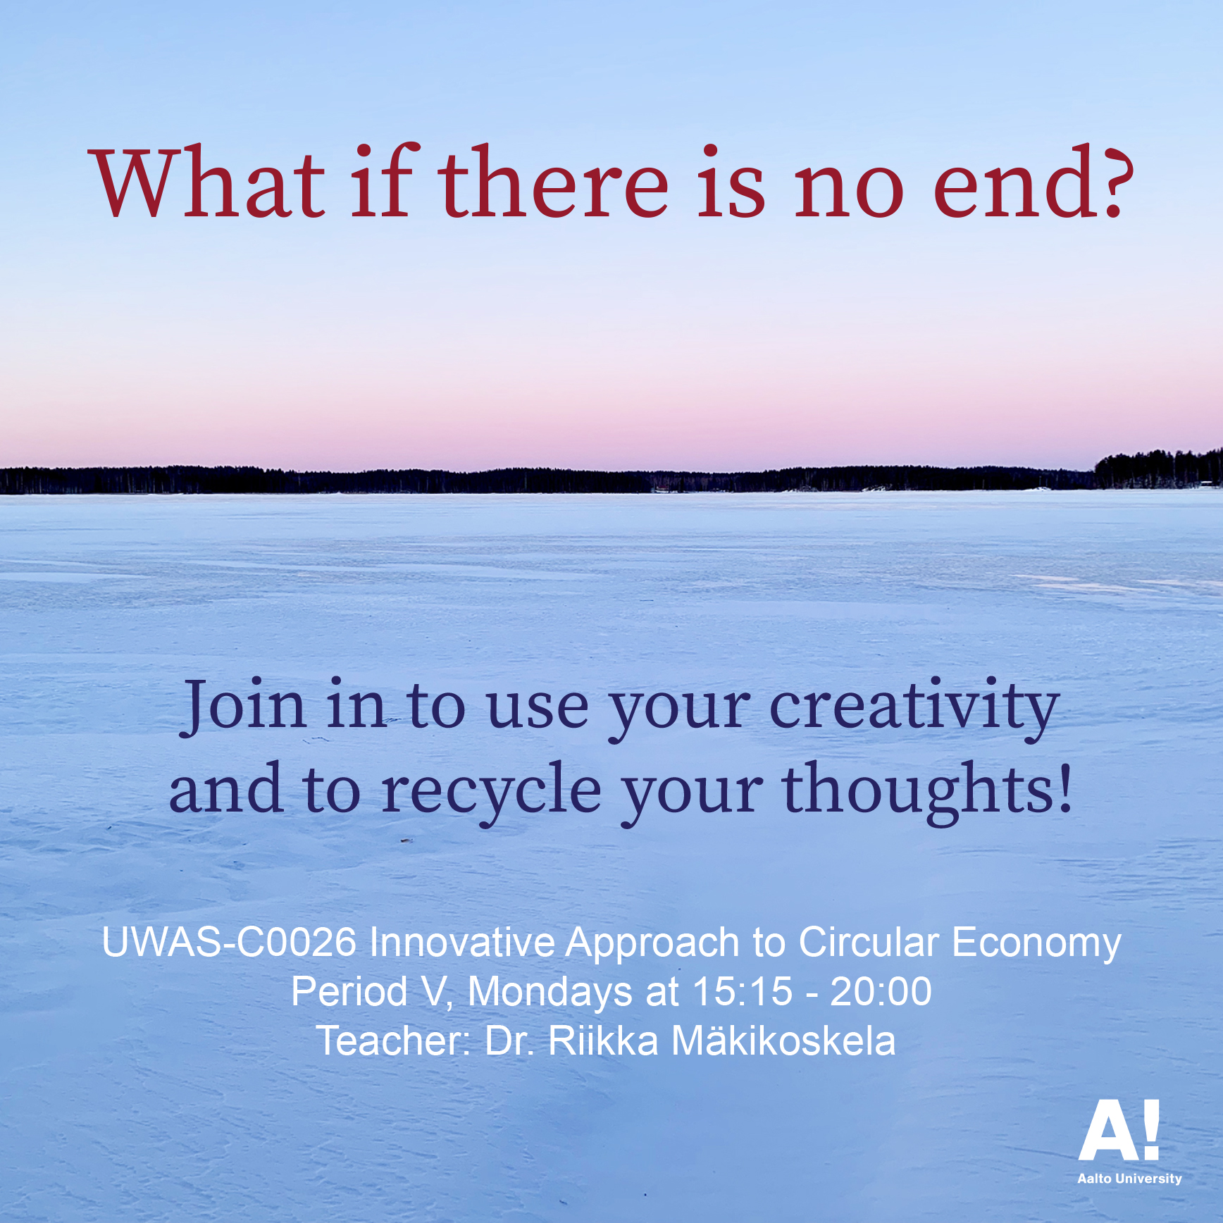

Slide 2
UWAS-C0026 Innovative Approach to Circular Economy
Teacher: Dr. Riikka Mäkikoskela
Time: 19 Apr – 24 May 2021
This is a course for anyone interested in the artistic possibilities of tackling the environmental crisis. The course provides practical and theoretical knowledge and operating models in which aesthetic, ethical, and ecological phenomena intertwine in circular economy. The course combines discussions and group work with hands-on activities in which the students will concretize their learning through material ideation and experimentation. During the course, students will create artistic proposals of new solutions and possible futures to implement sustainability and circular economy.

Slide 3
The course is evolved from the teaching development and research project:
https://www.sitra.fi/en/projects/study-package-circular-economy-environmental-art-cultural-change/
Part of the course's teaching and learning can be done in
the Test Site:
http://acs.aalto.fi/category/test-site/
(I will tell you more about this next time)

Slide 4
Circular Economy, Art and the Change in Consumption/Consumer Culture
The change in consumption culture towards a more sustainable society requires collaboration with several operators. This means multidisciplinary cooperation. The circular economy also requires a change in the practices of artistic activity. For example, in environmental education and environmental art the wider perspective of sustainable development that spans society must be introduced alongside environmental thinking. An even bigger change needs to be implemented when it comes to the image of traditional art, because the idea of a circular economy conflicts with the concept of producing unique works of art.

Slide 5
Doctor of Arts Riikka Mäkikoskela (FIN) is a practicing sculptor. She is doing practice-led and artistic research from the point of view of a practitioner, emphasizing working by hand, materiality, and movement. Her research interests focus on how phenomena are identified in sensory, material, and bodily experiences and how thinking is intertwined with this activity. Through this, Mäkikoskela is developing artistic thinking. She is also interested in the methodology of artistic research and how it can be applied transdisciplinary.

Slide 6
Research in Art and Education 3-2018:
https://researtsedu.com/2018-december-issue
Mäkikoskela, Riikka. 2018. FROM FAR TO CLOSE (AND BACK). MATERIAL RESISTANCE AND CHANGING PERSPECTIVES IN VISUAL ART PRACTICE. Synnyt/Origins Journal, Issue 3: Special issue on Catalyses, Interventions, Transformations, 349–378, https://researtsedu.com/2018-december-issue

Slide 7
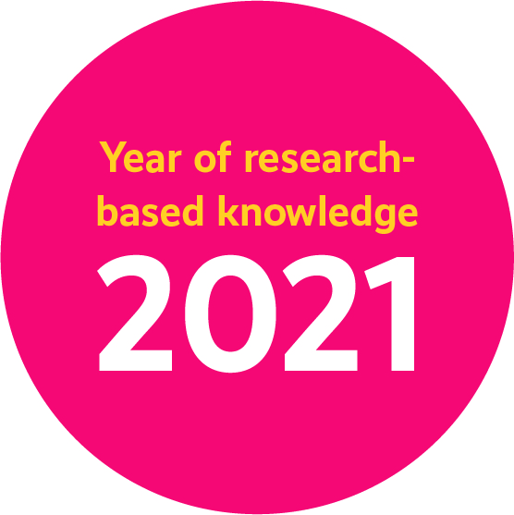


Doctor of Arts Riikka Mäkikoskela
Secretary General
The Year of Research-Based Knowledge
https://tutkittutieto.fi/en/
Twitter: @tttv2021
Instagram: @tttv2021
makikoskela@gmail.com
Twitter: @RMakikoskela
Instagram: @rmakikoskela

Slide 8
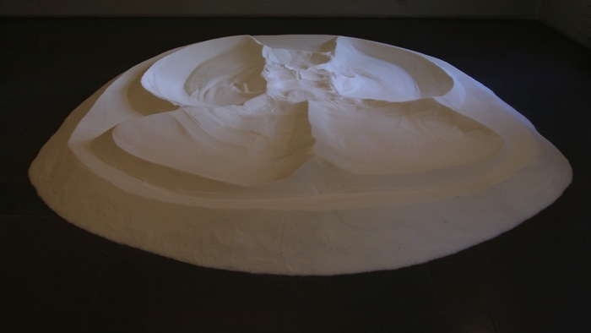

Slide 9
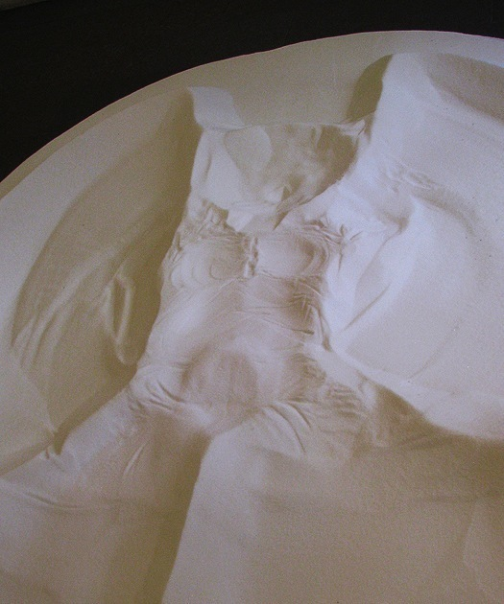
Ecstacy
2006 – 2009
granulated sugar
app. 35 x 300 x 250 cm

Slide 10
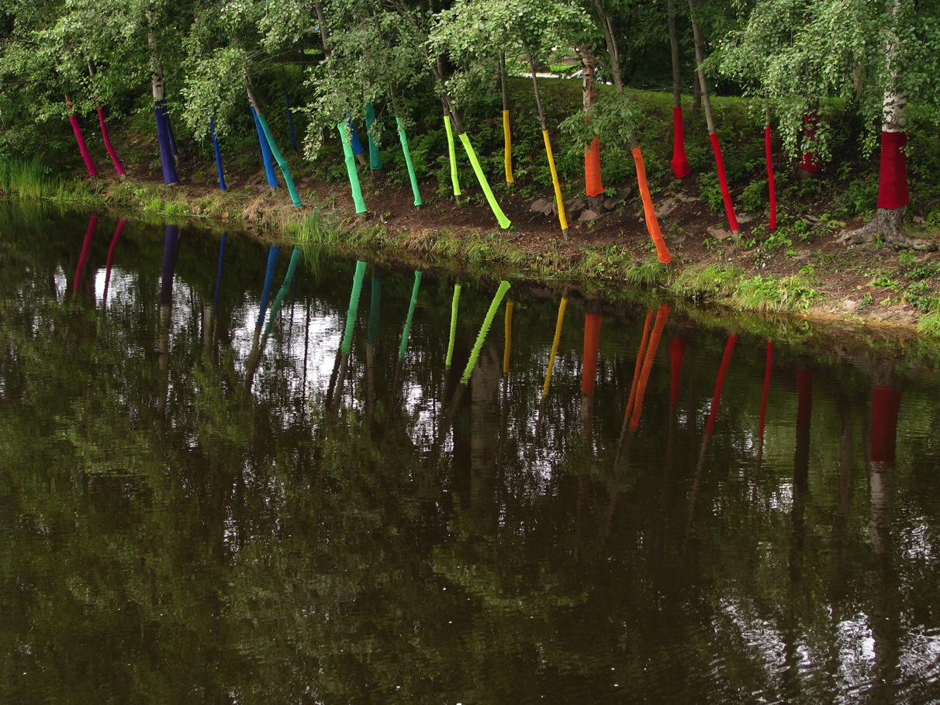
At Home, 2013, knitted yarn

Slide 11
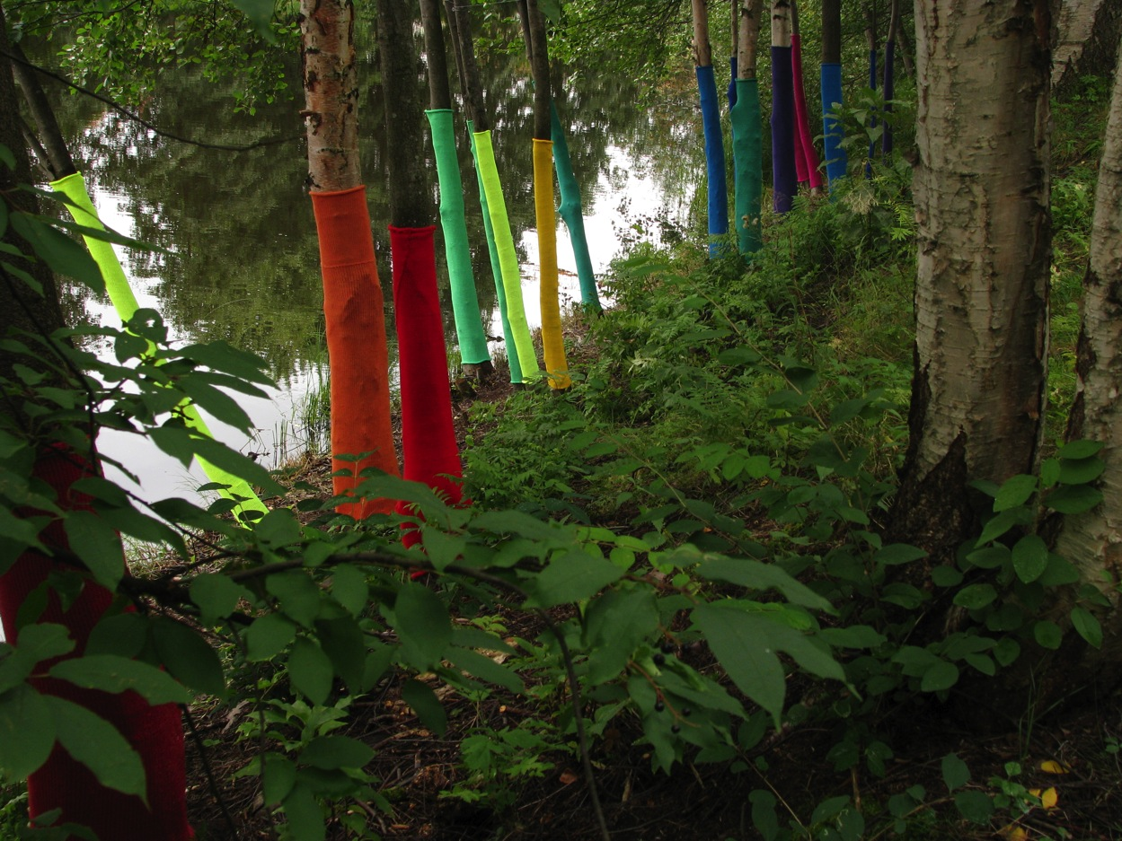

Slide 12
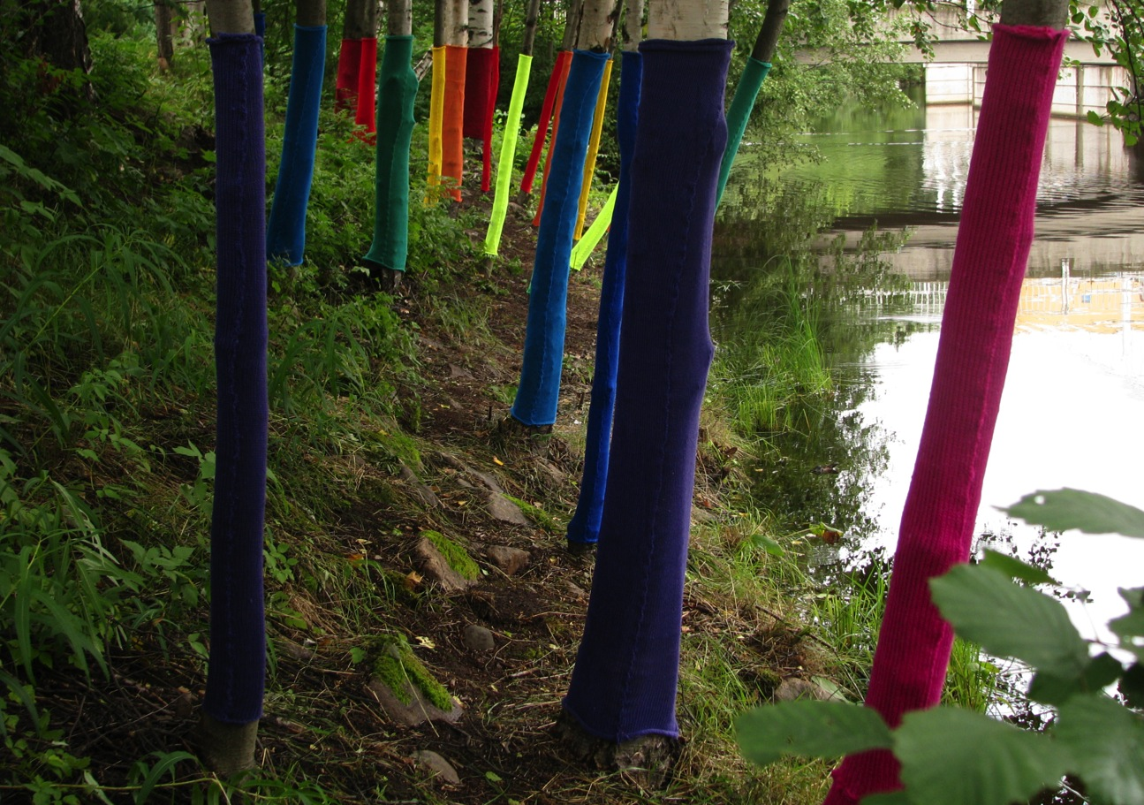

Slide 13
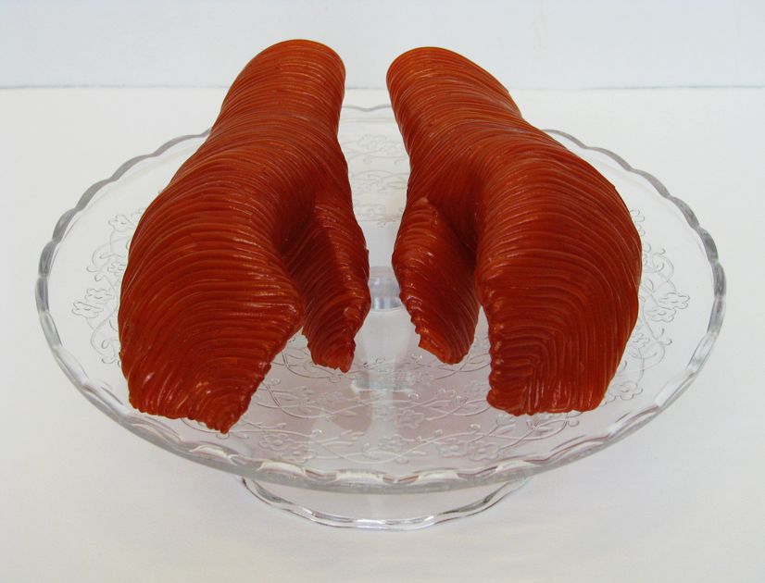

Slide 14
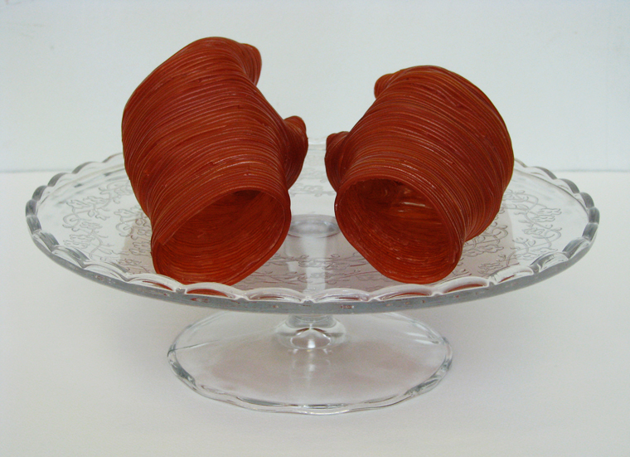
From Hand to Mouth, 2011, strawberry flavored candy laces, tape, glue, glycerol, acrylic varnish and glass cake stand, 18 x 29 x 29 cm

Slide 15
Breaking out the Silos! Art and Engineering Perspectives in Circular Economy
With D.Sc. (Tech.) Nani Pajunen (Aalto CHEM)
Combining art, engineering and environmental research perspectives
Cyclical artistic thinking (Mäkikoskela 2015) < > linear and systemic thinking
Exploring innovative ways to promote sustainability and circular economy

Slide 16
In addition to theoretical knowledge, we strive to find new ways to act. So, we work on case studies, which are implemented as workshops and exhibitions
We aim at increasing material efficiency, extending product lifecycles and saving natural resources in process industry via product design and material development.

Slide 17
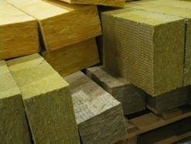
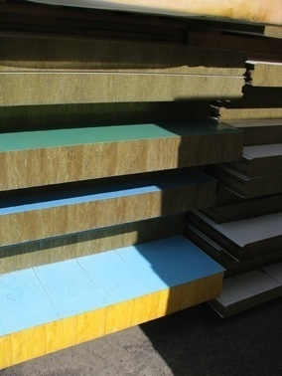
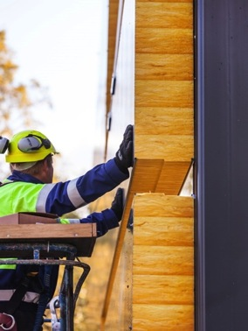
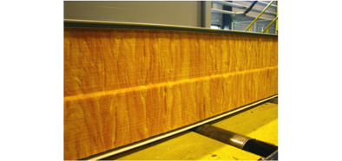
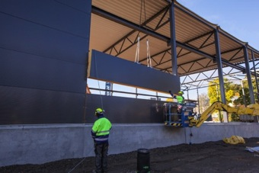
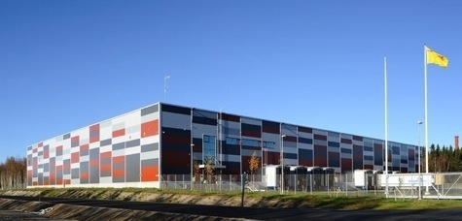
SANDWICH PANEL

Slide 18
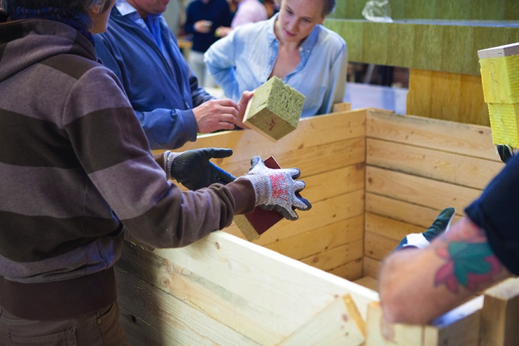
WORKSHOPS /
UPCYCLING
architect
visual artists
textile artist
designers
engineers
aircraft mechanic
research scholars
IT expert
transport expert
sales professional
nurse
teacher
OBJECTIVE: to look for solutions what to do with sandwich panels already once used in construction and to make new products, works of art and design

Slide 19
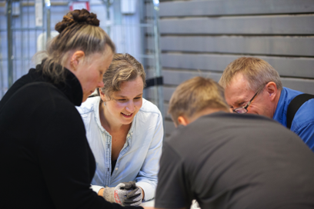
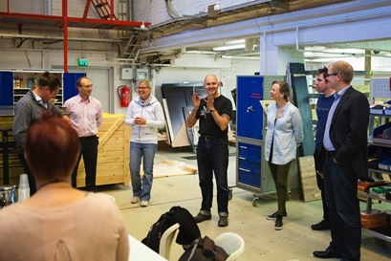
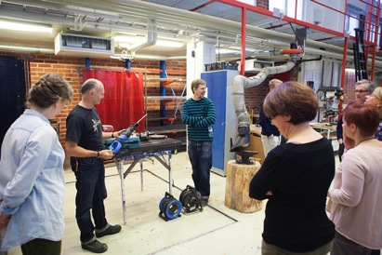
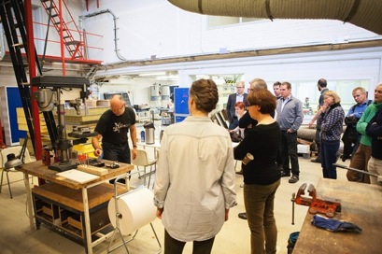
WORKING METHODS: visual-art, craft and
design practices

Slide 20
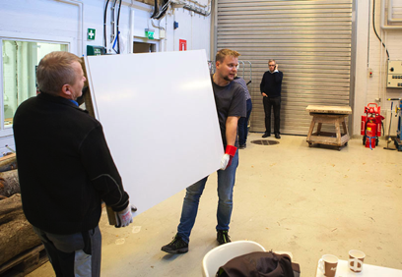
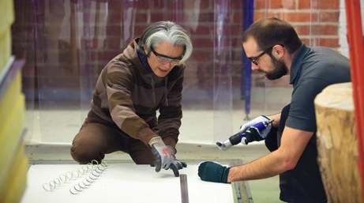
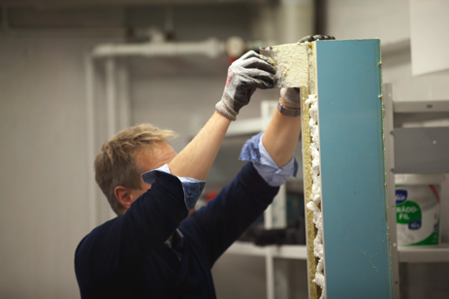
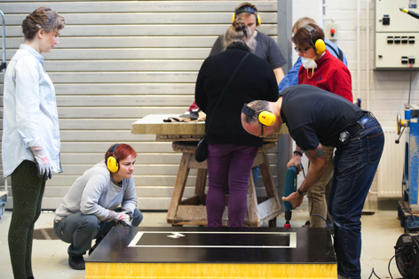

Slide 21
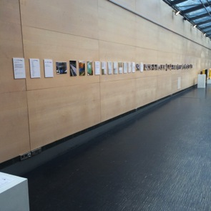
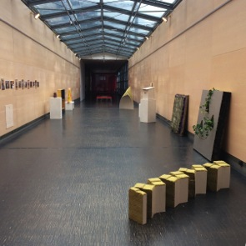
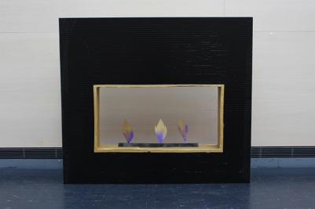

Slide 22
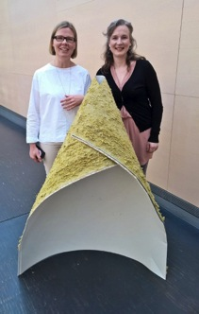
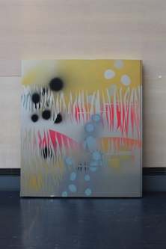
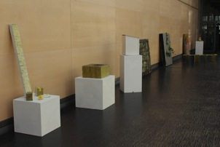

Slide 23
HOW THE SILOS HINDER TRANSITION
TOWARDS CIRCULAR ECONOMY?

Slide 24
Let's take a tour around our multidisciplinary table!
1 Who are you?
2 Where do you come from?
3 What do you expect from this course?

Slide 25
Course Schedule (excel)
1. Course diary
2. Hands-on activities/workshop making/art and design projects: artistic proposals of new solutions and possible futures to implement sustainability and circular economy

Slide 26
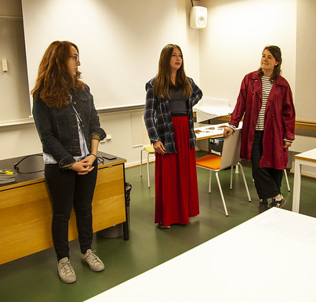
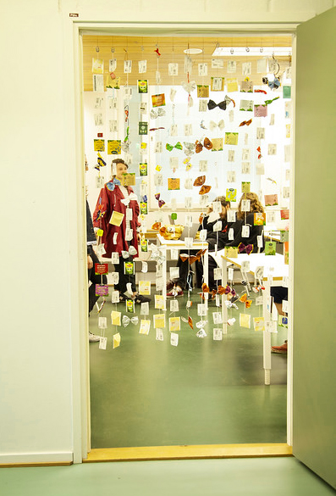
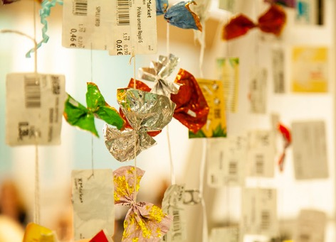
Photos by Elisa Dametto

Slide 27
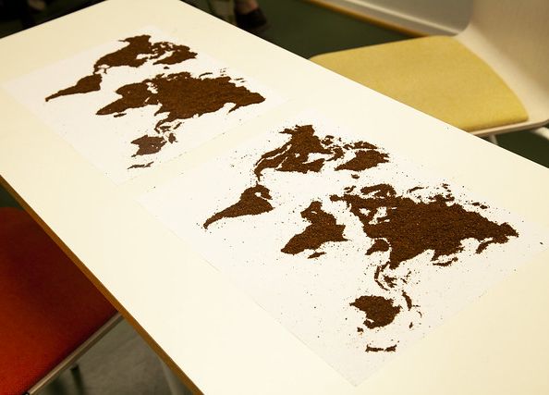
Photo by Elisa Dametto

Slide 28
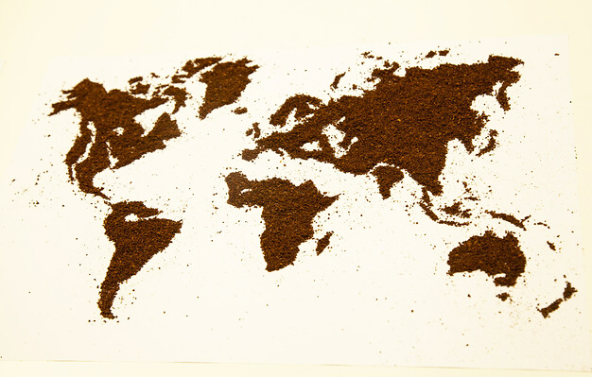
Photo by Elisa Dametto

Slide 29
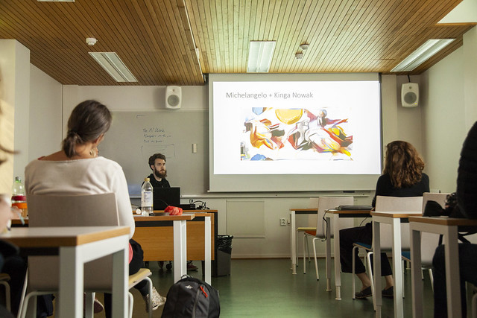
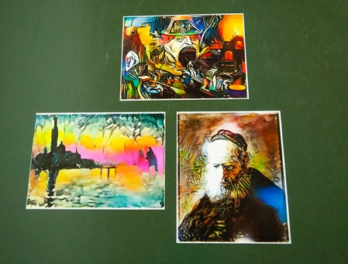
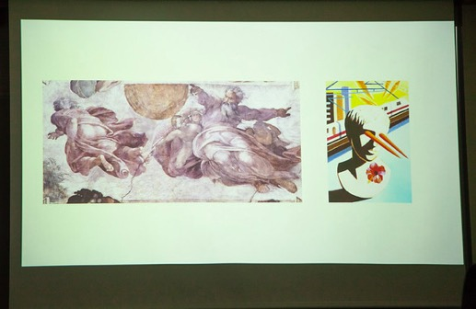
Photos by Elisa Dametto

Slide 30
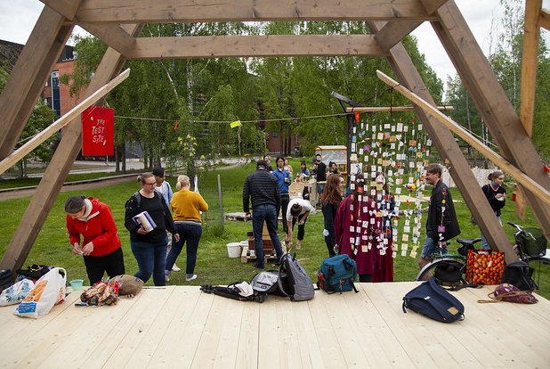
Photo by Elisa Dametto

Slide 31
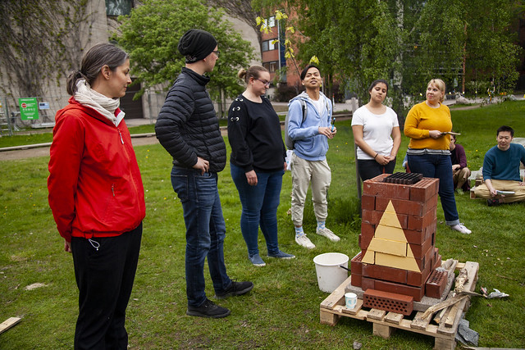
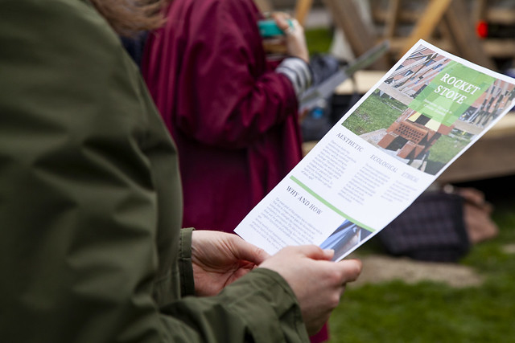
Photos by Elisa Dametto

Slide 32
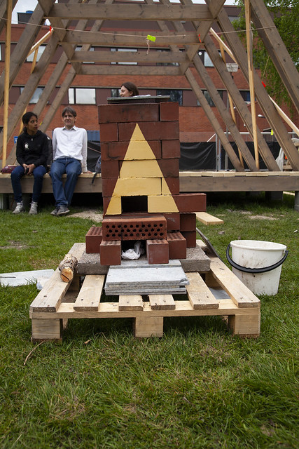
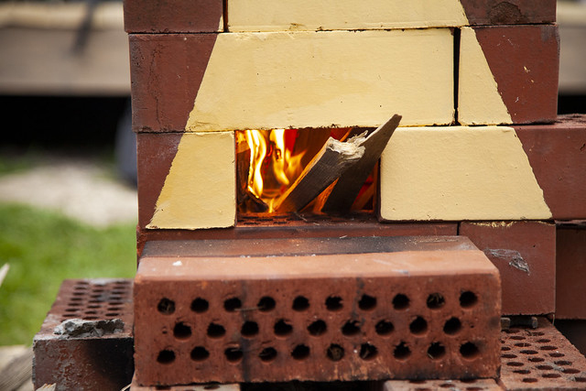
Photos by Elisa Dametto

Slide 33
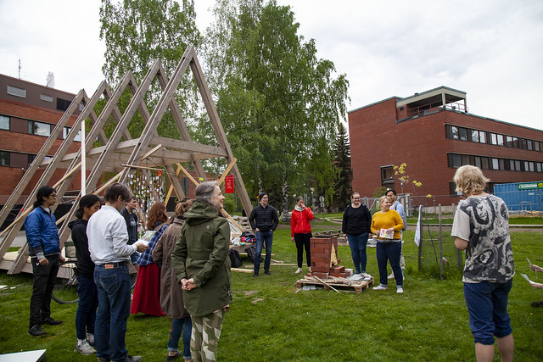
The combination of environmental and social art and circular
economy is seen in this study as a strategy for change
in consumer culture in society
Photo by Elisa Dametto

Slide 34
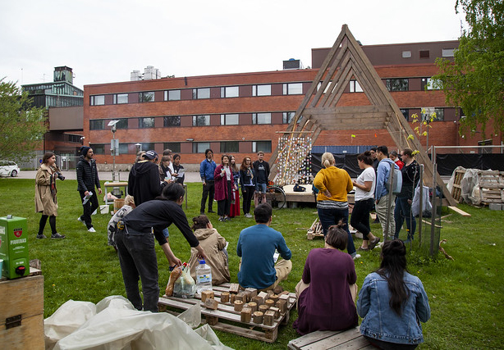

Slide 35
Course diary
The students keep a course diary (for example, in the digital form or as a portfolio), where they discuss the questions raised in the course both from the point of view of their own field and from the point of view of artistic methods and where they present the course assignments. The course diary has to be handed in to pass the course.
1.
A Circular Economy (about 100–200 words)
B Art
C Change in Consumption/Consumer Culture

Slide 36
Readings:
Soini, K.; Dessein, J. Culture-Sustainability Relation: Towards a Conceptual Framework. Sustainability 2016, 8, 167
https://www.mdpi.com/2071-1050/8/2/167
Mäkikoskela, Riikka. 2018. FROM FAR TO CLOSE (AND BACK). MATERIAL RESISTANCE AND CHANGING PERSPECTIVES IN VISUAL ART PRACTICE. Synnyt/Origins Journal, Issue 3: Special issue on Catalyses, Interventions, Transformations, 349–378
https://researtsedu.com/2018-december-issue
Niinimäki, Kirsi (ed.), 2018:
Sustainable Fashion in a Circular Economy
https://shop.aalto.fi/media/filer_public/53/dc/53dc45bd-9e9e-4d83-916d-1d1ff6bf88d2/sustainable_fashion_in_a_circular_economyfinal.pdf
Riikka Mäkikoskela: riikka.i.makikoskela@aalto.fi

