Slide 1
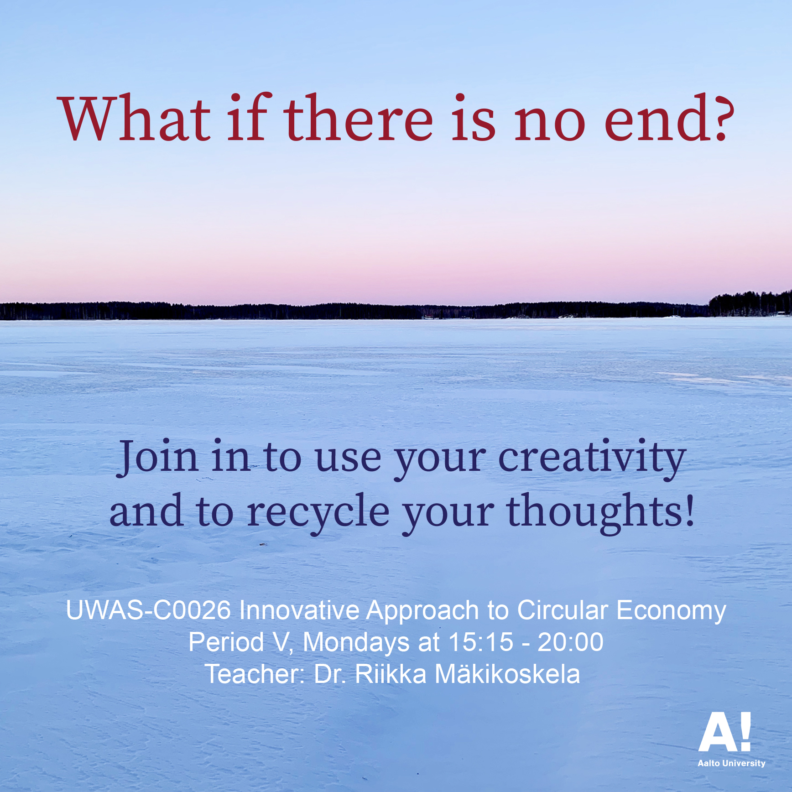

Slide 2
Cultural Approach to Sustainable Society and Circular Economy
Doctor of Arts Riikka Mäkikoskela
Mon 26.4.2021
riikka.i.makikoskela@aalto.fi

Slide 3
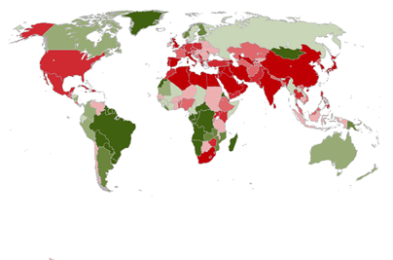

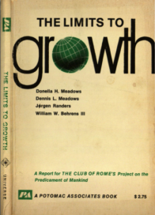


Slide 7
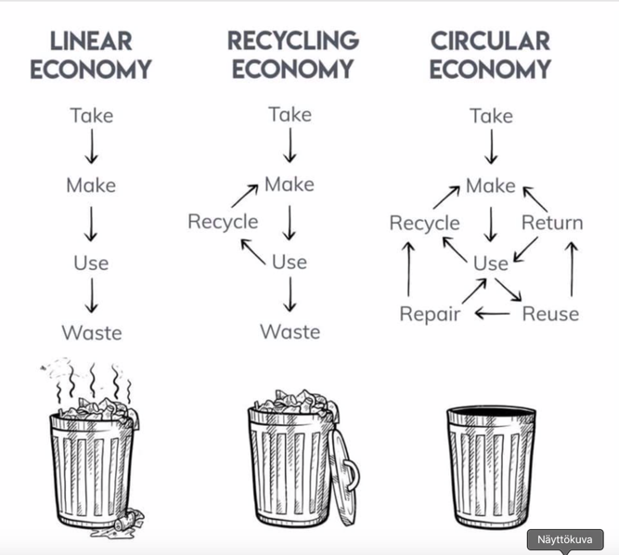

Slide 8
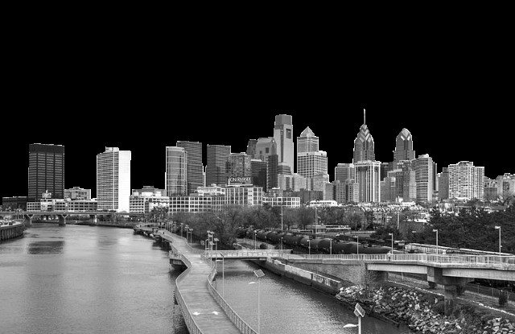
Circular economy society
FORESTRY AND FOREST INDUSTRY
MINING AND
PROCESS INDUSTRY
SPORT AND CULTURE
OTHER AREAS
ENERGY
AGRICULTURE
CONSTRUCTION INDUSTRY
LEISURE TIME
FOOD
EDUCATION AND RESEARCH
INDIVIDUAL
HOUSING
LOGISTICS AND TRANSPORTATION
SOCIAL SECTOR
Everywhere there is a need for change,
and everyone has to find their own role in making the change.

Slide 10
The Ellen MacArthur Foundation
www.ellenmacarthurfoundation.org
A new system, circular economy, can meet our needs
within planetary boundaries
1. Design out waste and pollution
2. Keep materials and products in use
3. Regenerate natural systems

Slide 11
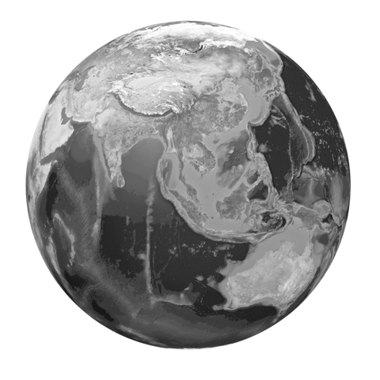
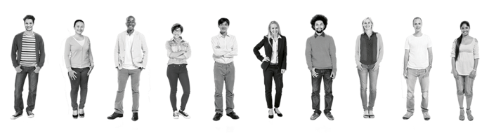
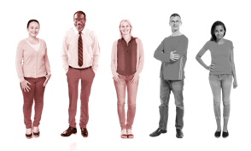
Changing the consumption culture towards circular economy requires
multidisciplinary and societal cooperation (Pajunen et al. 2013)
How to make transition towards circular economy society?
How is the change made socially (culturally) and equally?

Slide 12
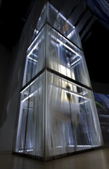
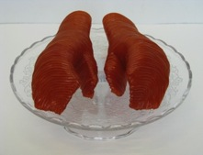
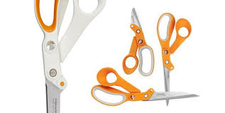
NEW WAY TO THINK AND ACT
Kone Oyj Elevator
DESIGN THINKING
SYSTEMIC THINKING
MATERIAL DEVELOPMENT
CREATIVE MAKING
ARTISTIC THINKING
Mäkikoskela, R. 2011.
From Hand to Mouth.
PRODUCT DESIGN
PRODUCT DEVELOPMENT
INNOVATIVE ACTION
BREAKING OUT THE SILOS!
Nani Pajunen & Riikka Mäkikoskela
Fiskars scissors

Slide 13
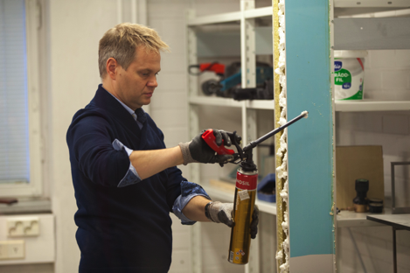
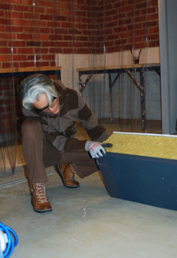
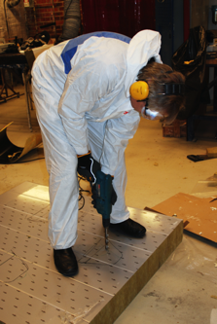
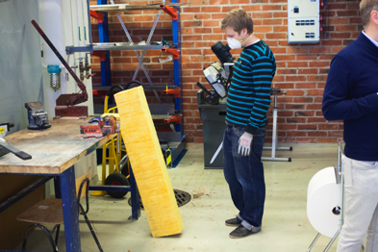
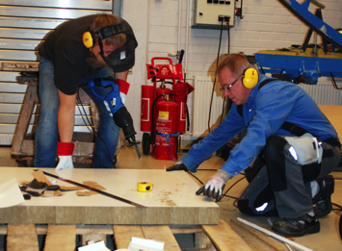
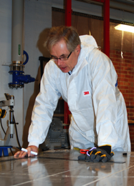
Instead of brainstorming and ideation on paper, workshop participants now work on sandwich panels by hand

Slide 14
BREAKING OUT THE SILOS!
Multidisciplinary and societal cooperation
Change is needed both in the material development and product design phases
Processes also need to be reconsidered: How to promote material cycles? How to make better use of side streams?
The circular economy also requires a change in the practices of arts
The life cycle of works of art often ends with a work of art
The traditional notion of art: the idea of a circular economy conflicts with the concept of producing unique works of art

Slide 15
Art and design practices promoting sustainable society and its circular economy
Circular economy can be also seen as a change of consumer culture in society
The cultural and social play a key role in consumption and recycling
The importance of the cultural dimension has strengthened in ecological thinking (Soini & Dessein 2016)

Slide 16
Art and design practices promoting sustainable society and its circular economy
The communal, social, and cultural material inexorably influence consumption habits
In material circulation, besides concrete materiality, mental images and cultural and social materiality are important
The key factors in the sustainable change of consumer culture are the knowledge of the significance of art and creative practice and thinking and the production of culture in the overall picture of the circular economy

Slide 17
Art and design practices promoting sustainable society and its circular economy
In art and design, we can work on the cultural and social material that play a key role in consumption and recycling
In art and design, we can, in addition to concrete materiality, work on imaginative
In art and design, we can imagine, envision and test beyond today's realities and solutions

Slide 18
Art and design practices promoting sustainable society and its circular economy
Referring to the previous, it is crucial to understand the possibilities of creative and artistic methods in creating cultural change towards regenerative sustainability
This means the discussion of the radical intertwinement of aesthetical, ethical and ecological processes and the way we are experiencing them
This way the original idea of material processes extends towards ideas of experiential and social materials (Tuovinen & Mäkikoskela 2018)

Slide 19
Art, art-making, artistic thinking, design thinking, creativity
Embodied
Knowledge
Humanity
Emotions
Empathy
Art-making processes contain a lot of sensory and embodiment and are thus challenging to disassemble by the means based on reason and linearity

Slide 20
Art and design practices promoting sustainable society and its circular economy
Art practice is considered as thinking linked to action, in which new ideas can be experienced, tested, trialed and challenged (Mäkikoskela 2015)
Do – undo – redo (Bourgeois 2008)
> CYCLICALITY/CIRCULARITY
Open-ended practice

Slide 21
INDUSTRIAL DESIGN AND CYCLIC ARTISTIC PROCESS

Slide 22
Art and design practices promoting sustainable society and its circular economy
Creative practices employ various means

Slide 23
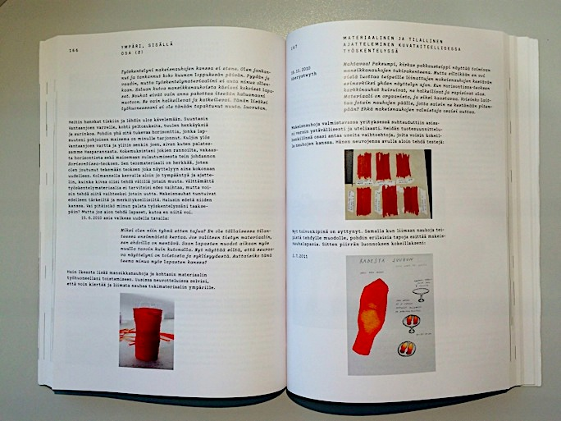

Slide 24
Creative practice, for example art-making, can make new ideas visible but also visualize and create new possible cultural ways of acting
BUT…
Circular economy requires change in art world and art-making: the traditional notion of a unique work of art does not allow the recycling of the work

Slide 25
Recycle Even the Unique!
The uniqueness and singularity of visual arts
Recycling of works of art?
Can we reuse the artwork?
Finding innovative ways to use limited natural resources
in a sustainable way
Public art & public pedagogy > material cycles

Slide 26
Pasi Karjula and Marko Vuokola, Olo n:o 22, 2000
polished steel, Hietalahti, Helsinki

Slide 27
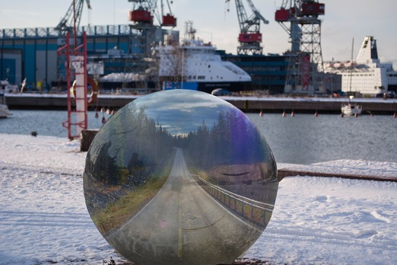
Adel Mekhane’s, Vesteri Ollinen’s, and Aaro Packalén's student work for We comment! assignment. The students commented the themes of traveling, transportation, and climate change. They combined the visual experience of the environment and digital image processing.

Slide 28
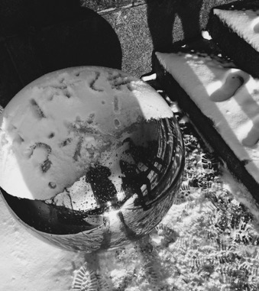
Aino Hörkkö’s, Katariina Kujapelto’s, and Julianna Tiirikka’s comic commentary
on Pasi Karjula’s and Marko Vuokola’s artwork. The students took a stand for
social and environmental issues in the winterly and urban environment.
The authors of the statement and the urban environment of the public artwork are
reflected in the underlying part of the artwork.
Notes:
art

Slide 29
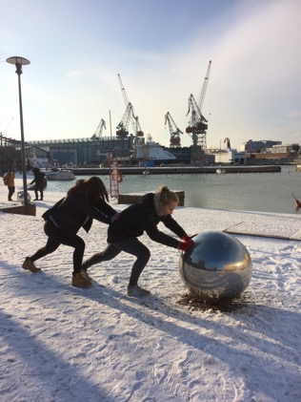
Silja Lampinen, Iina Martikainen, and Siri Piippo-Pinho worked on the We comment! assignment kineticly and performatively. The students used their own bodies as material of the new artwork they created.

Slide 30
Group work
Assignment 1
Circular economy encompasses more than the sustainable production and consumption of material, goods and services. It includes a discussion of the intertwinement of aesthetical, ecological and ethical processes that can influence the change in consumer culture.
Can you find an example of your everyday life in which aesthetic, ecological and ethical have intertwined? Please, present your example to your group and explain how.

Slide 31
Assignment 2 for the group work
It is crucial to understand not only the concrete materiality but also the mental images and the cultural and social materiality that influences consumption habits.
As a group, discuss examples of the group’s fields, in which
the cultural and social content play a key role in consumption and recycling. Sort out specifically the cultural and social material of your examples. Prepare to present one of the examples to the course participants.

Slide 32
Course diary
The students keep a course diary (for example, in the digital form or as a portfolio), where they discuss and reflect on the questions raised in the course, both from the point of view of their own field and from the point of view of artistic methods, and where they present the course assignments. The course diary has to be handed in to pass the course.
The diary can be made in text or image format. You can express your thinking for example in words, drawings or photographs.
2.
Describe and/or illustrate your group’s work on your course diary.

Slide 33
Assignment/Independent studying/Group work
Watch the movie: Tavarataivas / My Stuff
Petri Luukkainen, 2013, 80 minutes, with English subtitles
http://tavarataivaselokuva.fi
https://www.youtube.com > tavarataivas / my stuff
https://vimeo.com/ondemand/mystuff/162674607
Meet Petri Luukkainen, 26. Amidst an existential crisis, he arrives at the idea that his happiness might be found by rebuilding his everyday existence. What does he really need – and what about all that stuff?
The concept: Take all of your stuff into a storage and bring back only one item per day. The result? An everyday adventure driving him deeper and deeper into the empty spot in his heart. You’re right: this would be borderline insane even without his decision of constantly filming himself.
Buck naked at his flat in Helsinki, it’s another story – not a pretty one but pretty damn fun to watch.

Slide 34
Course diary
2.
A Why does the main character feel his stuffy life is hollow?
B How does the film make our stuff-filled lives visible?
C How does the main character succeed in his decision not to buy any stuff?
D Would you be ready for such a radical lifestyle change?
On the other hand, updating lifestyles on a more sustainable basis does not have to be such a radical abandonment – with much less can be done positive changes. A change in your life can reward you with new experiences, be positively reflected on the people around you, and have a direct impact on the future.
Where could you start or have already started?

Slide 35
Pre-task for Taneli’s lecture on 3rd of May
ARTS, PEDAGOGY AND CULTURAL RESISTANCE (MyCourses > Materials)
Familiarize yourself with the introduction chapter of this book ARTS, PEDAGOGY AND CULTURAL RESISTANCE. How does the relationship of pedagogy and matter is introduced? Do you agree? What do you think yourself? What have matter thought you at your work/practice? Think of a practical example.
We will start next week’s lecture with these questions and with sharing your thoughts and examples.

Slide 36
Readings
1. Soini, K.; Dessein, J. Culture-Sustainability Relation: Towards a Conceptual Framework. Sustainability 2016, 8, 167
https://www.mdpi.com/2071-1050/8/2/167
2. Mäkikoskela, Riikka. 2018. FROM FAR TO CLOSE (AND BACK). MATERIAL RESISTANCE AND CHANGING PERSPECTIVES IN VISUAL ART PRACTICE. Synnyt/Origins Journal, Issue 3: Special issue on Catalyses, Interventions, Transformations, 349–378
https://researtsedu.com/2018-december-issue
Niinimäki, Kirsi (ed.), 2018:
Sustainable Fashion in a Circular Economy
https://shop.aalto.fi/media/filer_public/53/dc/53dc45bd-9e9e-4d83-916d-1d1ff6bf88d2/sustainable_fashion_in_a_circular_economyfinal.pdf
Especially the chapters:
3. Collaborative Consumption and the Fashion Industry (Henninger, Jones, Boardman & Mc Cormick)
4. Designing for a Circular Economy (Balkenende & Bakker)

Slide 37
Pick two articles/chapters from the reading list
Please, read them by the 10th of May!
Then, we will have group works based on the text ☺

