Slide 1
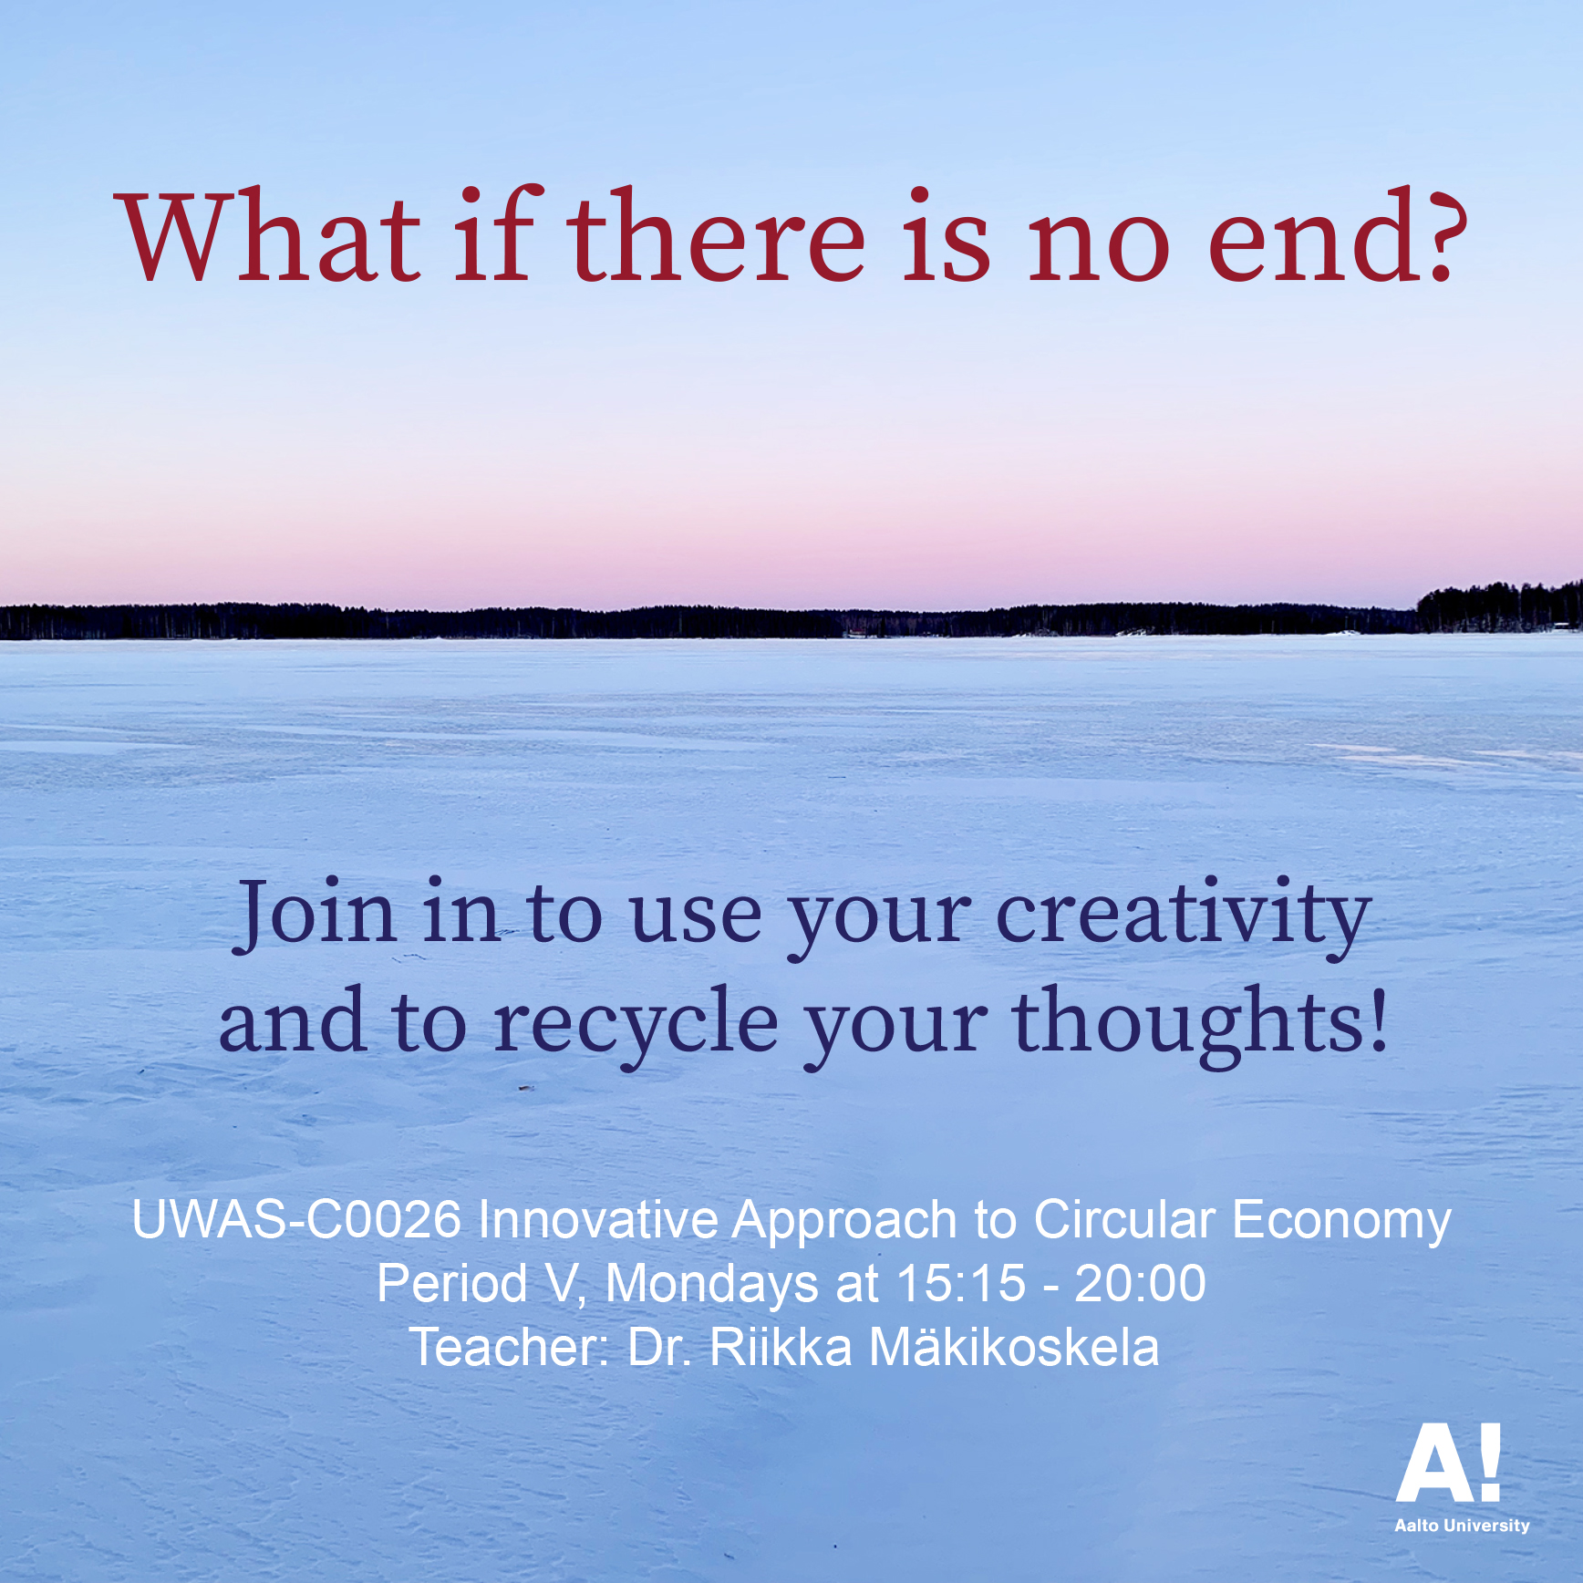

Slide 2
Creative, innovative, hands-on projects of the course
Doctor of Arts Riikka Mäkikoskela
Mon 3.5.2021
riikka.i.makikoskela@aalto.fi

Slide 3
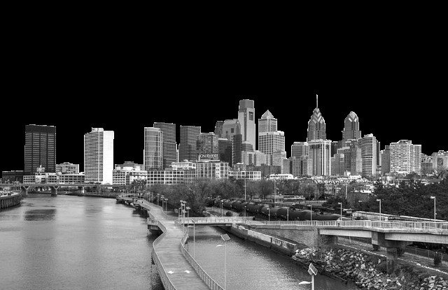
Circular economy society
FORESTRY AND FOREST INDUSTRY
MINING AND
PROCESS INDUSTRY
SPORT AND CULTURE
OTHER AREAS
ENERGY
AGRICULTURE
CONSTRUCTION INDUSTRY
LEISURE TIME
FOOD
EDUCATION AND RESEARCH
INDIVIDUAL
HOUSING
LOGISTICS AND TRANSPORTATION
SOCIAL SECTOR
Everywhere there is a need for change,
and everyone has to find their own role in making the change.

Slide 4
The Ellen MacArthur Foundation
www.ellenmacarthurfoundation.org
A new system, circular economy, can meet our needs
within planetary boundaries
1. Design out waste and pollution
2. Keep materials and products in use
3. Regenerate natural systems

Slide 5
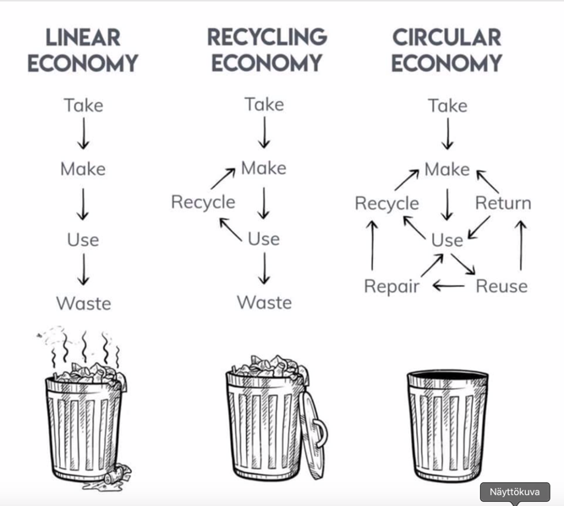

Slide 6
Project work. Let’s make experiments for making and consuming in the circular economy.
For example:
Use a product that already exists and design of it a new product. Expand the life cycle of the product and its materials. Draw a model, make a prototype and/or write down the idea of the new product.
Recycle an artwork that already exists and make a new artwork out of it.
Work on the Test Site. Join in an already existing project or create a new one. Or make an experimentation on the Test Site in which materials circle.

Slide 7
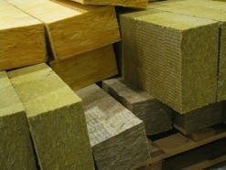
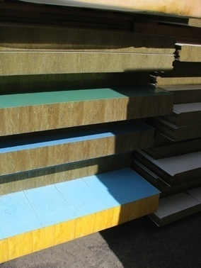
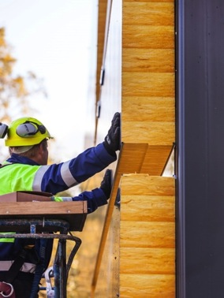
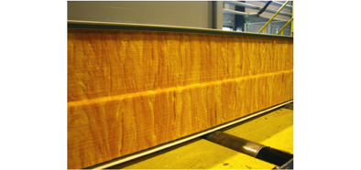
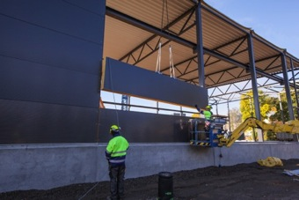
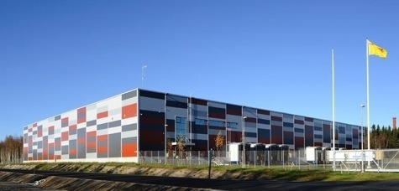
SANDWICH PANEL

Slide 8
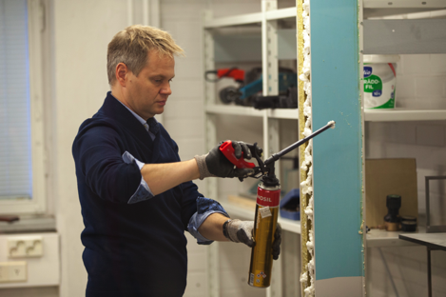
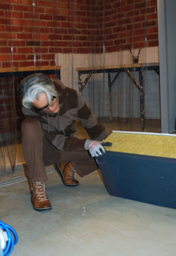
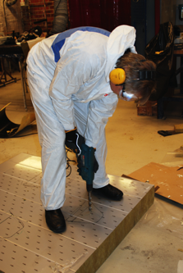
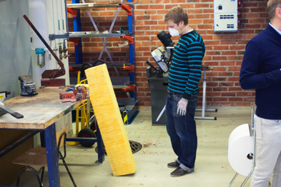
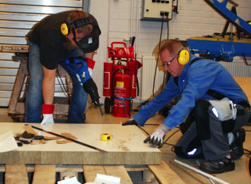
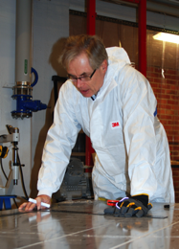
Instead of brainstorming and ideation on paper, workshop participants now work on sandwich panels by hand

Slide 9
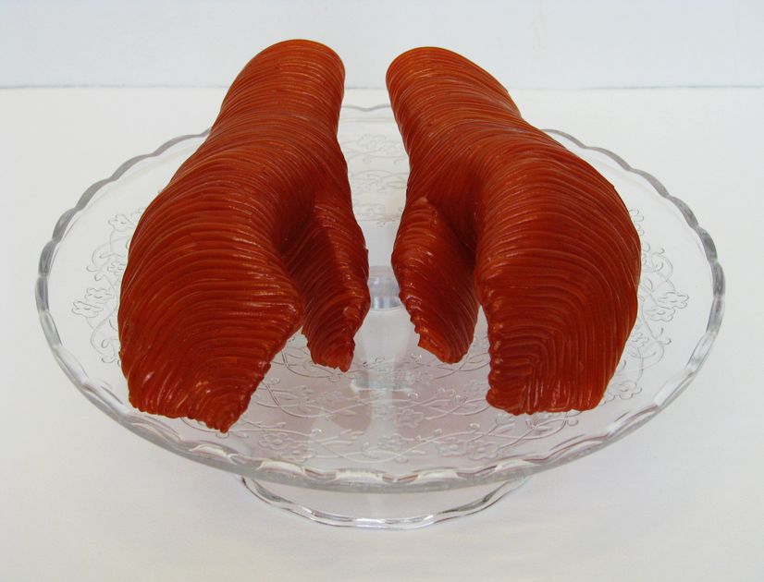

Slide 10
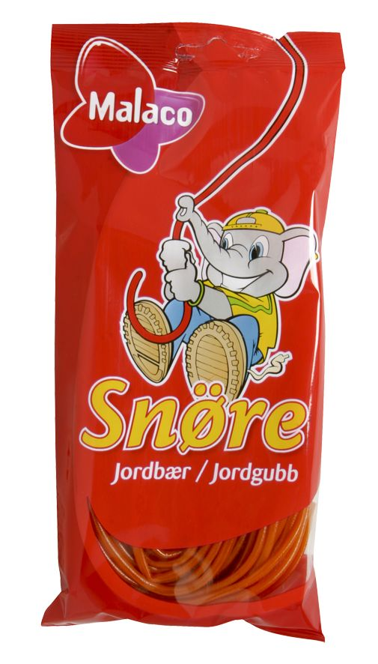

Slide 11
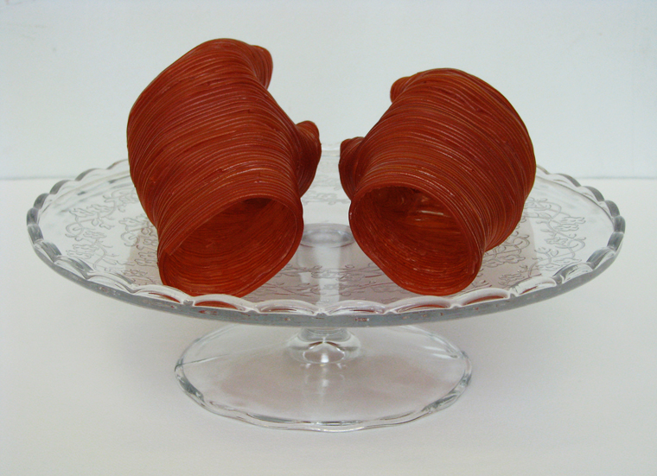
From Hand to Mouth, 2011, strawberry flavored candy laces, tape, glue, glycerol, acrylic varnish and glass cake stand, 18 x 29 x 29 cm

Slide 12
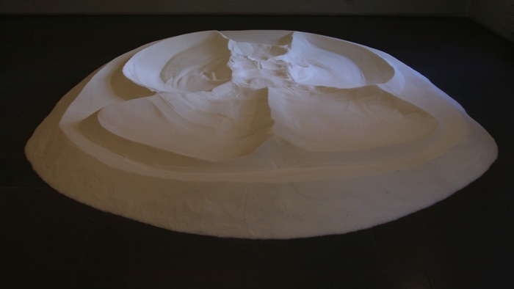

Slide 13
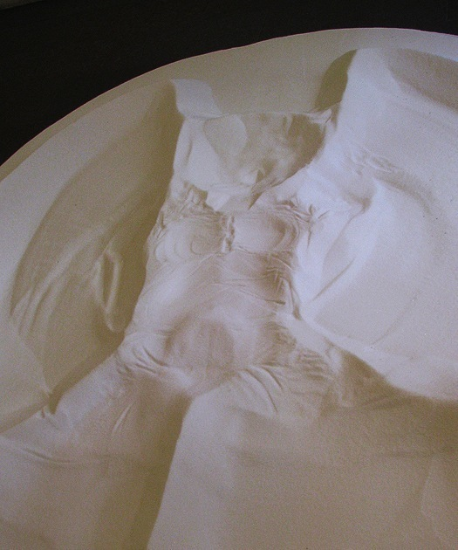
Ecstacy
2006 – 2009
granulated sugar
app. 35 x 300 x 250 cm

Slide 14
Pasi Karjula and Marko Vuokola, Olo n:o 22, 2000
polished steel, Hietalahti, Helsinki

Slide 15
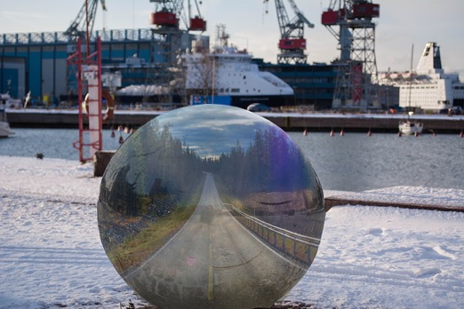
Adel Mekhane’s, Vesteri Ollinen’s, and Aaro Packalén's student work for We comment! assignment. The students commented the themes of traveling, transportation, and climate change. They combined the visual experience of the environment and digital image processing.

Slide 16
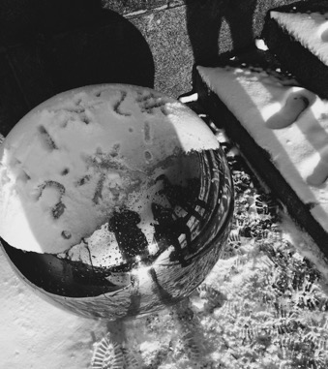
Aino Hörkkö’s, Katariina Kujapelto’s, and Julianna Tiirikka’s comic commentary
on Pasi Karjula’s and Marko Vuokola’s artwork. The students took a stand for
social and environmental issues in the winterly and urban environment.
The authors of the statement and the urban environment of the public artwork are
reflected in the underlying part of the artwork.
Notes:
art

Slide 17
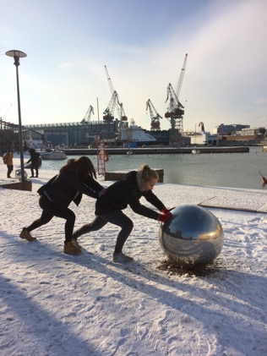
Silja Lampinen, Iina Martikainen, and Siri Piippo-Pinho worked on the We comment! assignment kineticly and performatively. The students used their own bodies as material of the new artwork they created.

Slide 18
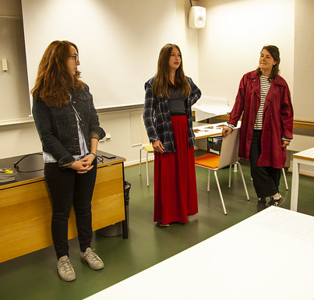
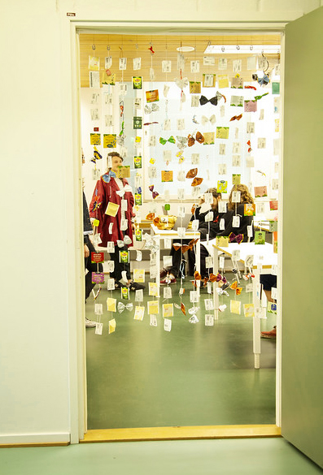
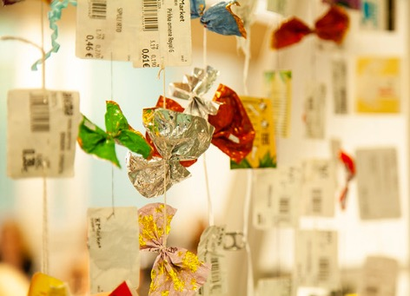
Photos by Elisa Dametto

Slide 19
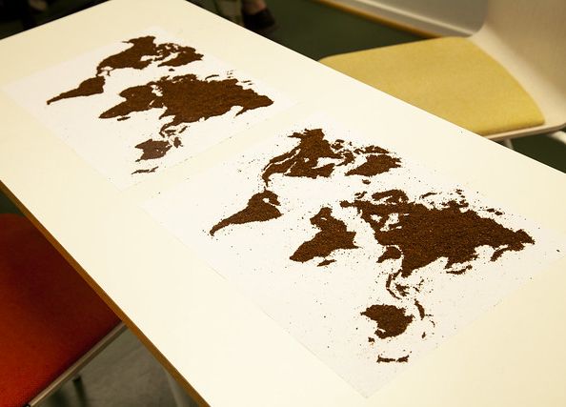
Photo by Elisa Dametto

Slide 20
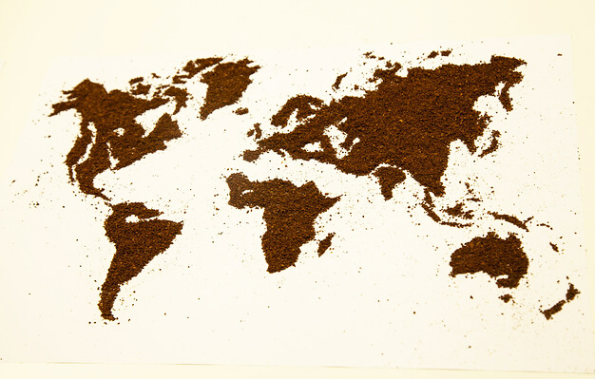
Photo by Elisa Dametto

Slide 21
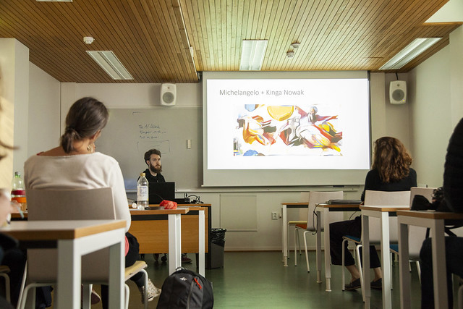
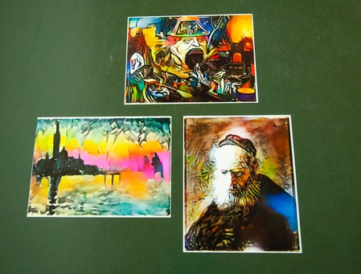
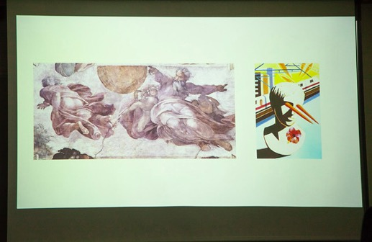
Photos by Elisa Dametto

Slide 22
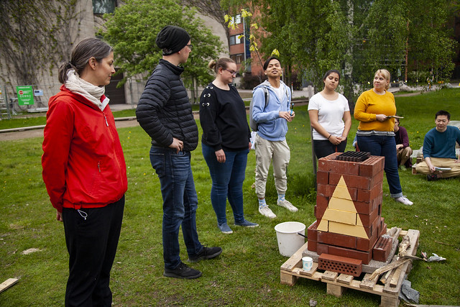
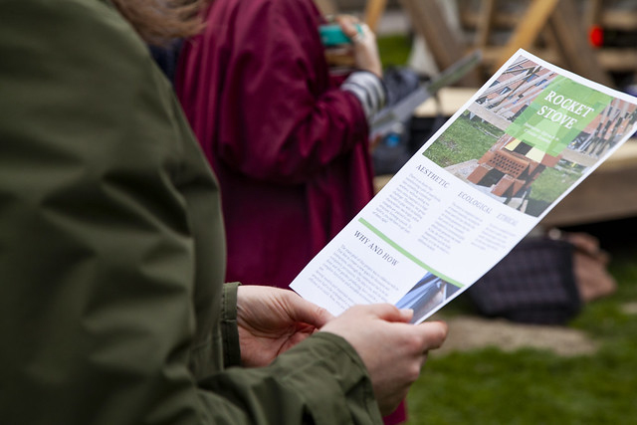
Photos by Elisa Dametto

Slide 23
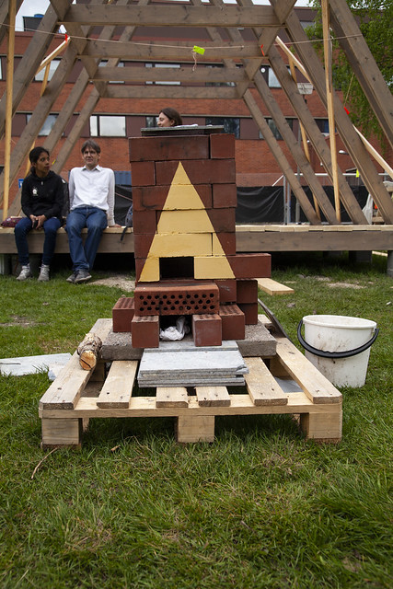
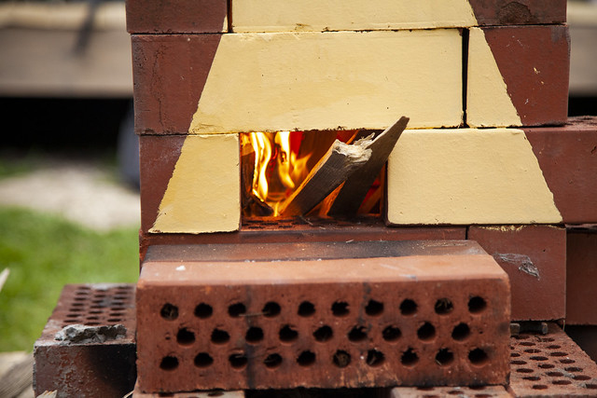
Photos by Elisa Dametto

Slide 24
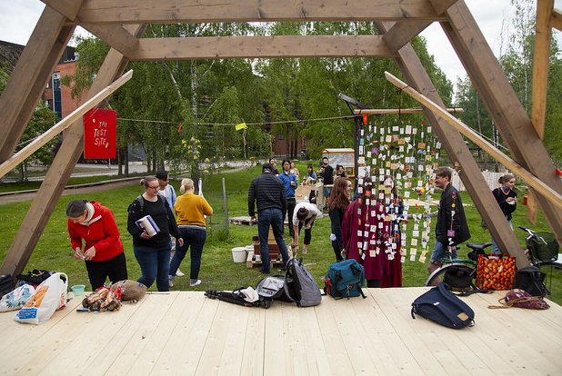
Photo by Elisa Dametto

Slide 25
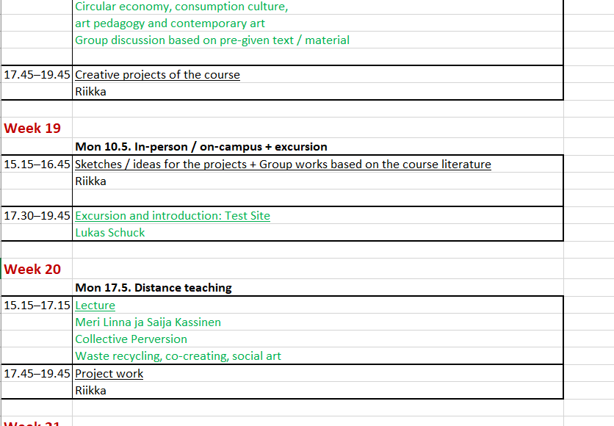

Slide 26
Or inspire by the lectures by the visiting lecturers of the course!
Dr. Raisa Foster
Dr. Taneli Tuovinen
Artist duo Meri Linna ja Saija Kassinen (yet to come)
Don’t forget the Tavarataivas / My Stuff movie!
And the course literature!!!

Slide 27
Project work. Let’s make experiments for making and consuming in the circular economy.
Circular economy can be also seen as a change of consumer culture in society
The cultural and social play a key role in consumption and recycling
In material circulation, besides concrete materiality, mental images and cultural and social materiality are important
The communal, social, and cultural material inexorably influence consumption habits

Slide 28
Project work. Let’s make experiments for making and consuming in the circular economy.
Let’s work on the cultural and social material that play a key role in consumption and recycling!
Can we imagine, envision and test beyond today's realities and solutions?
Let’s work so that the radical intertwinement of aesthetical, ethical and ecological can be a reality!

Slide 29
INDUSTRIAL DESIGN AND CYCLIC ARTISTIC PROCESS
Not worth thinking about either or – but both of that!

Slide 30
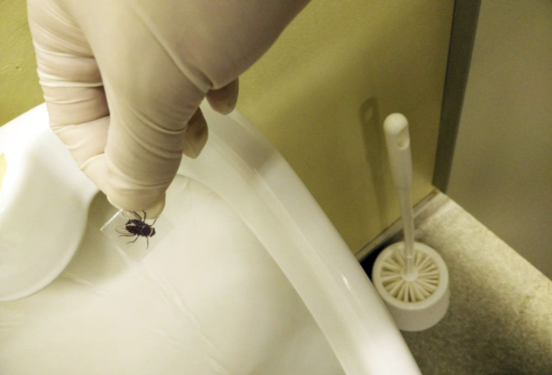
One more example - a peculiar one
Yle, Climate crisis, 2 May 2021
https://yle.fi/uutiset/3-11906818
Sustainability issues can be presented to people so that the desired option is an attractive or effortless choice (nudging).
In Amsterdam, at Schiphol Airport, flies appeared in the urinals of men's toilets. The men could not help but aim at the fly at the bottom of the urinal. This is exactly what was wanted. Splashes and thus cleaning costs were significantly reduced - up to 80% and without preaching.

Slide 31
Course diary
The students keep a course diary (for example, in the digital form or as a portfolio), where they discuss and reflect on the questions raised in the course, both from the point of view of their own field and from the point of view of artistic methods, and where they present the course assignments. The course diary has to be handed in to pass the course.
3.
Start the ideation and skecthing for the project work. You can make an individual project or work as a group.
Is your life and choices good for sustainability?
Or do you have any habits you could develop to be more environmentally friendly?
Is there a problem in our society that you would like to find a solution or a partial solution to?
Remember, anything is possible, and you should have gasoline for group discussions!

Slide 32
Readings
1. Soini, K.; Dessein, J. Culture-Sustainability Relation: Towards a Conceptual Framework. Sustainability 2016, 8, 167
https://www.mdpi.com/2071-1050/8/2/167
2. Mäkikoskela, Riikka. 2018. FROM FAR TO CLOSE (AND BACK). MATERIAL RESISTANCE AND CHANGING PERSPECTIVES IN VISUAL ART PRACTICE. Synnyt/Origins Journal, Issue 3: Special issue on Catalyses, Interventions, Transformations, 349–378
https://researtsedu.com/2018-december-issue
Niinimäki, Kirsi (ed.), 2018:
Sustainable Fashion in a Circular Economy
https://shop.aalto.fi/media/filer_public/53/dc/53dc45bd-9e9e-4d83-916d-1d1ff6bf88d2/sustainable_fashion_in_a_circular_economyfinal.pdf
Especially the chapters:
3. Collaborative Consumption and the Fashion Industry (Henninger, Jones, Boardman & Mc Cormick)
4. Designing for a Circular Economy (Balkenende & Bakker)

Slide 33
Pick two articles/chapters from the reading list.
Please, read them by the 10th of May!
Then, we will have group works based on the text ☺

