Slide 1
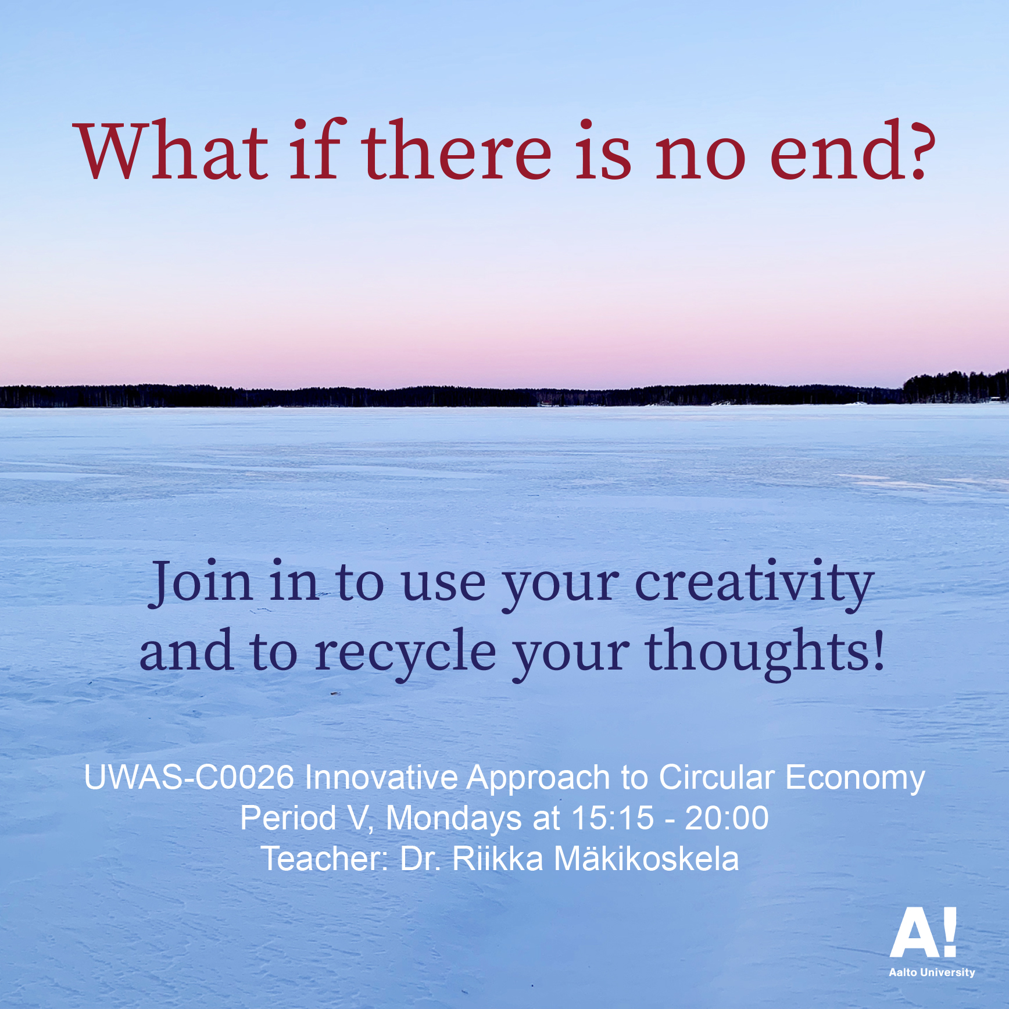

Slide 2
Mon 10.5. In-person / on-campus + excursion to the Test Site
Internal instructions related to coronavirus:
https://www.aalto.fi/en/aalto-university/internal-instructions-related-to-coronavirus
Teaching may be arranged on campus when the nature and goals of the teaching demand, for example, for experimental work and artistic activities. Schools are responsible for identifying and prioritising such teaching.
If you have any questions about course arrangements at the general level, you can contact the UWAS office.
If you have symptoms of a cold, influenza or some other infectious disease, stay at home.

Slide 3
When you arrive on campus:
Make sure you comply with the general hygiene instructions and wash your hands.
We use face masks in all university indoor spaces, except in the case of individuals who are prevented from doing so for health reasons. If you forget to bring a mask, you may obtain a spare one from the lobby services of the building.
The safety distance between two persons must be two metres at a minimum. Everyone is responsible for seeing to their own physical distancing.
Avoid staying in public indoor spaces on campus.

Slide 4
Mon 10.5. at 15.15–16.45
Lecture rooms: Q201 ja Q202 at Väre
Group works based on the course literature and lectures
+
Sketches / ideas for the projects

Slide 5
Readings
1. Soini, K.; Dessein, J. Culture-Sustainability Relation: Towards a Conceptual Framework. Sustainability 2016, 8, 167
https://www.mdpi.com/2071-1050/8/2/167
2. Mäkikoskela, Riikka. 2018. FROM FAR TO CLOSE (AND BACK). MATERIAL RESISTANCE AND CHANGING PERSPECTIVES IN VISUAL ART PRACTICE. Synnyt/Origins Journal, Issue 3: Special issue on Catalyses, Interventions, Transformations, 349–378
https://researtsedu.com/2018-december-issue
Niinimäki, Kirsi (ed.), 2018:
Sustainable Fashion in a Circular Economy
https://shop.aalto.fi/media/filer_public/53/dc/53dc45bd-9e9e-4d83-916d-1d1ff6bf88d2/sustainable_fashion_in_a_circular_economyfinal.pdf
Especially the chapters:
3. Collaborative Consumption and the Fashion Industry (Henninger, Jones, Boardman & Mc Cormick)
4. Designing for a Circular Economy (Balkenende & Bakker)

Slide 6
ASSIGNMENT
Pick two articles/chapters from the reading list.
Please, read them by the 10th of May!
Then, we will have group works based on the text ☺

Slide 7
15.15–15.55 Q201 at Väre
Group 1
Group 2
15.15–15.55 Q202 at Väre
Group 3
Group 4

Slide 8
Assignment 1 for the group work
The importance of the cultural dimension has strengthened in ecological thinking. How can culture be understood within the context of sustainability and circular economy?
Discuss and pick one long-lived product, service or widely known artwork, which has evolved in several time periods.
Can it be said that a product, service or work of art includes culture as capital or cultural capital?
Can it be said that a product, service or work of art is related to culture as a way of life?
Can it be said that a product, service or work of art includes culture as semiosis (the process of signification and meaning making)?
Do these features or characteristics mentioned above make the product, service or work of art sustainable and environmentally friendly?
What should be changed in a product, service or work of art to be in line with the circular economy?

Slide 9
Course diary
The students keep a course diary (for example, in the digital form or as a portfolio), where they discuss and reflect on the questions raised in the course, both from the point of view of their own field and from the point of view of artistic methods, and where they present the course assignments. The course diary has to be handed in to pass the course.
4A
Describe your group’s work on your course diary

Slide 10
16.00–16.40 Q201 at Väre
Group 1
Group 2
16.00–16.40 Q201 at Väre
Group 3
Group 4

Slide 11
Assignment 2 for the group work
Introduce to your group members at least one and a maximum of three of your ideas for project work. Consider for a moment how the idea(s) could be developed further towards implementation.
Also discuss whether the ideas of the group members are of the same type and whether you could collaborate and set up a group for the course’s project works.

Slide 12
Course diary
The students keep a course diary (for example, in the digital form or as a portfolio), where they discuss and reflect on the questions raised in the course, both from the point of view of their own field and from the point of view of artistic methods, and where they present the course assignments. The course diary has to be handed in to pass the course.
4B
Develop your idea based on the group discussion to move towards implementation

Slide 13
If you do the whole course remotely
Do the assignments 1 and 2
Form a group of your loved ones or family members. Invite, for example, your brother, sister, mom, dad or your boy friend or a girl friend to discuss with you about the assignments.
Course diary 4 A ja B: discuss and reflect on the assignments 1 and 2

