Slide 1
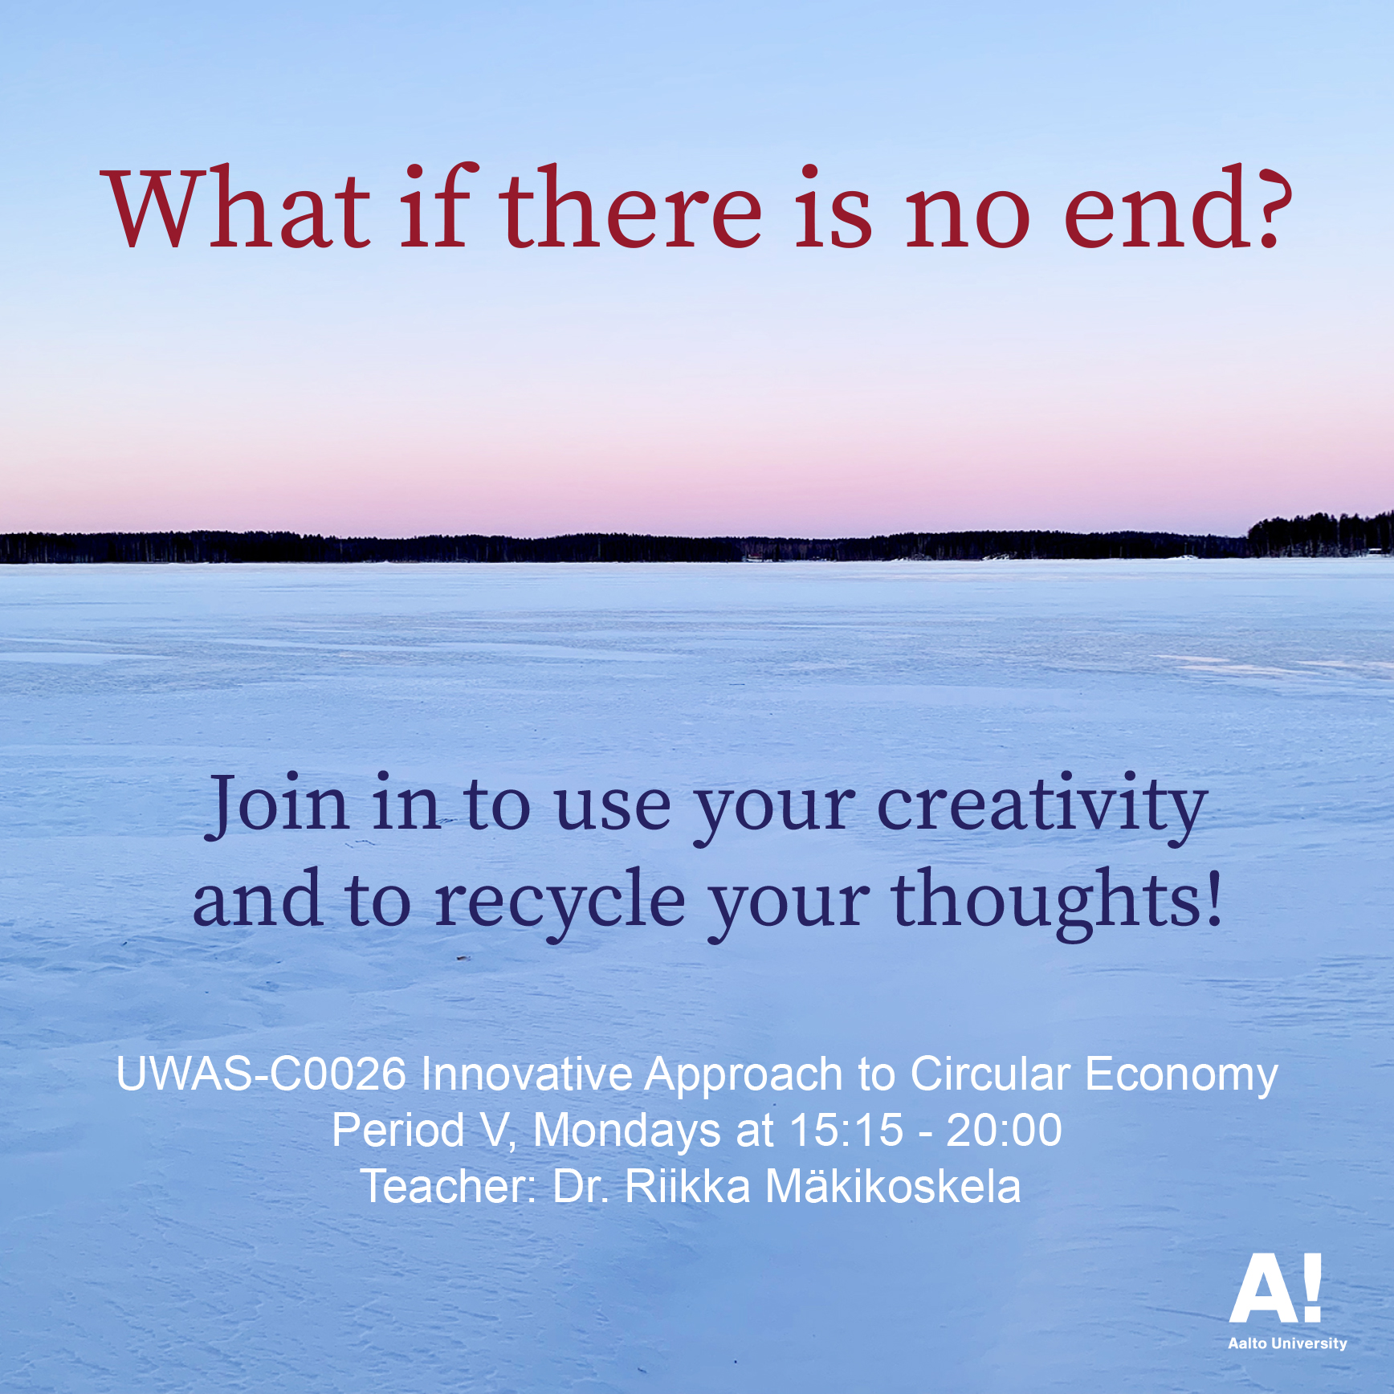

Slide 2
Course diary
The students keep a course diary (for example, in the digital form or as a portfolio), where they discuss and reflect on the questions raised in the course, both from the point of view of their own field and from the point of view of artistic methods, and where they present the course assignments. The course diary has to be handed in to pass the course.
5
Continue doing the project work. Describe your / your group’s progress in the diary. Take photos and / or video of the process, draw or write about your thoughts and work. You can take advantage of all this process description when you present your project work next Monday. I will send you more detailed instructions for presentations.

