Slide 1
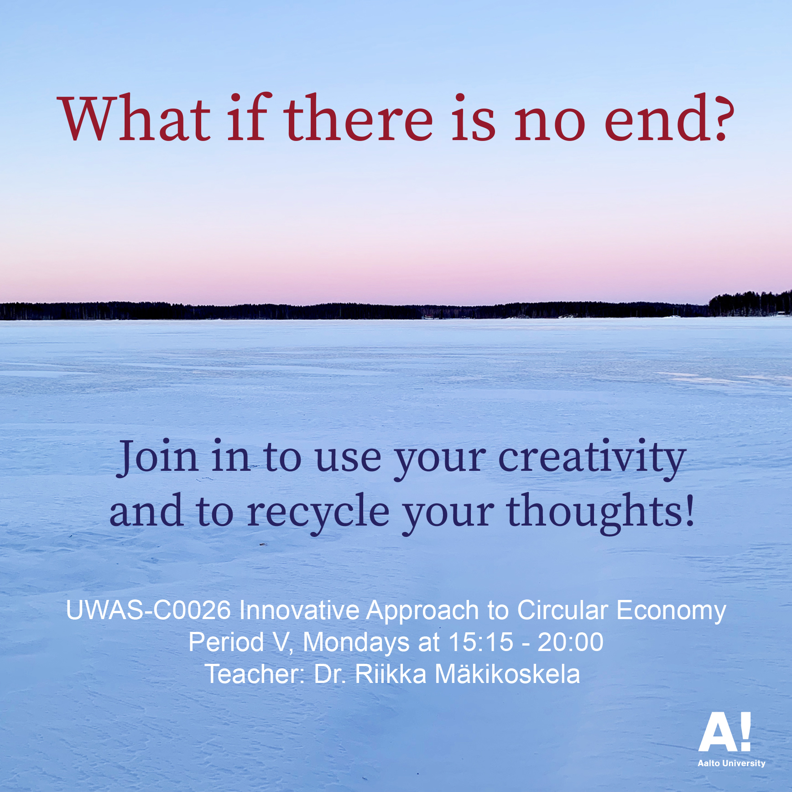

Slide 2
Prepare to present your thinking and making on Monday 24 May 2021
First module on Teams at 15.15: Project work presentations
Present your project work orally and, for example, with slides, sketches, photos and videos
Please, make your / your group’s thinking visible

Slide 3
Illustrate your / your group’s process with the project work. Here, you can utilize everything you have done on the course diaries.
Focus on material circulation and recycling ideas
If you have made an object or a product, please, think and present what to do with it after the course
We have 10 minutes for each project work presentation

Slide 4
Schedule for project work presentations
1. Time 15.15-15.25 Anni
2. Time 15.25-15.35 Mari
3. Time 15.35-15.45 Max
4. Time 15.45-15.55 Irina, Emily & Jesse
5. Time 15.55-16.05 Carlotta, Samyukta, Eszter & Marek
Break
6. Time 16.15-16.25 Lara
7. Time 16.25-16.35 Nina, Elina & Daniel
8. Time 16.35-16.45 Veera
9. Time 16.45-16.55 Pihta
10. Time 16.55-17.05

Slide 5
To finish your course diary
The students keep a course diary (for example, in the digital form or as a portfolio), where they discuss and reflect on the questions raised in the course, both from the point of view of their own field and from the point of view of artistic methods, and where they present the course assignments. The course diary has to be handed in to pass the course.
6
First, check the texts you produced for the 1st course diary assignment:
A Circular Economy (about 100–200 words for each)
B Art
C Change in Consumption/Consumer Culture

Slide 6
Read the rest of the course literature. After the course lectures, excursion, group works and project work, think again. Also reflect from your discipline and develop your texts on.
About 200-300 words for each: A Circular Economy, B Art, C Change in Consumption/Consumer Culture
For example:
What could be your and/or your disciplines role in circular economy?
What are the art’s and creative practices’ possibilities for ecological and social issues?
How do you see the change, what should be first done to change out consumption habits?

Slide 7
How and when to hand in your course diary?
If your course diary is in a digital form, please, send it to me via email, riikka.i.makikoskela@aalto.fi
If your course diary is in a paper form, please, send it to my address: Riikka Mäkikoskela, Henrik Sohlbergin tie 25 a 2, 00640 Helsinki
The dead line for course diaries is 31 May 2021

Slide 8
Please, note that my Aalto email closes 1 June 2021. My other working email is riikka.makikoskela@aka.fi
If you need your course credits earlier than the normal procedure, hand in your course diary early enough that I can send your credits on.

