Slide 1
Phase I – Rational/USP Branding
Product Attribute + Brand Association (if needed)

Slide 2
The Biggest Branding Opportunity since…

Slide 3
Differentiation comes from Ingredients

Slide 4
Differentiation comes from product outcomes
The key to branding is that consumers perceive differences among brands in a product category.
- Kevin Keller

Slide 5
Brand Manager as a Product Differentiator

Slide 6
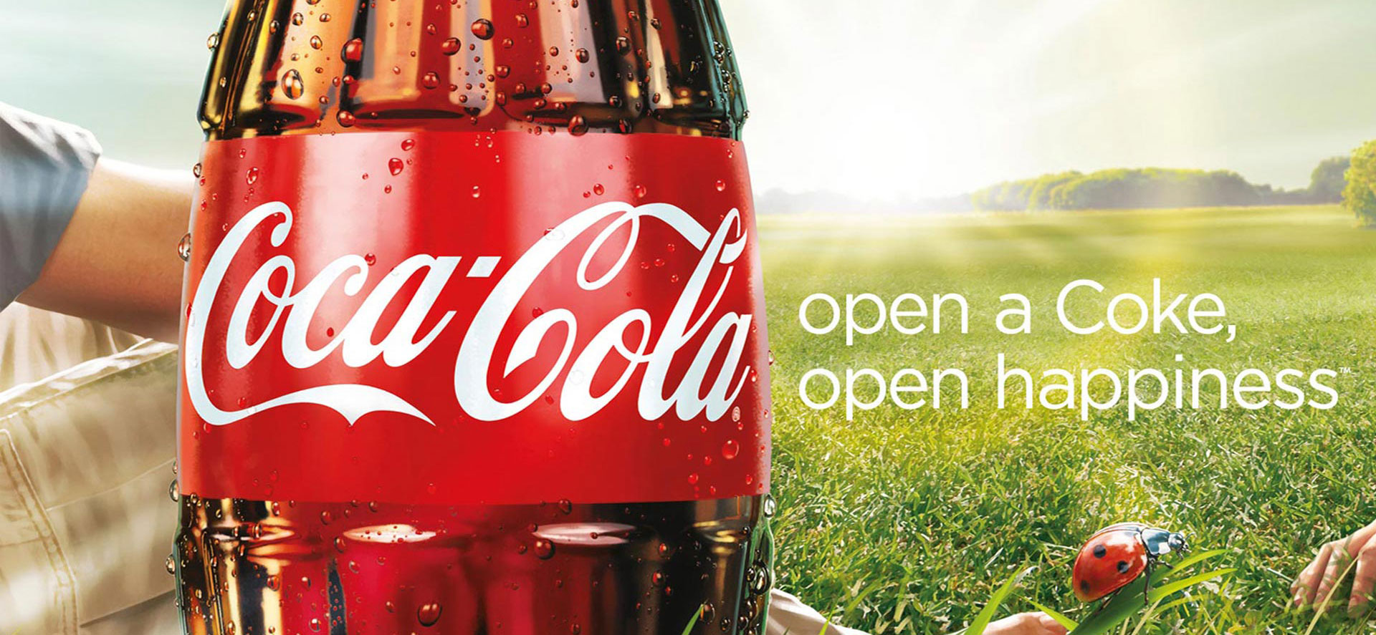
Phase II – Emotional Branding
Consumer’s Emotional State > Product

Slide 7
Moving away from Product attributes
https://www.youtube.com/watch?v=1jmqeLNCDJc

Slide 8
Emotional Branding – Red Bull

Slide 9
Brand Manager as Emotional Manipulator
Remember the “wheel” video

Slide 10
Phase III – Cultural Branding
Cultural conversation + Brand Meaning + Product

Slide 14
Brand Management as cultural entrepreneurship
Difference in conceptualizing consumer needs
Consumer as a social animal VS consumer as an individual benefit seeker
Cultural Insight vs Consumer Insight

Slide 15
Phase III – Experiential Branding
Desired consumer experience + emotional script

Slide 17
Many place brands
Camino De Santiago

Slide 19
Something to reflect upon
What are the necessary conditions for each branding approach to be successful?
What were the things you agreed with?
What were the things you disagreed with?

