Slide 1
Business Communication Skills
61A00200
Session 2 (4 November)
Lecturer: Mark Badham

Slide 2
Today’s agenda
Effective Business Writing
Review & edit A1 Written Request in groups: Strategy Analysis & Request: Collect now
Fine-tune A2a Individual Persuasive Presentation Strategy Outline: Collect 1 copy from each student now

Slide 3
Mark Badham
Organisational communication
Media publicity
Magazine editor
Weekly TV show & monthly health program on radio
Speeches
Publications (annual reports, magazines, newsletters, brochures, books, white papers, websites, intranets),
Corporate social media sites,
Media spokesperson,
National lobbying campaigns,
Public relations company.

Slide 4
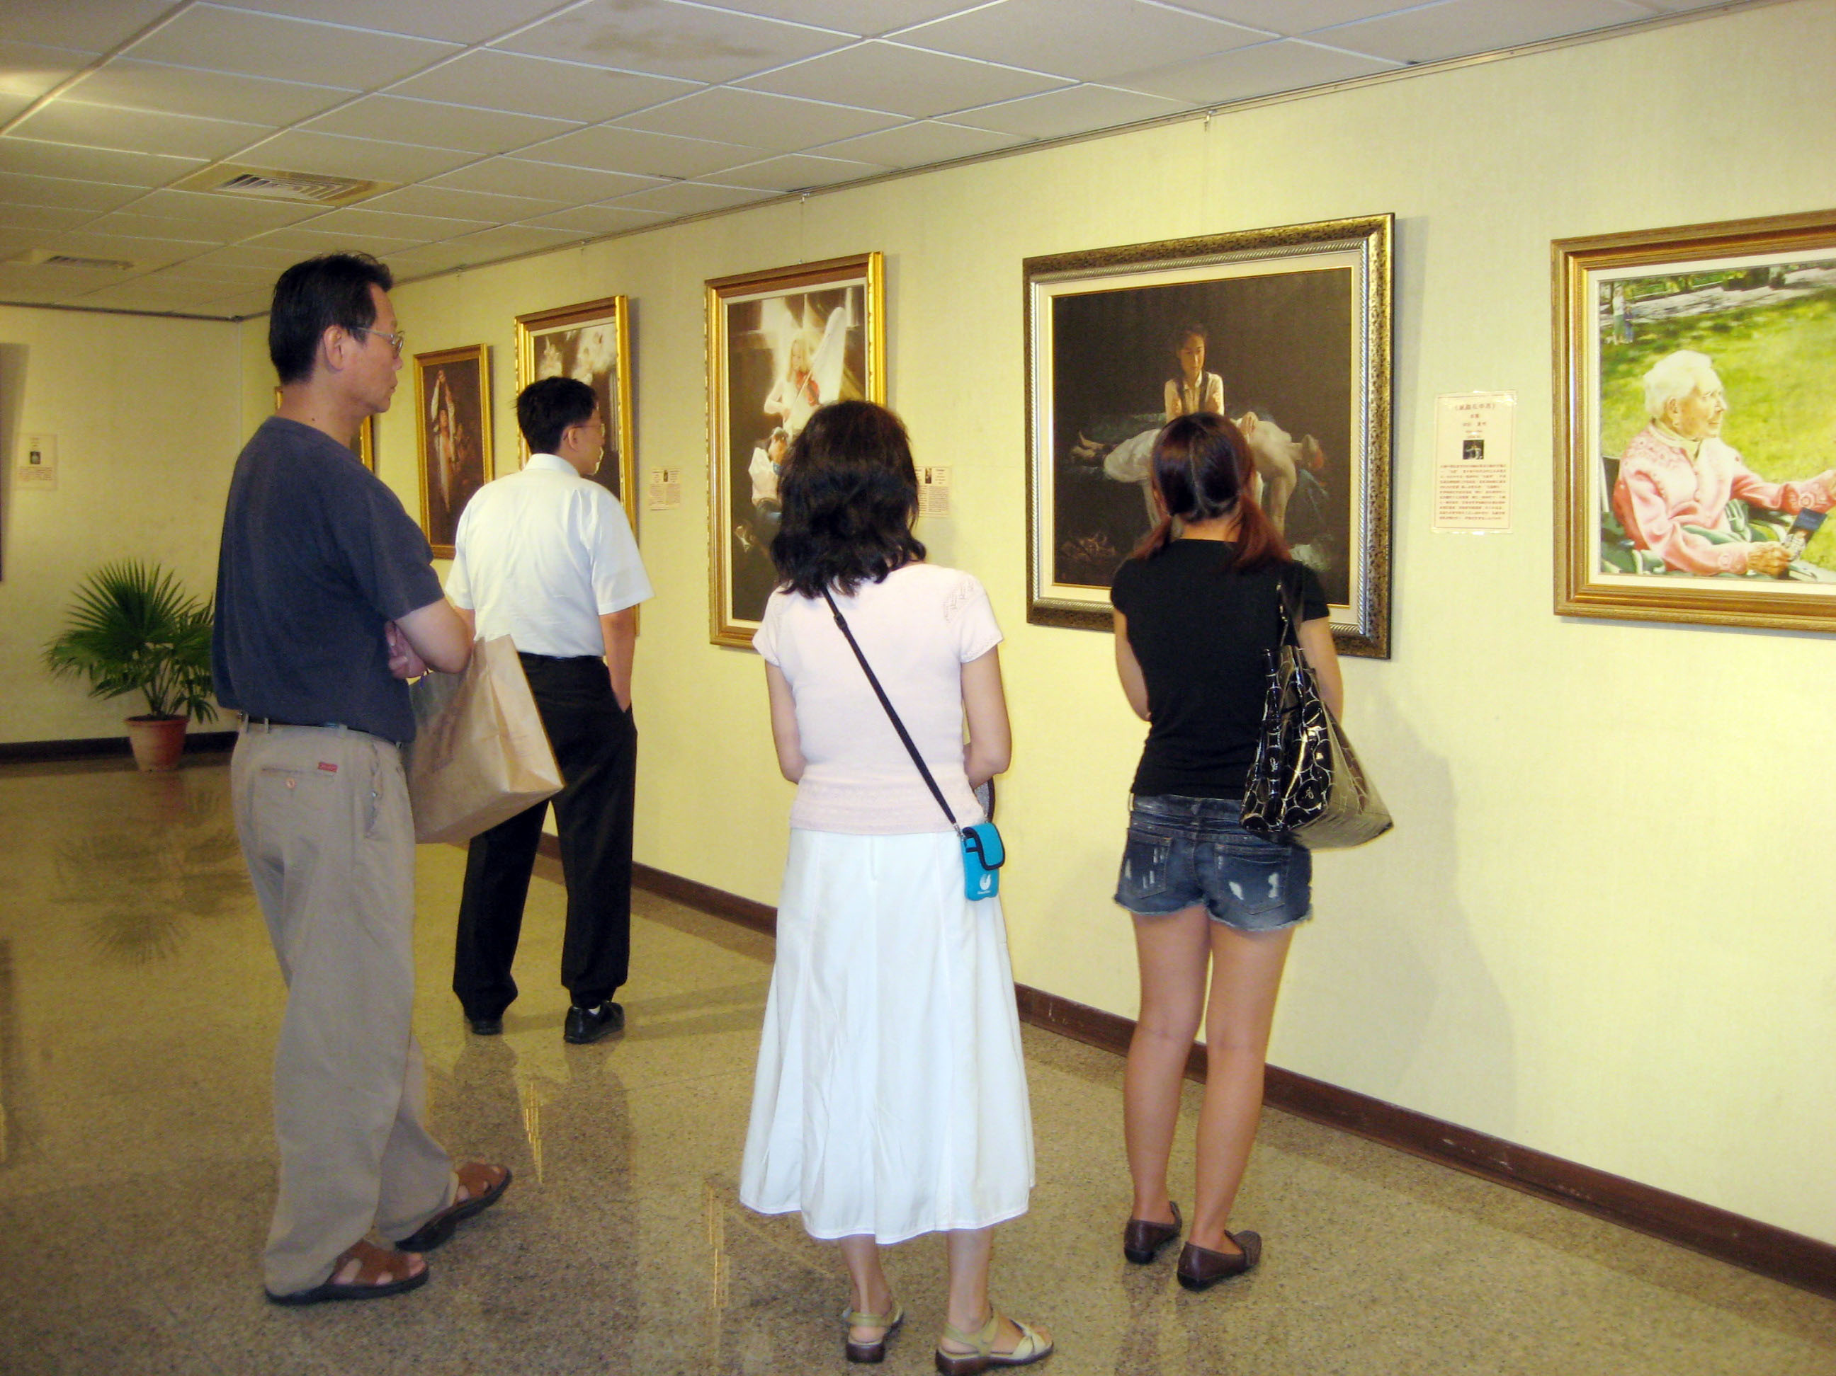
Gloria Jeans’ Coffees: Franchisee communication
Gold Coast City Council: Mayor’s public speeches
Gold Coast City Council: Taiwanese Art Exhibition sponsorship

Slide 5
Define
objectives,
choose style
SITUATION
Analyse
audience
Assess
credibility
Communicating
strategically
DESIGN
Choose
channel
Craft
message
Notes:
Comprenhensive knowledge of company’s product. Including product features and recent innovative product. Sales and negotiating, best product mix to meet customer need. 그 이외 key competence, help to ensure the company vision and strategy. President’s management policy.
In the same boat, rowing same direction.

Slide 6
“MESSAGE STRATEGY”
Beginnings & endings
Message organisation: Direct (get to the point) or indirect?
Message content: Achieving an appropriate mix of
Ethos (character/trustworthiness)
Pathos (emotions)
Logos (logic).
Craft
message
Aristotle in Business Communication (2007)

Slide 7
Choose message organisation
Direct
Indirect
Main idea
Explain
Explain
Main idea

Slide 8
Beginnings & Endings
The Middle:
Chunking
Repetition
Flagging signals
The unexpected gets attention
Storytelling
Craft
message

Slide 9
BUSINESS WRITING
Composing Techniques
FIRST: Prepare Strategy Analysis
Communicator strategy
Audience strategy
Message strategy
Channel Choice strategy
Culture strategy
TIPS:
Write 1st draft
Edit &/or ask someone to check &/or test it
Edit again

Slide 10
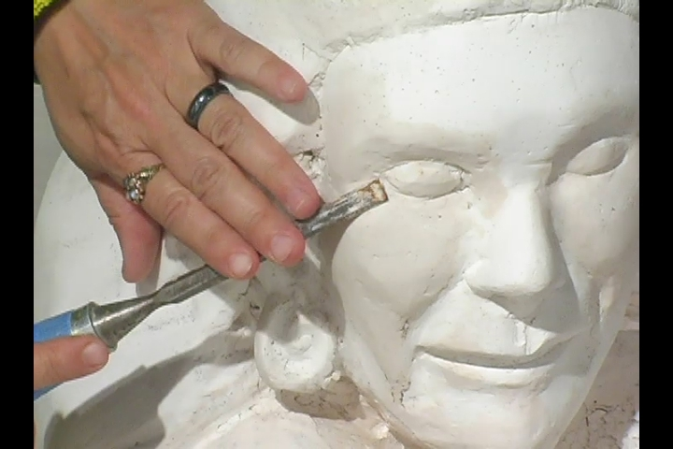
Composing Techniques
1. Research:
Interview/s
Company documents
Company communications (eg emails)
Surveys
5Ws & H
4. Draft:
Start with lots of text
Like sculpture, begin with ‘mess’ (in Draft stage) & methodically perfect (in Edit stage)
2. Organize (Structure):
Group ideas: mindmap/idea chart
5. Edit:
For strategy 1st
For macro issues
For micro issues
For correctness (eg spelling, grammar & punctuation)
3. Focus:
Skim
Nutshell
Bottom line
Elevator pitch
Busy boss

Slide 11
Composing Techniques
5. Edit:
For strategy 1st
Communicator strategy
Audience strategy
Message strategy
Channel Choice strategy
Culture strategy
For macro issues: Paragraphs & sections
Progression & linkages & connections
For micro issues: sentences & words
Brevity
Appropriate style (formal/informal)
For correctness (eg spelling, grammar & punctuation)

Slide 12
Composing Techniques
MACRO Writing
Headings & subheadings
Stand-alone sense
Action words
Questions
White space: indents, spacing, lists

Slide 13
Composing Techniques
MACRO Writing
Progression & linkages:
Introduction
Section heading 1
First subsection heading

Slide 14
MICRO Writing
Avoid wordiness
Shorten & vary lengths of sentences
Bold, underline, capitalize, headings, sub-headings
Style – depends on:
Relationship with audience
Communication context: indirect & impersonal in academic context vs direct & personal in business
Nature of message: good vs bad news, sensitive vs non sensitive

Slide 15
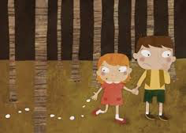
MICRO Writing
Transitions (Hansel & Gretel bread crumbs):
Addition: And, in addition, again, also, similarly, finally…
Contrast: But, however, or, nevertheless, on the other hand…
Example: For example, for instance, such as, that is…
Sequence: First, second, third… then…
Conclusion: Finally, therefore, in conclusion, as a result…
Clarification/summary: In other words, what this means is, to summarize…

Slide 16
PWR Automation case
(available in MyCourses)
Discuss in groups

Slide 17
A2 Individual persuasive presentation
Exercise: In pairs, fine-tune each others’ Strategy Outline
Announcement: 60 second individual presentation ‘trailers’ will be held at the end of this session – prepare now
(Revised) Deadline for Strategy Outline: 5pm this Friday 6 November. Place in MyCourses + bring 2 copies to class in Session 3 (next week)

Slide 18
A2 Individual persuasive presentation – Strategy Outline
Peer review feedback – common challenges to overcome?

Slide 19
A1 Written request (group)
A1a Communication strategy analysis using Munter Ch 1 (10%)
A1b Email request (15 %)
Review & edit A1 Written Request in groups: Strategy Analysis & Request
Deadlines:
Draft due today
Teacher to email feedback by Friday 6 November
Final due 9am Wednesday 11 November via MyCourses

Slide 20
A1 Written request (group)
Teacher Feedback – common challenges to overcome

Slide 21
60 second individual presentation ‘trailers’
Outline context 1st

Slide 22
Assignments over the coming week
Deadline for final version of Written Request (A1):
I will email feedback by Friday 6 November
Final due 9am Wednesday 11 November via MyCourses
Revised deadline for Strategy Outline of A2a Individual Persuasive Presentation: 5pm this Friday 6 November. Place in MyCourses + bring 2 copies to class in Session 3 (next week)
Finalise your A2a Individual Persuasive Presentation – to be presented to small groups in Session 3 (next week)
Prepare for in-class test in Session 4: Read Munter chapters I, III and IV

