Slide 1
Business Communication Skills
61A00200
Session 3 (11 November)
Lecturer: Mark Badham

Slide 2
Today’s agenda
High Impact Presentations
Individual Persuasive Presentations in groups
Discuss A4 Team Presentation & A3 Test

Slide 3
High Impact Intros
Create motivation: what’s in it for me?
Promise of new ideas or info
Solution to a problem they are facing
Gain credibility
Context/Overview
Arouse interest – “grabbers”
Great Grabbers!
Surprise: interesting facts, stats or controversial claims
Question
Quotation: ‘However beautiful the strategy, you should occasionally look at the results.’ – Sir Winston Churchill

Slide 4
High Impact Conclusions
Repeat key message/s
Link back to Intro
Call for action - next steps
Finish on high note (something to clap about & get audience talking in the break)
“Feelgood” or “goodwill” endings

Slide 5
High Impact Transitions
First… next…
Why? Because…
Now let’s look at…
Here’s how I think we can solve this problem
You may be asking “How do we achieve that?” Well, let me tell you
Here’s my next point

Slide 6
High Impact Engagement
Speak directly to their needs, problem, situation:
“You may be a first-year student looking for part-time work.”
“You may be sitting there thinking ‘So what’s in it for me?’”
“When you go back to your office tomorrow, do this…”

Slide 7
More High Impact presentation tips
Use previews (agenda)
Consider the audience your friends
Give them powerful visualizations – metaphors, similes, mental images… like fireworks in their imagination
Own the content – eg Bit Bang experience
Simplify complexities – eg image of “wrestling” to show industry tensions…

Slide 8
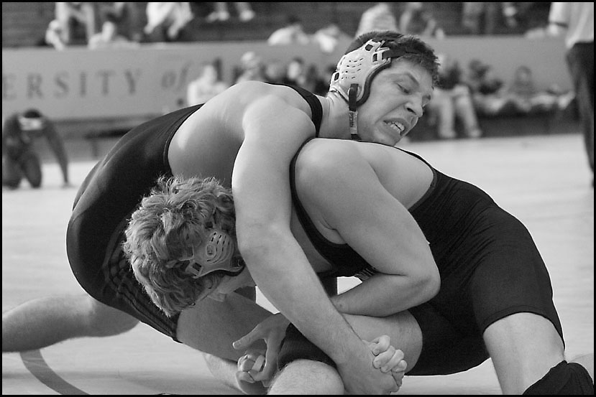
Power to the people

Slide 9
share
collaborate
produce

Slide 10
High Impact non-verbal presentation tips
Body language:
Posture
Body movement
Hand & arm gestures
Facial expression
Eye contact
Notes?

Slide 11
High Impact non-verbal presentation tips
Vocal traits:
Intonation
Volume
Rate
Pauses

Slide 12
A2 Individual Persuasive Presentations
6-8 minutes each presentation + give feedback
Peer feedback to be based on:
Audience orientation
Organization: intro, body, conclusion
Delivery
Visual design
Language (oral delivery)
Rooms:
R001/U359a
R001/U359b
R001/U359c
R001/U360a
R001/U262

Slide 13
Feedback on Individual Persuasive Presentations
Debriefing on individual presentations: 1 person / group to talk about what was done well & what could have been done better
Class feedback discussion based on:
Audience orientation
Organisation: intro, body, conclusion
Delivery
Visual design
Language (oral delivery)
Common challenges?

Slide 14
A3 In-class test (Session 4)
Based on Munter textbook: chapters I, III and IV
Begin at 2.15pm in PC classroom U257
90 minutes
Closed book: no notes, no textbook, no internet
Upload to In-Class Test folder in MyCourses

Slide 15
Assignment 4: Persuasive team presentation (15%) & critical appraisal (10%)
See details in MyCourses
Teams to choose their topics this week

Slide 16
Preparation for session 4
Individual Persuasive Presentation reflection paper (A2b) – due 5pm Wednesday 18 November in MyCourses
Prepare for in-class test (A3) beginning 2.15pm in room U257
Begin preparing for A4 final team presentation - including strategy outline due in MyCourses midday Tuesday 24 November

