Slide 1
Entrepreneurial
Mindset
Session 2
March 28, 2022
Sonja Hilavuo, Milja Hannu-Kuure, Lidia Borisova & Kyösti Ruuttunen

Slide 2
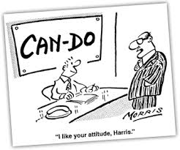
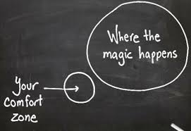
Our Starting Point

Slide 3
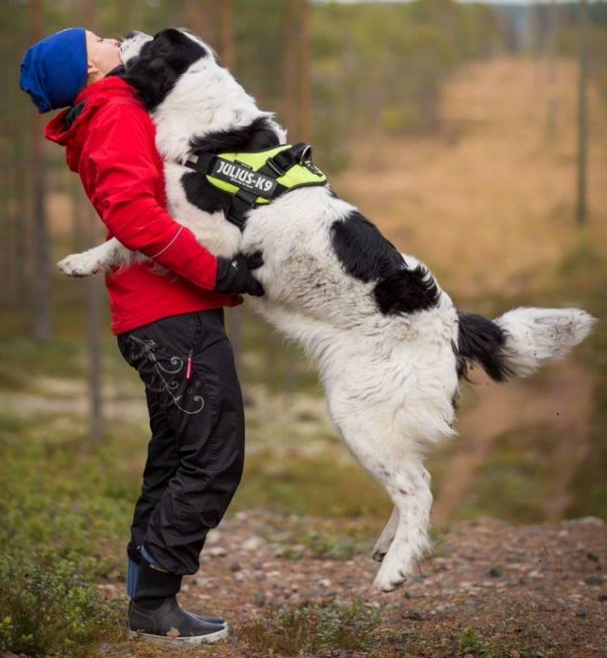
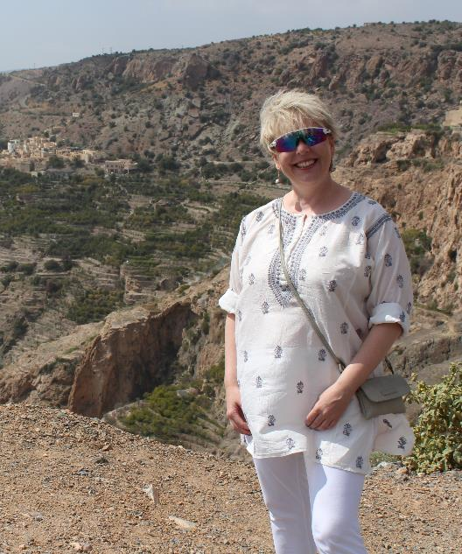
Discussing entrepreneurship and intrapreneurship
Milja Hannu-Kuure
Founder, Entrepreneur
Sonja Hilavuo
Board Executive, Intrapreneur
Notes:
Over 40 years of enjoyable working life ahead …

Slide 4
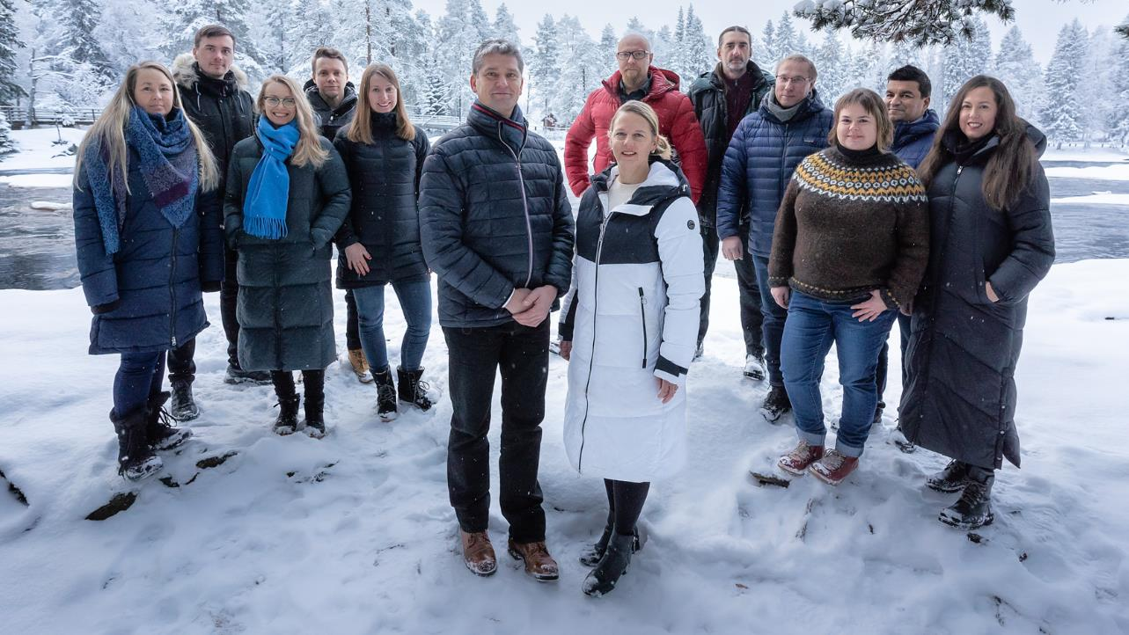
Brightplus: 3,85 M€ Growth funding received
”The talented team in Brightplus has developed and patented a technology that is able to meet growing biomaterial needs of multiple industries in terms of performance and functionality. The company’s growth potential is significant, as a large number of manufacturers are looking to substitute fossil-based materials.
Jaakko Lampela, CEO Nordic Option

Slide 5
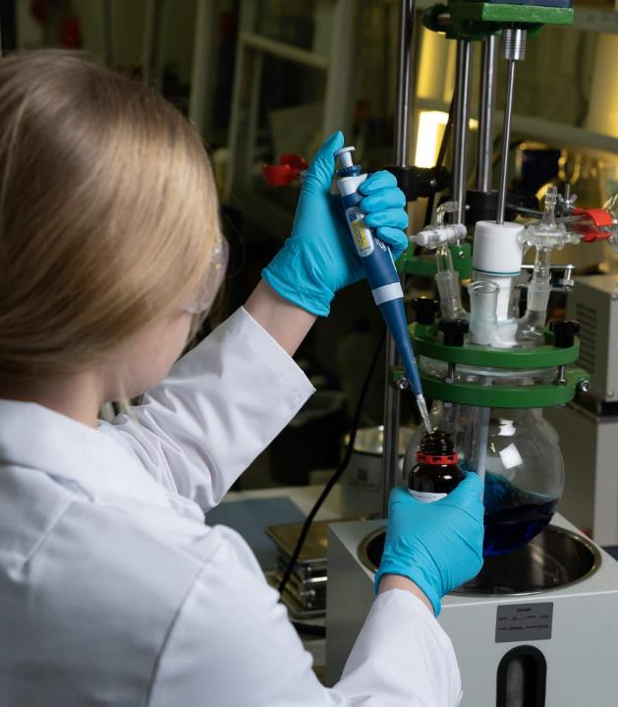
Career Journey
Milja Hannu-Kuure
Childhood
Studies
Start-ups
Founder of Brightplus, CEO

Slide 6
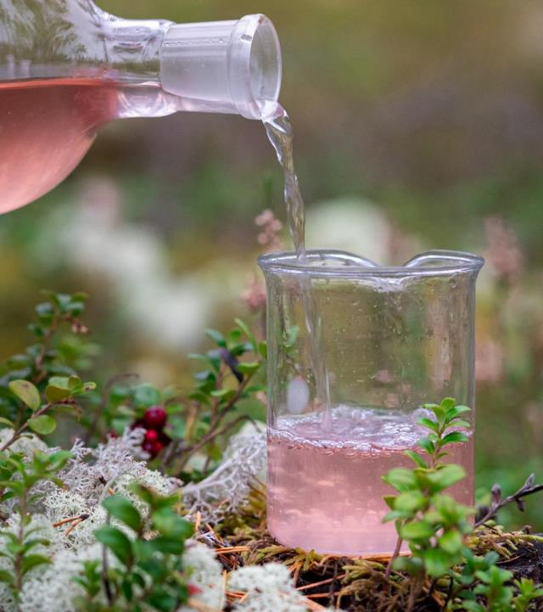
Practitioners’ perspectives
Transition from scientist/expert to a business leader
Entrepreneurial ways of working
Growth mindset

Slide 7
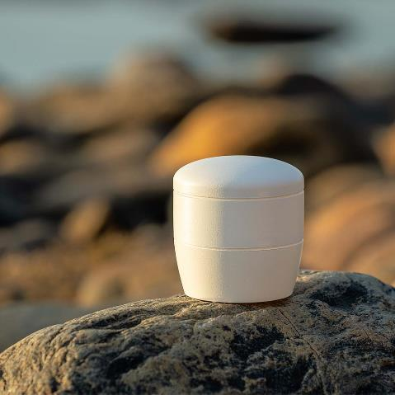
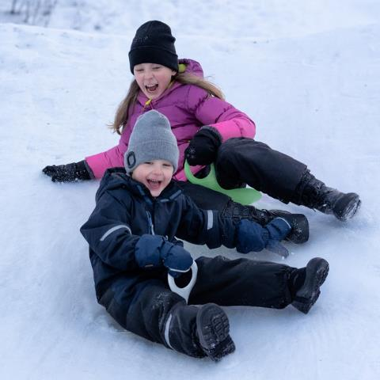
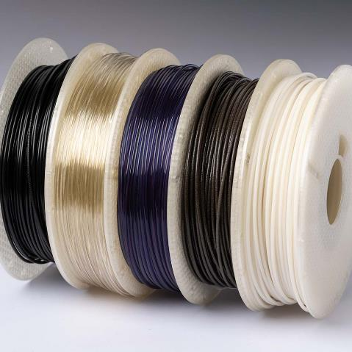
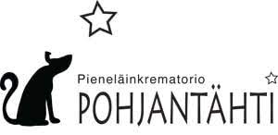
Building growth with customers
Biodegradable pet urn with Pek-Pohjantähti
Biomaterial toys with Wiitta
Sustainable filaments with Maker3D

Slide 8
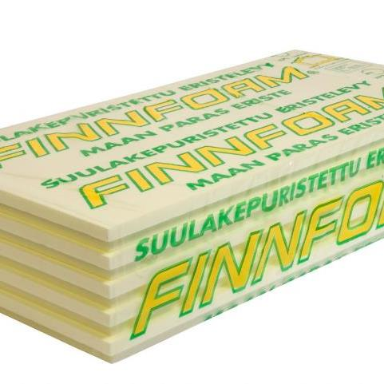
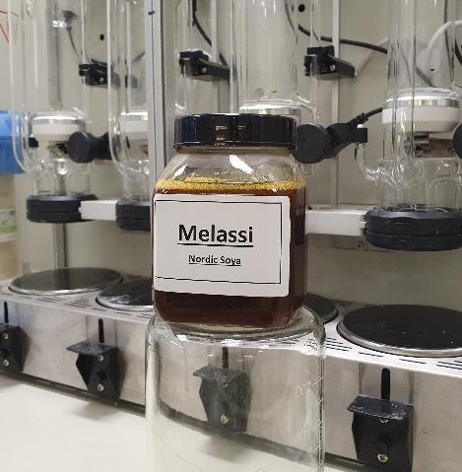
Building growth with partners
Biomaterials from feed production side-streams
Sustainable decorative natural colours
Recyclable construction materials with Finnfoam

Slide 9
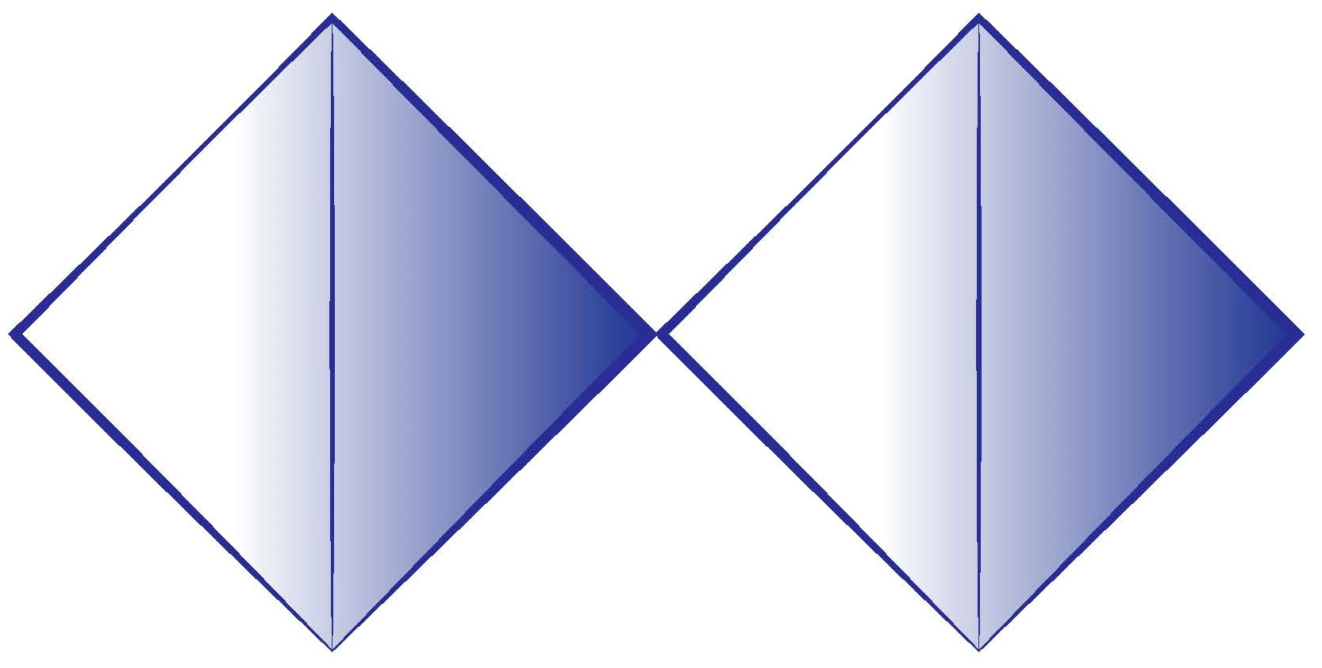
How to foster innovations in practice?
Perspectives on the Design thinking process. Double-diamond model.
t
convergence
divergence
divergence
convergence
The focus is on the problem
The focus is on the solution
Discover
Define
Develop
Deliver
http://www.designcouncil.org.uk/news-opinion/design-process-what-double-diamond
Notes:
Let’s pass to the core of the process – double diamond model – a simple visual map of the design process.
Why diamond – the sequence of divergence and convergence phases.
In all creative processes a number of possible ideas are created (‘divergent thinking’) before refining and narrowing down to the best idea (‘convergent thinking’), and this can be represented by a diamond shape.
But the Double Diamond indicates that this happens twice – once to confirm the problem definition and once to create the solution.
This model was created in 2005 by Design council UK to describe the stages of every design process
design thinking is too structured and linear. And for them, that’s certainly true. But managers on innovation teams generally are not designers and also aren’t used to doing face-to-face research with customers, getting deeply immersed in their perspectives, co-creating with stakeholders, and designing and executing experiments. Structure and linearity help managers try and adjust to these new behaviors
the structure of design thinking creates a natural flow from research to rollout.
But don’t be too process oriented. Is what many big companies are trying to do. To avoid a focus on process alone, develop a mindset and environment that are conducive to design thinking.

Slide 10
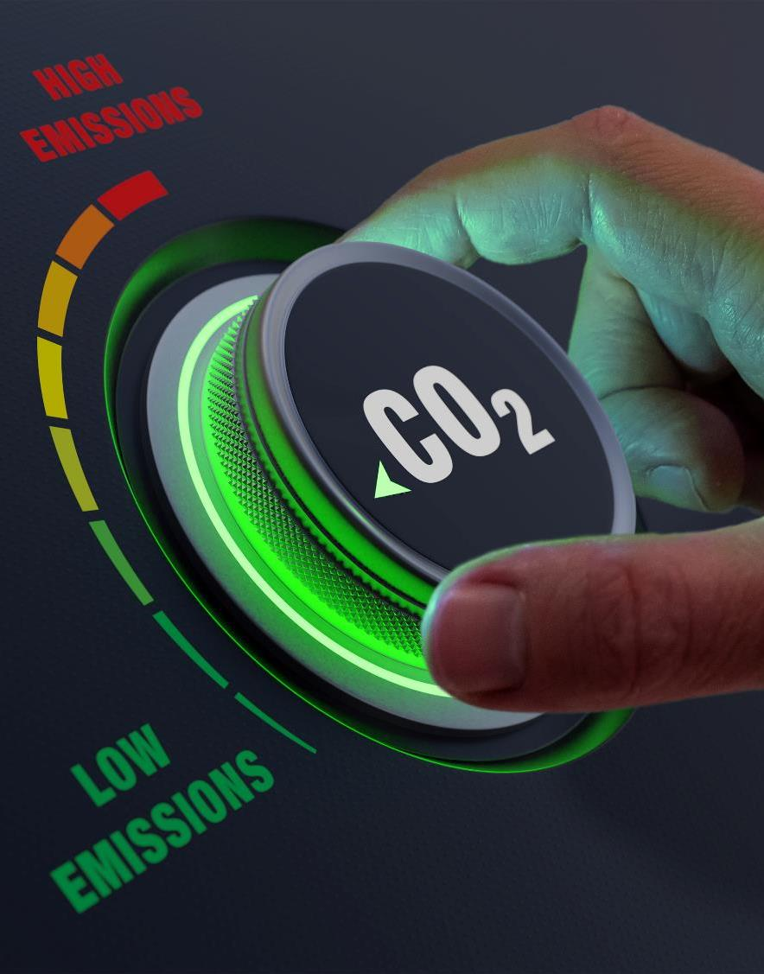
Building carbon neutrality
Our portfolio includes products with renewable content as high as 99.5 %.
Majority of our granulates have over 50 % renewable or recycled content.
We reduce the circularity gap. 30 % of our products contain industrial
side-streams such as bio ash.

Slide 11
Buzz groups in breakout rooms
What was interesting ?
What entrepreneurial ways of working can you see in Brightplus and Valmet stories?
How to foster growth mindset?
15 minutes

Slide 12
Conclusions from the company cases
Ideas
LEARN
BUILD
Lean Start-Up
THE LOOP
Data
Minimun Viable Product
(MVP)
MEASURE
Eric Ries, book “The Lean Startup”, 2008

Slide 13
LESSONS LEARNED
Stories from the road

Slide 14
RESPECT - Ethics & Integrity

Slide 15
Maintain solution mindset

Slide 16
Rigorous attention to detail

Slide 17
SIMPLIFY !

Slide 18
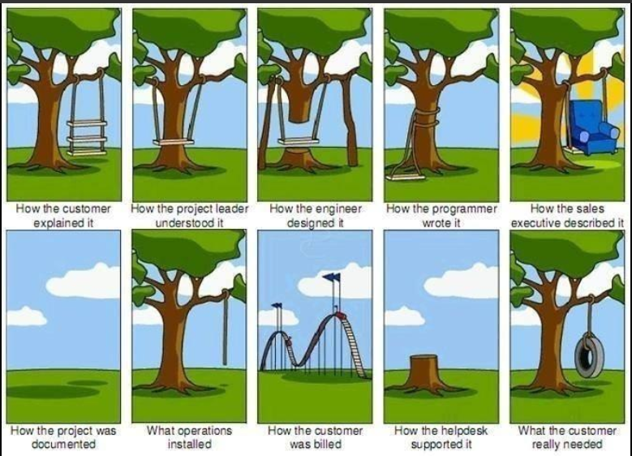
Never miss the fun of being in the customer interface

Slide 19
Final Essay on entrepreneurial mindset
Write an essay as an answer to the following questions:
Please, provide your definition of entrepreneurship? What entrepreneurship means for you and why it is important?
Provide your understanding of the skills that entrepreneurs have. What kind of entrepreneurship skills you already have and which skills you are missing? Probably you had some entrepreneurial experience. Could you briefly describe what you learn out of this experience?
Provide feedback on 2 of your peers essays (criteria for feedback in MyCourses)

Slide 20
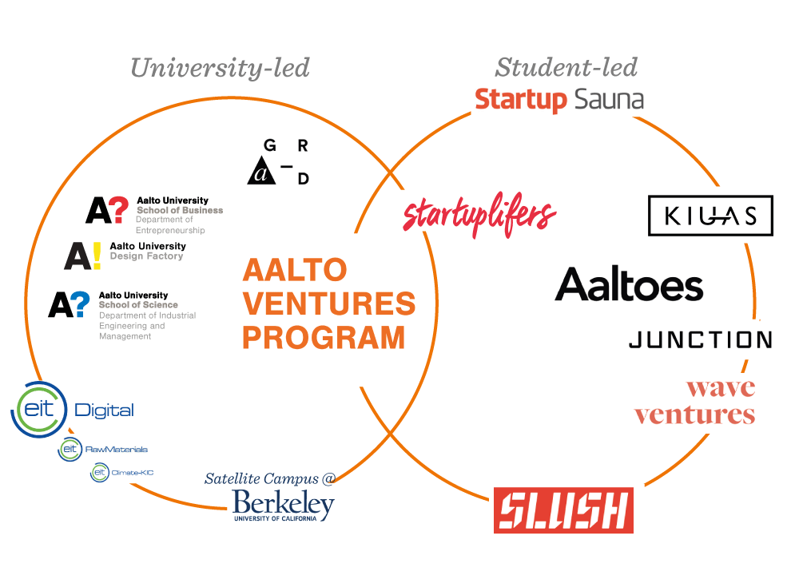
Aalto Entrepreneurial Ecosystem
Notes:
Aalto University is a merge of 3 major schools in capital areas of Finland in 2010
- Helsinki School of Economics, University of Arts and Design Helsinki, Helsinki University of Technology.
Helsinki School of Economics was running Small Business Centre and had Department of Entrepreneurship on its own.
Aalto Design Factory has started before Aalto in 2008 as an experiment of multidisciplinary prototyping and also merge of schools.
Students-led activities have started since 2009.
Actually, 10 years ago, most of Finnish students wanted to work for a big corporation e.g Nokia.
However, around 2008, Nokia wasn’t doing well and Finland had a seriously high unemployment rate(13%), so students had to create their own jobs because they couldn’t get a job from a big company.
Especially after some students visited MIT, as you have already heard from Startup Sauna, they were inspired to do something in Finland, to do something to make ecosystem for startups, eventually for them, to boost Finland’s economy.
As a result, Aalto ES, Startup Sauna and Startup Life have founded.
Aalto Ventures Program is entrepreneurship education at Aalto University focusing on hands-on entrepreneurial skills.
Our teaching is also based on strong research from all different schools and organisations.
Basically, current Aalto Entrepreneurial Ecosystem is a result of matching two parties’ demands as aspiration of innovation
Bottom-up and at the same time, top-down.

Slide 21
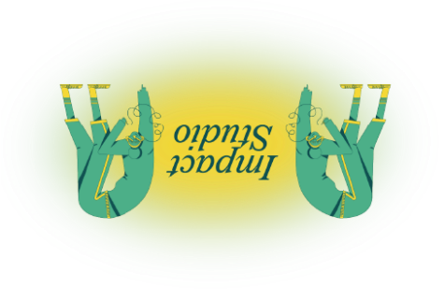
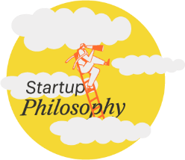
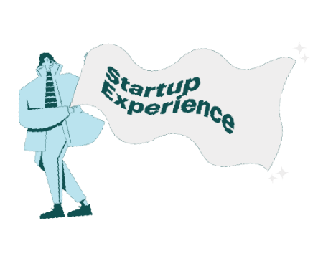
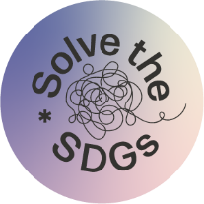
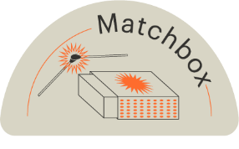
Learn
Entrepreneurship education for the whole Aalto community
Build
Opportunities and support for putting what you've learnt into practice
Hands-on education
Sustainability through entrepreneurship.
Open events
Hackathon in
April 22-24.4. 2022
avp.aalto.fi
Notes:
Sustainability through entrepreneurship.
We help the Aalto community in creating a sustainable future through entrepreneurship by solving problems related to Sustainable Development Goals.
Learn — Entrepreneurship education for the whole Aalto community
At AVP, students work in multidisciplinary teams, do hands-on exercises and gain tool of mass disruption, ready to be used either to construct a startup or to renovate an existing company from within.
Hands-on education. No exams, no textbooks, no BS. At AVP courses, you’ll learn by solving meaningful problems and working with real companies.
Open events. Ranging from hands-on workshops for small groups to inspiring talks for hundreds of people, our not-for-credit events are always free to attend.
Build — Opportunities and support for putting what you've learnt into practice
Education is important but so is putting what you’ve learned into practice. Take what you know, form a team, and build something that makes you proud and the world better. We'll give you wings — all you have to do is fly.
Impact Studio will verify whether your idea has the potential to become a sustainable business, scale up and make the world a slightly better place.
Solve the SDGs is an annual hackathon where we solve sustainability-related challenges. Organized by us and Junction, it’s for anyone who wants to change the world for the better.
Call to action
1) Welcome to the course Good Life Engine and Startup Experience starting from September. Add it into your study plan.
2) Unfolding Tomorrow is a monthly discussion on SDGs with representatives from academia, business and government. Next one is on 31.3 / 20.4.
3) Solve the SDGs hackathon is 22-24.4. registration will start on 25.3 and end on 8.4. Read more on avp.aalto.fi

Slide 22
“Fortune favours the prepared mind.”
Louis Pasteur
Notes:
19th century French chemist and microbiologist, bacteriologist, breakthroughs in modern medicine via vaccinations and treating milk and wine via pasteurization.

