Slide 1
Understanding media and design research Introduction to media design and research, part 2
Lily Díaz-Kommonen
Professor of New Media,
Aalto University
22 September 2021

Slide 2
How are we ‘knowing’ media
• Research about media – 15 September
- Media archaeology – Brief intro.
- Contemporary media format and genres – How formats and genres have been changing (e.g. from inscription media to recorded media.)
- Media effects ‘in the world’ – Series of concepts that are discursively negotiated but which at some point are anchored in our materiality as beings/entities that exist in the world.

Slide 3
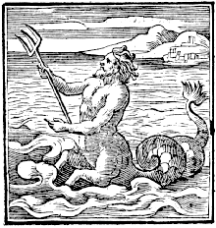
Computer as a meta-medium
“The protean nature of the computer is such that it can act like a machine or like a language to be shaped and exploited. It is a medium that can dynamically simulate the details of any other medium, including media that cannot exist physically. It is not a tool, although it can act like many tools. It is the first meta-medium, and as such it has degrees of freedom for representation and expression never before encountered and as yet barely investigated.” Alan Kay, “Computer Software”, Scientific American, Sept. 1984

Slide 4
How are we ‘knowing’ media
Research through media
Media usage: 5Ws (What, Where, Who, Why and When)*
Patterns of media – Information visualization design for storytelling.
* Vannevar Bush, “As we May Think”, Atlantic Monthly, July 1945.
Notes:
We will study the digital media that has literally overcome our world. Vanevar Bush As We may Think

Slide 5
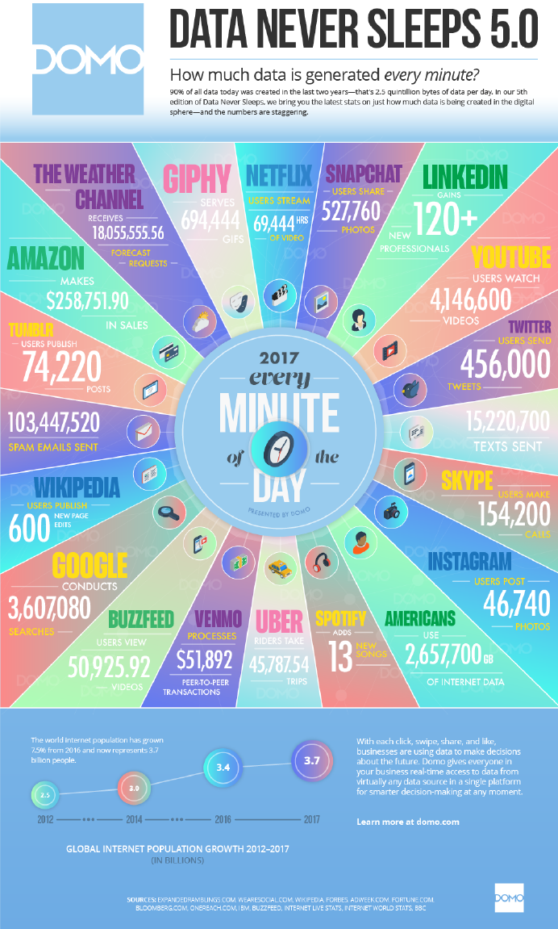
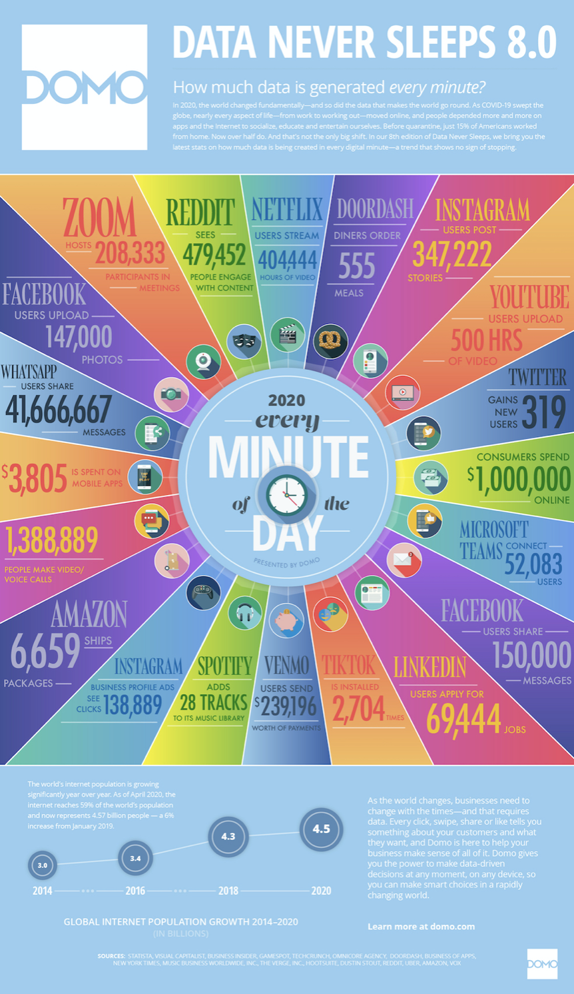
Notes:
Youtube. 4,146,600 (2017) 4,500,000 (2019)
- Instagram. 46, 740 (2017) 277,777 (2019)
Twitter 456,000 (2017) 511, 200 (2019) Twits
Google search 3,607,080 (2017) and 4,497, 420 (2019)

Slide 6
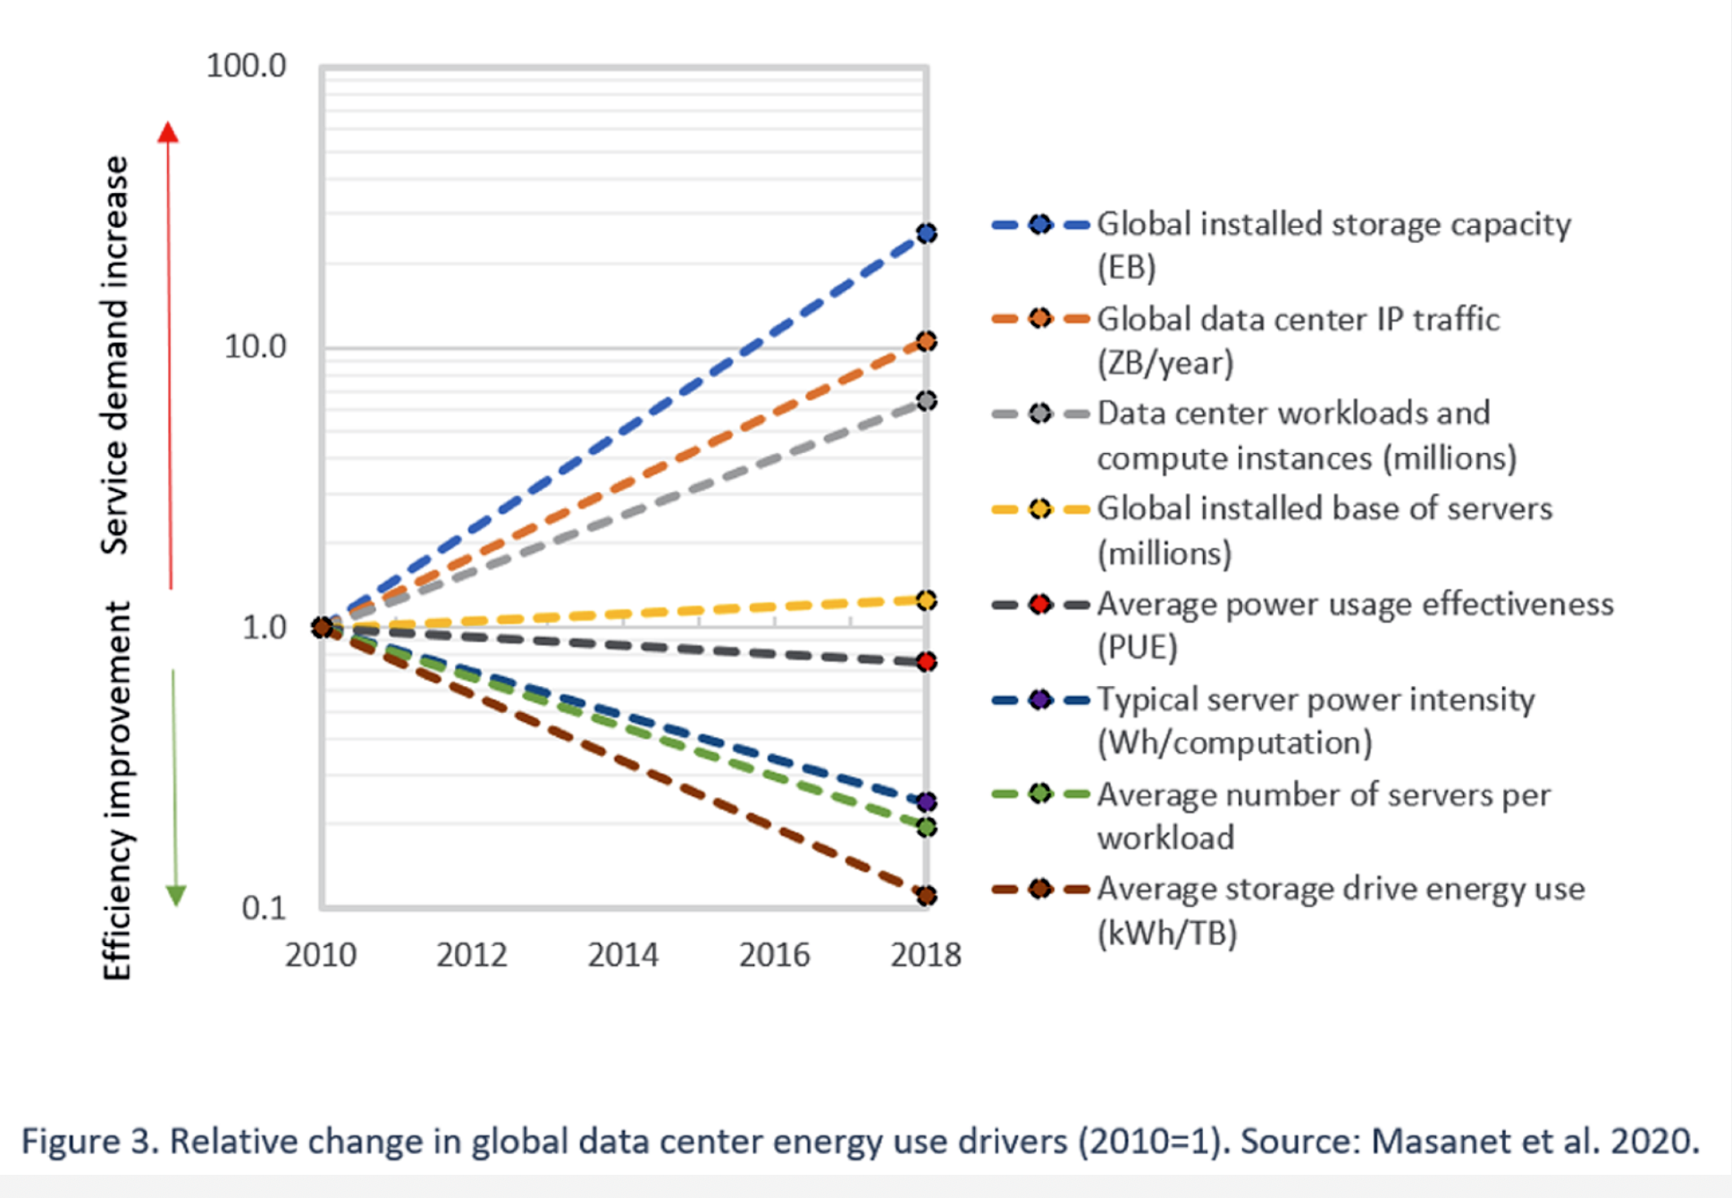

Slide 7
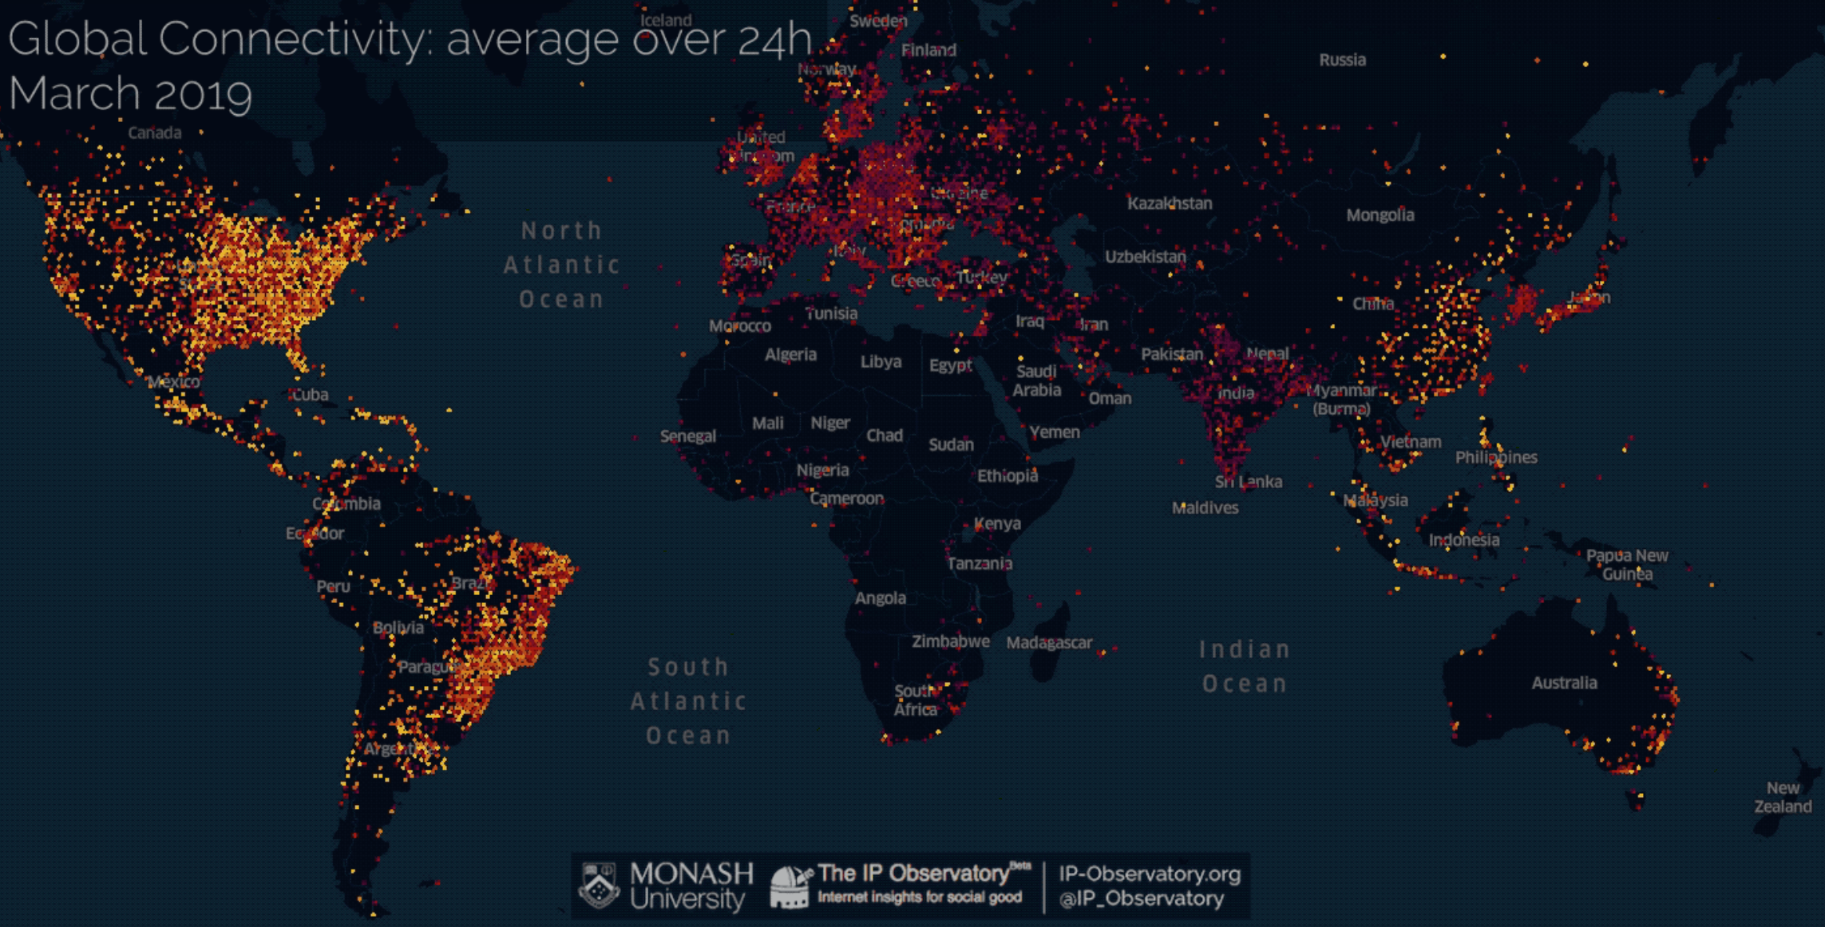
Digital Patterns
Notes:
Connectivity in 2019 that also reveals so-called BRIC countries: Brazil, Russia, India and China.

Slide 8
How are we ‘knowing’ media
Research for media
New media tools – Similarity cluster tool
New media formats and genres – Virtual reality

Slide 9
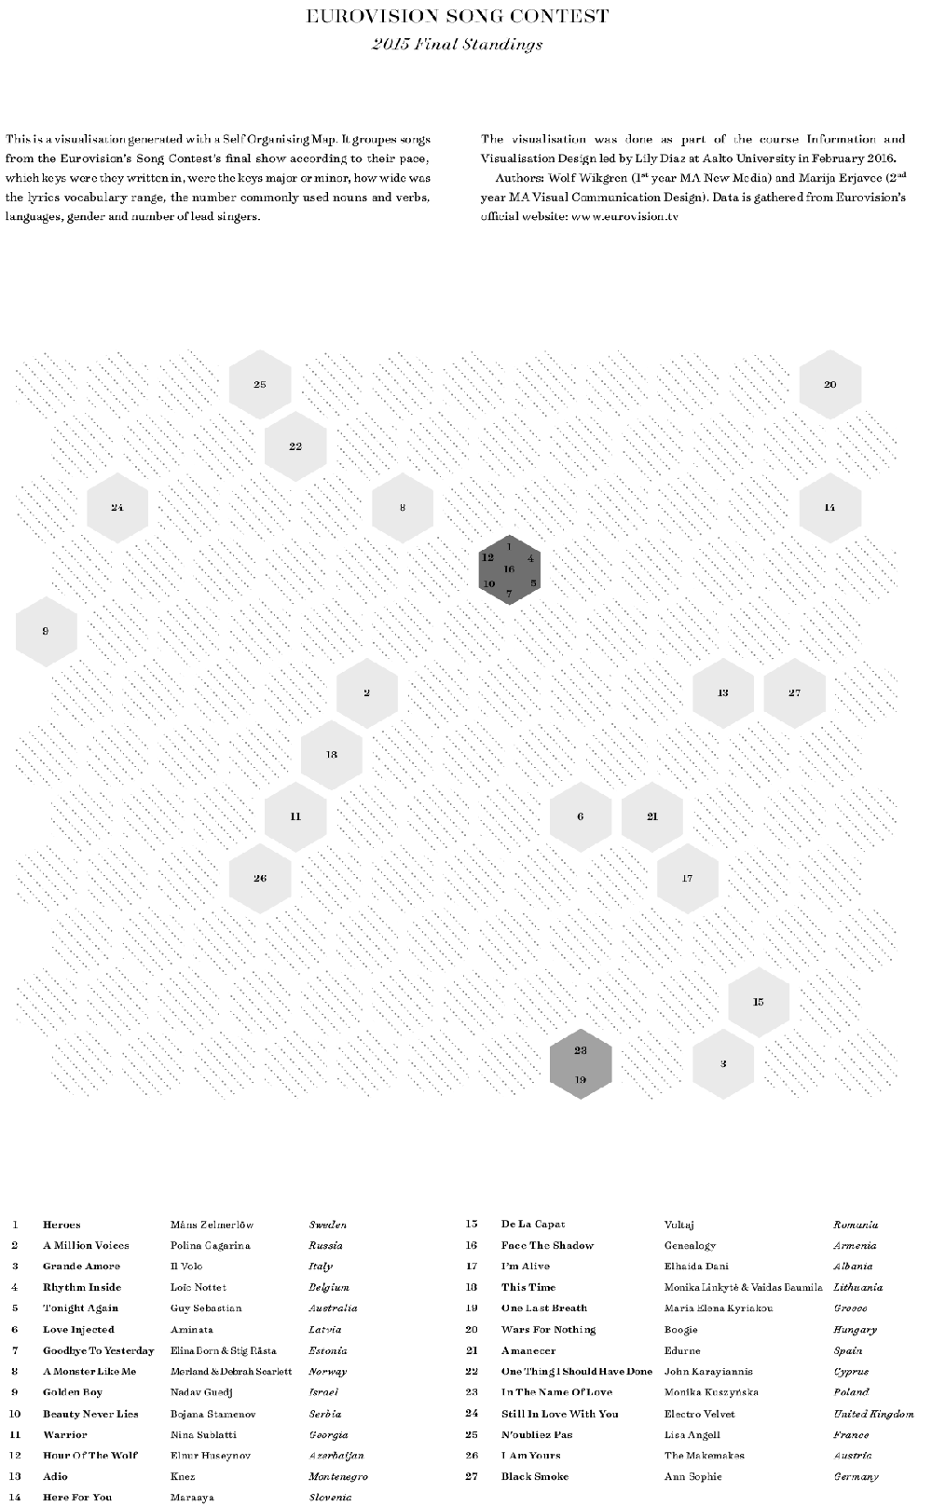
Similarity clusters map

Slide 10
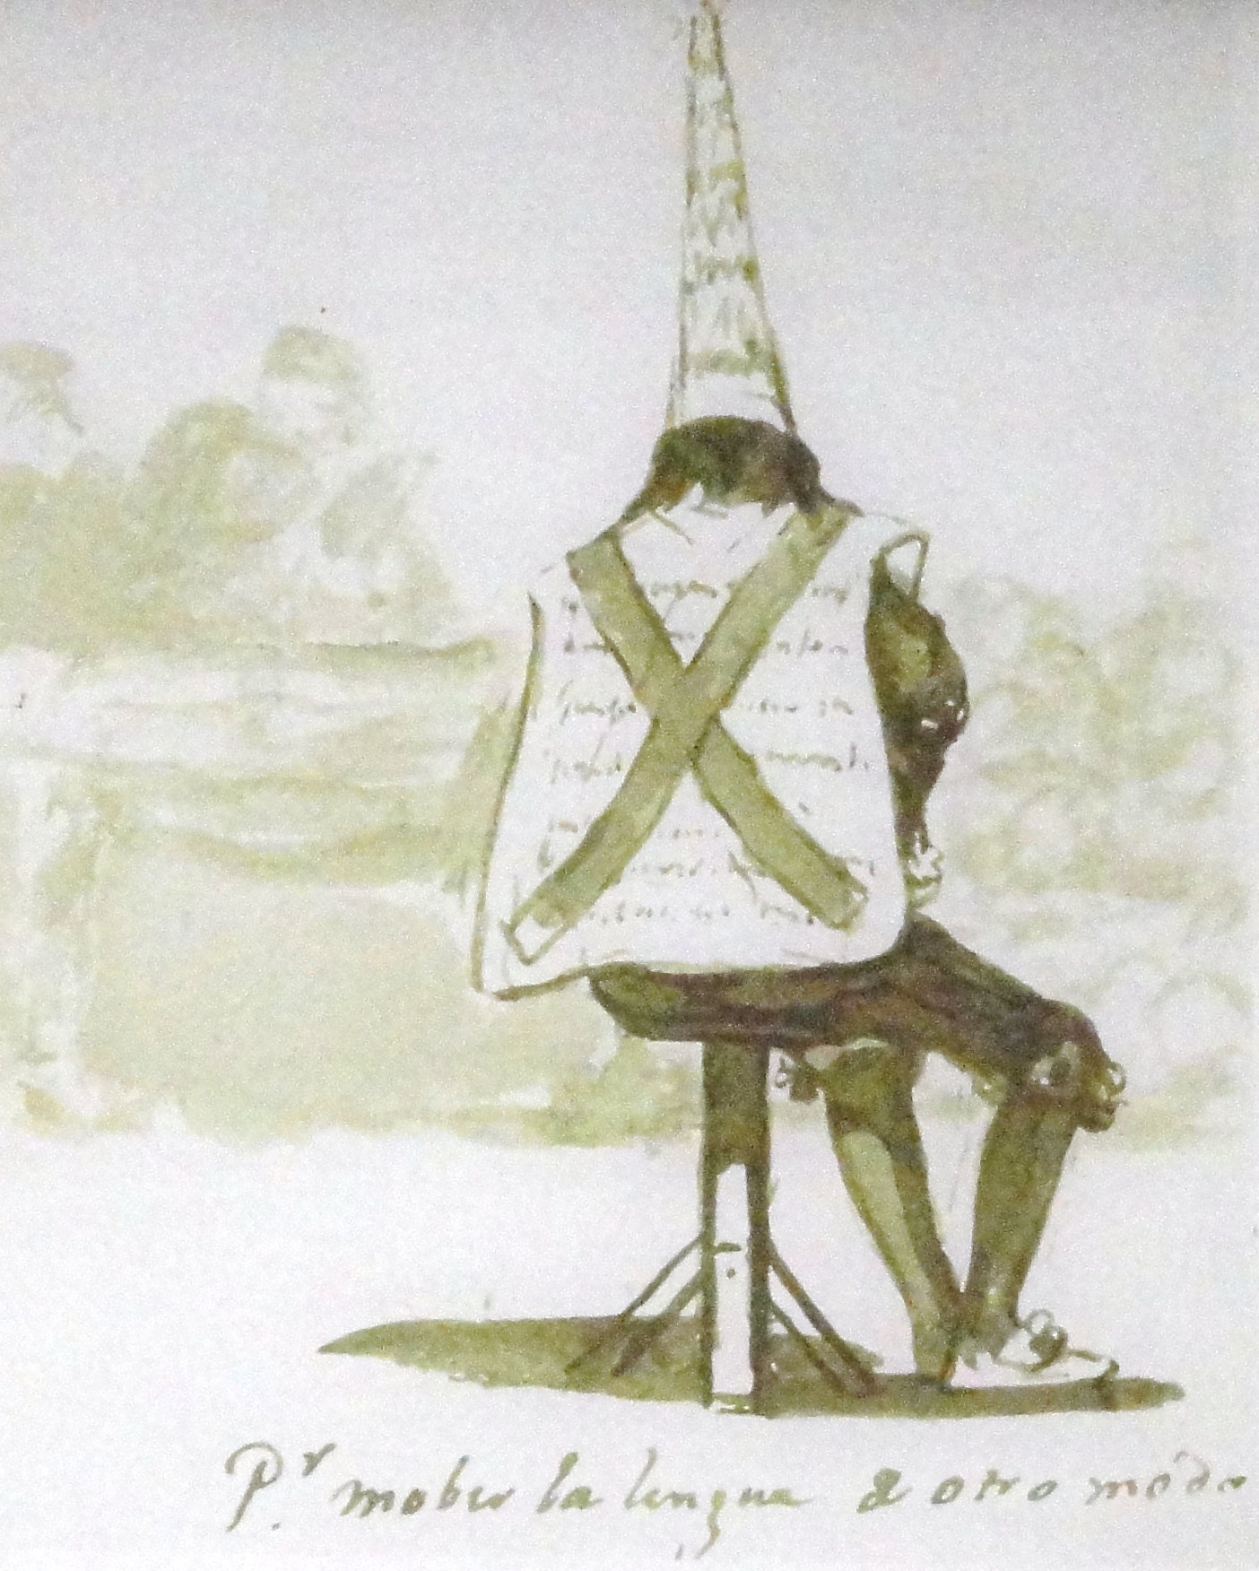
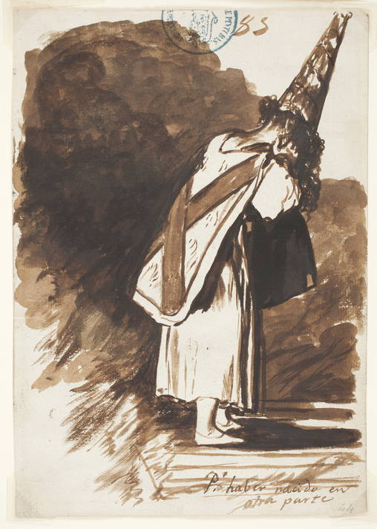
Shame

Slide 11
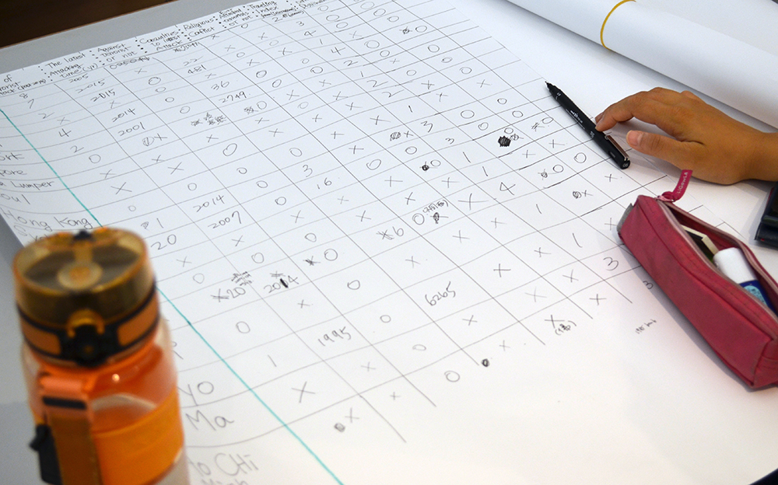
Self-organizing map

Slide 14
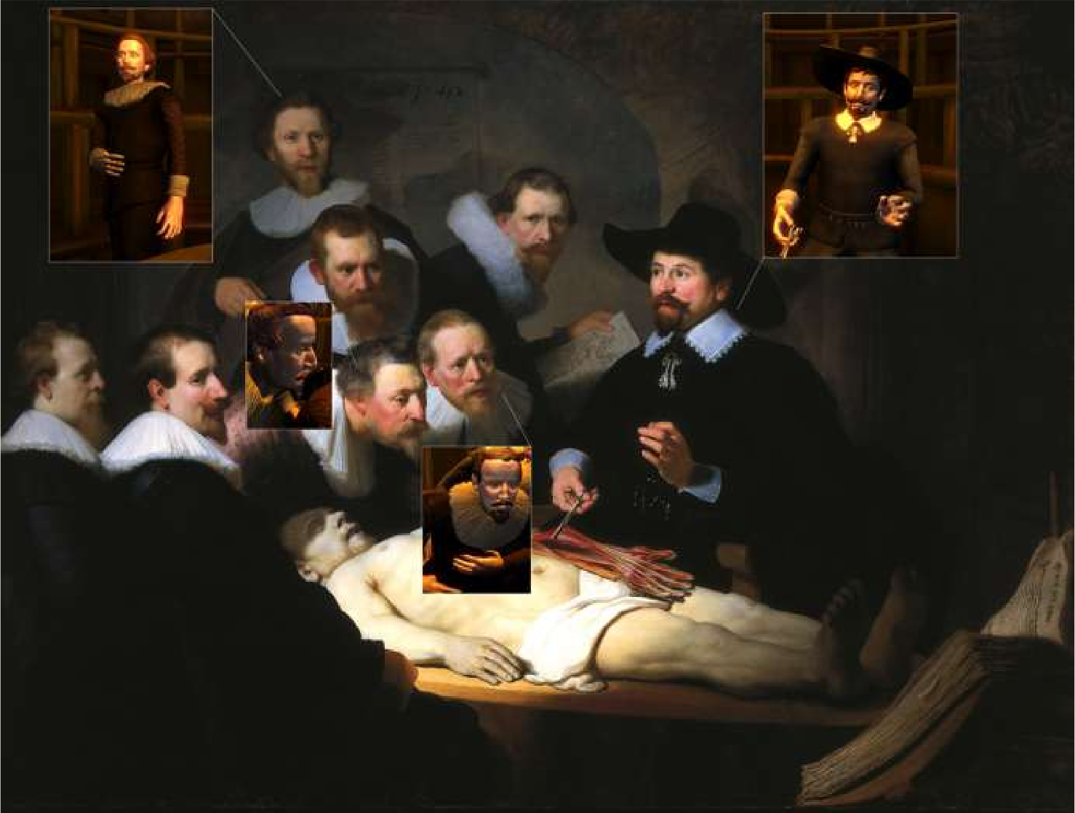
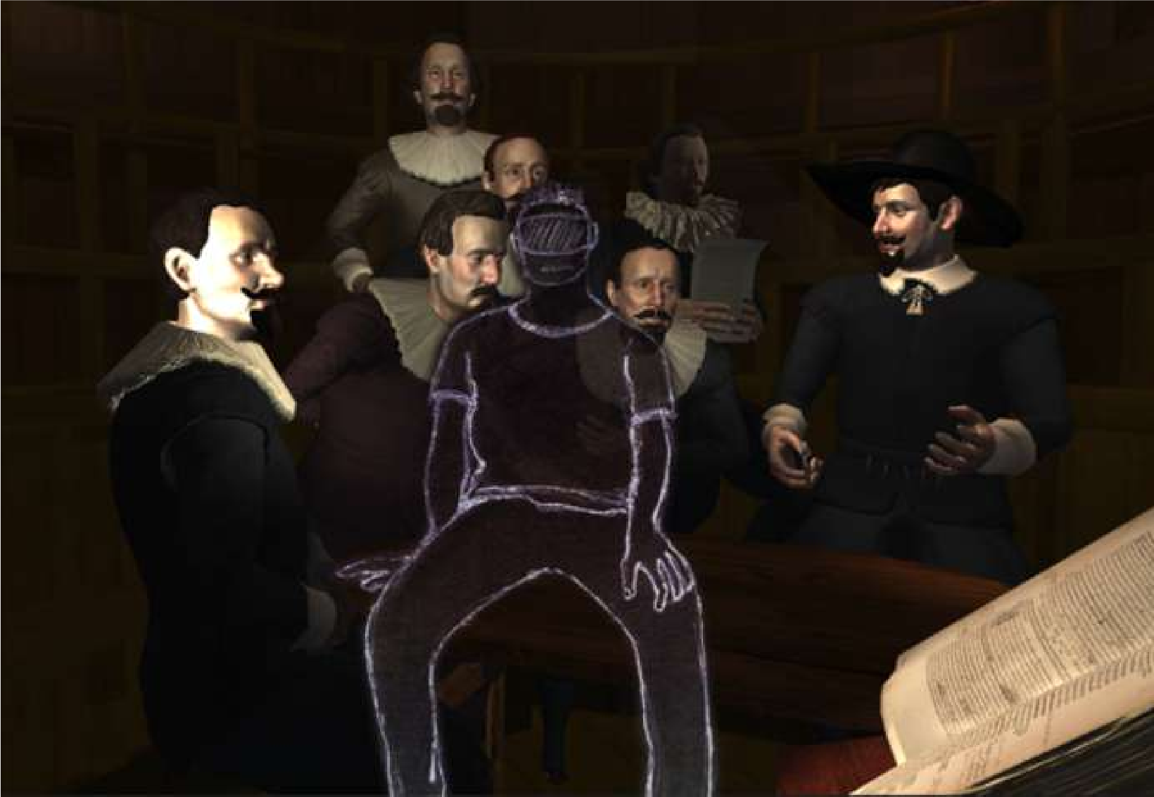
Interactive Diorama – Rembrandt, 1632
An interactive VR historical reconstruction
Based on The Anatomy Lesson of Dr. Nicolaes Tulp by Rembrandt.
Notes:
See, image of installation at Ars Alectronica 2017, https://www.flickr.com/photos/arselectronica/37200195145
Watche the video at Oodi, https://www.youtube.com/watch?v=eMPGvinUQrU

Slide 15
Interactive Diorama – Rembrandt, 1632
An interactive VR historical reconstruction.
Based on The Anatomy Lesson of Dr. Nicolaes Tulp
painting by Rembrandt.
Notes:
See video, https://vimeo.com/225970453

Slide 16
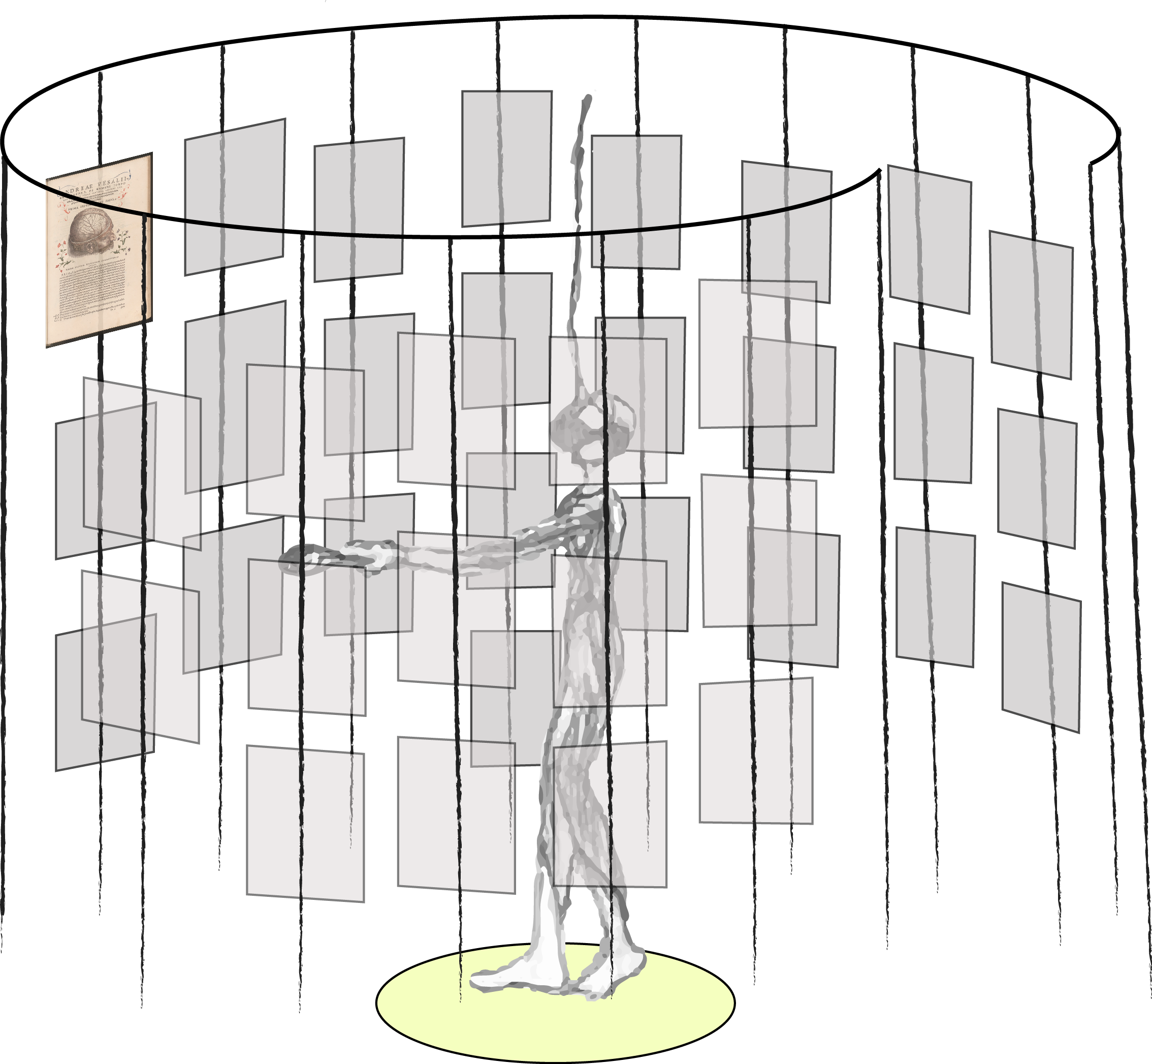
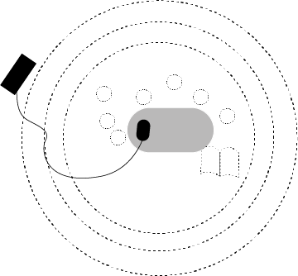
Interactive Diorama – Rembrandt, 1632
An interactive VR historical reconstruction
Oodi Public Library Helsinki
13–20 September 2019, Cube Gallery.

